Slide 1


Crafting the Ultimate IPL Team
SELECTORS :
BAI PHANEENDRA
G. PRANAY KUMAR REDDY
N.SAIKUMAR

Slide 2
Project Overview
Conclusions
Data Preprocessing
Exploratory Data Analysis
Data Visualizations
Insights
Recommendations
Future Scope
Q/A
Problem Statement
Objectives
Data Collection

Slide 3

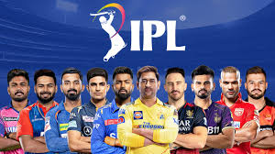
PROBLEM STATEMENT
To analyze player performance data from IPL seasons (2021-2024) to identify trends and insights, select top-performing players across different teams and roles (batsmen, bowlers, and all-rounders), and create the best possible IPL playing XI. This involves
🤲 Objective :-
Conducting team-wise performance evaluation to identify the contributions of players in their respective teams.
Identifying the best players based on consistent performance metrics and overall impact.
Formulating a well-balanced IPL playing XI by including players based on role-specific excellence (batsmen, bowlers, all-rounders).

Slide 4

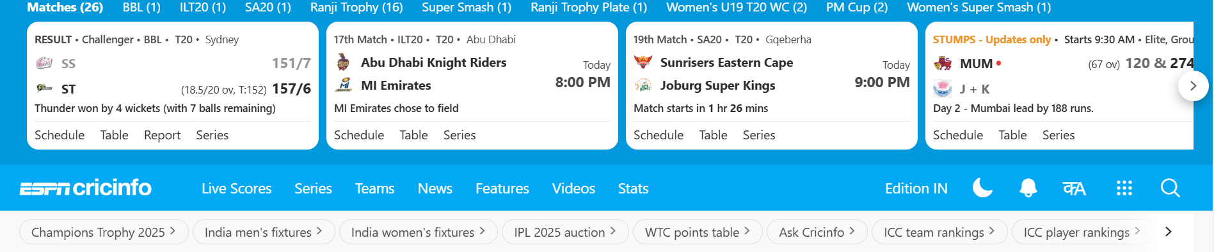
WEBSITE
URL:- https://www.espncricinfo.com/

Slide 5
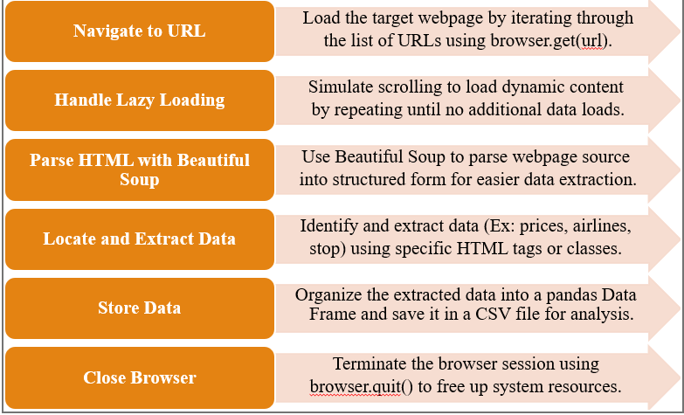
Web Scraping:

Slide 6
🧹🧹DATA CLEANING🧹🧹
Data cleaning is the most essential to ensure accuracy and quality in Analysis.
After Successfully importing the data
We started cleaning the data.
We have checked the null values and duplicated values and Unwanted
Columns.
By using Regex functions . We Eliminated the special symbols

Slide 7

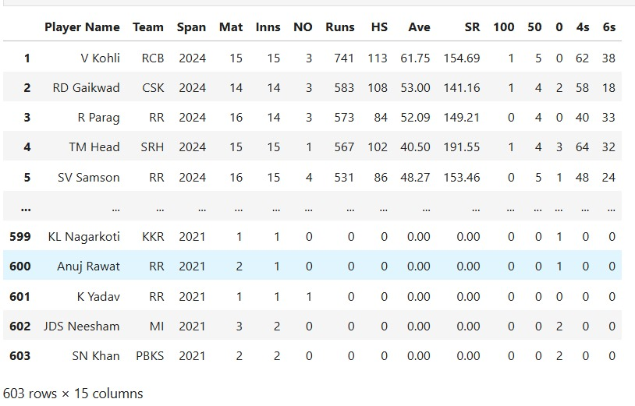
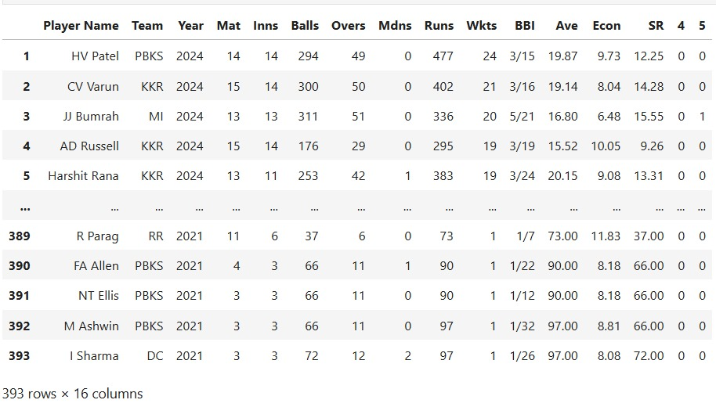
DATAFRAME AFTER CLEANING
🏏BATSMEN🏏
BOWLERS

Slide 8
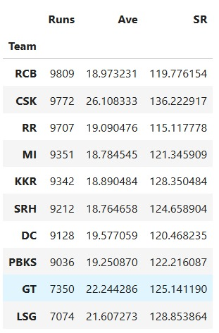
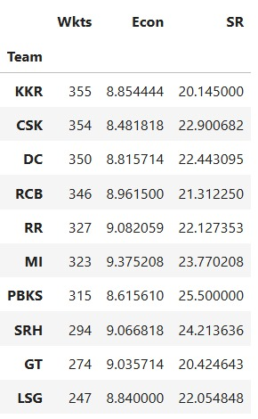
HIGHEST RUNS AND WICKETS BY TEAM
Observations :
From Batsmen dataset the team which scored the highest runs is RCB With most runs and
From Bowlers Data Set the KKR Team has highest wickets with an economy of 8.5

Slide 9
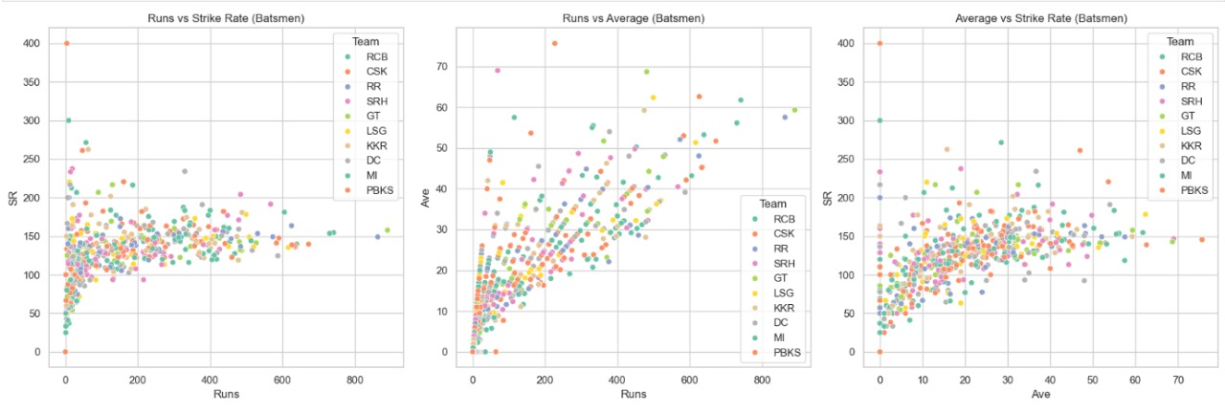
Creating a Scatter Plot For Runs vs. Strike Rate , Runs vs. Average ,
Average vs. Strike Rate

Slide 10
.
Observations:
The image shows three scatter plots that analyze the relationship between runs, average, and strike rate for different teams in a cricket tournament.
Runs vs Strike Rate: This plot shows the relationship between the total runs scored by each Player by its team and their strike rate. A higher strike rate indicates a faster scoring rate.
Runs vs Average: This plot shows the relationship between the total runs scored by each player in a particular team and their average score per innings. A higher average indicates a more consistent performance.
Average vs Strike Rate: This plot shows the relationship between the average score per innings and the strike rate for each player from the team . This helps to understand if teams with higher averages also tend to have higher strike rates.

Slide 11
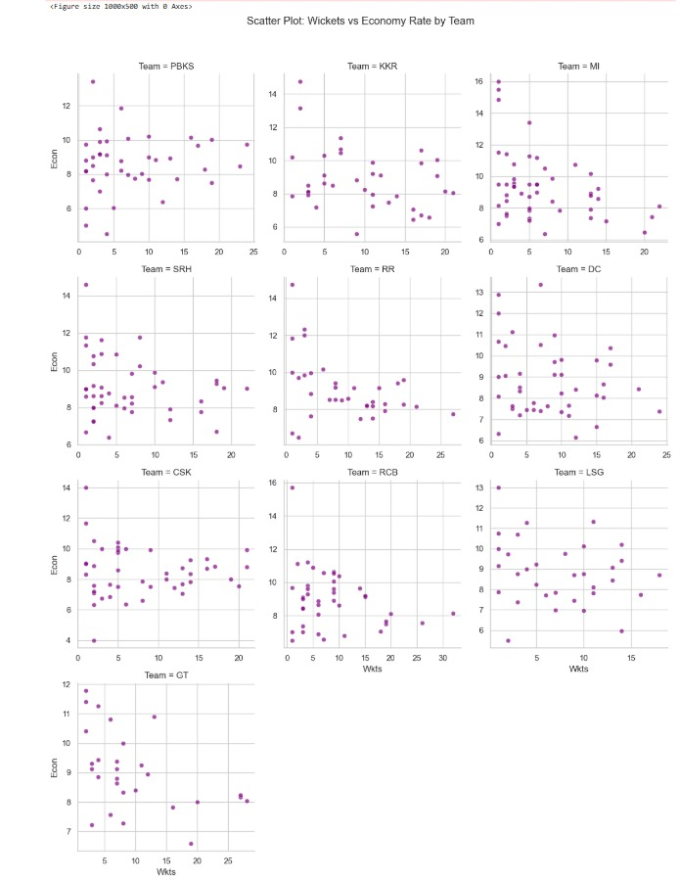
Observations Relationship between Wickets and Economy: In most plots, there's a general trend suggesting that as the number of wickets taken by a bowler increases, their economy rate tends to improve (decrease). This indicates that bowlers who are more effective at taking wickets are also generally more economical in terms of runs conceded per over. Team-Specific Variations: While the overall trend is similar across teams, there are variations in the spread of data points and the strength of the relationship. Some teams might have bowlers who consistently take wickets with good economy rates, while others might have more variability in their performance.
Scatter Plot For Wicketss vs Economy Rates By Team

Slide 12
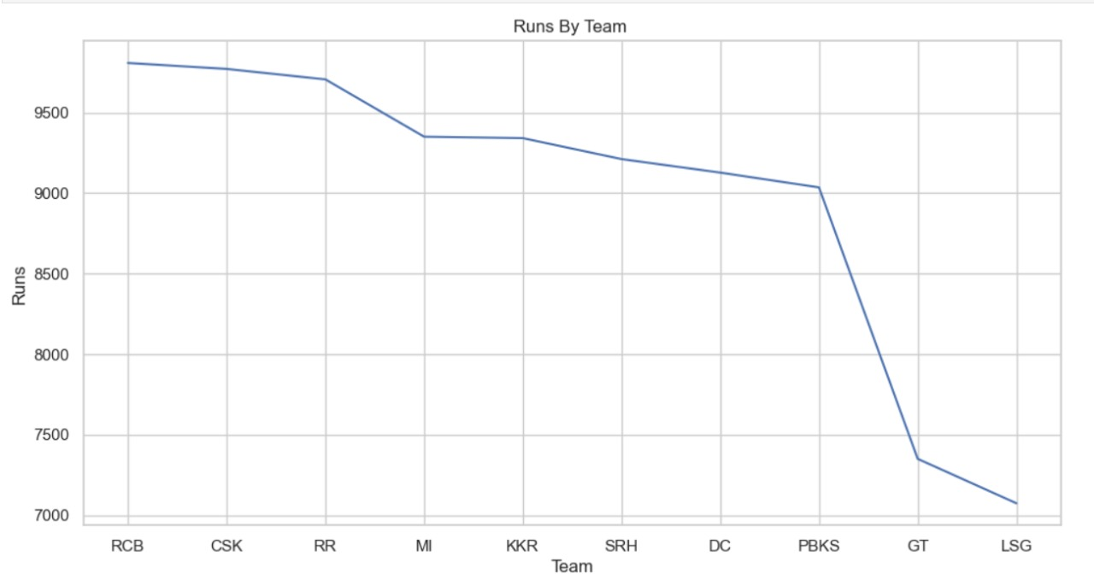
LINE-PLOT For Runs BY TEAMS :
Observations:
Highest Runs: RCB appears to have scored the highest number of runs. Lowest Runs: LSG appears to have scored the lowest number of runs. Trend: The line generally shows a decreasing trend, suggesting that the teams on the right-hand side of the graph scored fewer runs compared to those on the left.

Slide 13
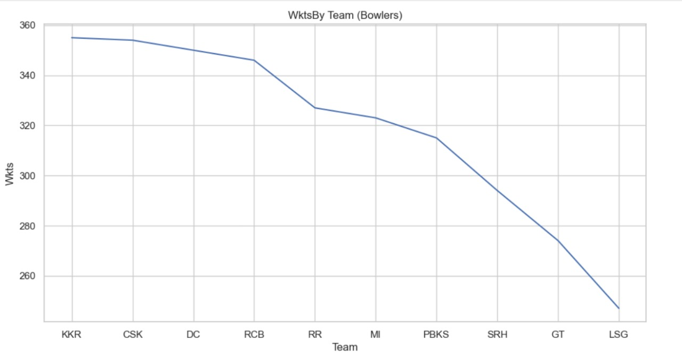
LINE-PLOT For WICKETS BY TEAMS(BOWLERS) :
Observations:
Highest Wickets: KKR appears to have taken the highest number of wickets.
Lowest Wickets: LSG appears to have taken the lowest number of wickets.
Trend: The line generally shows a decreasing trend, suggesting that the teams on the right-hand side of the graph took fewer wickets compared to those on the left.

Slide 14
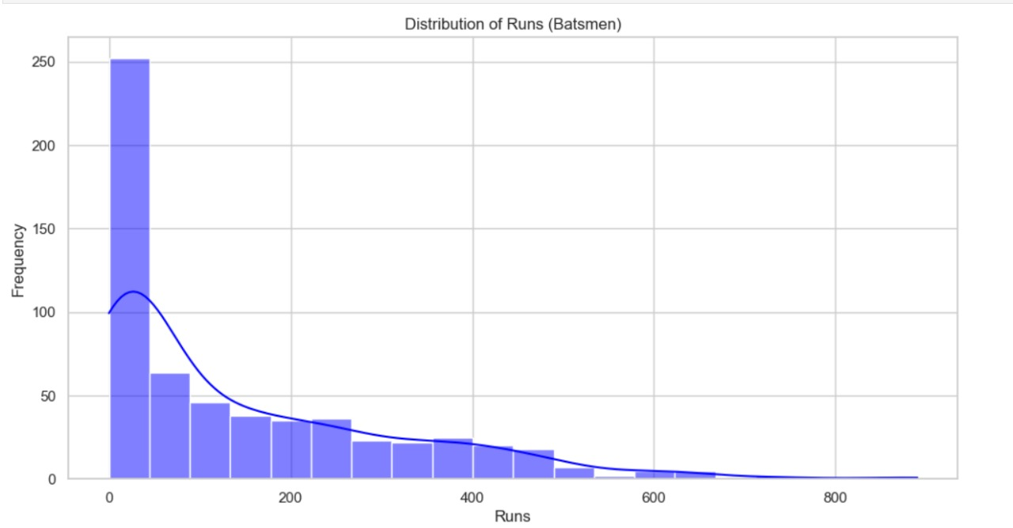
Histogram Plot For Distributions of Runs (Batsmen)

Slide 15
Observations: Shape: The distribution appears to be right-skewed or positively skewed. This means that most of the batsmen have scored a relatively small number of runs, while a few have scored a large number of runs. Central Tendency: The peak of the distribution is towards the left, indicating that the majority of batsmen have scored between 0 and 100 runs. Spread: The distribution is quite spread out, with a long tail extending to the right. This suggests a high variability in the number of runs scored by the batsmen. Outliers: There might be a few batsmen who have scored an exceptionally high number of runs, which would appear as outliers on the right tail of the distribution.

Slide 16
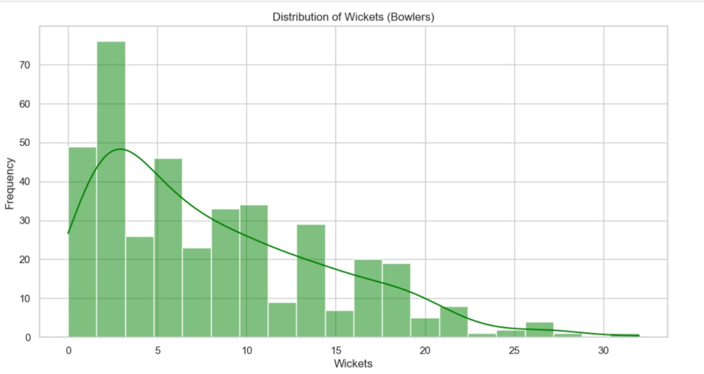
Histogram Plot on Distributions of Wickets(Bowlers)

Slide 17
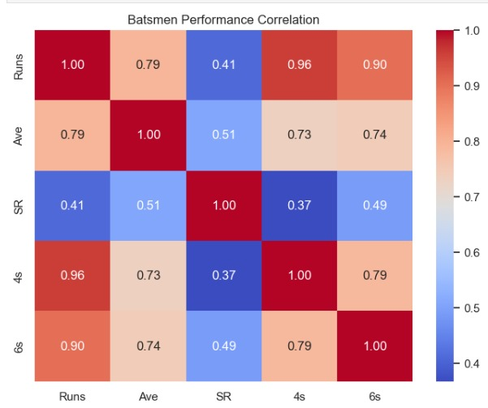
HEATMAP FOR Batsmen Performance correlation
Runs have the strongest correlation with fours and sixes.Average has a strong correlation with runs and a moderate correlation with fours and sixes.Strike rate has a moderate correlation with runs, fours, and sixes.

Slide 18
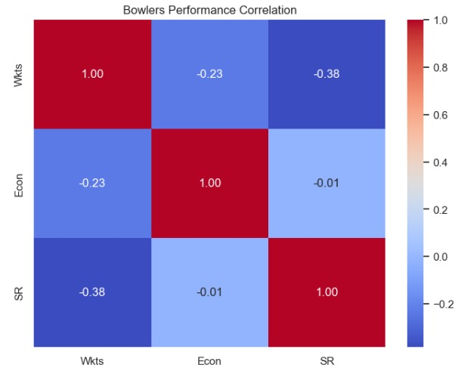
HEATMAP FOR Bowlers Performance Correlation
Overall, the heatmap shows that bowlers who take more wickets tend to have higher economy rates and slightly higher strike rates. However, the relationship between economy rate and strike rate is very weak.

Slide 19
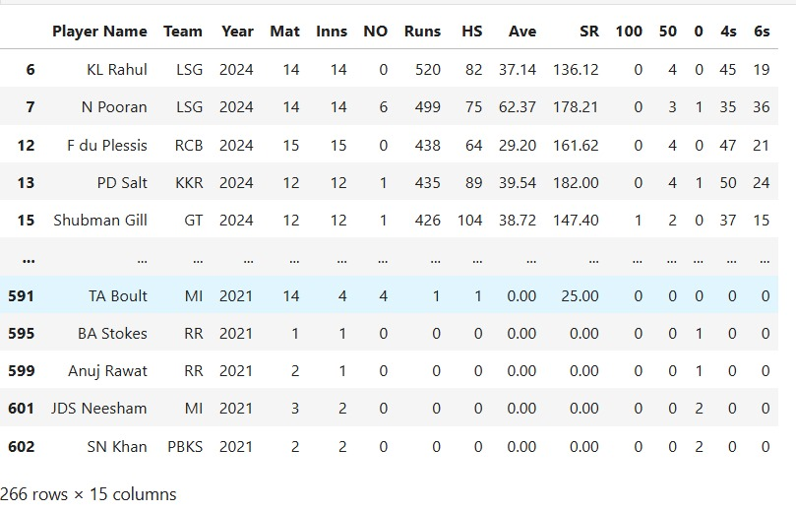

Slide 20
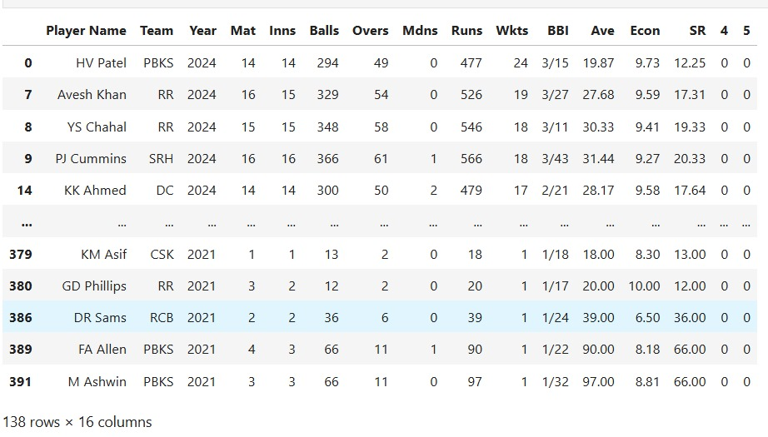

Slide 21
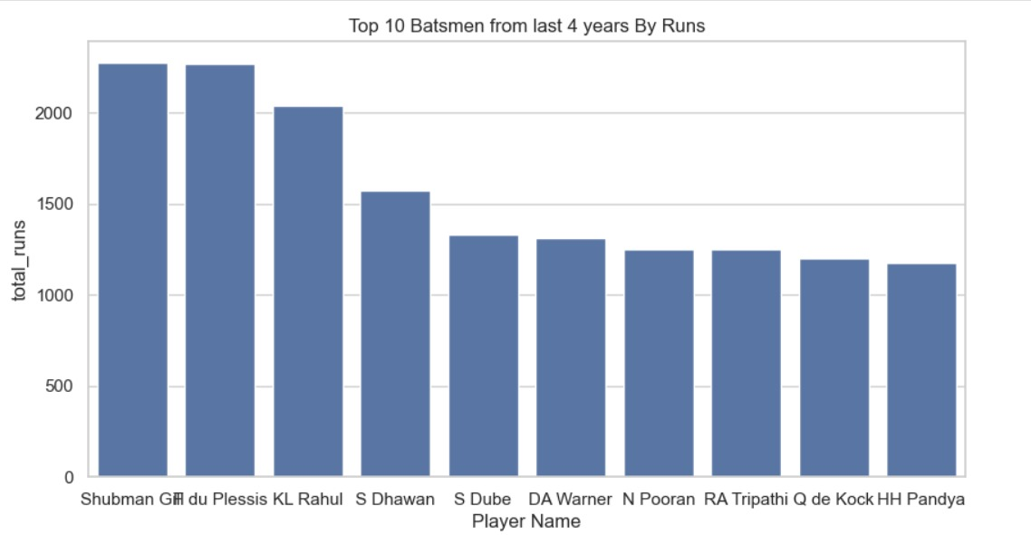
Top 10 Batsmens from last 4 years By Runs:

Slide 22
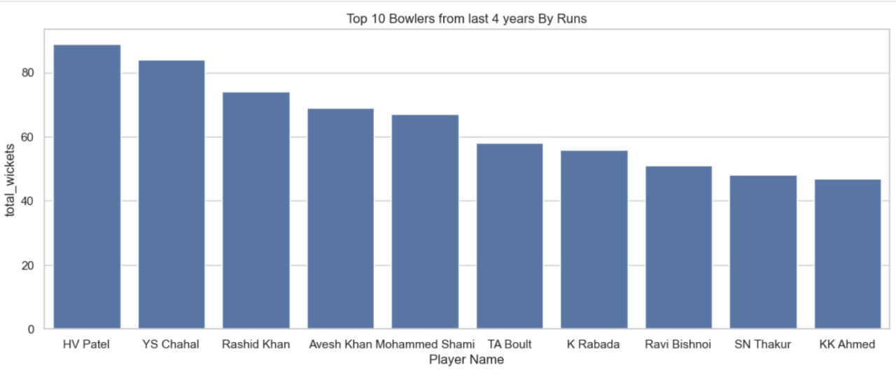
Top 10 Bowlers from last 4 years By Runs :

Slide 23
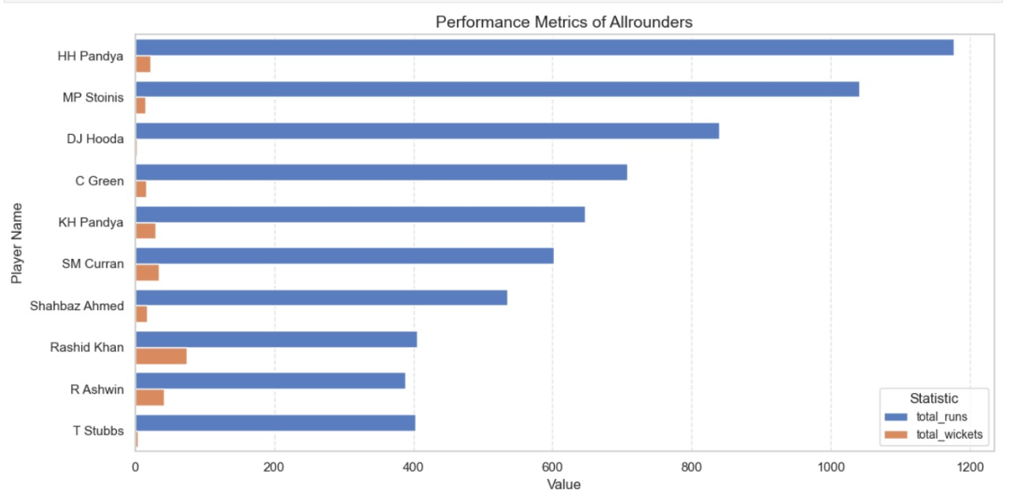

Slide 24
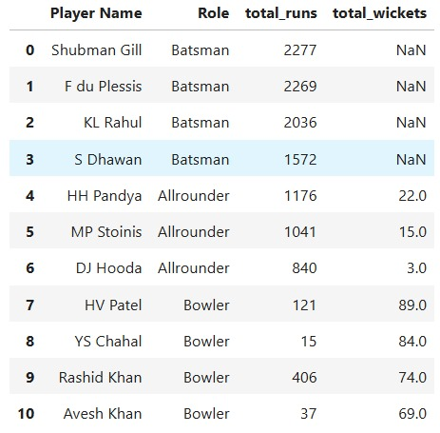

Slide 25
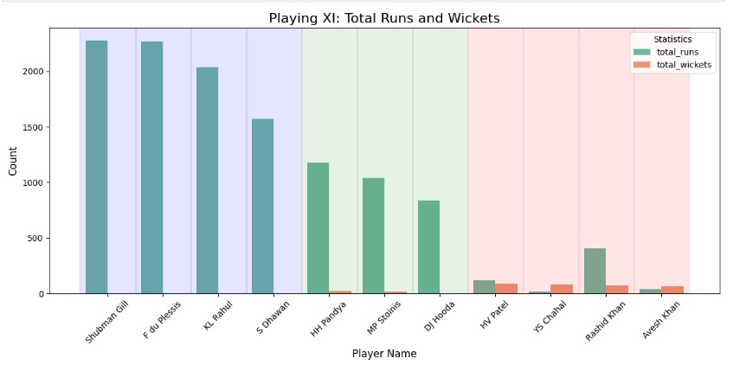
Playing XI: Total Runs and Wickets:
Overall:The team has a strong batting lineup with several key contributors.The bowling attack is effective, with a combination of experienced and emerging bowlers.The presence of all-rounders like HH Pandya adds versatility to the team.

Slide 26
CONCLUSION :
Through in-depth analysis of IPL data from 2021 to 2024, we identified key trends and player performances across teams.
Our insights highlight : Team Contributions: RCB leads in batting with the highest total runs,
While KKR dominates in bowling with the most wickets and an impressive economy rate.
Performance Trends: Consistent relationships between key metrics like strike rate, average, runs, and economy reflect the influence of balanced team compositions.
Top XI Selection: By combining role-specific excellence and statistical consistency, we formulated a well-rounded IPL XI capable of excelling across formats.
This data-driven approach underlines the importance of leveraging performance metrics for team optimization and strategic decision-making in Cricket.

Slide 27


