Slide 1
FAKE JOB POSTS DETECTION
MILESTONE 1 - Data Preprocessing & Exploration

Slide 2
MILESTONE 1 - . Dataset cleaned and transformed
Removed all unnecessary HTML tags, scripts, and formatting noise
Removed HTML tags and special characters from all text fields
Example: “<br> APPLY NOW!!!” → “apply now”
Handled missing values using imputation or row removal
Converted incorrect data types to proper formats
Example: salary strings → numeric values
Normalized text by converting to lowercase
Tokenized text to break sentences into meaningful words
Ensured the dataset is clean, consistent, and ready for further analysis

Slide 3
Exploratory Data Analysis (EDA) Completed and Documented
It Generates statistical summaries for all major features
Created visual charts such as histograms, bar plots, and word clouds
Example: Fake job word clouds showed terms like “urgent hiring”, “quick money”
Identified class imbalance between fake and real job postings
Analysed patterns such as unusually short descriptions or repetitive phrases
Compared traits of fake vs real jobs
Documented all findings in an EDA report/notebook

Slide 4
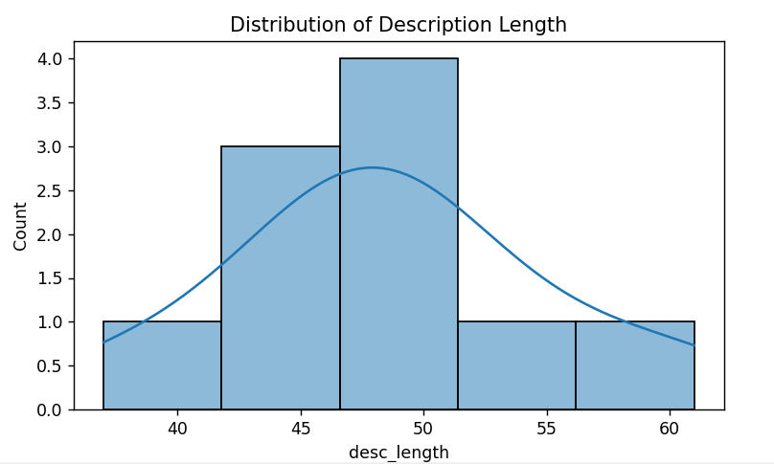
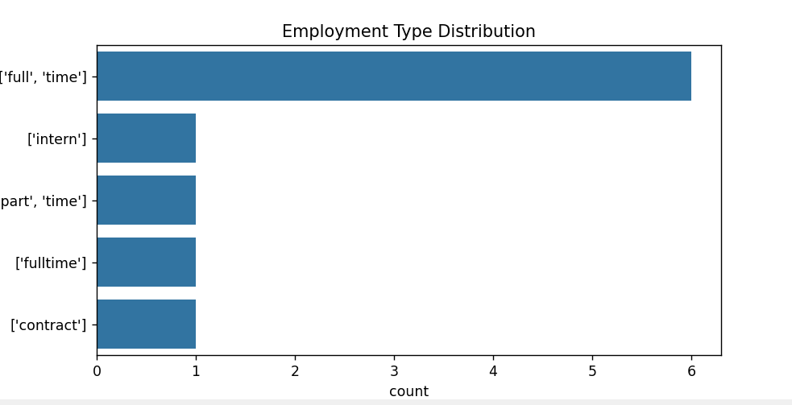

Slide 5
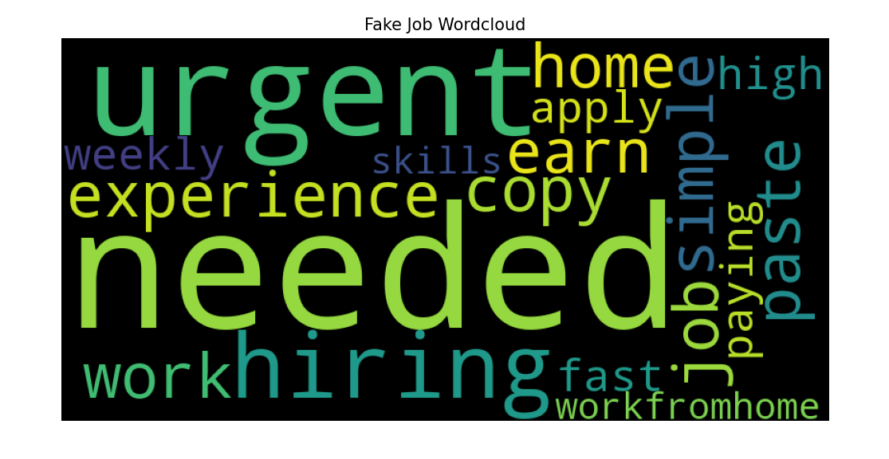
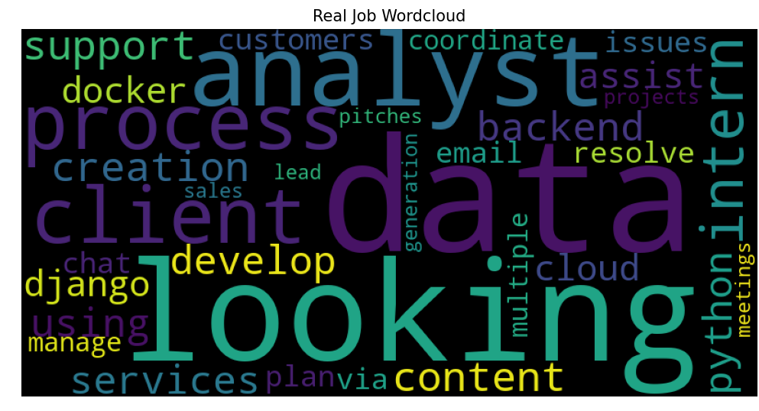

Slide 6
Feature Extraction Working with TF-IDF or Embeddings
It Implements TF-IDF vectorizer to convert text into numerical features
It Generates the TF-IDF feature matrix
Example: “analyst” gets a higher weight compared to “required”
Ensured stopwords and very common words have low importance
Explored optional embedding methods (Word2Vec, GloVe, BERT)
Verified that the feature extraction pipeline is reproducible
Prepared feature data for the next stage: model training

Slide 7


