Slide 1
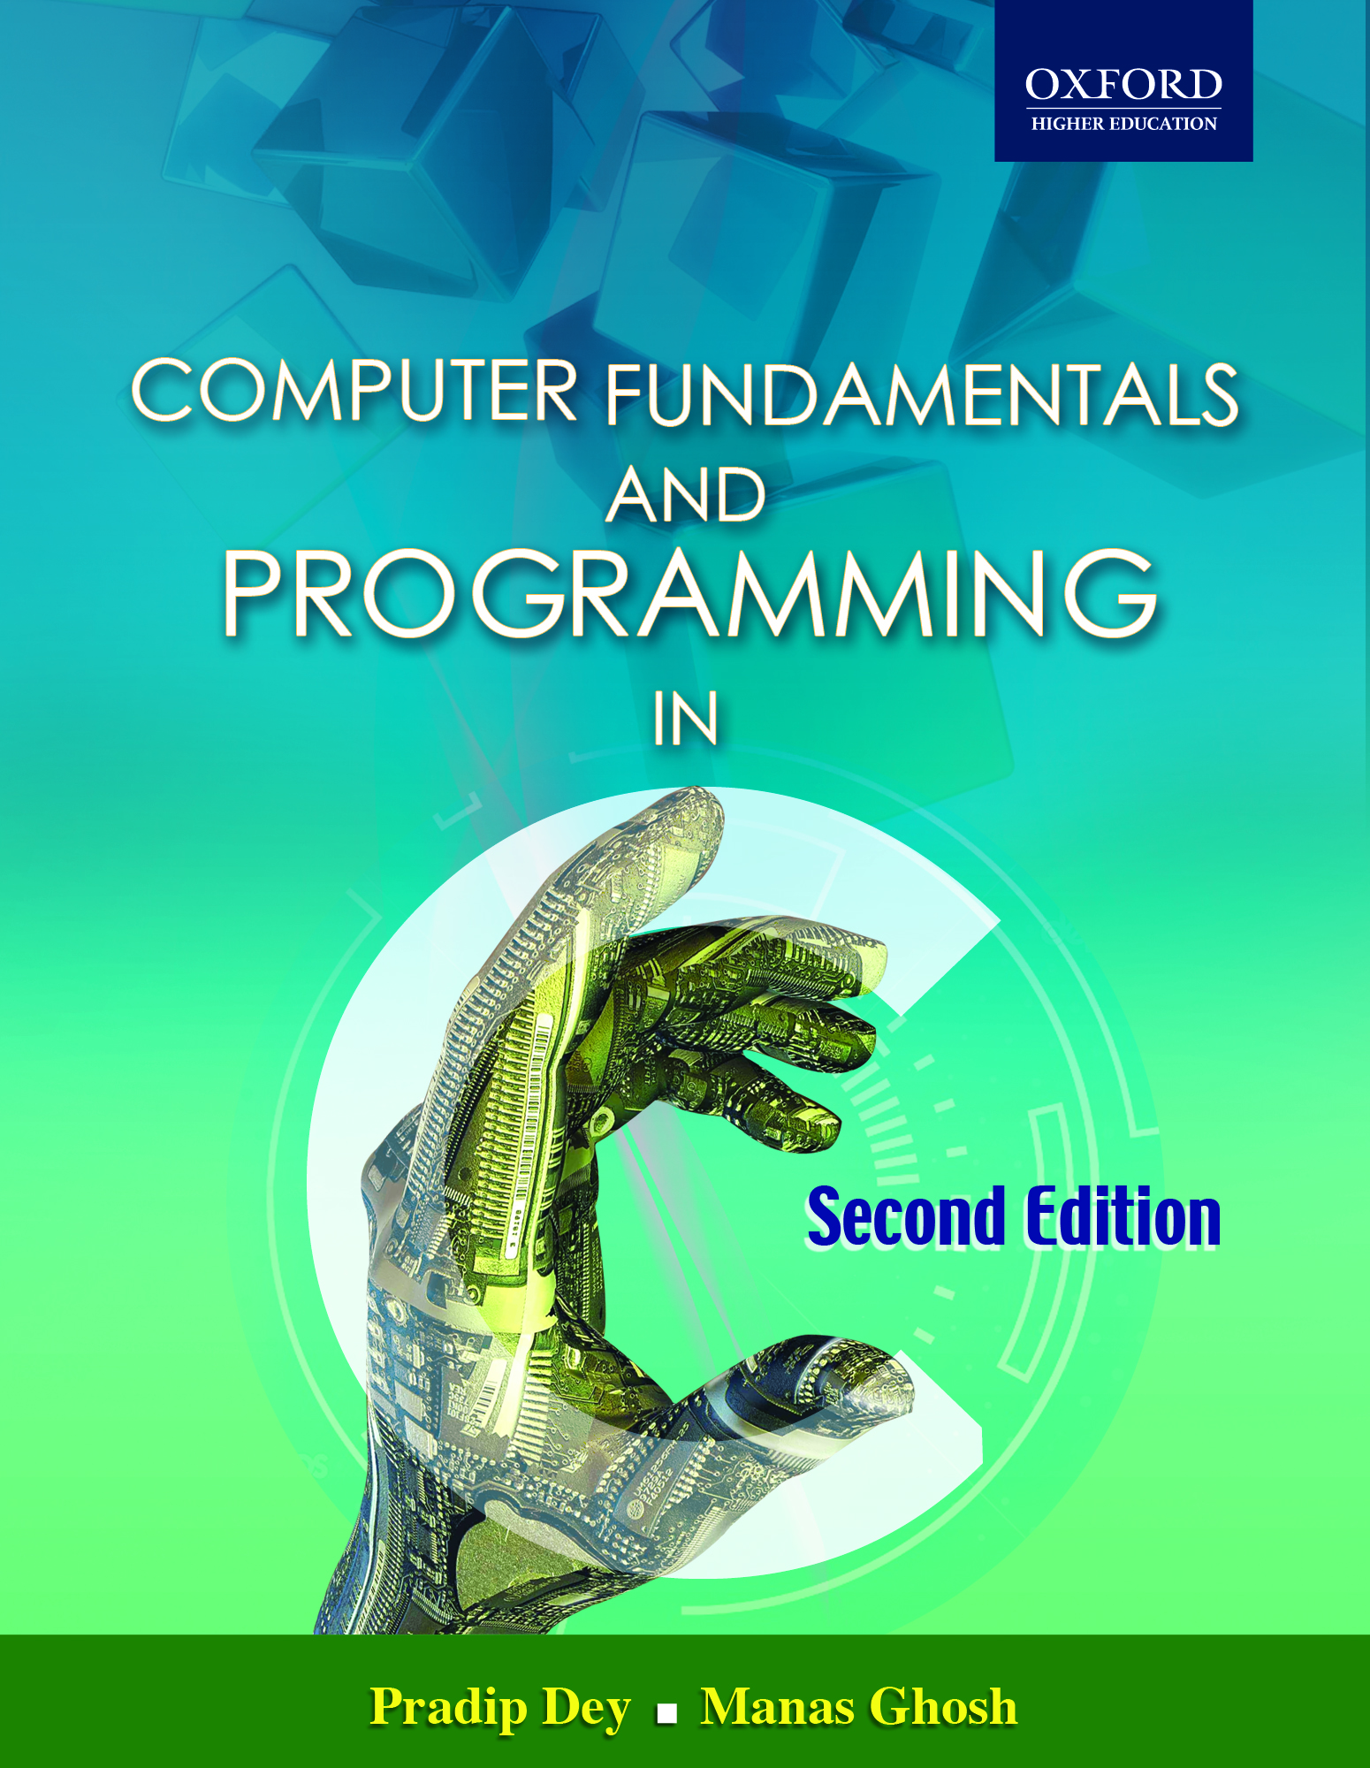
Computer Fundamentals and Programming in C
By: Pradip Dey & Manas Ghosh
© Oxford University Press 2013. All rights reserved.

Slide 2
Pointers in C
CHAPTER 13
© Oxford University Press 2013. All rights reserved.

Slide 3
Learning Objectives
Understand memory addresses
Understand the concept of pointers
Learn the use of pointer variables and understand call-by-value and call-by-address
Get acquainted with dereferencing
Study equivalence among arrays and pointers—treating pointers as arrays
Learn about the concept and construction of array of pointers and pointer to array
© Oxford University Press 2013. All rights reserved.

Slide 4
Learning Objectives
Discuss pointers and functions—parameter passing techniques, pointers as function parameters.
Get an idea about pointers to functions—functions as arguments to another function.
Understand dynamic memory allocation using pointers.
Comprehend memory leak, memory corruption, and garbage collection.
Decipher (long) pointer declarations.
Understand pointer arithmetic.
© Oxford University Press 2013. All rights reserved.

Slide 5
Introduction
Pointers allow new and ugly types of bugs.
Pointer bugs can crash in random ways, which makes them more difficult to debug.
But at the same time, pointers seem to make the code harder to understand. However, with increased power, pointers bring increased responsibility.
The only peculiarity of C, compared to other languages is its heavy reliance on pointers and the relatively permissive view of how they can be used.
© Oxford University Press 2013. All rights reserved.

Slide 6
Key Words
Dynamic data structures: Those that are built up from blocks of memory allocated from the heap at run-time.
Memory leak: A commonly used term indicating that a program is dynamically allocating memory but not properly deallocating it, which results in a gradual accumulation of unused memory by the program to the detriment of other programs, the operating system, and itself.
Heap :This memory region is reserved for dynamically allocating memory for variables at run-time. Dynamic memory allocation is done by using the malloc() or calloc() functions
© Oxford University Press 2013. All rights reserved.

Slide 7
Key Words
Call by address: facilitating the changes made to a variable in the called function to become permanently available in the function from where the function is called.
Call-by-value :A particular way of implementing a function call, in which the arguments are passed by their value (i.e., their copies).
Dangling pointer: A pointer pointing to a previously meaningful location that is no longer meaningful; usually a result of a pointer pointing to an object that is deallocated without resetting the value of the pointer.
© Oxford University Press 2013. All rights reserved.

Slide 8
Key Words
Dynamic memory allocation :The process of requesting and obtaining additional memory segments during the execution of a program.
Function pointer: A function has a physical location in memory that can be assigned to a pointer. Then it is called function pointer. This address is the entry point of the function and it is the address used when the function is called.
Garbage collection: If only implicit dynamic allocation is allowed then deallocation must also be done by implicit means, which is often called garbage collection.
© Oxford University Press 2013. All rights reserved.

Slide 9
Key Words
NULL :A special C constant, defined as macro in stdio.h as or 0, or (void*)), that can be used as the null value for pointers.
Null pointer: A null pointer is a special pointer value that points nowhere. I is initialized with value 0 or NULL.
Pointer : A value or a variable with two attributes: (i) an address and (ii) a data type of what should be found at that address.
© Oxford University Press 2013. All rights reserved.

Slide 10
Key Words
Ragged array: An array of pointers whose elements are used to point to arrays of varying sizes is called a ragged array.
Stack :A data structure resembling a deck of cards; a new item can only be put on top of the deck (the push operation) or removed from the top of the deck (the pop operation).
Static memory allocation: Memory layout for static data prepared by the compiler.
Void pointer :A void pointer is a special type of pointer that can point to any data type,
© Oxford University Press 2013. All rights reserved.

Slide 11
Understanding Memory Addresses
All computers have primary memory, also known as RAM or random access memory.
For example, a computer may have 16, 32, 64, 128, 256, or 512 MB of RAM installed.
RAM holds the programs that the computer is currently running along with the data they are currently manipulating.
© Oxford University Press 2013. All rights reserved.

Slide 12
Understanding Memory Addresses
C uses pointers in three main ways.
  Pointers in C provide an alternative means of accessing information stored in arrays, which is especially valuable when working with strings. There is an intimate link between arrays and pointers in C.
  C uses pointers to handle variable parameters passed to functions.
  They are used to create dynamic data structures, those that are built up from blocks of memory allocated from the heap at run-time. This is only visible through the use of pointers.
© Oxford University Press 2013. All rights reserved.

Slide 13
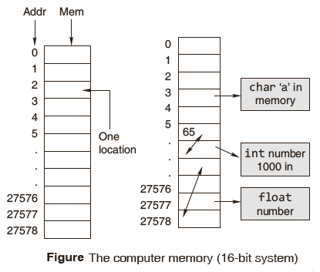
Understanding Memory Addresses
The stack has three major functions:
  1. The stack provides the storage area for local variables declared within the function.
  2. The stack stores housekeeping information involved when function call is made.
  3. The stack is needed for recursive call.
© Oxford University Press 2013. All rights reserved.
© Oxford University Press 2013. All rights reserved.

Slide 14
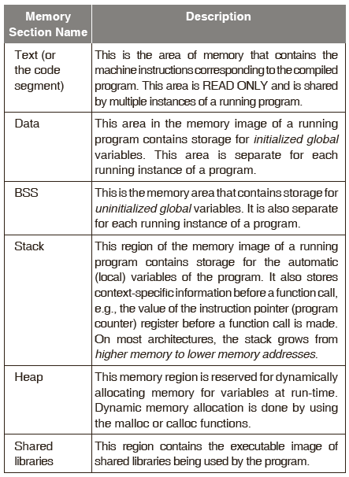
Memory Layout Summary
© Oxford University Press 2013. All rights reserved.

Slide 15
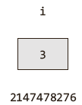
Address Operator (&)
After declaring a variable, where the variable is to be located, is decided by the compiler and the operating system at run-time.
After declaring a variable, if an attempt is made to output its value without assigning a value, the result is a garbage value.
Readers might have noticed that when we call certain functions in C the & sign is used. For example,
  scanf(“%d”, &n);
This declaration tells the C compiler to
  reserve space in memory to hold the integer value
  associate the name i with this memory location
  store the value 3 at this location
© Oxford University Press 2013. All rights reserved.

Slide 16
Pointer
A pointer provides a way of accessing a variable without referring to the variable directly.
    The mechanism used for this is the address of the variable.
    A program statement can refer to a variable indirectly using the address of the variable.
    A pointer variable is a variable that holds the memory address of another variable.
Put another way, the pointer does not hold a value in the traditional sense; instead, it holds the address of another variable.
© Oxford University Press 2013. All rights reserved.

Slide 17
Pointer
They are called pointers for the simple reason that, by storing an address, they ‘point’ to a particular point in memory.
A pointer points to that variable by holding a copy of its address.
Because a pointer holds an address rather than a value, it has two parts. The pointer itself holds the address. The address points to a value.
© Oxford University Press 2013. All rights reserved.

Slide 18
Pointers can be used to:
Call by address, thereby facilitating the changes made to a variable in the called function to become permanently available in the function from where the function is called.
Return more than one value from a function indirectly.
Pass arrays and strings more conveniently from one function to another.
Manipulate arrays more easily by moving pointers to them (or to parts of them) instead of moving the arrays themselves.
© Oxford University Press 2013. All rights reserved.

Slide 19
Pointers can be used to:
Create complex data structures, such as linked lists and binary trees, where one data structure must contain references to other data structures.
Communicate information about memory, as in the function malloc() which returns the location of free memory by using a pointer.
Compile faster, more efficient code than other derived data types such as arrays.
© Oxford University Press 2013. All rights reserved.

Slide 20
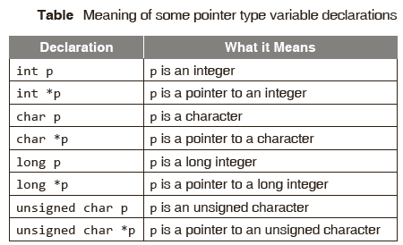
Declaring a Pointer
Just as any other variable in a program, a pointer has to be declared; it will have a value, a scope, a lifetime, a name; and it will occupy a certain number of memory locations. The pointer operator available in C is ‘*’, called ‘value at address’ operator.
The syntax for declaring a pointer variable is
  datatype * pointer_variable;
© Oxford University Press 2013. All rights reserved.

Slide 21
Consider the following program
OUTPUT
In Turbo C:
the size of integer pointer is 2
the size of fl oat pointer is 2
the size of double pointer is 2
the size of character pointer is 2
In GCC:
the size of integer pointer is 4
the size of fl oat pointer is 4
the size of double pointer is 4
the size of character pointer is 4
#include <stdio.h>
int main()
{
int *p;
float *q;
double *r;
printf(“\n the size of integer pointer is %d”,
sizeof(p));
printf(“\n the size of fl oat pointer is %d”,
sizeof(q));
printf(“\n the size of double pointer is %d”,
sizeof(r));
printf(“\n the size of character pointer is %d”,
sizeof(char *));
return 0;
}
© Oxford University Press 2013. All rights reserved.

Slide 22
Drawbacks
A programmer is likely to commit mistakes such as typographical mistakes and providing wrong offsets.
Porting the code to other implementations would require changes, if data type sizes differ. This would lead to portability issues.
Pointers have data types but the size of a pointer variable is always four bytes (in a 32-bit machine) whatever the data type is used in declaring it.
© Oxford University Press 2013. All rights reserved.

Slide 23
Where is a Pointer Stored?
It can be defined and stored globally, or it can be defined local to a function and stored on the stack but generally not stored on the heap.
  The size of the pointer depends on the implementation and for 32-bit operating systems, it generally requires four bytes of storage space.
  A compiler writer can use any number of bytes desired to store a pointer.
A pointer is like any other variable in the sense that it requires storage space somewhere in the computer’s memory, but it is not like most variables because it contains no data, only an address.
  Since it is an address, it actually contains a number referring to some memory location.
  Dynamically allocated arrays can also be expanded during the execution of the program.
© Oxford University Press 2013. All rights reserved.

Slide 24
Initializing Pointers
Unlike a simple variable that stores a value, a pointer must be initialized with a specified address prior to its use.
A pointer should be initialized with another variable’s memory address, with 0, or with the keyword NULL prior to its use;
Otherwise the result may be a compiler error or a run-time error.
  Consider the following program.
    #include <stdio.h>
    int main()
    {
    int *p; /* a pointer to an integer */
    printf(“%d\n”,*p);
    return 0;
    }
© Oxford University Press 2013. All rights reserved.

Slide 25

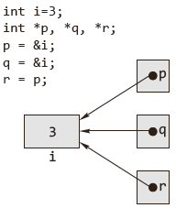
Assigning the Pointer
A pointer is bound to a specific data type (except pointer to void) . A pointer to an int cannot hold the address of a character variable in which case a compiler error would result.
The following pointer initializations are invalid.
  int a=3, *ip;
  fl oat *p;
  char ch=’A’;
  p=&a;
  ip=&ch:
r points to the same address that p points to, which is the address of i.
  We can assign pointers to one another, and the address is copied from the right-hand side to the left-hand side during the assignment.
© Oxford University Press 2013. All rights reserved.
© Oxford University Press 2013. All rights reserved.

Slide 26
Printing Pointer Value
A pointer variable contains a memory address that points to another variable. To print the memory address stored in pointers and non-pointer variables using the %p conversion specifier and to learn the use of the %p conversion specifier.
  Addresses must always be printed using %u or %p or %x. If %p is used, the address is printed in hexadecimal form. If %u is used, address is printed in decimal form.
  Study the following program.
    #include <stdio.h>
    int main(void)
    {
    int a=10, *p;
    *p=&a;
    printf(“\n *p = %p”, *p);
    return 0;
    }
    Output:
    p = 0022FF2C
© Oxford University Press 2013. All rights reserved.

Slide 27
Is it possible to assign a constant to a pointer variable?
A pointer is a variable that holds the address of a memory location. That is, pointers are variables that point to memory locations.
In C, pointers are not allowed to store any arbitrary memory address, but they can only store addresses of variables of a given type.
Consider the following code:
    int *pi;
    pi= (int*)1000;
    *pi = 5;
Location 1000 might contain the program. Since it is a read only, the OS will throw up a segmentation fault.
© Oxford University Press 2013. All rights reserved.

Slide 28
Indirection Operator & Dereferencing
The primary use of a pointer is to access and, if appropriate, change the value of the variable that the pointer is pointing to. The other pointer operator available in C is ‘*’, called the ‘value at address’ operator. It returns the value stored at a particular address.
  The value at address operator is also called indirection operator or dereference operator.
  In the following program, the value of the integer variable num is changed twice.
© Oxford University Press 2013. All rights reserved.

Slide 29

Example
#include <stdio.h>
int main()
{
int num = 5;
int *iPtr = &num;
printf(“\n The value of num is %d”, num);
num = 10;
printf(“\n The value of num after num = 10 is\
%d”, num);
*iPtr = 15;
printf(“\n The value of num after *iPtr = 15 is\
%d”, num);
return 0;
}
Output:
The value of num is 5
The value of num after num = 10 is 10
The value of num after *iPtr = 15 is 15
© Oxford University Press 2013. All rights reserved.

Slide 30
Void Pointer
A void pointer is a special type of pointer.
  It can point to any data type, from an integer value or a float to a string of characters.
Its sole limitation is that the pointed data cannot be referenced directly (the asterisk * operator cannot be used on them) since its length is always undetermined.
Therefore, type casting or assignment must be used to turn the void pointer to a pointer of a concrete data type to which we can refer.
  Void pointer can point to a variable of any data type, from an integer value or a float to a string of characters.
  The type casting or assignment must be used to turn the void pointer to a pointer of a concrete data type to which we can refer.
© Oxford University Press 2013. All rights reserved.

Slide 31
Example
#include <stdio.h>
int main()
{
int a=5,
double b=3.1415;
void *vp;
vp=&a;
printf(“\n a= %d”, *((int*)vp));
vp=&b;
printf(“\n a= %d”, *((double *)vp));
return 0;
}
Output:
a= 5
b= 3.141500
© Oxford University Press 2013. All rights reserved.

Slide 32
Null Pointer
A null pointer is a special pointer that points nowhere. That is, no other valid pointer to any other variable or array cell or anything else will ever be equal to a null pointer.
  #include <stdio.h>
  int *ip = NULL;
It is also possible to refer to the null pointer using a constant 0, and to set null pointers by simply saying int *ip = 0;
NULL is a constant that is defined in the standard library and is the equivalent of zero for a pointer. NULL is a value that is guaranteed not to point to any location in memory.
© Oxford University Press 2013. All rights reserved.

Slide 33
Use of Pointers
Call by address:
One of the typical applications of pointers is to support call by reference. However, C does not support call by reference as do other programming languages such as PASCAL and FORTRAN.
  Typically a function call is made to communicate some arguments to the function.
  C makes use of only one mechanism to communicate arguments to a function: call by value.
  This means that when a function is called, a copy of the values of the arguments is created and given to the function.
© Oxford University Press 2013. All rights reserved.

Slide 34
Example
#include <stdio.h>
void swap(int a, int b)
{
int temp;
temp=a;
a=b;
b=temp;
}
int main()
{
int x=5,y=10;
void swap(int,int);
printf(“%d %d\n”,x,y);
swap(x,y);
printf(“%d %d\n”,x,y);
return 0;
}
Output:
5 10
5 10 No swapping
© Oxford University Press 2013. All rights reserved.

Slide 35
Call by Address
Call by reference does not exist in C, but it can be simulated through the use of pointers.
To make a function be able to modify a certain variable, the function must be provided with information about the location of the variable in memory (i.e., its address).
If the function knows where the variable is in memory, it will be able to access that area of memory by using pointers and change its content. This is known as call by address.
C only supports call by value. C does not support call by reference in true sense, but it can be simulated through the use of pointers known as call by address.
#include <stdio.h>
void swap(int *a, int *b)
{
int temp;
temp = *a;
*a = *b;
*b = temp;
}
int main()
{
int x=5,y=10;
void swap(int *,int *);
printf(“%d %d\n”,x,y);
swap(&x, &y);
printf(“%d %d\n”,x,y);
return 0;
}
Output:
5 10
10 5
© Oxford University Press 2013. All rights reserved.

Slide 36
Returning more than one value from a function
Functions usually return only one value and when arguments are passed by value, the called function cannot alter the values passed and have those changes reflected in the calling function.
Pointers allow the programmer to ‘return’ more than one value by allowing the arguments to be passed by address, which allows the function to alter the values pointed to, and thus ‘return’ more than one value from a function.
#include <stdio.h>
int main()
{
float r, area, perimeter;
float compute(fl oat, fl oat *);
printf(“\n enter the radius of the circle:”);
scanf(“%f”,&r);
area=compute(r, &perimeter);
printf(“\n AREA = %f”, area);
printf(“\n PERIMETER = %f”, perimeter);
return 0;
}
float compute(fl oat r, fl oat *p)
{
fl oat a;
a=(fl oat)3.1415 * r * r;
*p=(fl oat)3.1415 * 2 * r;
return a;
}
© Oxford University Press 2013. All rights reserved.

Slide 37
Returning Pointer from a function
It is also possible to return a pointer from a function. When a pointer is returned from a function, it must point to data in the calling function or in the global variable. Consider the following program. In this program, a pointer would point an integer variable whichever is larger between two variables through a function which returns the address of the larger variable.
#include <stdio.h>
int *pointMax(int *, int *);
int main(void)
{
int a,b,*p;
printf(“\n a = ?”);
scanf(“%d”,&a);
printf(“\n b = ?”);
scanf(“%d”,&b);
p=pointMax(&a,&b);
printf(“\n*p = %d”, *p);
return 0;
}
int *pointMax(int *x, int *y)
{
if(*x>*y)
return x;
else
return y;
}
Output:
a = ?5
b = ?7
*p = 7
© Oxford University Press 2013. All rights reserved.

Slide 38
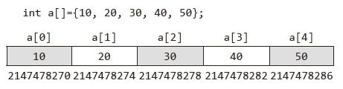
Arrays & Pointers
One-dimensional Arrays and Pointers
An array is a non-empty set of sequentially indexed elements having the same type of data.
Each element of an array has a unique identifying index number. Changes made to one element of an array does not affect the other elements.
An array occupies a contiguous block of memory. The array a is laid out in memory as a contiguous block, as shown.
© Oxford University Press 2013. All rights reserved.

Slide 39

One Dimensional Arrays & Pointers
Array name is an pointer constant. It cannot be used as l- value.
That is array names cannot be used as variables on the left of an assignment operator.
Both array and &array would give the base address of the array, but the only difference is under ANSI/ISO Standard C, &array yields a pointer, of type pointer to- array of-the data type to the entire array.
Example
#include <stdio.h>
int main()
{
int array[]={10, 20, 30, 40, 50};
printf(“%u %u”, array, &array[0]);
return 0;
}
Output:
2147478270 2147478270
© Oxford University Press 2013. All rights reserved.

Slide 40
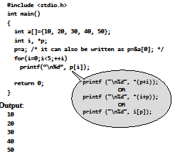
One-dimensional Arrays & Pointers
A pointer variable (of the appropriate type) can also be
used to initialize or point to the first element of the array.
© Oxford University Press 2013. All rights reserved.

Slide 41
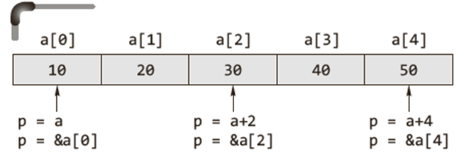

One-dimensional Arrays & Pointers
Below figure depicts the equivalence among array notation and pointer notation.
For any one-dimensional array a and integer i, the following relationships are always true.
• a[i] ≡ *(a+i) ≡ *(i+a) ≡ i[a]
© Oxford University Press 2013. All rights reserved.

Slide 42
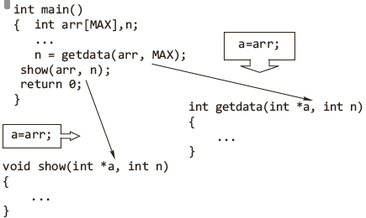
Passing an Array to a Function
An array may be passed to a function, and the elements of that array may be modified without having to worry about referencing and dereferencing.
© Oxford University Press 2013. All rights reserved.

Slide 43
Passing an Array to a Function
When an array is passed to a function, it degenerates to a pointer.
All array names that are function parameters are always converted into pointers by the compiler.
Because when passing an array to a function, the address of the zero-th element of the array is copied to the pointer variable which is the formal parameter of the function.
However, arrays and pointers are processed differently by the compiler, represented differently at runtime.
© Oxford University Press 2013. All rights reserved.

Slide 44
Differences between Array Name & Pointer
When memory is allocated for the array, the starting address is fixed, i.e., it cannot be changed during program execution. Therefore, array name is an address constant.
The & (address of) operator normally returns the address of the operand. However, arrays are the exception.
  When applied to an array (which is an address), it has the same value as the array reference without the operator.
  This is not true of the equivalent pointers, which have an independent address.
The sizeof operator returns the size of the allocated space for arrays.
  In case of a pointer, the sizeof operator returns two or four or more bytes of storage (machine dependent).
© Oxford University Press 2013. All rights reserved.

Slide 45
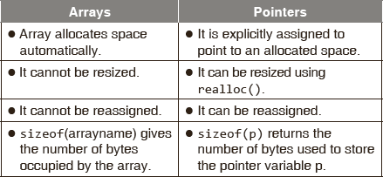
Differences between Pointers & Arrays
© Oxford University Press 2013. All rights reserved.

Slide 46
Pointers & Strings
Strings are one-dimensional arrays of type char. By convention, a string in C is terminated by the end-of-string sentinel \0, or null character.
A string constant is treated by the compiler as a pointer.
For a string, the number of elements it has need not be passed to a function because it has the terminating null character.
© Oxford University Press 2013. All rights reserved.

Slide 47
Pointer Arithmetic
The only valid operations on pointers are as follows.
Assignment of pointers to the same type of pointers: the assignment of pointers is done symbolically. Hence no integer constant except 0 can be assigned to a pointer.
Adding or subtracting a pointer and an integer.
Subtracting or comparing two pointers (within array limits) that point to the elements of an array
© Oxford University Press 2013. All rights reserved.

Slide 48
Pointer Arithmetic
Incrementing or decrementing the pointers (within array limits) that point to the elements of an array.
  When a pointer to an integer is incremented by one, the address is incremented by two (as two bytes are used for int).
  Such scaling factors necessary for the pointer arithmetic are taken care of automatically by the compiler.
Assigning the value 0 to the pointer variable and comparing 0 with the pointer. The pointer with address 0 points to nowhere at all.
© Oxford University Press 2013. All rights reserved.

Slide 49
Pointer Arithmetic
These valid address arithmetic are discussed below in detail. Do not attempt the following arithmetic operations on pointers. They will not work.
Addition of two pointers
Multiplying a pointer with a number
Dividing a pointer with a number
© Oxford University Press 2013. All rights reserved.

Slide 50
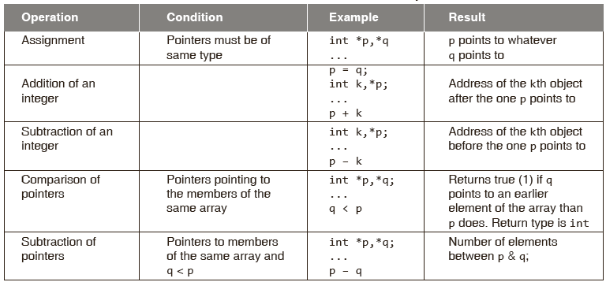
Pointer Arithmetic
© Oxford University Press 2013. All rights reserved.

Slide 51
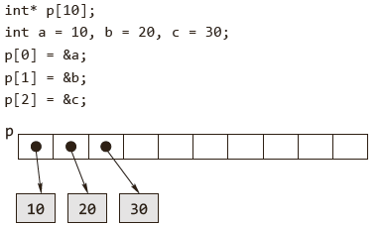
Array of Pointers
An array of pointers can be declared very easily. It is done thus.
  int *p[10];
  This declares an array of 10 pointers, each of which points to an integer.
The first pointer is called p[0], the second is p[1], and so on up to p[9].
  These start off as uninitialized—they point to some unknown point in memory. We could make them point to integer variables in memory thus.
© Oxford University Press 2013. All rights reserved.

Slide 52
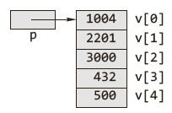
Pointers to an Array
We can declare a pointer to a simple integer value and make it point to the array as is done normally.
  int v[5] = {1004, 2201, 3000, 432, 500};
  int *p = v;
  printf(“%d \n”, *p);
This piece of code displays the number, which the pointer p points to, that is the first number in the array, namely 1004.
© Oxford University Press 2013. All rights reserved.

Slide 53
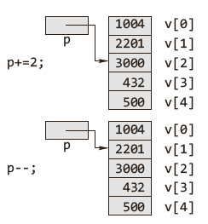
Pointers to an Array
We can use instructions such as += and -= to refer to different elements in the array.
© Oxford University Press 2013. All rights reserved.

Slide 54
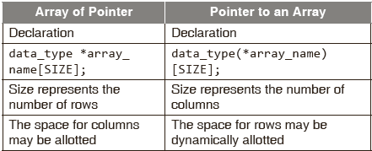
Difference between an array of pointers and a pointer to an array
© Oxford University Press 2013. All rights reserved.

Slide 55
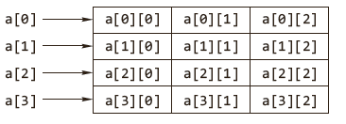
Two-dimensional Arrays & Pointers
A two-dimensional array in C is treated as a one dimensional
array whose elements are one-dimensional arrays (the rows).
Logical representation of a two-dimensional array
© Oxford University Press 2013. All rights reserved.

Slide 56
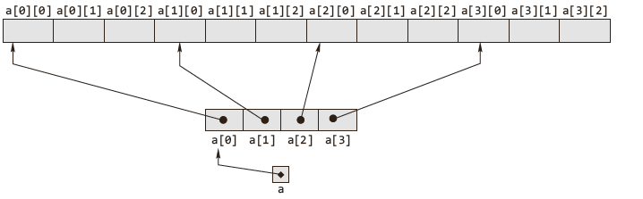
Two-dimensional Arrays & Pointers
Physical representation of a two-dimensional array.
Physical representation of a two-dimensional array
© Oxford University Press 2013. All rights reserved.

Slide 57
Two-dimensional Arrays & Pointers
C does not do run-time range checking of array subscripts.
In C the rightmost subscript of a two-dimensional array varies faster than the leftmost.
Multi-dimensional array is stored in a ‘row major addressing’ format.
The following expressions are equivalent for a two dimensional
  Array a[i][j]= *(a[i]+ j) = (*(a + i))[j] = *(*(a + i) + j)
© Oxford University Press 2013. All rights reserved.

Slide 58
Two-dimensional Arrays & Pointers
Arrays of dimension higher than two work in a similar fashion.
  Let us describe how three-dimensional arrays work.
  If the following is declared int a[7][9][2];
In case of multi-dimensional arrays all sizes except the first must be specified.
Caution These three declarations are equivalent only in a header to a function definition.
© Oxford University Press 2013. All rights reserved.

Slide 59
Pointers to Functions
Declaration of a Pointer to a Function
Function pointers are declared as follows:
Return_type(*function_pointer_name (argument_type1, argument_type2, ...);
Initialization of Function Pointers:
f add() and sub() are declared as follows
int add(int, int); and int sub(int, int);
The names of these functions, add and sum, are pointers to those functions.
These can be assigned to pointer variables.
fpointer = add;
fpointer = sub;
© Oxford University Press 2013. All rights reserved.

Slide 60
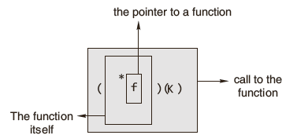
Pointers to Functions
Calling a Function using a Function Pointer
result1 = fpointer(4, 5);
result2 = fpointer(6, 2);
Passing a Function to another Function
A function pointer can be passed as a function’s calling argument.
© Oxford University Press 2013. All rights reserved.

Slide 61
Pointers to Functions
How to Return a Function Pointer
float(*GetPtr1(char opCode))(float, float)
{
if(opCode == ‘+’) return &Add;
if(opCode == ‘-’) return &Sub;
}
A solution using a typedef defines a pointer to a function that takes two float values and returns a float.
© Oxford University Press 2013. All rights reserved.

Slide 62
Example
Arrays of Function Pointers:
int main()
{
void(*p[3])(int, int);
int i;
void Add(int, int);
void Sub(int, int);
void Mul(int, int);
p[0] = Add;
p[1] = Sub;
p[2] = Mul;
for(i = 0; i <= 2; i++)
(*p[i])(10, 5);
return 0;
}
void Add(int a, int b)
{
printf(“\n Result of Addition = %d”,a+b);
}
void Sub(int a, int b)
{
printf(“\n Result of Subtraction = %d”,a-b);
}
void Mul(int a, int b)
{
printf(“\n Result of Multiplication = %d”,a*b);
}
© Oxford University Press 2013. All rights reserved.

Slide 63
Dynamic Memory Allocation
Static memory allocation
The compiler allocates the required memory space for a declared variable. By using the address of operator, the reserved address is obtained that may
be assigned to a pointer variable. Since most declared variables have static memory, this way of assigning pointer value to a pointer variable is known as static memory allocation.
Dynamic memory allocation
A dynamic memory allocation uses functions such as malloc() or calloc() to get
memory dynamically. If these functions are used to get memory dynamically and the values returned by these functions are assigned to pointer variables, such assignments are known as dynamic memory allocation. Memory is assigned during run-time.
© Oxford University Press 2013. All rights reserved.

Slide 64
Dynamic Memory Allocation
In dynamic memory allocation, memory is allocated at runtime from heap.
  According to ANSI compiler, the block pointer returned by allocating function is a void pointer.
  If sufficient memory is not available, the malloc()and calloc() returns a NULL.
  According to ANSI compiler, a cast on the void pointer returned by malloc() is not required.
© Oxford University Press 2013. All rights reserved.

Slide 65
Dynamic Memory Allocation
calloc() initializes all the bits in the allocated space set to zero where as malloc() does not do this.
  A call to calloc() is equivalent to a call to malloc() followed by one to memset().
  calloc(m, n) is essentially equivalent to p = malloc(m * n); memset(p, 0, m * n);
When dynamically allocated, arrays are no longer needed, it is recommended to free them immediately.
© Oxford University Press 2013. All rights reserved.

Slide 66
Dynamic Memory Allocation
Dynamic Allocation of Arrays:
To allocate a one-dimensional array of length N of some particular type where N is given by the user, simply use malloc() to allocate enough memory to hold N elements of the particular type.
#include <stdio.h>
#include <stdlib.h>
int main()
{
int N,*a,i,s=0;
printf(“\n enter no. of elements of the array:”);
scanf(“%d”,&N);
a=(int *)malloc(N*sizeof(int));
if(a==NULL)
{
printf(“\n memory allocation unsuccessful...”);
exit(0);
}
printf(“\n enter the array elements one by one”);
for(i=0; i<N;++i)
{
scanf(“%d”,&a[i])); /* equivalent statement
scanf(“%d”,(a+i));*/
s+=a[i];
}
printf(“\n sum is %d ”,s);
return 0;
}
© Oxford University Press 2013. All rights reserved.

Slide 67
Dynamic Memory Allocation
Freeing Memory :
Dynamically allocated memory is de-allocated with the free function. If p contains a pointer previously returned by malloc(), a call such as free(p);
malloc() requires two parameters, the first for the number of elements to be allocated and the second for the size of each element, whereas calloc() requires one parameters.
© Oxford University Press 2013. All rights reserved.

Slide 68
Dynamic Memory Allocation
calloc() initializes all the bits in the allocated space set to zero whereas malloc() does not do this.
A call to calloc() is equivalent to a call to malloc() followed by one to memset().
calloc(m, n) is essentially equivalent to p = malloc(m * n); memset(p, 0, m * n);If malloc() is called with a zero size, the results are unpredictable.
It may return some other pointer or it may return some other implementation-dependent value.
© Oxford University Press 2013. All rights reserved.

Slide 69
Dynamic Memory Allocation
Reallocating Memory Blocks
malloc() will not work. It is the realloc() function that is required
ip = realloc(ip, 200 * sizeof(int));
© Oxford University Press 2013. All rights reserved.

Slide 70
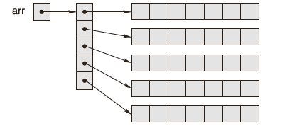
Dynamic Memory Allocation
Implementing Multidimensional Arrays using Pointers:
It is usually best to allocate an array of pointers, and then initialize each pointer to a dynamically allocated ‘row’.
© Oxford University Press 2013. All rights reserved.

Slide 71
Memory Leak & Memory Corruption
Dangling pointer
A pointer may be used to hold the address of dynamically allocated memory. After this memory is freed with the free() function (in C), the pointer itself will still contain the address of the released block. This is referred to as a dangling pointer.
Memory corruption
Memory when altered without an explicit assignment due to the inadvertent and unexpected altering of data held in memory or the altering of a pointer
to a specific place in memory is known as memory corruption.
Buffer overflow
Overwrite beyond allocated length char *a = malloc(128*sizeof(char));
memcpy(a, data, dataLen); /* Error if dataLen is too long. */
© Oxford University Press 2013. All rights reserved.

Slide 72
Pointer & Const Qualifier
Pointer to Constant
The const keyword can be used in the declaration of the pointer when a pointer is declared to indicate that the value pointed to must not be changed.
int n = 10;
const int *ptr=&n;
Constant Pointers
Constant pointers ensure that the address stored in a pointer cannot be changed. Consider the following statements -
int n = 10;
int *const ptr = &n; /* Defi nes a constant */
© Oxford University Press 2013. All rights reserved.

Slide 73
Pointer & Const Qualifier
Constant parameters
To prevent an array argument from being altered in a function, use the const qualifier as demonstrated in the next programs.
#include <stdio.h>
void change(char *);
int main(void)
{
char s[]=“Siva”;
change(s);
printf(“\n The string after calling change():\
%s”, s);
return 0;
}
© Oxford University Press 2013. All rights reserved.

