Slide 1
Evolution of Endpoint Detection and Response (EDR)
A Comprehensive Review
Authors: Harpreet Kaur et al.

Slide 2
Introduction to EDR
Definition: Security solution monitoring end-user devices to detect and respond to threats.
Core Function: Continuous telemetry collection (processes, network, connections).
Proactive Nature: Unlike reactive Antivirus, EDR hunts for suspicious behavior.
Importance: Critical defense against sophisticated, persistent cyber-attacks.

Slide 3
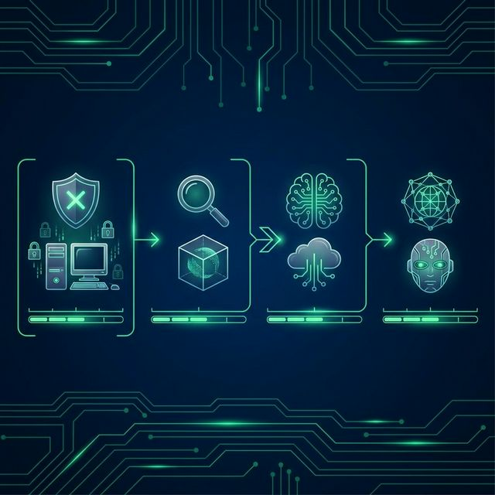
The Evolution Timeline (2005-2023)
2005-2010 (Foundation): Signatures, Firewalls, Manual Response.
2011-2015 (Behavioral): Logic-based detection, Sandboxing, IoCs.
2016-2020 (Intelligence): Machine Learning, UEBA, File-less detection.
2021-2023 (Advanced): XDR, AI-powered, Zero Trust, Automated Response.

Slide 4
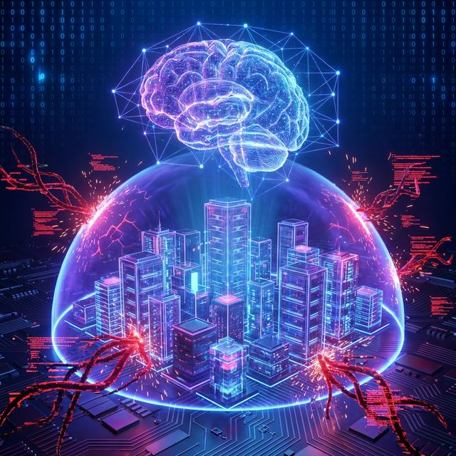
Machine Learning & AI in EDR
Role: Analyze massive data volumes impossible for humans.
Pattern Recognition: Establish baselines to flag anomalies.
Zero-Day Detection: Identify unknown threats via intent/behavior.
Challenges: False positives, adversarial attacks, model drift.

Slide 5
Advanced Concepts: DOPS
DOPS (Deep Ocean Protection System): Enhances EDR capabilities.
Architecture: Endpoint Service Pack collects data; Microservice processes it.
Innovation: Image-Based Malware Detection.
How it works: Converts binary code to images -> logic detects visual patterns of malware -> faster/more accurate.

Slide 6
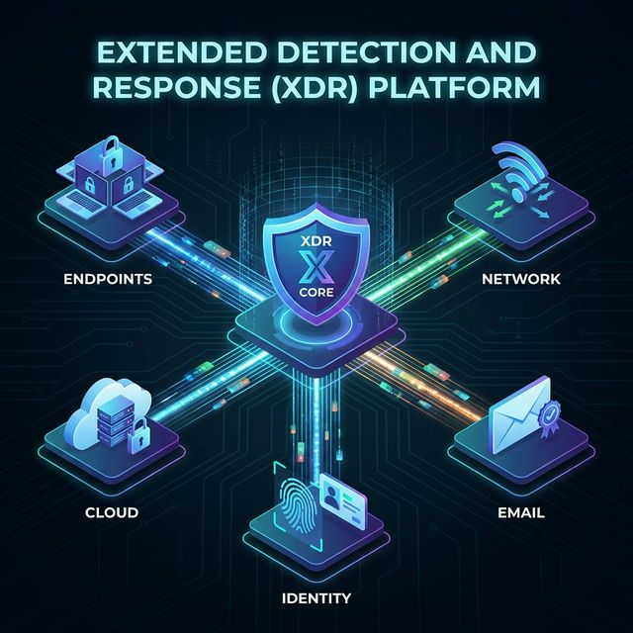
Extended Detection and Response (XDR)
The Future: Evolving beyond endpoints.
Unified Visibility: Network + Cloud + Email + Identity + Endpoint.
Holistic Defense: Correlates signals across layers.
Automated Response: Remediate threats across the entire ecosystem.

Slide 7
Conclusion
Summary: EDR has shifted from signatures to AI-driven behavioral analysis.
Key Driver: Validating AI/ML is essential for modern defense.
Outlook: Integration (XDR) and Automation are the future.
Takeaway: As threats evolve, our defenses must evolve faster.

