Slide 1
Topological Sort
Introduction.
Definition of Topological Sort.
Topological Sort is Not Unique.
Topological Sort Algorithm.
An Example.
Implementation.
Review Questions.

Slide 2
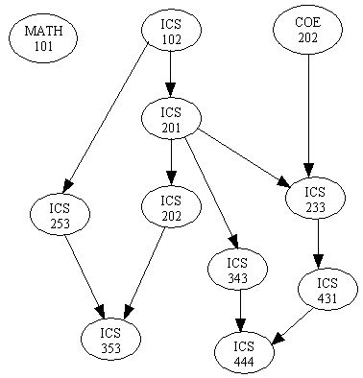
Introduction
There are many problems involving a set of tasks in which some of the tasks must be done before others.
For example, consider the problem of taking a course only after taking its prerequisites.
Is there any systematic way of linearly arranging the courses in the order that they should be taken?
Yes! - Topological sort.

Slide 3
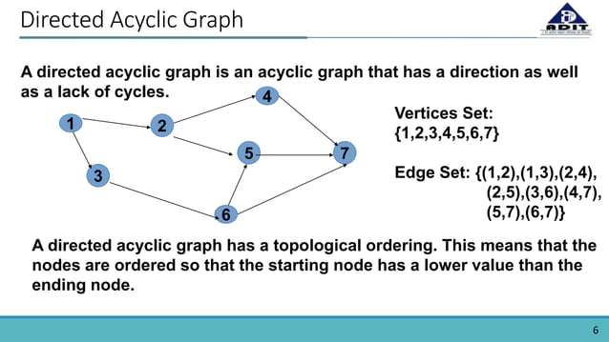

Slide 4
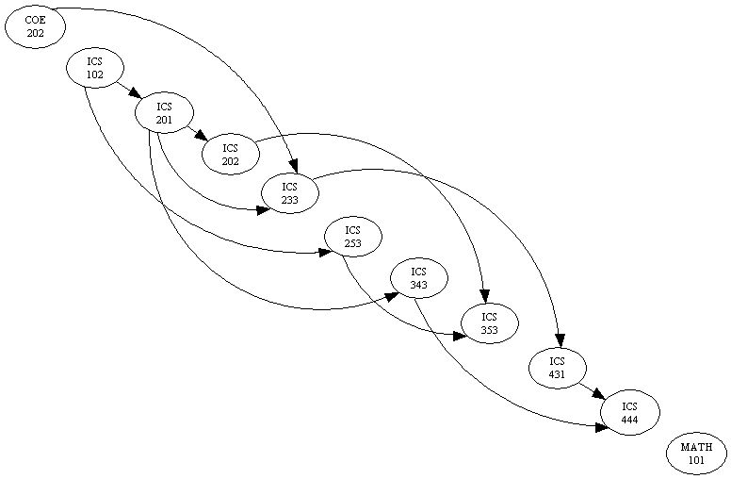
Definition of Topological Sort
Topological sort is a method of arranging the vertices in a directed acyclic graph (DAG), as a sequence, such that no vertex appear in the sequence before its predecessor.
The graph in (a) can be topologically sorted as in (b)
(a)
(b)

Slide 5
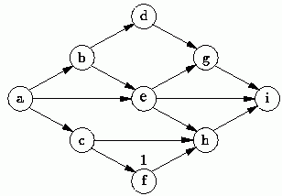
Topological Sort is not unique
Topological sort is not unique.
The following are all topological sort of the graph below:
s1 = {a, b, c, d, e, f, g, h, i}
s2 = {a, c, b, f, e, d, h, g, i}
s3 = {a, b, d, c, e, g, f, h, i}
s4 = {a, c, f, b, e, h, d, g, i}
etc.

Slide 6
Topological Sort Algorithm
One way to find a topological sort is to consider in-degrees of the vertices.
The first vertex must have in-degree zero -- every DAG must have at least one vertex with in-degree zero.
The Topological sort algorithm is:
int topologicalOrderTraversal( ){
int numVisitedVertices = 0;
while(there are more vertices to be visited){
if(there is no vertex with in-degree 0)
break;
else{
    select a vertex v that has in-degree 0;
    visit v;
    numVisitedVertices++;
    delete v and all its emanating edges;
}
}
return numVisitedVertices;
}

Slide 7
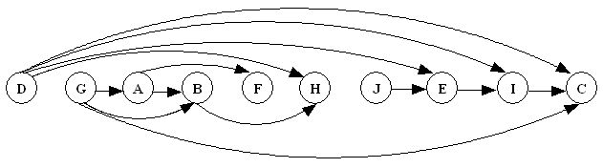
Topological Sort Example
Demonstrating Topological Sort.
1
2
3
0
2
A
B
C
D
E
F
G
H
I
J
1
0
2
2
0
D G A B F H J E I C

Slide 8
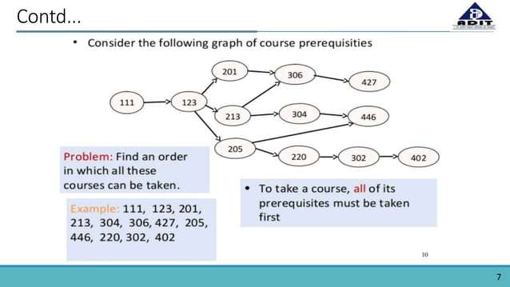

Slide 9
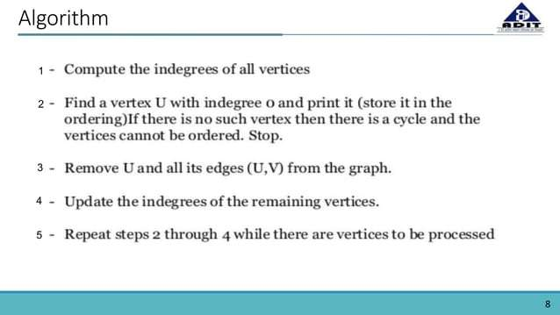

Slide 10
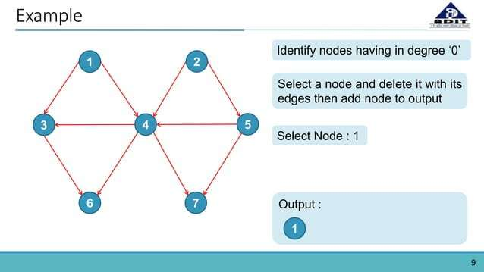

Slide 11
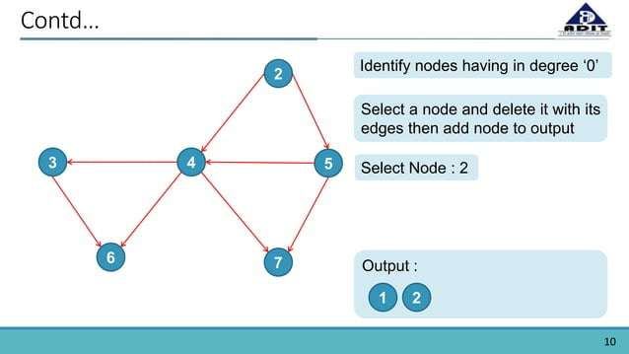

Slide 12
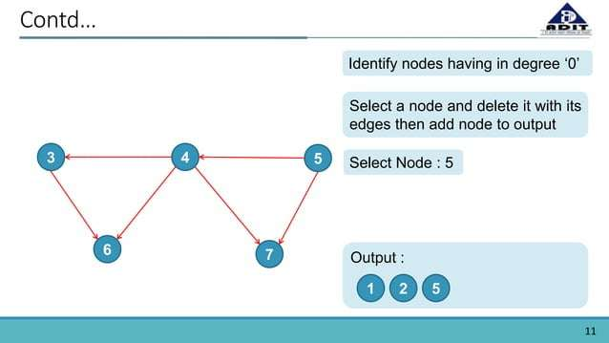

Slide 13
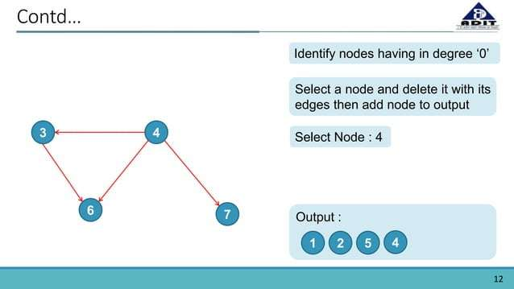

Slide 14
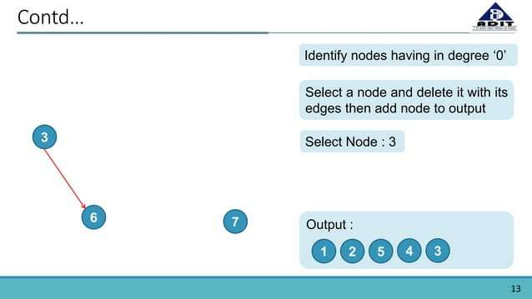

Slide 15
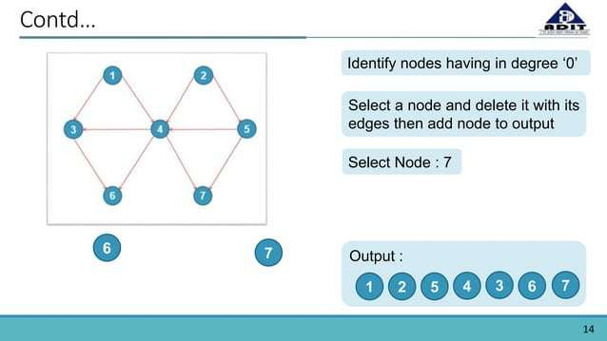

Slide 16
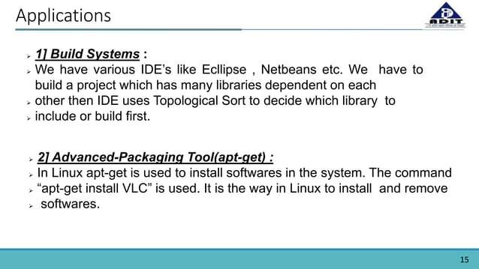

Slide 17
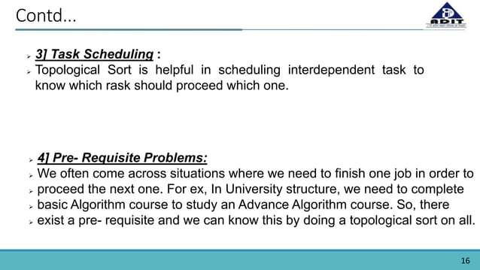

Slide 18
Implementation of Topological Sort
The algorithm is implemented as a traversal method that visits the vertices in a topological sort order.
An array of length |V| is used to record the in-degrees of the vertices. Hence no need to remove vertices or edges.
A priority queue is used to keep track of vertices with in-degree zero that are not yet visited.
public int topologicalOrderTraversal(Visitor visitor){
int numVerticesVisited = 0;
int[] inDegree = new int[numberOfVertices];
for(int i = 0; i < numberOfVertices; i++)
inDegree[i] = 0;
Iterator p = getEdges();
while (p.hasNext()) {
Edge edge = (Edge) p.next();
Vertex to = edge.getToVertex();
inDegree[getIndex(to)]++;
}

Slide 19
Implementation of Topological Sort
BinaryHeap queue = new BinaryHeap(numberOfVertices);
p = getVertices();
while(p.hasNext()){
Vertex v = (Vertex)p.next();
if(inDegree[getIndex(v)] == 0)
queue.enqueue(v);
}
while(!queue.isEmpty() && !visitor.isDone()){
Vertex v = (Vertex)queue.dequeueMin();
visitor.visit(v);
numVerticesVisited++;
p = v.getSuccessors();
while (p.hasNext()){
Vertex to = (Vertex) p.next();
if(--inDegree[getIndex(to)] == 0)
queue.enqueue(to);
}
}
return numVerticesVisited;
}

Slide 20
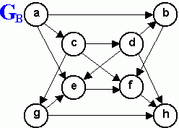
Review Questions
1. List the order in which the nodes of the directed graph GB are visited by topological order traversal that starts from vertex a.

