Slide 1
Principles of Blockchains
Professor Pramod Viswanath
Princeton University
University of Illinois at Urbana-Champaign

Slide 2
What are Blockchains?
Blockchains are decentralized digital trust platforms
This is a mouthful, so let us unpack it.
Notes:
Start demo:
launch network, how many AWS EC2 nodes
Show dashboard
Discuss plots: throughput, latency, forking performance

Slide 3
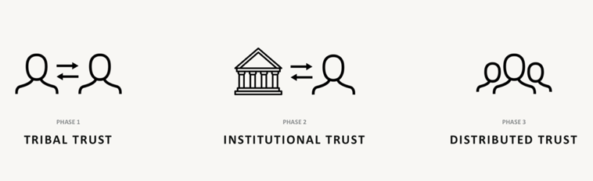
Trust Human success is based on flexible cooperation in large numbers. This requires trust
Evolution of Trust over human history
Notes:
Start demo:
launch network, how many AWS EC2 nodes
Show dashboard
Discuss plots: throughput, latency, forking performance

Slide 4
Platform Economy
2021 (year end)
Top US companies by market cap
Apple $2740 B
Microsoft $2280 B
Alphabet $1826 B
Amazon $1612 B
Tesla $1042 B
Facebook $889 B
2011
Top US companies by market cap
Exxon $417 B
Apple $321 B
Chevron $215 B
Microsoft $213 B
IBM $207 B
Walmart $204 B
Notes:
Start demo:
launch network, how many AWS EC2 nodes
Show dashboard
Discuss plots: throughput, latency, forking performance

Slide 5
A Decentralized Platform?
A decentralized Dropbox, eBay, Instagram?
Incentives aligned with consumers and resource providers?
No need for a trusted middle party?
Such is the siren song of blockchains.
Notes:
This is the end of Part 1.

Slide 6
Bitcoin: the original blockchain
Cryptocurrency
medium of exchange and store of value
Born during the 2008 Financial Crisis
Anonymous inventor
pseudonym: Satoshi Nakamoto
Very secure
no attacks, has been live continuously
Notes:
Start demo:
launch network, how many AWS EC2 nodes
Show dashboard
Discuss plots: throughput, latency, forking performance

Slide 7
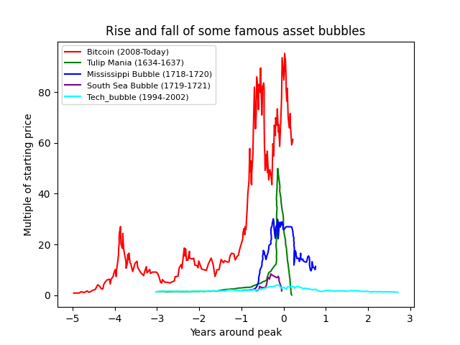
Bitcoin and Bubbles
Notes:
Start demo:
launch network, how many AWS EC2 nodes
Show dashboard
Discuss plots: throughput, latency, forking performance

Slide 8
Bitcoin performance
1. Security – 50% adversary
2. Transaction throughput – 7 tx/s
3. Confirmation Latency – hours
4. Energy consumption – medium size country
5. Compute – specialized mining hardware
6. Storage – everyone stores everything
7. Communication – everyone tx/rx everything

Slide 9
Bitcoin is far from a Platform
1M Trades / Sec
Exchanges
100K Tx / Sec
IoT
10K Tx / Sec
10K Tweet / Sec
Payments
Social Networks
1000 Tx / Sec
Gaming
assets
Prediction Market
1000 Tx / Sec
Ethereum: 20 Tx / Sec
Core Blockchain Infrastructure
Throughput
Notes:
This is the end of Part 2.
A platform for all platforms: gap -→ big cross mark
Highlights gap.

Slide 10
Building Block of Blockchains
Platforms are applications built on networked computers
Basic building block: Decentralized Computer
Multiple untrusted computers interacting with one another, forming consensus on an ordered list of instructions
A virtual machine interprets the instruction set
A programming language and a corresponding compiler provide a forum for decentralized applications (dApps)

Slide 11
Technical Components
Smart Contract Prog. Language
Decentralized Computer
Cryptographic data structures
Disk I/O and Database management
Memory management
Operating systems
Peer to peer networking
Consensus and distributed algorithms
Virtual Machine
Reduced instruction set, incentives
General purpose programming language
Turing complete, compatible with trust-free execution environments
Nearly all aspects of Computer Science
Virtual Machine
Decentralized Consensus

Slide 12
Principles of Blockchains
This course presents the design space of blockchains
Principles of good blockchain design choices
Full-stack view
Pre-requisite: maturity with nearly all aspects of computer science
Concretely: basic background in algorithms, systems programming

Slide 13
Course begins with Bitcoin
We start with an in-depth view of the Bitcoin design
The focus allows us to see the interacting components of the blockchain
Highlight the design constraints across the layers
Bitcoin design is very simple and yet
remarkably secure, elegant in an engineering sense
performance guarantees backed by sophisticated mathematics
Outstanding case study for a deep understanding of blockchains

Slide 14
Module 1. Bitcoin Blockchain
Next four lectures: Cryptographic data structures, Consensus, Peer to Peer Networking, Transaction structure, Ledger state management
Two lectures: mathematical security guarantees of Bitcoin
Implementation-intensive: students implement a full-stack Bitcoin client

Slide 15
Module 2. Scaling Blockchain
Adapting the Bitcoin design to scale its performance
Scaling:
Throughput
Latency
Computation, Storage
Energy
Layer 2 scaling via sidechains
The resulting blockchain designs are at the heart of many popular cryptocurrency platforms: Avalanche, Cardano, Solana, Polygon

Slide 16
Module 3. Beyond Bitcoin
Incorporating features absent in the Bitcoin design
Finality
Privacy
Connecting blockchains: Bridges
Importing data into blockchains: Oracles
The resulting blockchain designs are at the heart of many popular cryptocurrency platforms: Zcash, ChainLink,

Slide 17
Module 4: Applications and dApps
Smart Contract Ecosystem
Decentralized Finance (DeFi)
Digital Collectibles (NFT)
Focus:
1. Principles: programmable, permissionless, friction-free revolution in the application arenas of finance and collectibles.
2. Hands-on instruction: students implement basic dApps for both DeFi and NFT applications in the Solidity programming language
Notes:
Start demo:
launch network, how many AWS EC2 nodes
Show dashboard
Discuss plots: throughput, latency, forking performance

Slide 18
Logistics: course content
Website for the course: https://courses.grainger.illinois.edu/ece598pv/sp2022/
Assignments and Projects on Gitlab:
https://gitlab.engr.illinois.edu/ece598pv/ece598pv-sp2022
Communication: Instruction from staff via email
Students can post on Piazza, Discord and Gitlab
Notes:
Start demo:
launch network, how many AWS EC2 nodes
Show dashboard
Discuss plots: throughput, latency, forking performance

Slide 19
Logistics: programming language
Rust

Slide 20
What is Rust?
Rust is a compiled language just like C/C++. Rust code is compiled to executable binary.
Rust program is highly reliable. Rust’s type system and ownership model guarantee memory-safety and thread-safety.
Programmers eliminate many classes of bugs at compile-time, where the compiler message is highly useful to eliminate bugs and make the program more reliable.
www.rust-lang.org

Slide 21
Rust compiler doesn’t allow more than one owner (Miner & UI) of an object (Memory Pool).
Miner
User Interface
NOT ALLOWED
Get transactions
Add new transactions
Memory Pool
Transaction 1
Transaction 2
...

Slide 22
If an object is wrapped by a thread-safe lock, Rust compiler allows more than one owner (Miner & UI).
Miner
User Interface
Get transactions
Add new transactions
Thread-safe lock
Memory Pool
Transaction 1
...
Pass compiling
and safe

Slide 23
Besides its reliability, Rust also provides good ...
efficiency as C/C++,
network support as Go and Python,
functional-style programming as Scala,
community support as many other popular lanuages.

Slide 24


Why is Rust chosen for blockchains?
High reliability makes blockchains reliable and secure.
Good efficiency makes blockchains scalable.
Network support makes communication easy-to-code.
Influential blockchain projects are using Rust:

Slide 25
Logistics: programming language
Solidity

Slide 26
What is Solidity?
Solidity is an object-oriented, high-level language for implementing smart contracts.
Smart contracts are programs which govern the behavior of accounts within the Ethereum state.
Solidity is designed to target the Ethereum Virtual Machine (EVM).
Solidity is statically typed, like Java, C, Rust… unlike python or javascript.

Slide 27
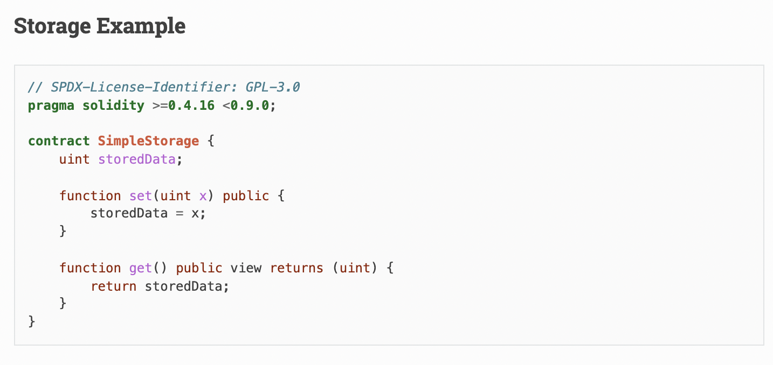
A Simple Smart Contract

Slide 28


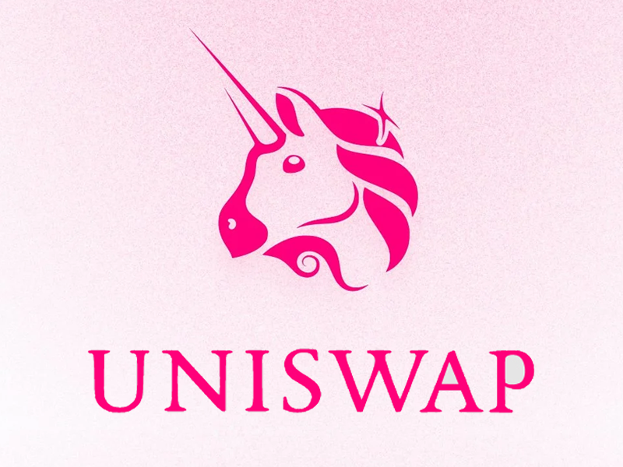
MPs using Solidity
Interact with Etheruem blockchain
Mint your own tokens (like ETH / CryptoKitties)
Create decentralized market maker (like Uniswap)

