Slide 1
Engineering Mathematics Miniproject
Topic :- Unconstrained Optimization: Newton's Method
Miniproject by :
57 Praneet Shrikrushna Revandkar
58 Susmita Manoj Sahu
59 Gauri Subhash Salunkhe
60 Aniket Sampatti Sargar

Slide 2

Unconstrained Optimization: Newton's Method
Unconstrained optimization is a fundamental concept in mathematics and computer science, with broad applications in fields like machine learning, engineering, and economics.

Slide 3
Introduction to Unconstrained Optimization
Definition
Significance
Unconstrained optimization aims to find the maximum or minimum value of a function without any restrictions on the input variables.
It's crucial for finding optimal solutions in numerous real-world problems.

Slide 4

Newton's Method Overview
1
Iterative Algorithm
It's an iterative method that repeatedly updates an estimate of the solution until convergence.
2
Gradient and Hessian
It leverages the first and second derivatives of the objective function to guide the search.

Slide 5
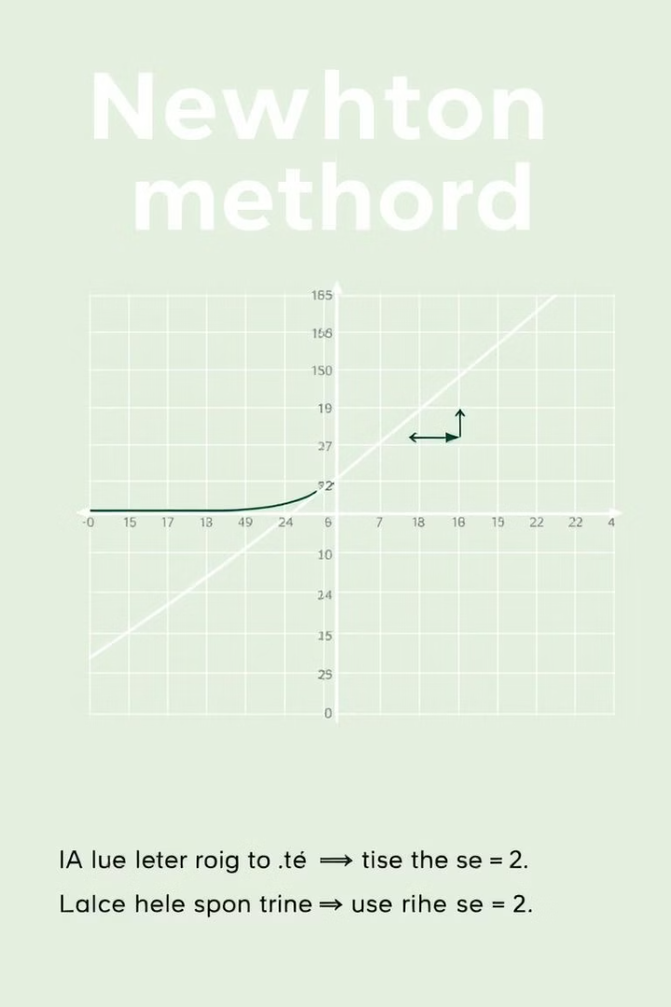



Defining Newton's Method
Objective Function
Finds the minimum or maximum of a function f(x).
Iterative Updates
Updates the solution estimate based on the gradient and Hessian.
Convergence
Continues until the solution converges to a minimum or maximum.

Slide 6
Understanding Gradient and Hessian
Gradient
Hessian
First derivative of the function, indicating the direction of steepest ascent.
Second derivative, providing information about the curvature of the function.

Slide 7

Step-by-Step Explanation of Newton's Method
Initialize
Choose an initial guess for the solution.
Compute Gradient and Hessian
Calculate the gradient and Hessian at the current guess.
Update Solution
Use the gradient and Hessian to update the solution estimate.
Repeat
Repeat steps 2-3 until convergence.

Slide 8





Outlining the Algorithm and Key Steps
1
Initialization
2
Gradient Calculation
3
Hessian Calculation
4
Solution Update
5
Convergence Check

Slide 9

Updating the Solution
Formula
Hessian Inverse
Gradient
The solution is updated using the formula: x_(k+1) = x_k - H^(-1)(x_k) * grad(x_k)
The Hessian inverse is used to determine the step size and direction.
The gradient guides the search towards the minimum or maximum.

Slide 10
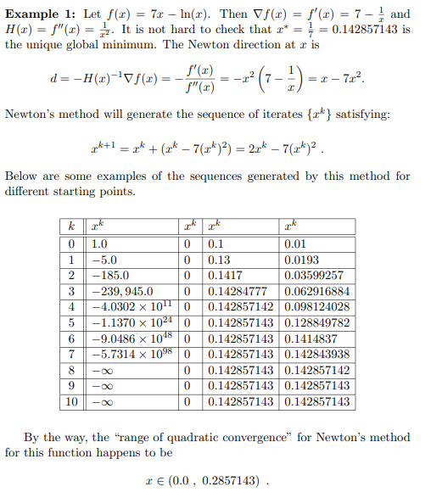
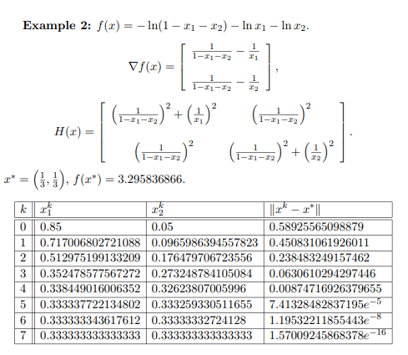
Worked Example: Solving an Optimization Problem

