Slide 1
TEAM 88

Slide 2
Introduction
The real estate industry is subject to various market forces, such as economic conditions, government regulations, and interest rates, which can significantly impact property values and the profitability of real estate transactions. The industry faces challenges like affordability issues, regulatory challenges, environmental concerns, and technological disruption.
The Proptech industry is rapidly growing and encompasses various technological innovations that enhance different aspects of real estate, making it more accessible, efficient, and cost-effective.
NoBroker is an Indian Proptech company that offers a platform to buy, sell, and rent properties without involving any brokers. The company uses cutting-edge technologies like AI and machine learning to provide a seamless experience to its users.
In India, several companies like NoBroker, Square Yards, Housing.com, 99acres, and Magicbricks are leveraging technology to disrupt and innovate the real estate sector.
REAL ESTATE INDUSTRY

Slide 3
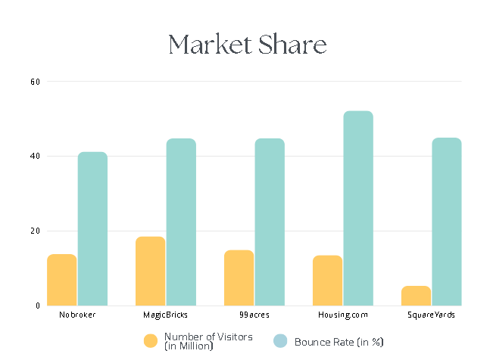
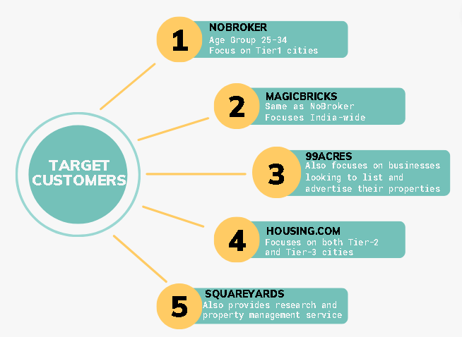
MARKET SHARE | TARGET CUSTOMERS

Slide 4
TECHNICAL ADVANTAGE
 | NoBroker | MagicBricks | Housing.com | SquareYards | 99acres
1 | NoBroker Pay offers interest-free financing Automated rent receipt generation | ProIndex empowers on the movement of residential apartment prices and supply of properties | Offers 360-degree virtual tours | Provides customer support through multiple channels | Currency converter feature on its platform
2 | Offers a no-brokerage approach Provides NBcash to avail discounts | Wide range of features like rate vs trend analysis, investment hotspots, property valuation | Partners with several real estate portals such as Proptiger,Makaan, IREF | Provides real estate market analysis and insights | Customized solutions for developers ,builders and brokers
3 | Provides services like background verification, rent agreements and home insurance | Real estate guide to know about property transactions,legal requirements etc. | Special plan for NRIs to cater their specific needs | Has a rental yield calculator to calculate potential rental income of a property | Offers a range of pricing plans taking the value of property into account

Slide 5
SWOT ANALYSIS of NOBROKER
STRENGTHS
WEAKNESSES
Allows tenants to pay their rent online without any transaction fees.
NoBroker Hood: Their community management platform.
Offers unique features like Refer and earn, NBcash, interest free payment, automated rent receipt generation,livability and transit score on properties
Lack of exploitation of lead generation business
Limited operational area coverage
UI/UX cluttered
OPPORTUNITIES
THREATS
Core offerings of subscription model.
Integration of advanced technologies like Metaverse, AR/VR, 3D view.
Monetising low rental marketplace.
User friendliness of the website and customer service can be improved by making the site available in regional languages.
Competition in community management platform
Growing sales and revenue in competitive environment
Expanding the team and operational area

Slide 6
SWOT ANALYSIS of Housing.com
STRENGTHS
WEAKNESSES
First mover advantage in number of segments
Stronger presence in Tier 2,Tier3 cities.
Offers unique features like 360-degree virtual tours.
Partnered with several real estate portals such as Proptiger, Makaan, and IREF.
Low Return on Investment
Customer Dissatisfaction
OPPORTUNITIES
THREATS
Opportunities in Adjacent Markets
Developments in Artificial Intelligence
Threats of New Entrants because of Reducing Costs and Increasing Efficiencies
Increasing revenue growth

Slide 7
SWOT ANALYSIS of MagicBricks
STRENGTHS
WEAKNESSES
Technical edge with features like-property valuation,trend insights
User friendly interface
Pricing is expensive
No verification system for agents
OPPORTUNITIES
THREATS
Potential market tapping
Add property exchange program
Complacency check
Competing at moderate pricing

Slide 8
SWOT ANALYSIS of 99Acres
STRENGTHS
WEAKNESSES
Large client base
Most preferred by NRIs
Verification of properties
Target only internet market
OPPORTUNITIES
THREATS
Economic slowdown
Quality of listing
Head to head competition
Gain from commercial real estate
Increase sales through resale market

Slide 9
SWOT ANALYSIS of SquareYards
STRENGTHS
WEAKNESSES
Customer support through various channels
Escrow,secure payment channel,KYC
Global presence
Being relatively new company, it has limited financial resources compared to competitors
Revenue vulnerable to market fluctuations
OPPORTUNITIES
THREATS
Rentals and property management
R&D and IP benchmarking
Competing with established companies in Indian market

Slide 10
REVENUE GROWTH STRATEGY FOR RENTAL MARKETS
1
2
3
02
REFER AND EARN
NEW MARKET ENTRY
EASY USER INTERFACE
4
5
6
CHANNELIZING PEOPLE TO HOME SERVICES
BUILDING PARTNERSHIP
MARKETING

Slide 11
REFER AND EARN
1
Incentives such as discounts on rent or cash rewards
Encourages existing customers to refer friends and family to the rental growth market.
REFER AND EARN
Extra listing visibility for both the referee and the referrer
Provides valuable data about customer referral behaviour to improve marketing

Slide 12
NEW MARKET ENTRY
2
Partner with local real estate agents to gain credibility and understand the local market.
Customer communication in local language
Build trust and credibility by providing transparency in pricing and services.
Market research to understand the local rental market and tailor services
Robust online presence

Slide 13
EASY USER INTERFACE
3
Adding ratings/reviews for properties, using a recommendation system, adding a compare feature, providing cost estimation for first-time sellers, and including a Rent-o-meter.
NoBroker's website has good features such as NoBroker Ranking, livability score, and transit score, but some improvements can be made.
EASY USER INTERFACE
Include adding budget as a filter, providing an overview of the person listing/selling/renting out the property, and showing the seller a preview of the listing.
Real estate blogs/guides, videos to help buyers/sellers, and analysis of Indian markets.

Slide 14
4
CHANNELIZING PEOPLE TO HOME SERVICES
Chatbot to answer inquiries from new tenants
Notify users about home services post-purchase
Discounts on purchasing a home service plan.
Convert the plan amount into NB cash, if unable to acquire a property which can then be used to purchase home services.
Encourage customers to avail home services who enter a listing without any plan.

Slide 15
5
BUILDING PARTNERSHIPS
Partner with property developers to sell their properties and offer virtual tours to potential customers in exchange for exclusive access to their properties and a commission on each sale.
Associate with banks and financial institutions to offer home loans and refer customers to them for loan processing in exchange for a commission on successful loan disbursals.
Building strong partnerships reduces customer acquisition costs and provides access to new markets and resources.

Slide 16
MARKETING
6
Effective marketing is crucial for attracting new customers to the rental growth market. Various marketing channels, such as social media, email marketing, SEO, and paid advertising, can be used.
Social media platforms are powerful tools for reaching potential tenants and owners. Paid Advertisement will help.
Regular and engaging social media content can help achieve higher occupancy, even during slower seasons.
Search Engine Optimization (SEO) can improve website ranking in search results.
Promoting unique features, such as competitive pricing, convenient location, or exceptional customer service, can attract more customers.
Competitive pricing helps prevent market share losses and track margins.
Expanding to newer geographical locations, like Tier-II cities, can expand the customer base and increase revenue growth

Slide 17
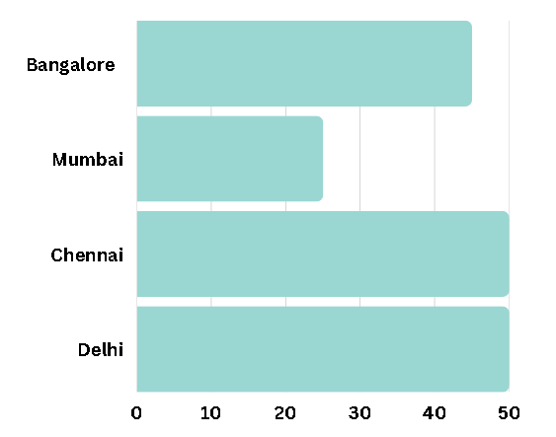

BETTER MONETIZATION OF THE LOW RENTAL SEGMENT
New Product for the low rental segment
Improve User Interface and User Experience
GOAL
STRATEGIES TO MONITISE THE LOW RENTAL SEGMENT
Improve customer Trust

Slide 18
NEW PLAN FOR THE LOW RENTAL SEGMENT
A new plan that may involve personalized rental assistance, rental agreement negotiation support, and exclusive ad access for registered users needs to be introduced.
Owner listings make up around 45% of the low-rent market, although the owners must pay between Rs. 2,000 and Rs. 3,000 for entry-level plans for both residential and commercial listings
The company limits the number of listings accessible to consumers with the cheap rental plan to prevent misuse.

Slide 19
2. IMPROVE CUSTOMER TRUST
The company's salesperson can more convincingly and transparently pitch their plans to potential customers, demonstrating their legitimacy
Tech unsavvy customers typically don't trust the companies enough to choose a plan that will be advantageous to them
Customers' trust will grow as a result, and they'll be more likely to buy plans

Slide 20
Chat Box Function
Selection of Preferred Language.
Relevant Service Information
Installation
Guide
Guiding For App Installation.
Visual Step By Step Guide.
3. UI/UX
ENHANCEMENT
Customer Support
Availability of List Property Assistance.
Responsive User Support.
Easy Listing OF Property
Effort Less Property Uploading.
Intuitive property explanation

Slide 21
STRATEGIES TO INCREASE REPEAT PURCHASE
INCENTIVIZING SECOND PURCHASE
Leveraging NB cash features: If a customer has total bill of x INR, this leads to x NBcash coins in their profile. On next purchase of amount above certain bracket will be eligible to the deduction of NBcash coins from the present purchase.
Availing premium features: 3D display of space, floors plans, virtual tours
Loyal Customer Tags:
Feedback and reviews after the purchase
Ratings awarded based on reviews and number of listings
Visibility and trust enhancement of customers

Slide 22
2. POST PURCHASING ENGAGEMENT
Customised offer
Tenant/ Buyer | Residential | Discounts on packers and movers services Adding warranty for decor services For every 4 repeats of services, adding extra free service
 | Commercial | Guiding shoppers in legalities Regular cleaning services and so on
Seller | Residential/ Commercial | Discounting the services like painting pre-selling the property Post selling providing acquaintance in shifting,etc.
 | Landlord | Marketing help to the firms by printing ads and mail campaigns
Pop-up features

Slide 23
3. CUSTOMER FEEDBACK ENHANCEMENT
Feedback form after every purchase
Incentivising feedback by providing NBcash coins.
Coins can be redeemed during their next purchase
.
Gathered Insights
Improved decision making based on reviews
Increased customer loyalty and trust

Slide 24
4. TARGETED MARKETING ON POTENTIAL REPEAT CUSTOMERS
Leveraging customer analytics, ML models and AI tools to identify potential customers.
Providing personalized services based on the user demographics and requirements.
Customers are notified through emails, social media, newsletters or through pop-ups about new updates.
Keep clients informed about the updates in the real estate market like price reductions, new listings and potential market, etc.

Slide 25

CONCLUSION
Several of India's top real estate platforms, including NoBroker, MagicBricks, Housing.com, 99acres, and Squareyards, strive to do away with the necessity for brokers in real estate transactions. Each platform provides a variety of services for purchasing, selling, and renting real estate. But, NoBroker's broker-free strategy, which aims to lower transaction costs and boost transparency in the real estate industry, is its key differentiator.
Refer and Earn, new market entry, channelizing customers to in-home services, using effective marketing approaches, forming partnerships with other businesses, and improving user interface are just a few of the suggested strategies for revenue growth.
Improving the user interface, adding new plans for the low rental segment and building customer’s trust are some of the ways to make money from this industry.
There are several ways to increase post-purchase activity. Acquisition of recurring consumers would benefit from point-based programmes that reward second purchases, additional services, and post-purchase involvement with premium facility categories, targeted customer identification, and customer feedback integration.

Slide 26
THANK YOU

