Slide 1

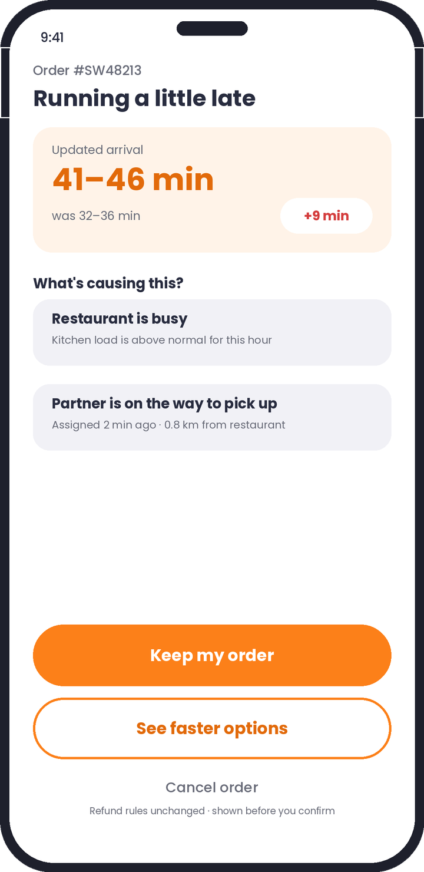
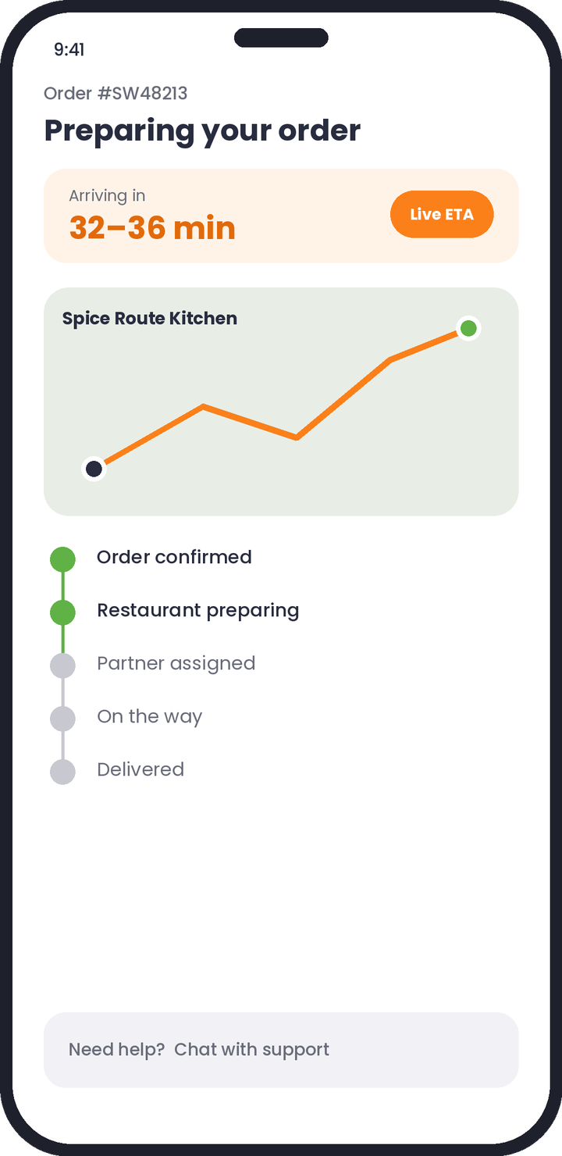
PRODUCT CASE STUDY
Swiggy
SmartSave
Reducing food delivery cancellations through predictive insights and intelligent order management
Independent portfolio project written from a product manager's point of view. Not affiliated with Swiggy. All figures are illustrative unless stated.
Notes:
Open with the framing: this is about preventing avoidable cancellations, not processing them better after the fact. Stress that every number in the deck is either a proposal or an illustrative scenario until baseline order-level data exists.

Slide 2
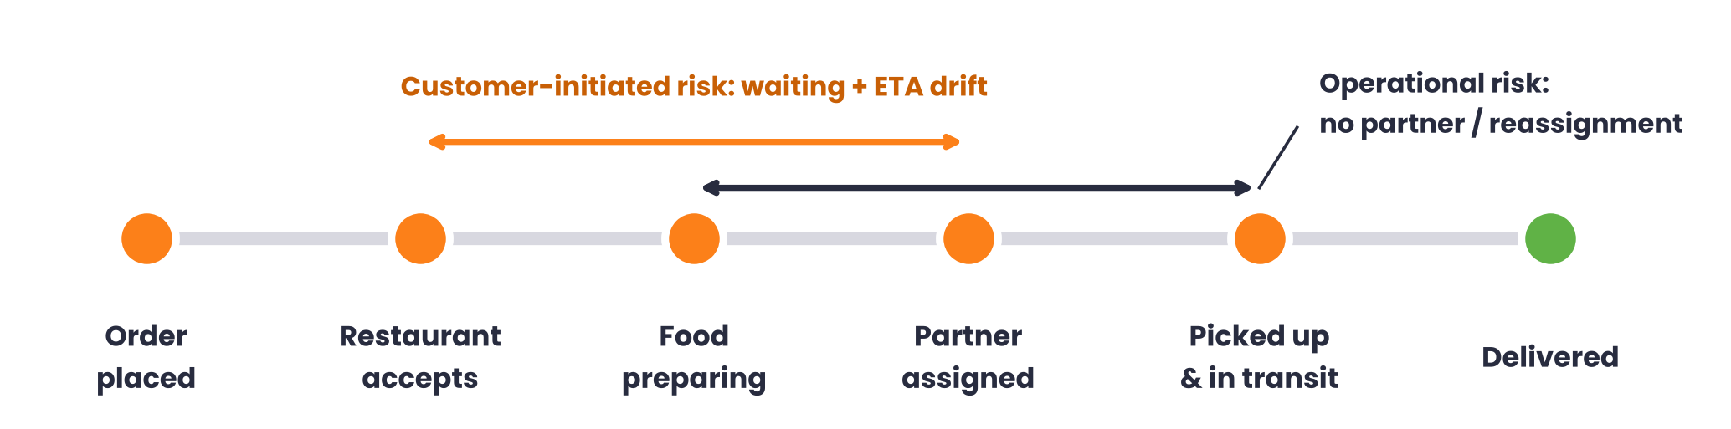




Avoidable cancellations hurt every side of the marketplace
Customer
Restaurant
Delivery partner
Swiggy
Wastes time, loses trust and is unsure when the refund lands.
Food may already be prepared: wastage and lost revenue.
Wasted pickup trip, idle time and a lost earning slot.
Lost orders, higher support load and weaker repeat usage.
Stage taxonomy is a research hypothesis, not published Swiggy data.
Notes:
The same cancellation costs four parties. The two risk windows matter: customer-initiated cancellations cluster while the customer waits and the ETA keeps moving; operational ones come from partner assignment problems. Academic work on on-demand delivery separates waiting-for-partner and post-assignment cancellations, so we analyse them separately.

Slide 3


Goals, non-goals and success metrics
Proposed targets for the pilot
Goals
Metric | Baseline | Target
Order cancellation rate | To be measured | -20%
Customer-initiated cancels | To be measured | -25%
Late deliveries | To be measured | -15%
Order-tracking engagement | To be measured | +20%
Cancellation support contacts | To be measured | -20%
Cut avoidable customer and operational cancellations
Make ETAs more accurate and transparent
Spot high-risk orders before they fail
Tighten restaurant and partner coordination
Build trust and repeat ordering
Non-goals
Eliminate every cancellation
Force customers to wait
Penalise partners for delays outside their control
Replace refund and support systems
Targets are proposals for the case study. Real baselines come from order-level data before any improvement is claimed.
Notes:
Non-goals matter as much as goals. We are not trying to trap customers in delayed orders. Every target is relative and hinges on measuring the baseline first.

Slide 4
Validating the problem before building anything
Hypothesis | Method | Survey Q
Delivery delays are a major cancellation trigger | Survey + order data | Q4, Q5
Customers want accurate ETAs at checkout | Survey + interviews | Q7
Customers prefer alternatives to cancelling | Survey, A/B later | Q8
Proactive updates prevent cancellations | Survey, then A/B test | Q9
Better tracking improves confidence | Survey + usability test | Q10
50–100
8–10
survey respondents
stakeholder interviews
3
5
groups: customers, restaurants, partners
hypotheses to prove or kill
A customer survey measures reported behaviour. It does not give the platform-wide cancellation rate; that must come from order logs.
Notes:
Triangulate: survey for stated preference, interviews for the why, order logs for the real baseline. No survey percentages appear in this deck until real responses exist.

Slide 5



Three personas, three versions of the same frustration
Rahul, 25
Priya, 21
Amit, 34
Software engineer · The busy professional
College student · The budget-conscious
Restaurant owner · The partner
Pain point
Pain point
Pain point
Orders lunch at his desk. Repeated ETA changes wreck his schedule.
Orders on discounts. Hates uncertainty after paying, and unclear refunds.
Rush-hour pressure. Sometimes cooks before a partner is assigned.
Ideal solution
Ideal solution
Ideal solution
Accurate ETAs and an early delay alert.
Alternatives plus transparent refund status.
Realistic prep times and earlier partner dispatch.
Illustrative personas to guide research, not interviewed individuals.
Notes:
The through-line: customers need reliable information, restaurants need coordination, partners need efficient assignment. Cancellation prevention is an ecosystem problem.

Slide 6



Three candidate solutions
Solution 1
Solution 2
Solution 3
Smart ETA & delay alerts
Smart alternatives
Restaurant–partner coordination
Use historical and real-time signals to give realistic ETAs and warn early.
When an order is badly disrupted, offer a viable way to keep the meal.
Align food-ready time with partner arrival, and escalate high-risk orders.
How it works
How it works
How it works
Predict prep time and partner arrival
Add travel and traffic signals
Detect when delay crosses a threshold
Alert with revised ETA and reason
Detect unavailable item or severe delay
Find similar dishes and restaurants
Show ETA, price and refund impact
Customer picks: switch or wait
Predict kitchen preparation time
Time partner arrival to food-ready
Match on proximity and availability
Flag risky orders for ops action
Notes:
Each solution attacks a different link in the chain. Solution 1 acts on information, 2 on choice, 3 on operations.

Slide 7
Trade-offs: customer impact versus operational lift
Criteria | 1 · Smart ETA | 2 · Alternatives | 3 · Coordination
Customer impact | High | High | Medium
Implementation complexity | Medium | Medium | High
Operational impact | Medium | Low | High
Data dependency | High | Medium | High
Scalability | High | High | Medium
Main advantage | Transparency and earlier customer intervention | Preserves purchase intent and gives control | Closes coordination gaps at pickup
Main drawback | Needs reliable real-time data | Alternatives may not exist; payment complexity | Needs restaurant-side adoption
Qualitative PM assessments, not measured results. Green is favourable, red unfavourable for that criterion.
Notes:
Complexity and data dependency are colored inverted because high is bad there. Solution 1 wins on breadth and reversibility; Solution 3 has the largest operational upside but the longest road.

Slide 8
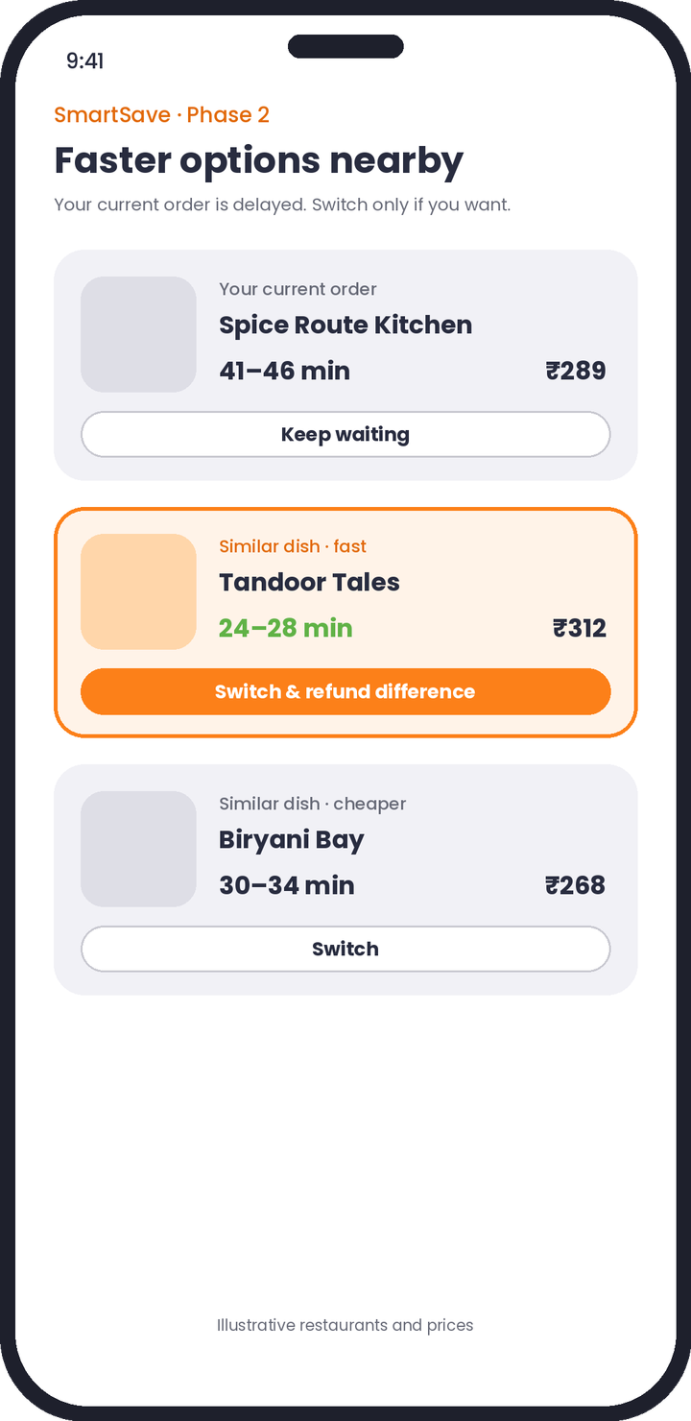
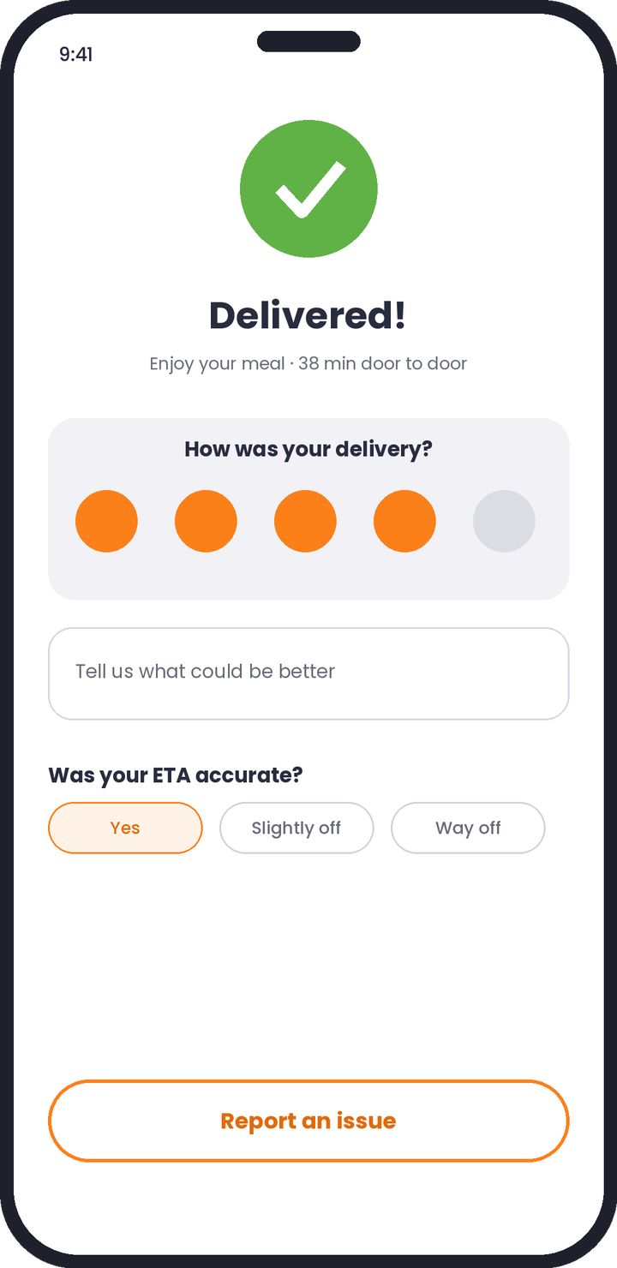
SmartSave inside the existing tracking experience
1 Order confirmed
2 Delay detected
3 Faster options
4 Delivered + feedback
Phase 1
Phase 1
Phase 2
Phase 1
Notes:
Design principle: the delay screen leads with the new ETA and the reason, makes 'Keep my order' the primary action, and keeps cancel visible and honest. Refund rules never change silently. Wireframes are illustrative, not Swiggy screenshots.

Slide 9
The journey: intervene before the customer gives up
Customer places order
Restaurant accepts
Food preparation
Partner assigned
Risk model monitors ETA
No
Yes
Low risk: normal delivery
Delivered
High risk: proactive alert + new ETA + reason
User story
Keep my order
Switch (Phase 2)
Cancel
As a Swiggy customer, I want an early notification when my delivery is likely to be late, so I can decide with information instead of cancelling out of uncertainty.
Customer decides
Alert fires only on a meaningful predicted delay
Revised ETA and reason are always shown
Customer can always keep waiting
Alternatives appear only when genuinely feasible. Cancellation and refund rules stay transparent.
Notes:
The model sits quietly in the background for normal orders. Only when predicted delay crosses a threshold with sufficient confidence does the customer see anything. The existing cancel flow is untouched.

Slide 10
Survey analysis plan: what the data must show
Pie
Bar
Horizontal bar
Decision rules (proposed)
Cancellation reasons
Cancellation frequency
Preferred SmartSave features
Delay-related reasons rank in the top two causes in Q4 and Q5, or Smart ETA is not the MVP.
At least half would wait if given an updated ETA (Q9).
If alternatives beat updated ETA in Q8, bring Solution 2 forward.
Report n, sampling method and bias with every chart.
Awaiting survey responses
Awaiting survey responses
Awaiting survey responses
Stacked bar
Bar
No numbers are shown until real responses exist.
Willingness to wait after a delay
Satisfaction with tracking
Awaiting survey responses
Awaiting survey responses
Notes:
This slide is deliberately a template. Once the Google Form closes, drop in real charts and set the thresholds before looking at the data, so the decision rules are not bent to fit the results.

Slide 11
RICE prioritisation picks Smart ETA as the MVP
Factor | Smart ETA | Alternatives | Coordination
Reach (monthly) | 10,000 | 7,000 | 8,000
Impact (1–3) | 2 | 3 | 3
Confidence | 0.8 | 0.7 | 0.6
Effort (person-months) | 4 | 5 | 8
RICE score | 4,000 | 2,940 | 1,800
Hypothetical team estimates. RICE = Reach × Impact × Confidence ÷ Effort.
Broadest reach
Lowest effort
Builds the foundation
Helps every delayed order
Fits the current ordering flow
ETA signals feed Solutions 2 and 3
Notes:
RICE is a forcing function, not an oracle. The confidence column carries the honesty: Coordination scores lowest partly because we know the least about restaurant-side adoption.

Slide 12
Risks, mitigations and how we will prove it works
Risk | Mitigation
Wrong ETA predictions erode trust | Recalibrate continuously; show ranges
Notification fatigue | Alert only on meaningful delay; cap per order
Inaccurate restaurant data | Improve restaurant-side status updates
Partner unavailability persists | Better assignment and reassignment logic
Low adoption | Contextual prompts, simple UX
Operational complexity | MVP pilot in selected cities
Control A
Treatment B
Existing tracking
SmartSave ETA + alerts
Primary metric
Cancellation rate among eligible orders
Secondary
On-time rate · CSAT · refund and support contacts · notification engagement · repeat orders
Guardrails
Partner waiting time · restaurant rejection rate · average delivery time · complaints
At an assumed 8% baseline and a 20% relative cut (8% to 6.4%), 80% power needs about 4,100 eligible orders per arm.
Random assignment where feasible; analyse customer cancellations separately from restaurant and platform cancellations.
Notes:
The sample size uses a two-proportion test, two-sided alpha of 0.05, power 0.8, and an assumed 8% baseline. If the true baseline differs, recompute. Eligible orders means those where the model predicts a meaningful delay.

Slide 13
Expected impact and the roadmap
1,600
Pilot targets to validate
Roadmap
Cancellation rate
-20%
Phase 1 · MVP
Predictive ETA and proactive alerts
cancellations potentially prevented per month in an illustrative 100,000-order pilot
Late deliveries
-15%
Phase 2
Support contacts
-20%
Alternative dishes and restaurants
100,000 × 8% = 8,000 cancelled
8,000 × 20% = 1,600 prevented
Customer satisfaction
+15%
Phase 3
A scenario, not a Swiggy forecast.
Advanced restaurant–partner coordination
Repeat orders
+10%
Every target above is a hypothesis for the pilot to confirm or reject.
Notes:
Close on the principle: prevent avoidable cancellations with better information, then give customers real choices. Ship the smallest thing that tests the core belief, which is that a timely, honest ETA changes behaviour.

Slide 14
Appendix: survey questionnaire for Google Forms
Q1
How often do you order food online?
Q6
How long past the first ETA before you consider cancelling?
Q2
Which food delivery apps do you use most?
Q7
How important is an accurate ETA when you order? (1–5)
H2
Q3
How many orders did you cancel in the last 3 months?
Q8
If your order is delayed, what would you prefer?
H3
Q4
What was the main reason for your most recent cancellation?
H1
Q9
Would an early alert with the reason make you wait longer?
H4
Q5
At which stage did you cancel?
H1
Q10
Which improvement would help you most?
H5
H1–H5 refer to the hypotheses on slide 4.
Notes:
Keep the form under three minutes. Add a screener question for recent online ordering and record city and age band for cut analysis.

