Slide 1


Fraudulent Activity Prediction using RF Classifier (88% Accuracy)
Praneeth Jajjara – Free Lancer, Data Science

Slide 2
Contents
S No. | Particular | Page No
1 | Understanding the data problem | 3
2 | Data cleaning | 4
3 | Exploratory Data Analysis | 5
4 | Methodology Used | 8
5 | Findings | 10
6 | Conclusion | 12

Slide 3
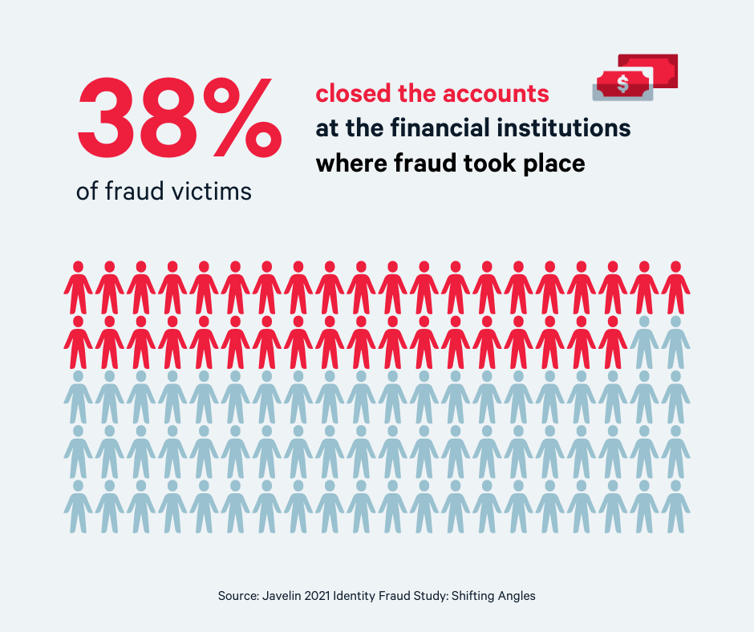
Fraud Detection – A major cyber threat
Understanding the Business Problem
According to a report by the Association of Certified Fraud Examiners (ACFE), organizations lose around 5% of their annual revenue to fraud.
This amounts to a staggering $4.5 trillion worldwide.
Cybersecurity Ventures estimates that cybercrime will cost the world $10.5 trillion annually by 2025.
In 2020, the United States Federal Trade Commission received over 4.7 million reports of fraud, resulting in a total loss of $3.3 billion for consumers.
LexisNexis Risk Solutions revealed that every $1 of fraud in the financial sector costs organizations $3.25, which includes losses due to chargebacks, fees, and other expenses.

Slide 4
Removed 7 columns, created 2, altered 1
Data Cleaning
Columns Removed
Customer ID – Any transaction may be fraud. Biasing on customer wouldn’t be right.
F (city) – Too much granularity. We have 82 unique cities, thereby increasing the curse of dimensionality
Device ID – 211 devices. As we don’t know what kind of devices these are, it wouldn’t add any information.
Device Model – 114 Device Models. Curse of dimensionality.
Screen Size – 92 unique screen sizes. Fraud would be independent of screen size.
Screen hash – 115 unique screen hash. Curse of dimensionality.
event_dttm_Deli – Date time of event. Too much granularity.
Columns created
Model Name – Extracting model name from device model and reducing the models to 5 popular ones and others.
Country – From city, we get the country the city belongs to. This reduces the dimensionality to 22, which is further reduced to India, Russia and Others.
Columns Altered
OS – Merged iPadOS and iOS into one

Slide 5
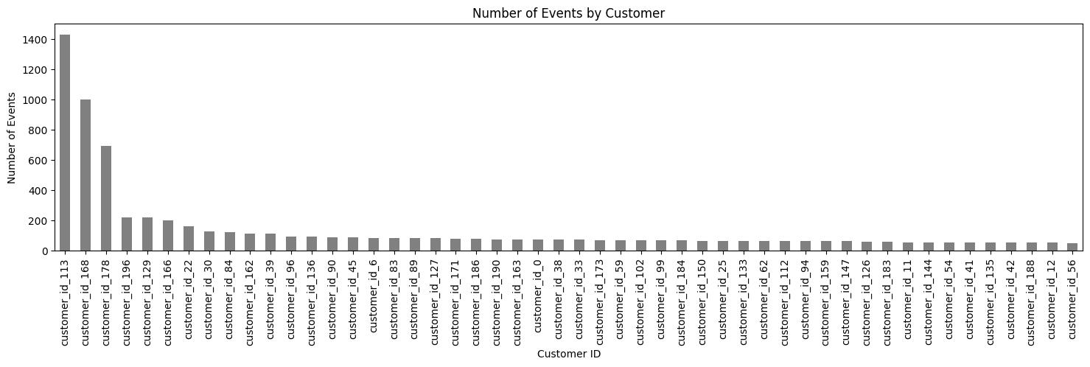
Customer_Id – only 3 users have more than 600 events
Data Understanding - Exploratory Data Analysis
Upon further examination, we see that only 3 customers have more than 600 events in a span of 2 months.
About 75% customers have just 50 events. Considering that this is not norm, the 3 customers raise huge red flags.
Higher number of transactions may signify greater probability of fraud (as in a greater number of failed attempts.)

Slide 6
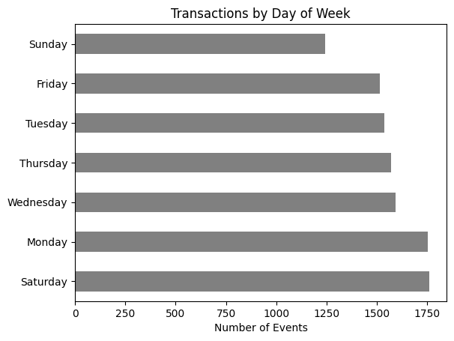
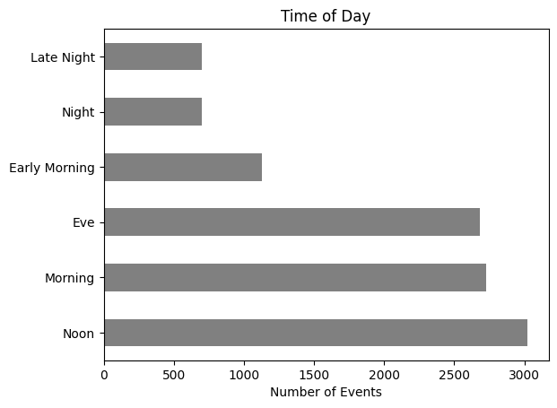
Day of Week and Time of Day Matters – Saturday has more events
Data Understanding
Monday and Saturday have more events than other days, Sunday being the least.
Since we don't have the target variable yet, we are unable to see the significance of this feature.
It is recommended to flag when high volume of transactions happen on Sunday, as it is the day with least transactions.
Addressing the timing of transactions in our financial operations is crucial.
Transactions occurring in the early morning or late at night may be considered suspicious or unusual.
It is recommended to implement additional measures specifically targeting transactions occurring in the suspicious time period.

Slide 7
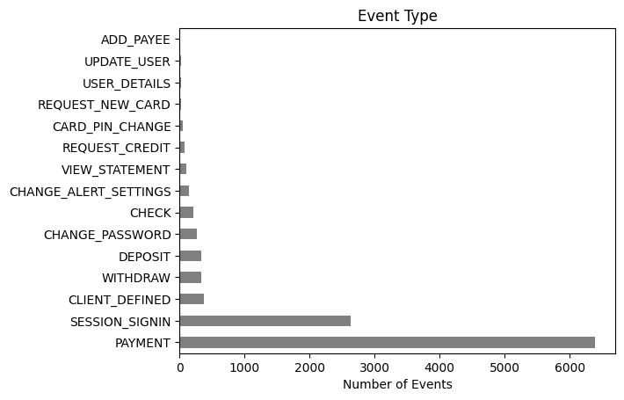
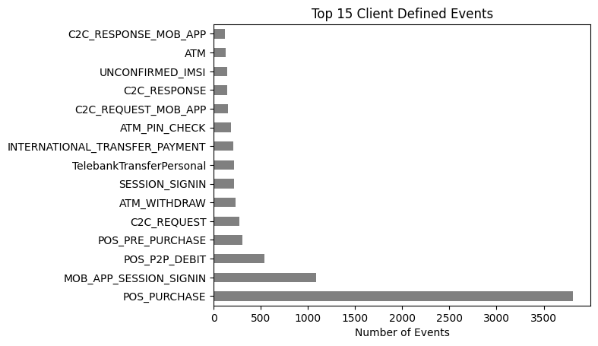
Purchase is the most significant transaction type
Data Understanding
Naturally, fraud happens to make monetary transaction, a.k.a purchases. Rarely does one commit fraud to get personal details. We want to see what purchases can be considered as fraud.
Purchase by itself isn't a fraud. But if someone consistently spends frugally, and then suddenly spends a whopping amount, it may be flagged suspicious.
We do not have what the person was purchasing. That would have added another dimension to the analysis, but for now, the purchase amount is the clue.

Slide 8
Methodology Used
Understanding the Data (Exploratory Data Analysis)
Feature engineering - creating new columns based on existing that would add depth to the outcome
Data cleaning - eliminating features that are redundant
Clustering - basic clustering to determine which transactions are different than others
Cluster Analysis - understanding why those clusters were formed, what makes them a cluster, cluster characteristics
Data Engineering - transposing the data such that the fraud event becomes the target variable, and all other becomes features for the same
Classification – Use multiple classification algorithms to predict for fraud from the cluster output

Slide 9
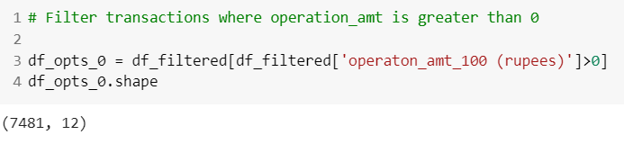
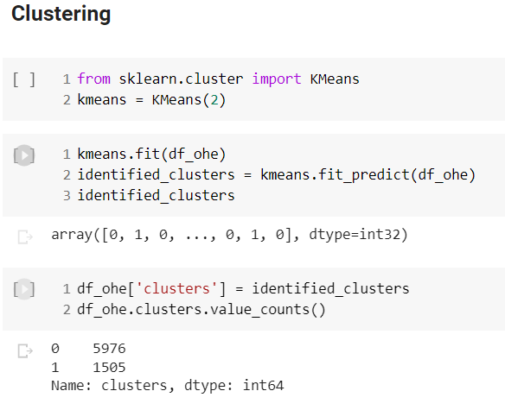
Fraud algo Logic – filtering transactions where amount > 0
Tools Used and Pseudo code
Tool used: Python, Google Colab
Libraries used: sklearn, imblearn, pandas, numpy
Model used: RandomForestClassifier
To identify which events are fraud, we first need to identify which transactions are fraudulent.
Once we identify those transactions, all the events that had led up to that transaction would be considered fraud.
Through this, we can generate rules as to what events transpire that likely helps us identify that a fraudulent transaction will take place.
Clustering: We cluster on n=2, as we want only two clusters – fraud, and non-fraud
We decide this as we are excluding all transactions that are 0. Fraudulent transactions must be among these transactions. Hence this decision.

Slide 10
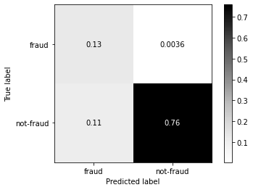
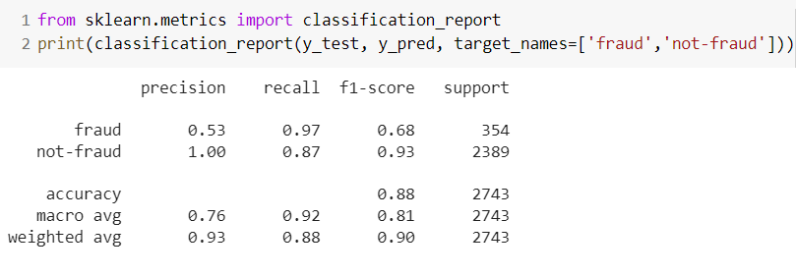
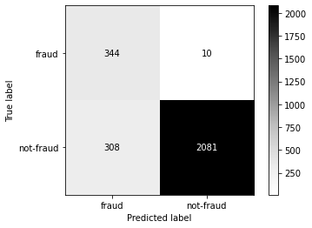
88% Accuracy using base Random Forest Classifier
Findings and Results
We evaluate our model using the classification report, and confusion matrix for visualization
Accuracy = 88%
f1-score = 68%
Precision = 53% (True Fraud / Actual Frauds)
Recall = 97% (True Fraud / Correct Predictions)

Slide 11
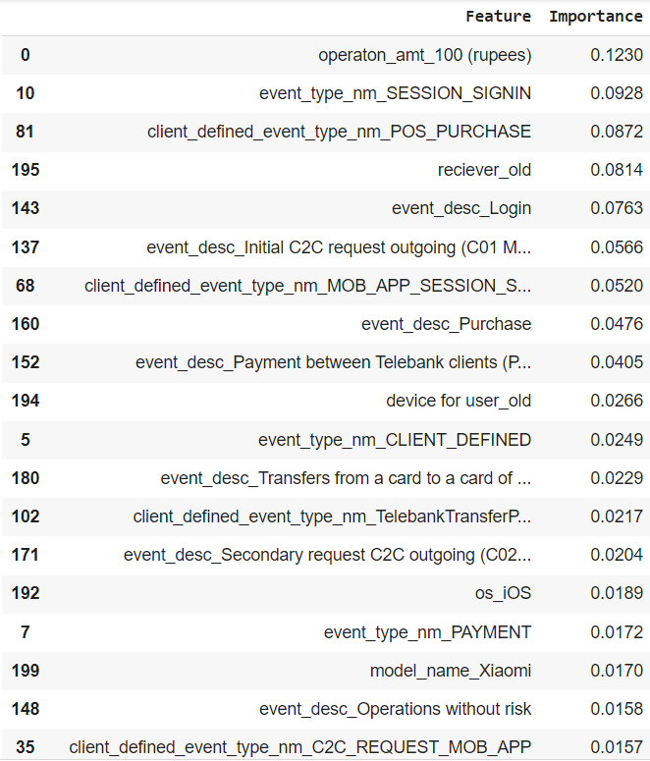
Operation Amount the foremost classifier of fraudulent transaction
Findings and Results
We see beside the features that are most important to detect fraudulent transactions.
Inferences:
Operation amount is the most important parameter
Among the events, session_signin is flagged as a red flag for fraudulent
POS_PURCHASE implies purchase at point of sales. As this is a physical transaction, the likeliness of fraud here is low. Hence important.
Similarly, if the receiver is old, fraud is less likely.
Through the features on the right, we can gauge where we should increase the security compliance to decrease the probability of fraud.

Slide 12
Way-forward
Conclusion
From this exercise, we see which features play major role in determining which events may be fraud.
However, with increasing complexity of fraudsters, upgrading the fraud analytics models becomes a regular event, and not a one-time activity.
To enhance the model we created, few additional information would greatly improve the performance of fraud detection.
One such would be Session ID – A session ID is the entire transaction log from when the user signed in to when he signed out or exited the platform. With this, we can identify the activities, such as location of login, behavior of the individual, and such characteristics.

Slide 13
Thank You

