Slide 1
FOUNDATION MODELS
From “predict the next token” to
AI that can reason, see, code and act
A simple 2026 guide for beginners
Updated: September 2026
https://www.praneethbadanapally.com/
Foundation Models • YouTube Edition • Sep 2026
1
Notes:
HOOK:
“Most people think ChatGPT is the AI. But ChatGPT is an application. Underneath it is a much more general idea: a foundation model.”
Say that this video updates older explanations of foundation models with the 2026 picture.
KEY MESSAGE:
A foundation model is a reusable, general-purpose AI base trained at large scale. It can be adapted into many applications.
TRANSITION:
“First, let’s make the definition extremely simple.”

Slide 2
1. The 30-second idea
• A foundation model is a general-purpose AI base model trained at large scale.
• Instead of building one model for every task, we start with one strong base.
• Then we adapt it with prompting, retrieval, fine-tuning or tools.
• Think: “AI engine” → many applications.
https://www.praneethbadanapally.com/
Foundation Models • YouTube Edition • Sep 2026
2
Notes:
EXPLAIN:
Imagine a student who studies an enormous library before choosing a career. The student first learns broad patterns; later, we teach them how to follow instructions or perform a specialized job.
A foundation model is similar: broad pretraining first, specialization later.
Do not say that every foundation model is necessarily a chatbot or necessarily generative. The important property is that it is a broad base that can support many downstream tasks.

Slide 3
2. Why is it called a FOUNDATION?
House analogy:
• Foundation = the pretrained model
• Rooms = specialized applications
• Furniture = prompts, data, RAG and tools
• The same base can power chat, coding, search, vision and agents.
https://www.praneethbadanapally.com/
Foundation Models • YouTube Edition • Sep 2026
3
Notes:
HOUSE ANALOGY:
Foundation = pretrained model.
Rooms = applications.
Furniture = prompts, retrieval, fine-tuning and tools.
Example:
The same underlying model can support a customer-support assistant, coding assistant, document analyzer or research agent.
TRANSITION:
“So how does that foundation actually get built?”

Slide 4
3. How does a foundation model learn?
STEP 1 — Pretraining: learn patterns from huge datasets
STEP 2 — Self-supervision: create learning signals from the data itself
STEP 3 — Post-training: improve instruction following, reasoning and safety
STEP 4 — Deployment: generate an output token-by-token or through another generation process
https://www.praneethbadanapally.com/
Foundation Models • YouTube Edition • Sep 2026
4
Notes:
STEP-BY-STEP:
1. PRETRAINING: expose the model to huge amounts of data and optimize it to learn useful patterns.
2. SELF-SUPERVISION: the training target can often be generated from the data itself; this avoids manually labeling every example.
3. POST-TRAINING: teach better instruction following, preferences, reasoning behavior and safety.
4. DEPLOYMENT: the trained model receives an input and produces an output.
Important correction to the older source:
Modern foundation-model explanations should not imply that GANs and VAEs are the main architecture behind today’s frontier language models. Transformers remain central to many language and multimodal systems, while other architectures and hybrids are also used.

Slide 5
4. A simple example: next-token prediction
• Prompt: “The capital of France is …”
• The model calculates probabilities for possible next tokens.
• It selects/samples a token, adds it to the context, and repeats.
• Important: this simple loop can produce surprisingly complex behavior after large-scale training.
https://www.praneethbadanapally.com/
Foundation Models • YouTube Edition • Sep 2026
5
Notes:
LIVE DEMO IDEA:
Put “The capital of France is” on screen.
Explain that a language model estimates a distribution over possible next tokens. It then generates a token, adds it to the context, and repeats.
VERY IMPORTANT:
Do not describe the model as simply “choosing the most likely word every time.” Real generation can use sampling and other decoding strategies.
Analogy:
It is like a very advanced autocomplete system—but trained deeply enough that the learned representations support much more than ordinary autocomplete.

Slide 6
5. What changed by 2026?
• Foundation models are no longer just “text chatbots.”
• Modern families can be multimodal: text + images + audio/video.
• Reasoning models spend more computation on difficult problems.
• Agentic systems connect models to tools and let them perform multi-step work.
• Open-weight models also make self-hosting and customization more practical.
https://www.praneethbadanapally.com/
Foundation Models • YouTube Edition • Sep 2026
6
Notes:
THIS IS THE “LATEST” SECTION:
The 2025 source lists GPT-4, BERT, DALL-E 3, CLIP, Stable Diffusion, LLaMA and Gato. Those are useful historically, but they should not be presented as the current 2026 frontier list.
In 2026, the important trends are:
• multimodality
• reasoning
• tool use
• agents
• long context
• open-weight models
• efficiency
Say:
“The foundation model is becoming a component inside a larger AI system.”

Slide 7

6. The modern foundation-model stack
Data
Pretraining
Post training
Model
Prompt/RAG/Finetune
Tools/Memory/Agent
Real Application
https://www.praneethbadanapally.com/
Foundation Models • YouTube Edition • Sep 2026
7
Notes:
EXAMPLES:
OpenAI: GPT-5.4 is documented as a flagship model for complex professional work, with up to a 1.05M-token context window.
Google: Google’s 2026 I/O material highlights Gemini Omni and Gemini 3.5, emphasizing multimodality and action.
Meta: Llama 4 Scout and Maverick are natively multimodal. Meta advertises Scout with a 10M context window.
Anthropic: Claude Fable 5.1 was announced September 1, 2026 as a latest model for coding and knowledge work.
NVIDIA: Nemotron 3 is a family of open models for agentic AI; NVIDIA also lists a Nemotron 3.5 Lightning release in August 2026.
NOTE:
Model names and product availability change quickly. Put the “updated September 2026” date on screen and verify model names before recording if you publish much later.

Slide 8
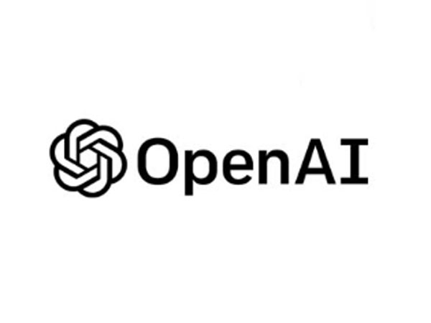
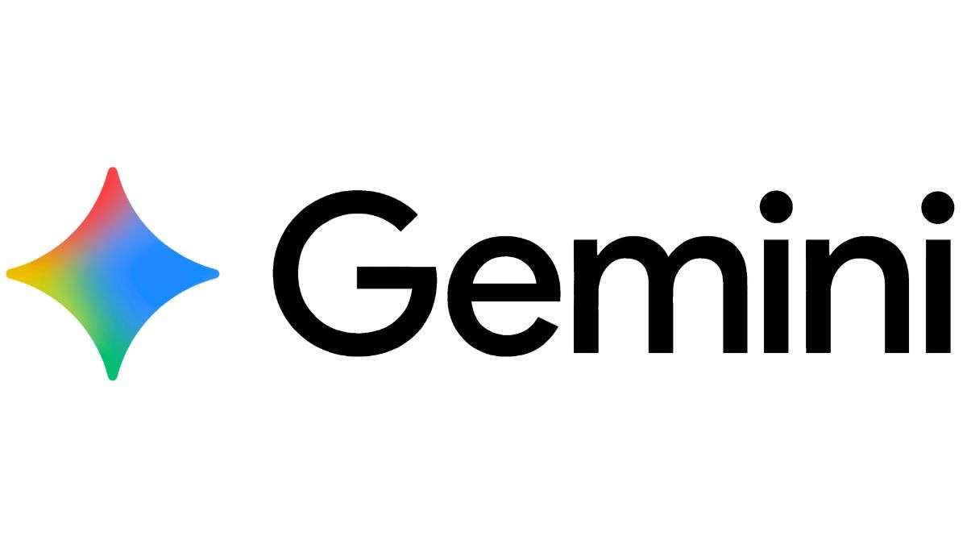
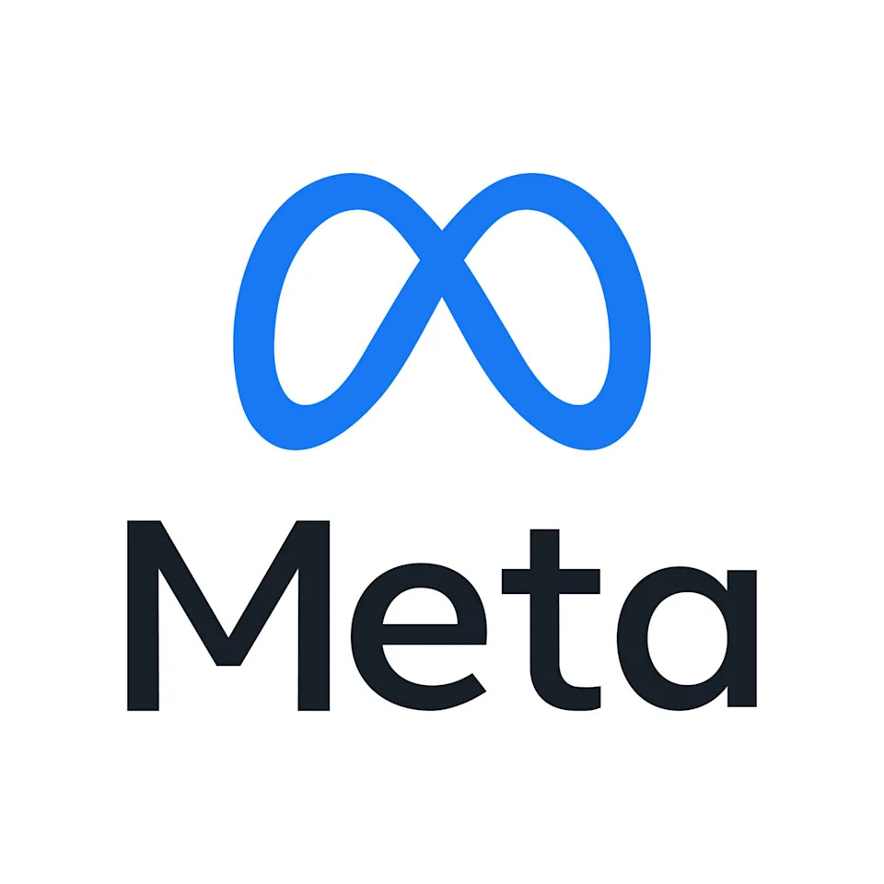
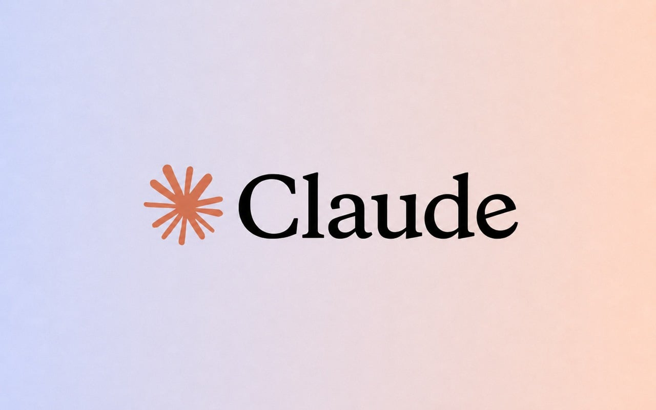

7. Examples you should know in 2026
OpenAI: GPT-5.4 — flagship model for complex professional work; 1.05M-token context.
Google: Gemini 3.5 / Gemini Omni — multimodal and action-oriented model direction.
Meta: Llama 4 Scout & Maverick — natively multimodal open-weight models; Scout advertises 10M context.
Anthropic: Claude Fable 5.1 — latest generation highlighted for coding and knowledge work.
ThePhoto by PhotoAuthor is licensed under CCYYSA.
NVIDIA: Nemotron 3 / 3.5 — open models aimed at efficient, long-running agents.
https://www.praneethbadanapally.com/
Foundation Models • YouTube Edition • Sep 2026
8
Notes:
THIS DISTINCTION WILL MAKE YOUR VIDEO UNIQUE:
A model is not the same thing as the application.
Example:
Model = engine.
RAG = attach a knowledge database.
Tools = attach capabilities such as search, calculator, database or APIs.
Agent = allow the model to decide what to do next and repeat the loop.
A useful mental model:
MODEL + CONTEXT + TOOLS + STATE + EVALUATION = MODERN AI SYSTEM.

Slide 9
8. Foundation model ≠ chatbot
• MODEL = the learned capability
• APPLICATION = the product built around the model
• RAG = give the model external knowledge
• TOOLS = let the model take actions
• AGENT = model + tools + loop + state/memory
• This distinction is one of the most important ideas for an AI engineer.
https://www.praneethbadanapally.com/
Foundation Models • YouTube Edition • Sep 2026
9
Notes:
Use this as the “reality check” section.
A foundation model can be powerful and still:
• hallucinate
• reproduce bias
• leak or mishandle sensitive information
• cost too much
• be too slow
• fail unpredictably on edge cases
• misuse tools if the surrounding system is poorly designed
Tell viewers:
“The model is only one part of reliability. The application architecture matters just as much.”

Slide 10
9. What are the hard problems?
• Hallucination: a fluent answer can still be wrong.
• Bias & safety: training data and model behavior can create risks.
• Privacy: sensitive data must be handled carefully.
• Cost & latency: large models can be expensive to run.
• Evaluation: benchmark scores do not automatically equal real-world reliability.
• Security: tool-using agents create a larger attack surface.
https://www.praneethbadanapally.com/
Foundation Models • YouTube Edition • Sep 2026
10
Notes:
FUTURE:
Avoid saying “bigger model = automatically better AI.”
Instead explain that the system is evolving along several dimensions:
reasoning, multimodality, agentic behavior, efficiency, specialization and better evaluation.
Mention that NVIDIA’s current Nemotron direction explicitly targets long-running multi-step agents, showing how foundation models are being optimized for system-level workloads.

Slide 11
10. The future: smaller, smarter, more agentic
• The direction is not simply “make the model bigger.”
• Expect stronger reasoning, multimodality, tool use and long-running agents.
• Efficiency matters: smaller models, MoE architectures, better inference and specialized models.
• The winning system is often MODEL + DATA + TOOLS + EVALUATION — not the model alone.
https://www.praneethbadanapally.com/
Foundation Models • YouTube Edition • Sep 2026
11
Notes:
FAST RECAP:
Pause after each term and let the viewer repeat it.
Foundation model → broad reusable base.
Pretraining → broad learning.
Post-training → useful behavior.
Prompt → instruction.
RAG → external knowledge.
Fine-tuning → specialized behavior.
Tools → actions.
Agent → iterative model-driven work.
If viewers remember only this slide, the video succeeded.

Slide 12
11. One-minute cheat sheet
• Foundation model = reusable AI base trained at large scale.
• Pretraining = learn broad patterns.
• Post-training = make behavior useful and safer.
• Prompting = tell it what to do.
• RAG = give it external information.
• Fine-tuning = specialize its behavior.
• Tools = let it interact with the world.
• Agent = model + tools + iterative decision/action loop.
https://www.praneethbadanapally.com/
Foundation Models • YouTube Edition • Sep 2026
12
Notes:
CLOSING:
The key idea is that modern AI is moving from isolated generation toward systems that can reason, retrieve information, use tools and complete multi-step tasks.
CTA:
“If you want, my next video will build a tiny foundation-model application from scratch: model + RAG + tools + agent loop.”
End with:
“Don’t just learn how to call an AI model. Learn how to build systems around it.”

Slide 13
12. Closing
• The big shift:
• 2020s AI started with “What can this model generate?”
• 2026 AI is increasingly about “What can this model accomplish?”
• If you understand foundation models, you understand the base layer behind modern GenAI systems.
• Next: build a tiny RAG + tool-using AI agent.
https://www.praneethbadanapally.com/
Foundation Models • YouTube Edition • Sep 2026
13

