Slide 1
REUSABLE CAPTCHA SECURITY ENGINE
Supervisor:
Dr. Ganesh B Regulwar
Associate Professor
Batch 4
Hari Bharadwaj Yadav-20881A1287
Touria Tanazzum-20881A12B7
Vaishnavi Yamsani-20881A12C0

Slide 2
Abstract
Completely Automated Public Turing Test to Tell Computers and Humans Apart (CAPTCHA) is an important human-machine distinction technology for website to prevent the automatic malicious program attack. CAPTCHA recognition studies can find security breaches in CAPTCHA, improve CAPTCHA technology, it can also promote the technologies of license plate recognition and handwriting recognition . The humans have limitations on the speed of response then compared to any computer and hence the computer must be slower than the human and so we will make full benefit of this and use it in the proposed system. The CAPTCHA security system will contain colored graphical interface with the font is limited to two while the border line thickness and color will be fixed. The CAPTCHA security system will generate random text which will be shorter than the present system but will be difficult to hack as it will randomly generate.

Slide 3
Existing System
In the existing CAPTCHA security system we use mainly text based CAPTCHA which we are using from the begging of time, so the today there is some software which can bypass this test. The hacker hacks the data from the system and then they make software according to that and the CAPTCHA is bypassed. While a human need to enter a long sentence in the box before the access to the website. While solving the CAPTCHA is a boring and sometimes even though it is right, it shows error and we can say that at first CAPTCHA use to protect from spam bot, but today bots are defeating the CAPTCHA while sometimes humans can’t solve it.

Slide 4
Proposed System
In the proposed CAPTCHA security system will generate the CAPTCHA by using a new improved algorithm which will be interesting to solve at the same time it will be tougher than previous to solved by the bots while they feel easy. The humans have limitations on the speed of response then compared to any computer and hence the computer must be slower than the human and so we will make full benefit of this and use it in the proposed system. The CAPTCHA security system will contain colored graphical interface with the font is limited to two while the border line thickness and color will be fixed. The CAPTCHA security system will generate random text which will be shorter than the present system but will be difficult to hack as it will randomly generate.

Slide 5
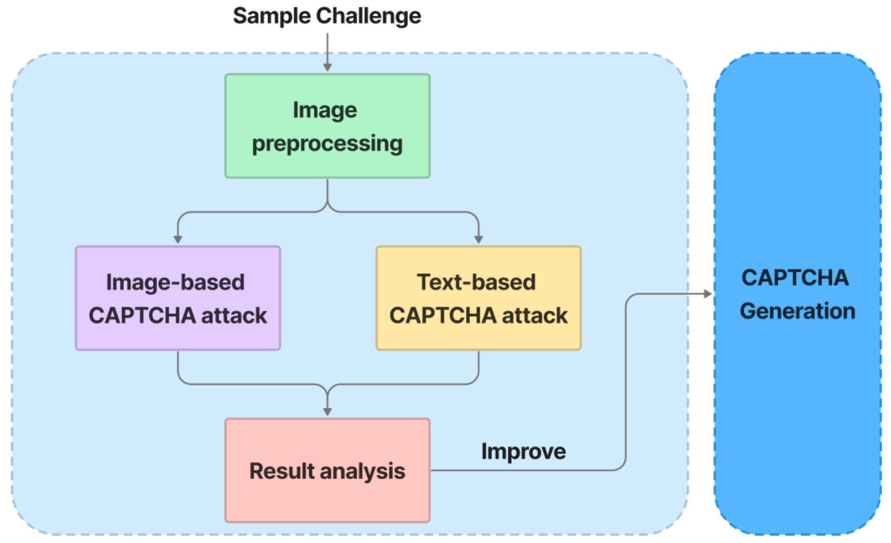
Basic Design Of Proposed System

Slide 6
Methods Used In Existing System
Invariant recognition.
Segmentation.
Context recognition

Slide 7
Methods Used For Proposed System
Invariant recognition.
Segmentation.
Context recognition

Slide 8
Challenges Faced While Execution
Security
Usability
Scalability
User experiences
Are difficult to use on mobile devices. In fact, one study found that mobile users were 27% less likely to complete a CAPTCHA than desktop users.

Slide 9
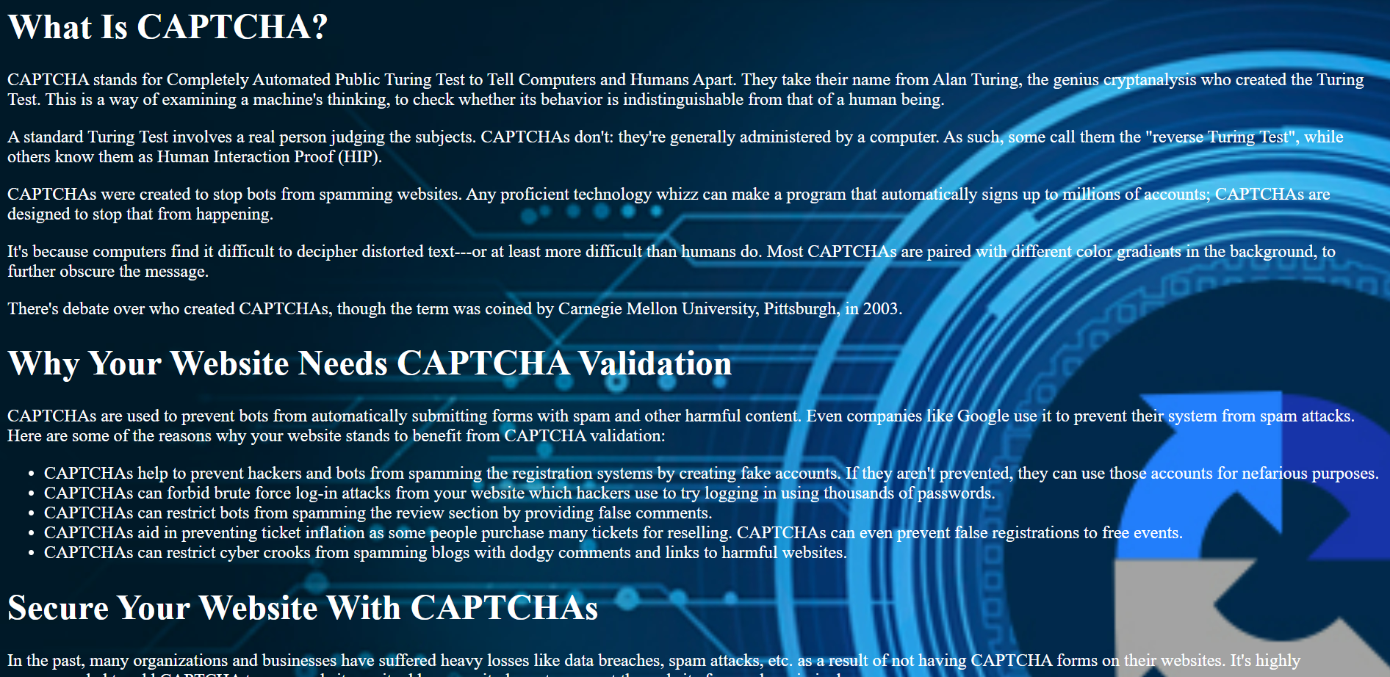
Output Screens

Slide 10
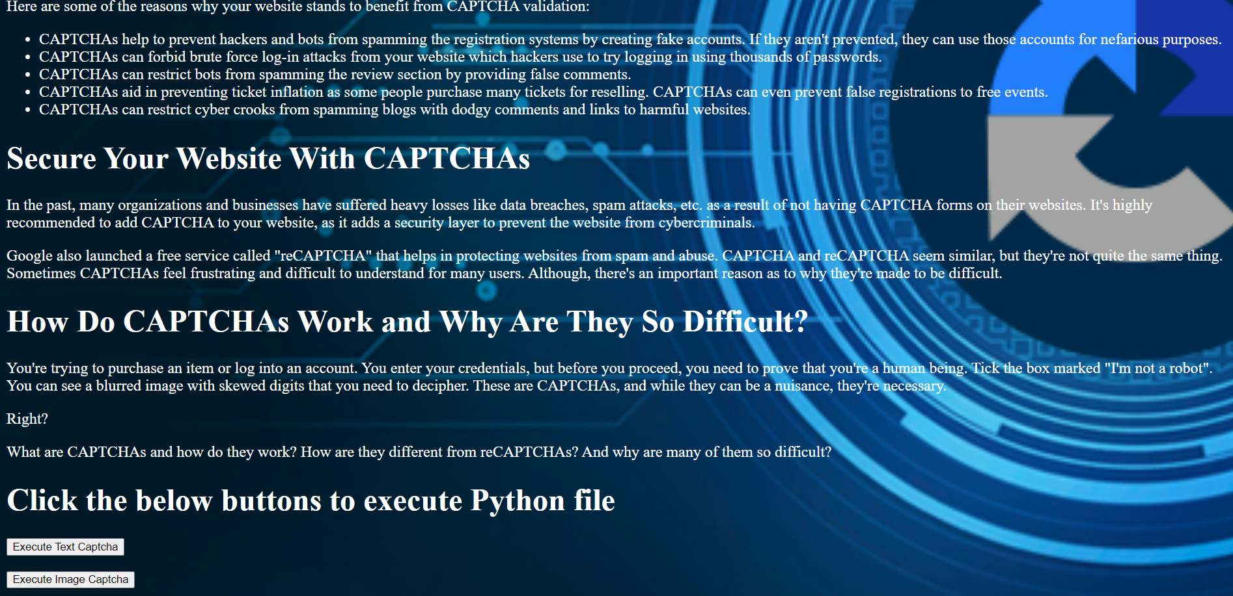

Slide 11
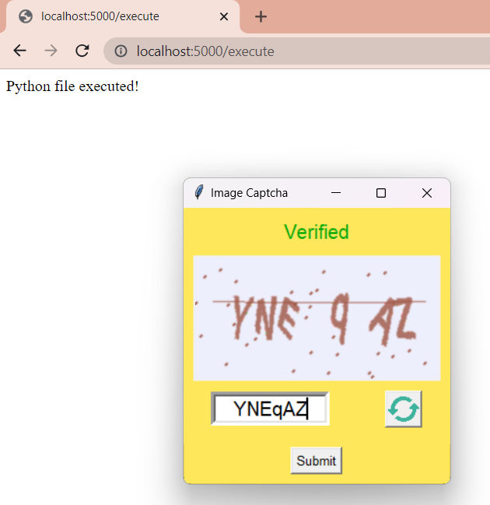
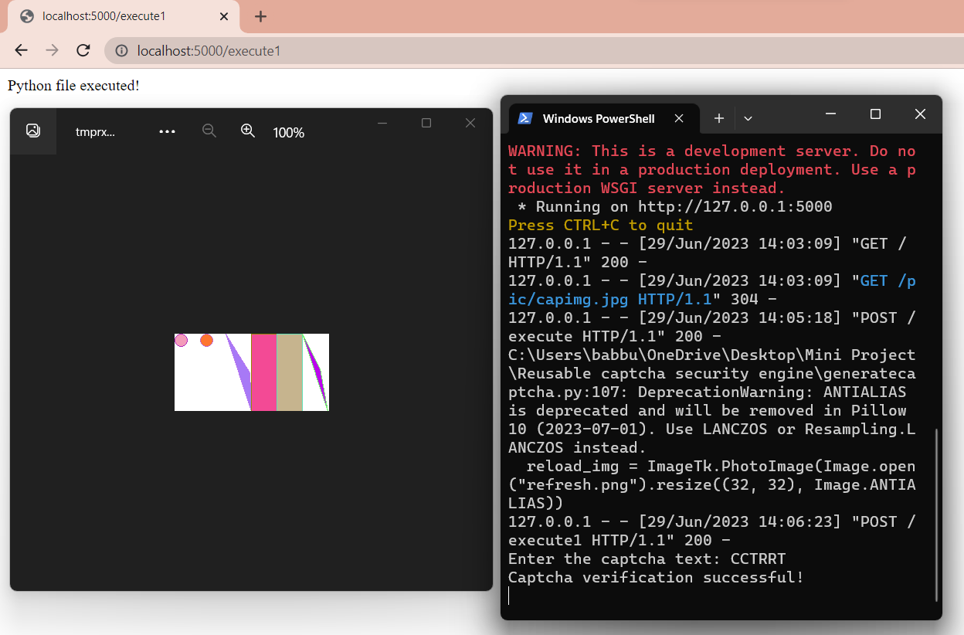

Slide 12
Future Scope
Improved Image Recognition: As technology advances, image recognition algorithms can become more sophisticated and accurate, leading to more robust CAPTCHA systems.
Biometric CAPTCHAs: CAPTCHAs could incorporate biometric data, such as fingerprint or facial recognition, to further enhance security.
Behavior-based CAPTCHAs: Instead of relying solely on static tests, future CAPTCHA systems could analyze user behavior, such as mouse movements, typing patterns, or browsing habits, to determine whether the user is human or a bot.

Slide 13
Conclusion
Reusable CAPTCHA security engines provide a secure and reliable solution for website security. They are cost effective and offer a higher level of security than traditional CAPTCHA security solutions.
Hence, we have developed a website where it contains all the information about CAPTCHA. We have different sections related to CAPTCHA .We also included two python files where we demonstrate the usage of CAPTCHA. We included two buttons which relate to the different python files. First one is the demonstration of text based CAPTCHA. And the second one in the demonstration of image based CAPTCHA.

Slide 14
Important Bibliography
https://www.usenix.org/system/files/sec21-gao.pdf
https://www.sciencedirect.com/science/article/pii/S0167404818312185
von Ahn, L., Maurer, B., McMillen, C., Abraham, D., & Blum, M. (2008). reCAPTCHA: Human-Based Character Recognition via Web Security Measures. Science, 321(5895), 1465-1468.

Slide 15

THANK YOU!!
THANK YOU!!

