Slide 1

Bottify
Credit Suisse- ChatBot Challenge
Code Gladiators 2019

Slide 2
Executive Summary
Building an AI assistant using Rasa that scales using machine learning and open source tools
I am using Rasa as it provides a complete stack of tools to create an AI assistant and it’s an open source tool that answers questions related to conference talks.

Slide 3
Problem at hand
We have to create a Q&A a based chat bot that answers questions related to certain type posed by user and along with it also greetings/welcome or any general questions asked by user.

Slide 4
Solution
I have used rasa to create the chat bot, it consists of two parts-
Rasa-NLU: library for natural language understanding with intent classification and entity extraction
Rasa-Core: framework for machine learning based contextual decision making.
Advantages of using Rasa:
Customizable – Tune the models as per our requirements to get higher accuracy.
Open source and free – No risk of vendor lock-in. No black boxes we can see all the models.
Easy to get started with

Slide 5
Demo/ Prototype
Provide the link to the demo/ prototype
OR provide snapshots for reference

Slide 6
Approach
Created my own FAQ dataset to suggest talks to attend during a conference.
I have used rasa-nlu, spacy & tensorflow which are also open source tools to identify multiple intents during a conversation & extract entities.
These entities were used by bot to extract information from database.
To handle dialogue management rasa-core & LSTM model using keras was used to create dialogues.
Also provided approach for feedback based learning, where the conversations were stored in a MongoDB database to create more training data for our bot.

Slide 7
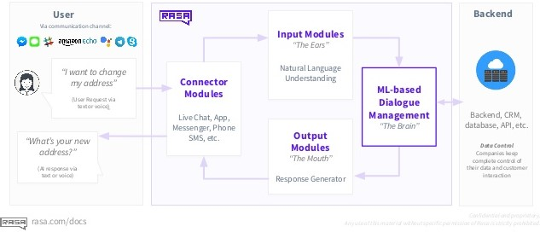
Approach: Flow

Slide 8
Technology Stack
Rasa Stack-
Rasa-core: for dialogue management
Rasa-nlu: for intent classification and entity recongnition
Tensorflow: for identifying multiple intents from a single text, also generating text
Spacy: for tokenization & creating bag of words
Sqlite Database: for storage of conference details
Sqlite3: to connect to the database from Python
Pandas: to read the data from database

Slide 9
Why our team is the best!
Implemented a chat bot using rasa, our chat bot can be scaled easily to different scenarios as adding extra training data is easy in rasa.
It’s totally open source so no worry of vendor lock-in or giving our data to other corporations as rasa doesn’t store any data. It becomes important for financial/credit sector industries as the data here is critical & the compliances like GDPR, etc. are strict.

Slide 10
Associated attachments/ files
Presentation- conference_chatbot.ppt
Main Directory-
actions.py
chat_session.py
domain.yml
nlu_config.yml
nlu_train.py
train_dm.py
data directory
nlu.md
stories.md

Slide 11
Thank you

Slide 12
Appendix

Slide 13
Challenges
Challenges-
Finding a full stack open source tool for creating chat bot- thanks to PyData Berlin tutorial came across this awesome library.
Creating stateless chat bots- rule based chat bots can get a lot of work done but when it comes to scaling them it becomes a lot tedious, so rasa gives a better way of creating new data by using interactive learning feature which helps in storing direct user feedback.
Data for chat bots – it was really tough in creating a diverse set of training data for chat bot as there is no such data available in public domain for chat bots.

Slide 14
Possible Improvements
Connecting my bot to popular messaging apps like slack or messenger.
Deploying it using heroku so that bot is able to interact with other people and can generalize better.
Creating more detailed stories.

