Slide 1
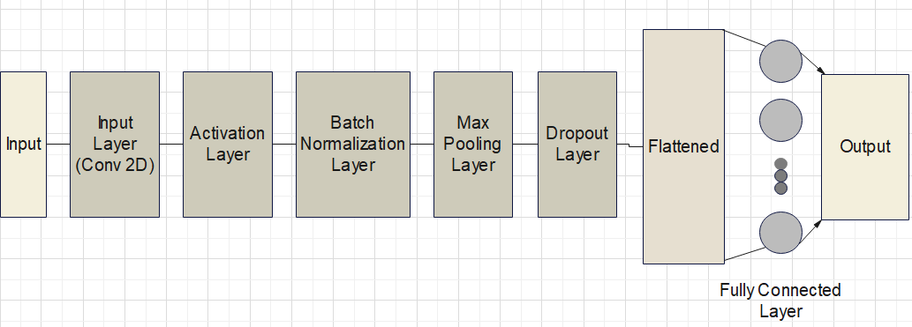
Proposed model
CNN Model Architecture

Slide 2
Input layer: processes the raw input data which is a matrix of pixel values. The shape of the input image is (224, 224, 3) and the output is (224,224,32)
Convolutional Layer: applies filters to the input image to detect features.
Activation layer: an activation function applied element-wise to introduce non-linearity to the network. The size of the output remains the same
Batch normalization layer: the technique used to improve stability and speed of the training of neural network. This technique is done in between the layers of the neural network instead of the full dataset.
Pooling layers: they are used to reduce the spatial dimensionality of input data while retaining its essential features. Here it reduces the spatial dimensions by half which is (112, 112, 32)
Fully connected layers: we add ‘ann’ to our ‘cnn’ for combining the features and attributes which helps predicting the classes better.

Slide 3
Summary of the cnn model:
Architecture: CNN for image classification.
Input: 224x224 pixels, RGB.
Initial Layers: Conv2D → ReLU → BatchNorm → MaxPooling → Dropout.
Subsequent Layers: Conv2D. ReLU, BatchNorm, MaxPooling, Dropout.
Flatten Layer: Converts feature maps to a 1D vector.
Dense Layers: Two dense layers (1024 units, 38 units), ReLU, BatchNormalization.
Output: Dense layer (38 units), softmax activation for class probabilities.

Slide 4
implementation
Data preparation: collect the dataset with labels indicating whether the plant is healthy or diseased
Data pre-processing: pre-processing the images ensure that they are of same size and resolution.
Model selection: choose a deep learning model architecture for image classification tasks which is convolutional neural network.
Training: split your dataset into training, validation, and testing sets. Train the model on the training dataset. Monitor the model’s performance on the validation set and adjust hyperparameters accordingly
Testing: to check the accuracy of a plant disease detection model using cnn algorithm, we can feed the testing images into the trained model and compare the labels of images
Parametric optimization: mathematical optimization technique where the goal is to find optimal solution while considering how changes in these parameters affect the solution

Slide 5
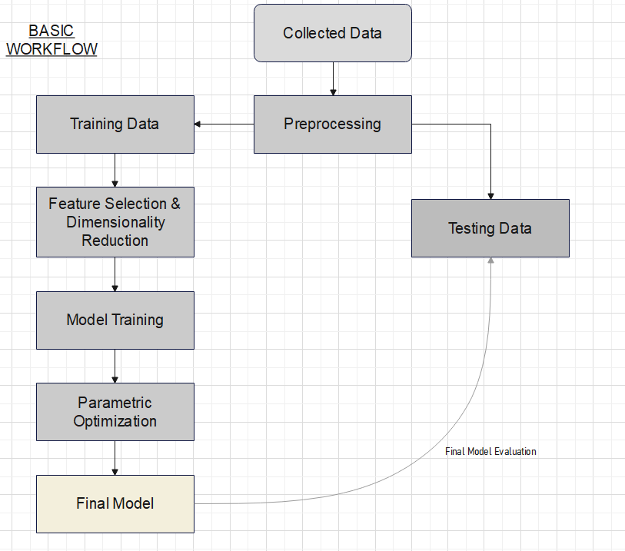

Slide 6
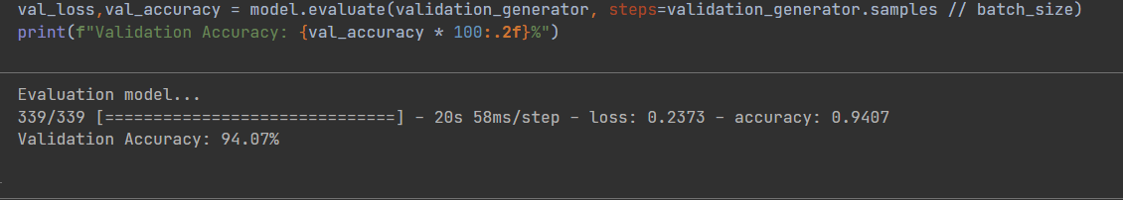
results

Slide 7
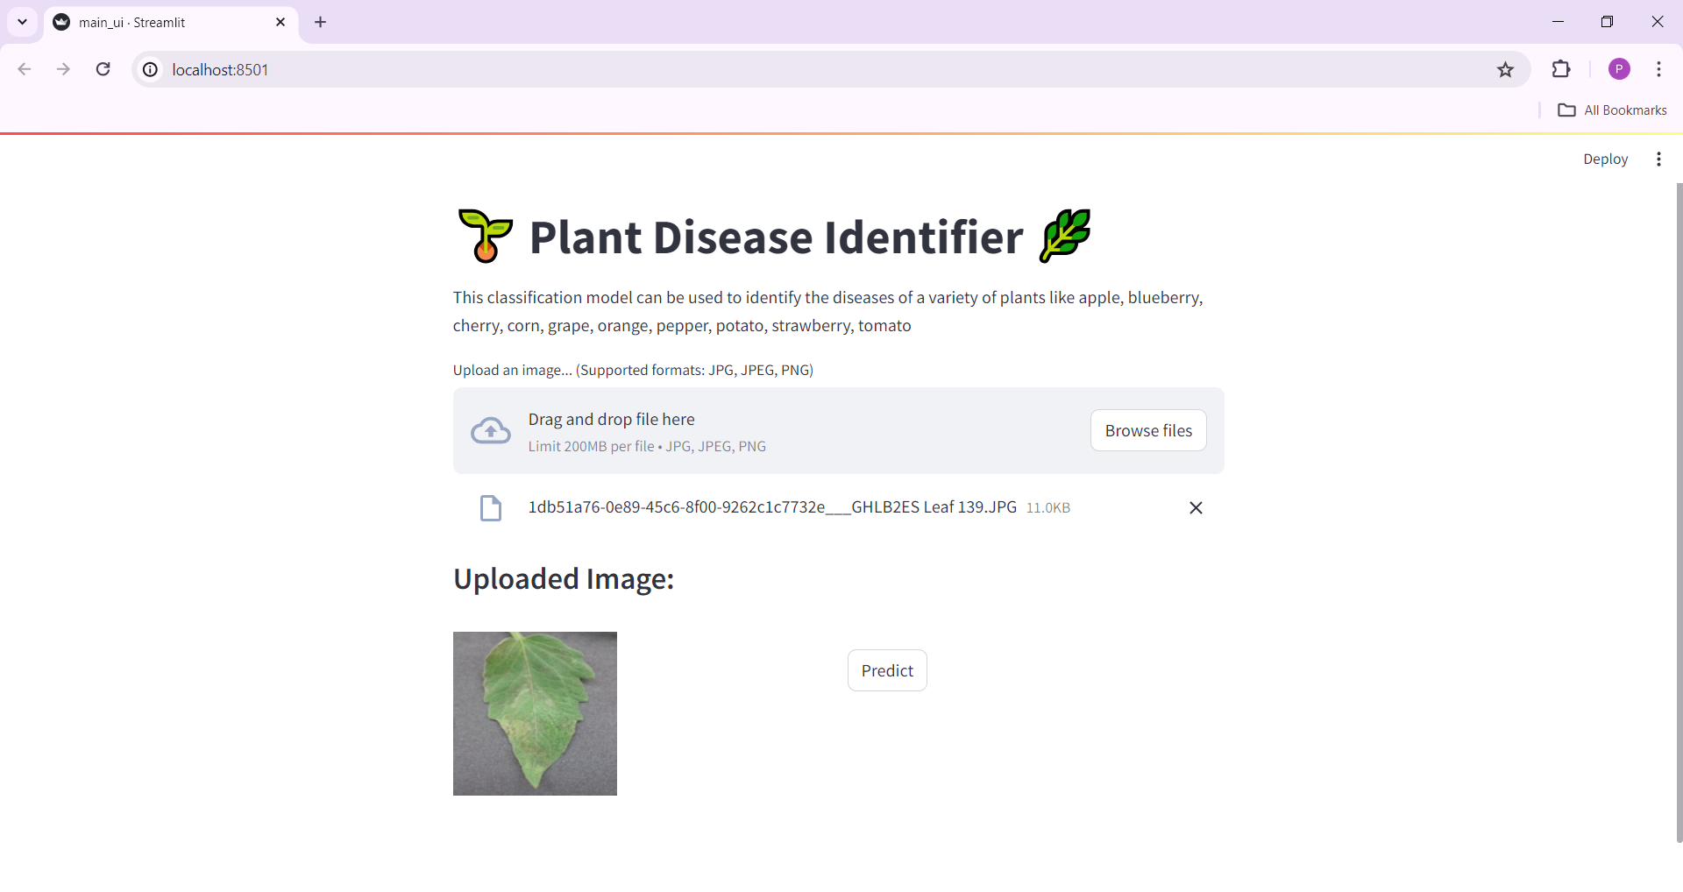

Slide 8
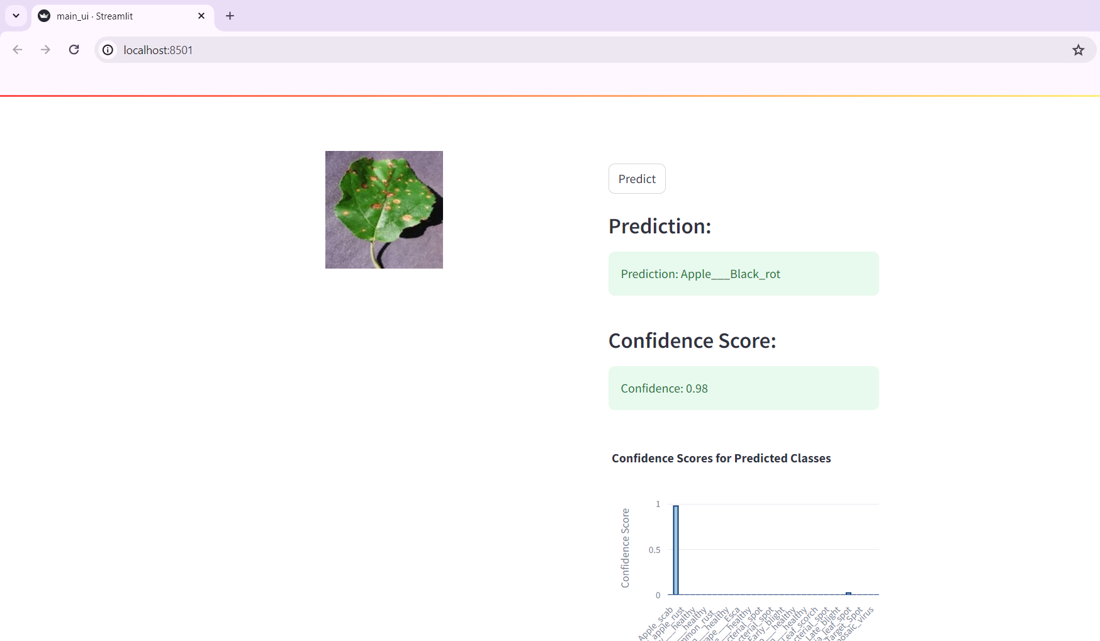
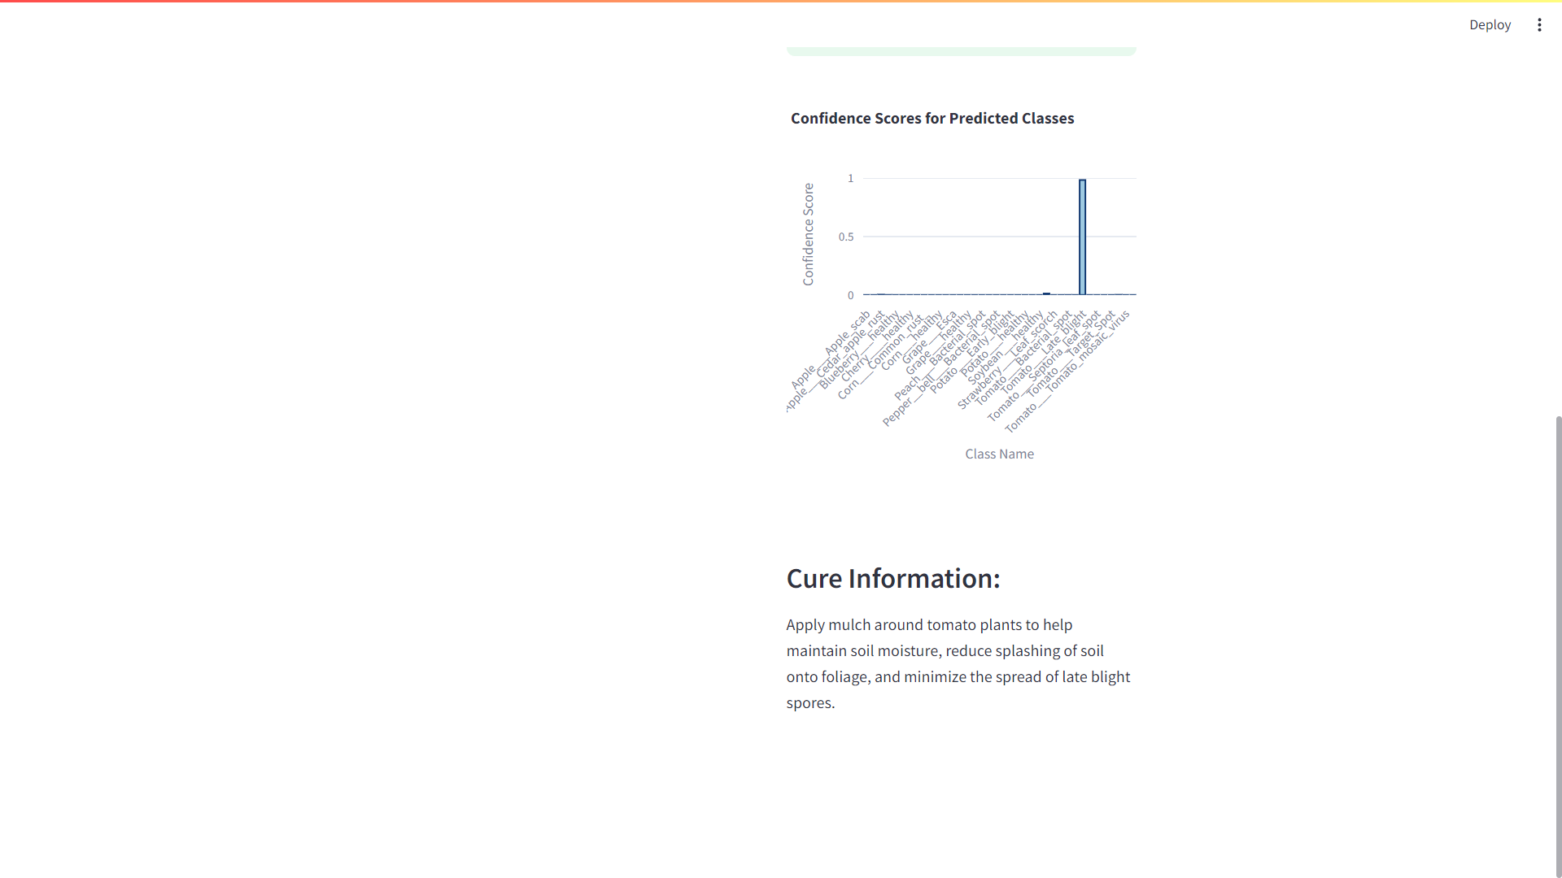

Slide 9
conclusion
In this project, we developed a plant disease identification system using deep learning techniques. The goal was to create a tool that could classify diseases in various plant species on input images. To make the system accessible, the Streamlit web application is used for the users to upload images through the trained model to classify diseases. Predicted images are displayed along with confidence scores and provide relevant cure information if available.

