Slide 1
Docker Implementation in AWS
Keshav Bhandary & Praneeth Bandi

Slide 2
Agenda
Templates and Proposals Application overview
Docker Basics
Container deployment at scale
Docker in AWS
Docker in Azure
Demo
Exercise

Slide 3
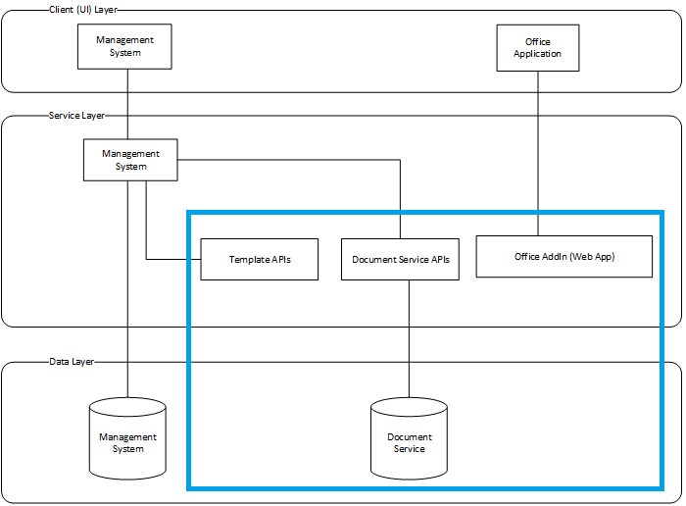
Templates and Proposals

Slide 4
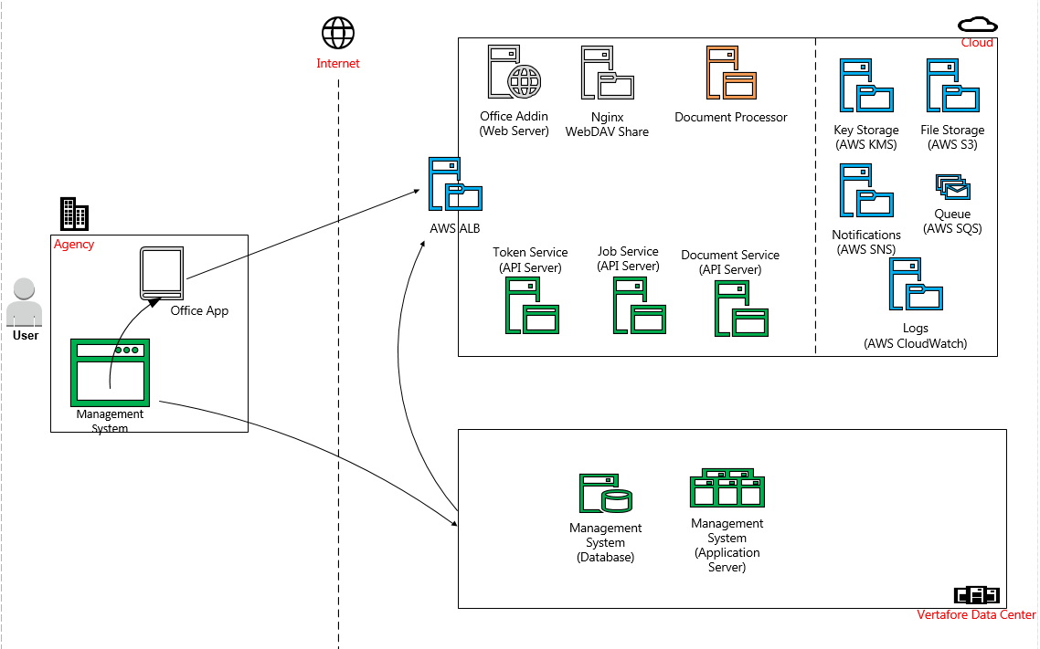
Templates and Proposals

Slide 5
Technology Stack
.Net Core 1.1 on Linux
Web App(MVC), Web API, Web DAV and OfficeJs
API servers on kestrel and Web DAV on nginx.
Docker
AWS - (ECS,S3,EC2,KMS,SQS etc…)
Azure - (VSTS online, CI&CD, Load Test and Application Insights)

Slide 6
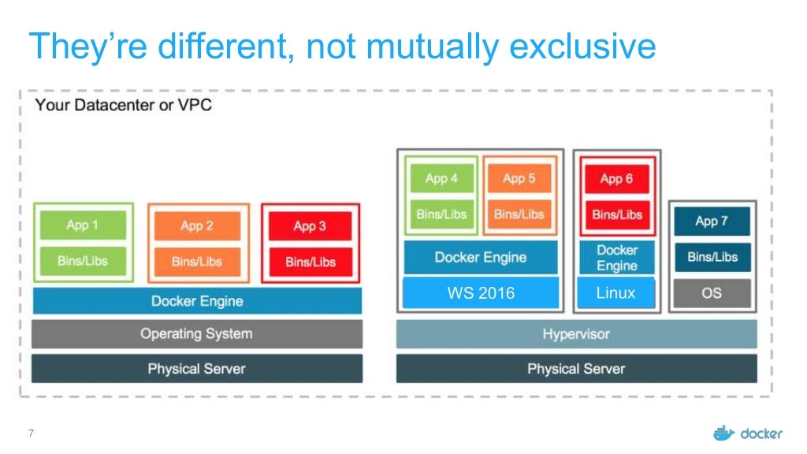
What is Docker?
Docker is a software technology providing containers, Docker provides an additional layer of abstraction and automation of operating-system-level virtualization on Windows and Linux.
Containers will provide process isolation, file system isolation, network isolation, CPU/Memory quotas, i/o rate limiting to the applications running in container.
On linux it uses runc, containerd, cgroups, namespaces and layered file system of host OS kernel to achieve isolation
On windows it uses job objects, object namespace and union file system extensions.
Not full isolation unlike VM. Containers do share Host OS kernel. i.e. provides user space/mode isolation not kernel space/mode.
Windows supports Hyper-V containers(light weight Hyper-V VM with kernel) which provides full isolation.

Slide 7
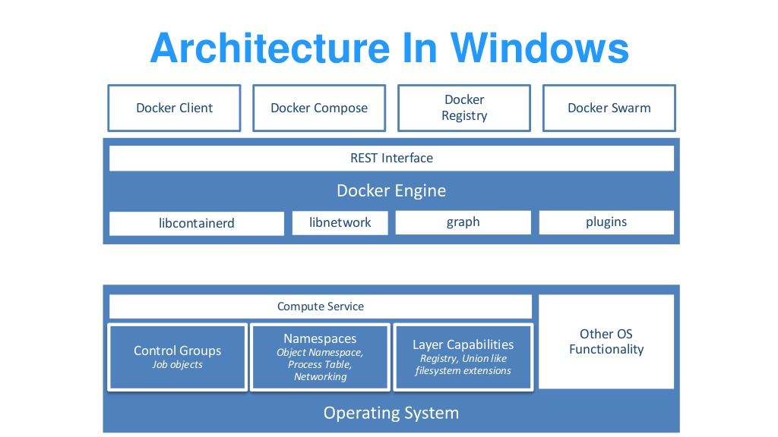
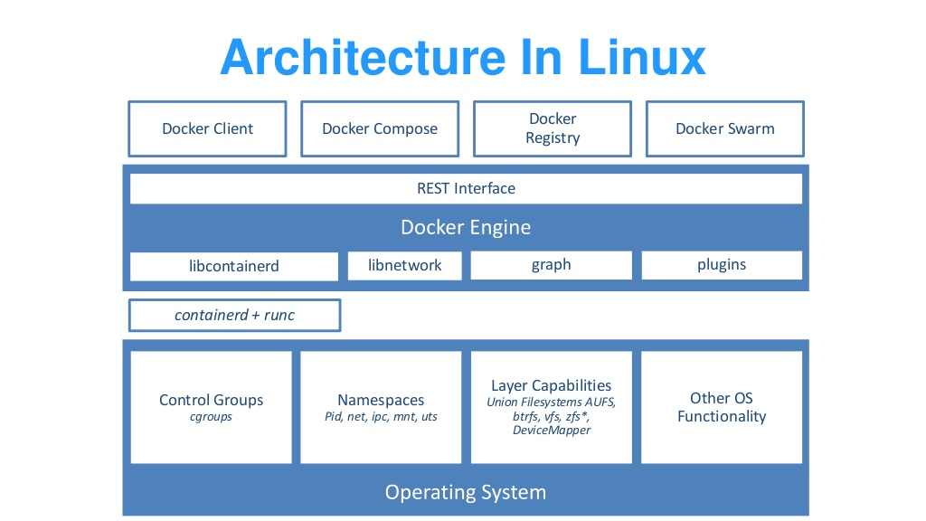
Docker Basics
. Windows server 2016 and windows 10 with anniversary update.
. All modern Linux distros

Slide 8
Why Docker
Application centric
Docker is optimized for the deployment of applications, as opposed to machines.
Simplicity
Abstracted the complex OS level virtual environment entities in Host OS kernel with simple API.
Same API across platforms – Linux and Windows.
Portable applications
Docker defines a format for bundling an application and all its dependencies into a single object called a container – thru image files.
Reusable image layers – fast image download.
Ideal for micro services.
Community
Hundreds of ready made open source base images in central repository.(always use official images or scan for vulnerabilities)
Build once deploy anywhere ( Docker enabled machine)
Deploying a consistent production/XX environment is easier.

Slide 9
Docker Terminology
Docker Image
The Basis of a Docker container. Represents full application
Docker Container
The Standard unit in which your application service resides and executes
Docker Engine
Creates, ships and runs Docker containers deployable on a physical or virtual, host locally, in a data center or cloud service provider.
Registry service
Cloud or server based storage and distribution service for your images

Slide 10
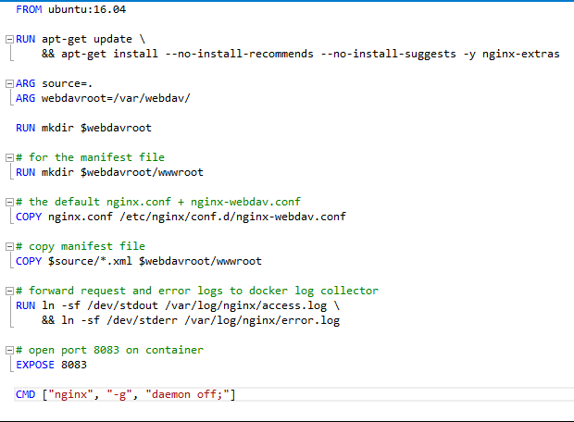
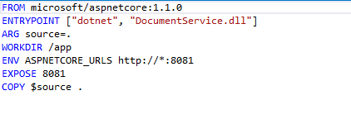
Sample Docker Image

Slide 11
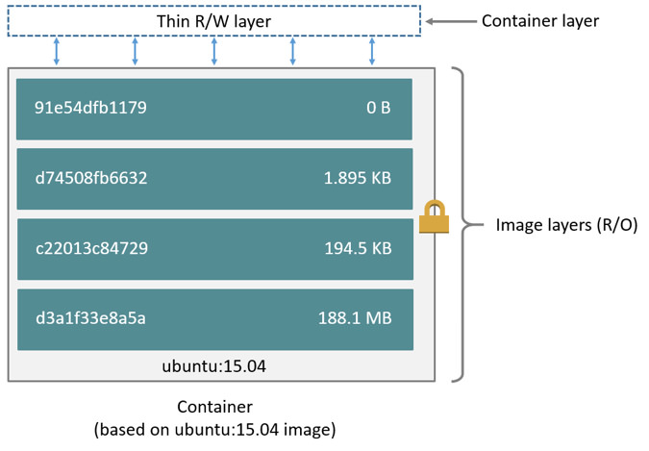
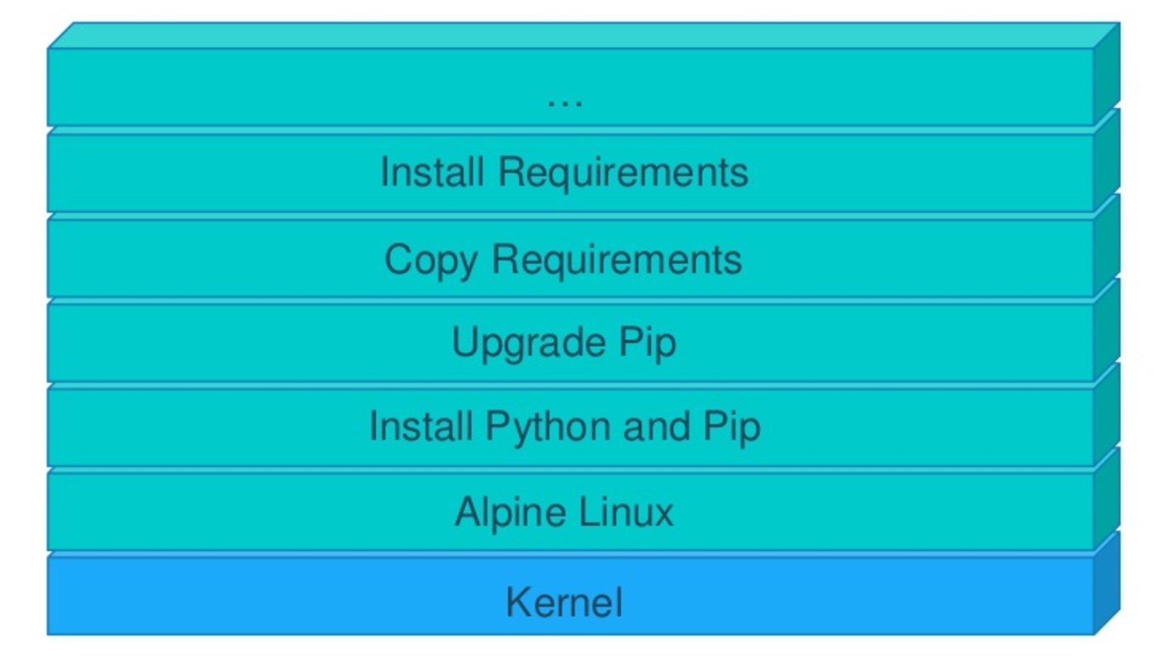
Docker image Layers

Slide 12
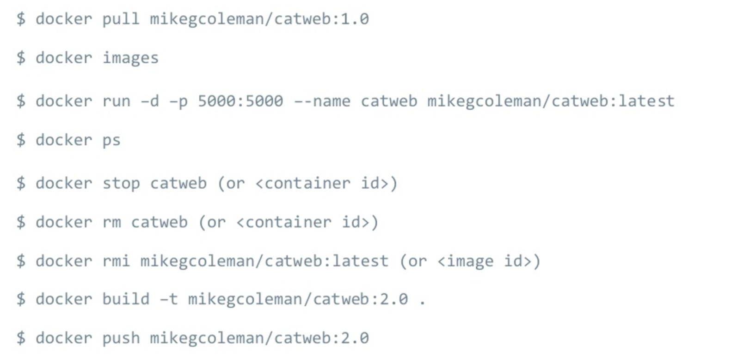
Basic Docker commands

Slide 13
Demo
http://labs.play-with-docker.com/

Slide 14
Container Deployment At Scale
Trusted Image Repository
Orchestration Engine
Service discovery
Ease of Deployments/Updates
High Availability
Desired State Reconciliation
Load balancing
Monitoring
Notifications
Security
And then some…

Slide 15
Docker Orchestration engines
Kubernetes
Docker Swarm
DC/OS Mesosphere Marathon
AWS ECS (Cloud Native)
Google Container Engine
Azure Container Service

Slide 16
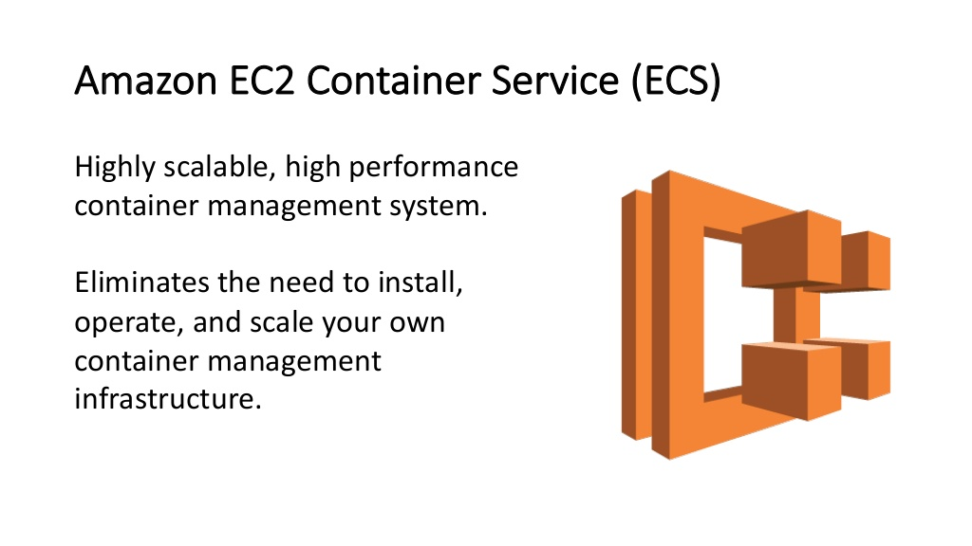
AWS ECS

Slide 17
AWS ECS Concepts
Container Instances
Traditional EC2 VMs
Can be custom VMs, but recommended to use Amazon ECS compatible AMI(comes with prerequisites)
Tasks
Defined using Task definition – json file containing all Docker ‘run’ arguments
Task definition can contain multiple image definitions.
At runtime tasks are same as sets of containers.
Ideal for batch jobs.
Services
Layer that manages and places tasks.
A Service is made of Task, Desired replica count, Routing, placement strategy and auto scale configuration.
Ideal for long running services

Slide 18
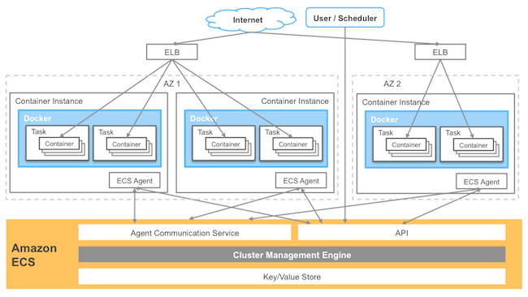
AWS ECS

Slide 19
AWS ECS Features
AWS Managed Service
Deep integration with other AWS services
Auto Scale at EC2 and Service level
High Availability – Using availability zones
Disaster recovery
Centralized logging and monitoring – using CloudWatch logs and CloudWatch metrics
Alerts and Notifications – using CloudWatch alarms
No In built Service Discovery (coming in 2017 Q3)
Consul
Traefik etc..
ALB
Path based routing
Dynamic port mapping using target groups
Health checks
Windows containers in Beta

Slide 20
AWS Services
S3 – file storage
EC2 – Compute resources – VMs
Different CPU, RAM, Hard drive and GPU configurations.
Supports Custom VHD also.
SQS – Manager Queue Service
FIFO Queues – exactly once processing
Standard queues – At least Once delivery
KMS – Key Management Service
Only symmetric keys
For encryption and decryption
Cloud watch
Central logging, Alerts and monitoring service
ELB – Elastic Load Balancer
ALB – Layer 7
SSL offloading
Path based routing
Only http
CLB – Layer 4
. Supports TCP and HTTP

Slide 21
AWS Services
Cloud formation
Infrastructure as code
Easy to manage whole infrastructure.
Code pipeline
Workflow for deployment Automation
Supports cloud formation in S3, code commit and GitHub etc.
SNS – Simple Notification Service
Alerts and Notifications – manager pub-sub service
Supports email, SMS etc..
Security Groups
Similar to fire wall rule
Rules to control inbound and outbound traffic between different AWS components.
Lambda
Server less functions.

Slide 22
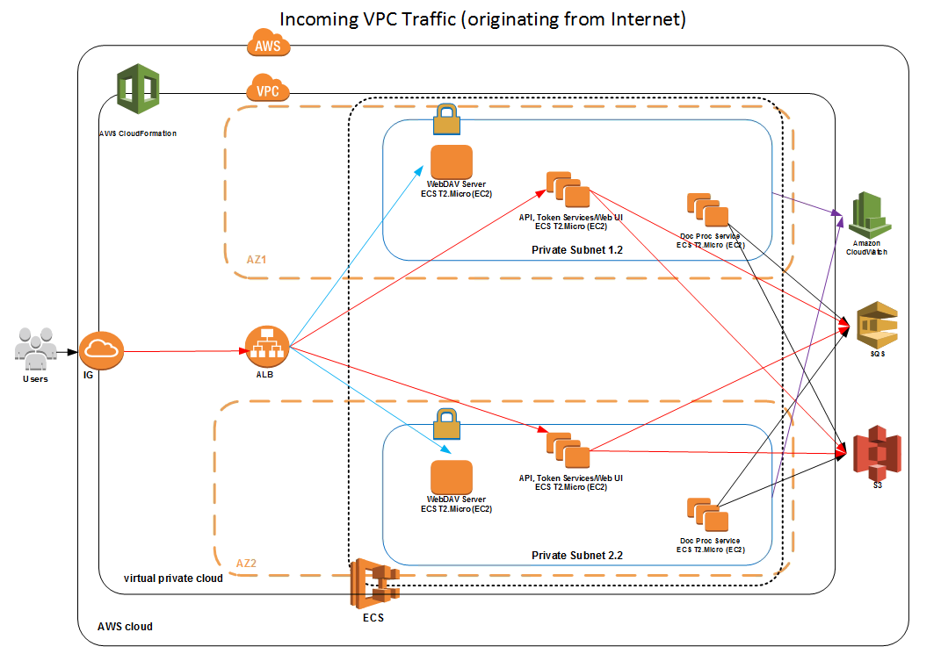
TNP Network Diagram

Slide 23
Demo

Slide 24
Docker in Azure
Azure Container Service
Docker For Azure
Automated Infrastructure setup for DC/OS, Kubernetes and Swarm(Not cloud Native)
Service Fabric(Cloud Native and early stages)

Slide 25
Docker Swarm(v17.03)
Cluster management integrated with Docker Engine
Scaling, No Auto scaling
Desired state reconciliation
Manger Nodes and Worker Nodes – Raft consensus
Need to manage ourselves
Secure Node Communication by default
Multi-host networking – Overlay Network
In built Service discovery
In built load balancing – Http Routing Mesh
Docker secrets
Rolling updates and rollbacks
HA scheduling and Health Aware Orchestration

Slide 26
Docker Swarm VS AWS ECS
Feature | Swarm | ECS
Service Discovery | In built | Third party tools
Network Isolation in Cluster | Overlay Networks | No, Can be achieved thru security groups
Logging/Monitoring | Third party | In built using Cloudwatch
Node TLS Traffic | In built | Implement manually
Secrets | In built Docker secrets | Manual Implementation using KMS
Service update rollbacks | Yes | No
Auto scale | Third party tools using Docker Api events | In built at EC2 and Service
Alters and Notifications | Third party tools using Docker Api events | Cloud Watch Alarms and AWS SNS notifications

Slide 27
TNP Performance Numbers
1 Core, 1 GB (t2.micro) 4 Amazon Linux EC2 Instances
16 Containers (12 participating In Load Test)
VSTS Cloud Load Test from Azure East-US Region, Api is in AWS West US Region.
10 min, 100 Users
~ 38,000 successful requests
~ 72 RPS
~ 320ms Avg Response Time at Client Side
~ 50% CPU
~ 40% RAM

Slide 28
REFERENCES
Docker and Docker Swarm
http://training.play-with-docker.com/
http://labs.play-with-docker.com/
https://docs.docker.com
https://veggiemonk.github.io/awesome-docker/
ECS
http://www.allthingsdistributed.com/2015/07/under-the-hood-of-the-amazon-ec2-container-service.html
http://docs.aws.amazon.com/AmazonECS/latest/developerguide/Welcome.html

Slide 29
AWS login details
https://codecamp.signin.aws.amazon.com/console
Username: TrainingUser1, TrainingUser2…10
Password: welcome1

Slide 30
Exercise
Use your group# prefix for all resource names to avoid name collisions.
Use you group# suffix for ALB port number starting from 9000
Eg: for training group1 – port# will be 9001.
Create a cloud watch log group
Create a task definition for UI and Service (use memory limit – soft limit -50)
Service container exposes port# 8081
UI container exposes port# 8080.
Use awslogs-region as “us-west-2”, else it will not work.
Create services – use task’s desire count for ‘db’ service as – 1 and UI – service as 2.
Db service path pattern - /api* and health check endpoint – ‘/api/values/getpollresults’
UI service path pattern - /home* and health check endpoint – ‘/home/index.html
Point your default rule(“/”) to UI target group.
Validation –
Go to ‘http://codecamp-363686496.us-west-2.elb.amazonaws.com:900<group#>/home/index’
Vote
Go to http://codecamp-363686496.us-west-2.elb.amazonaws.com:900<group#>/home/results

