Slide 1
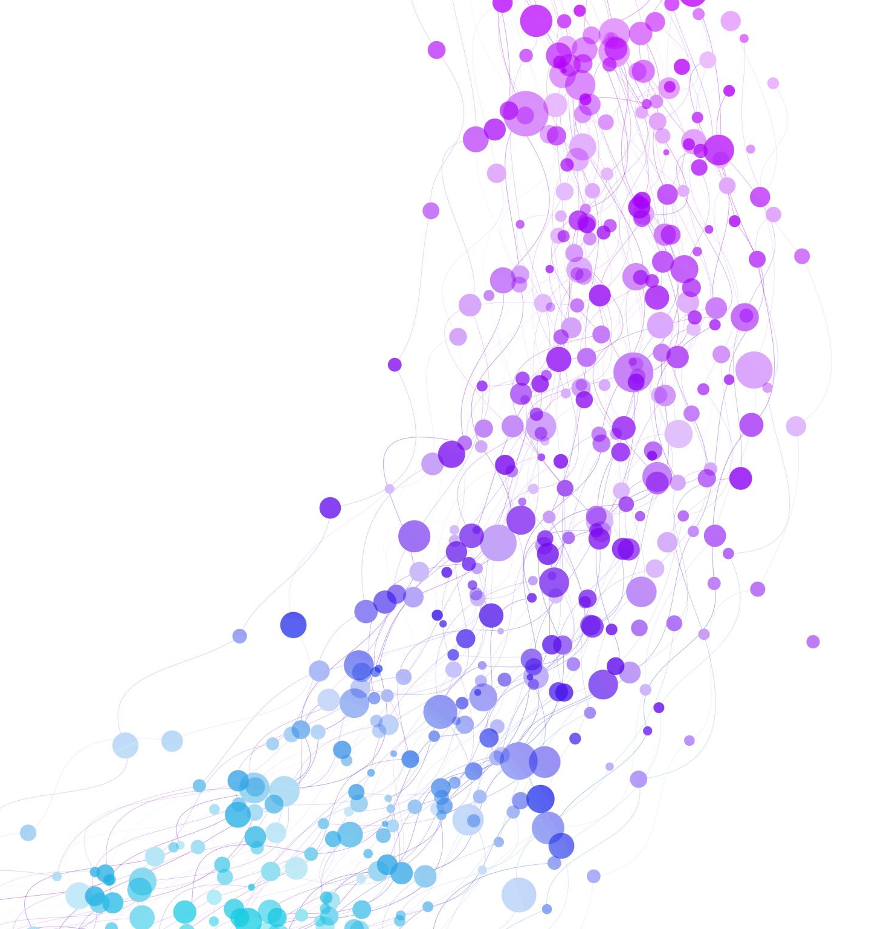
Detection of Yoga Poses using Openpose and CNN
SARAVANAN KISHAN – 19BCE1337
PRANEETH SETHUMADHAVAN– 19BCE1599
S.M. SATYA SREE NARAYANAN – 19BCE1172
Sanjit kapoor - 19bce1247

Slide 2
Problem Statement
During this period of the covid pandemic, learning yoga in a group class or having an instructor to teach yoga may become risky. The person who wants to learn yoga may not want to be in contact with anyone else.
There are online yoga classes provided but it is difficult for the instructor to monitor the student's progress. Learning yoga incorrectly could become harmful for your posture, so it is of utmost importance that the yoga poses that you do is accurate and does not affect your overall posture.
To achieve this, a model that can remotely detect and classify the images of yoga poses must be designed. This will overcome the issues mentioned above and ensure the user can conveniently learn yoga in the right way without any risks in a remote location.

Slide 3
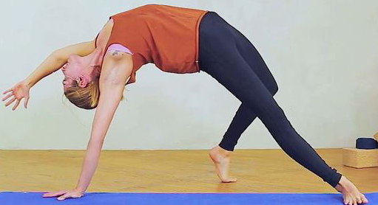
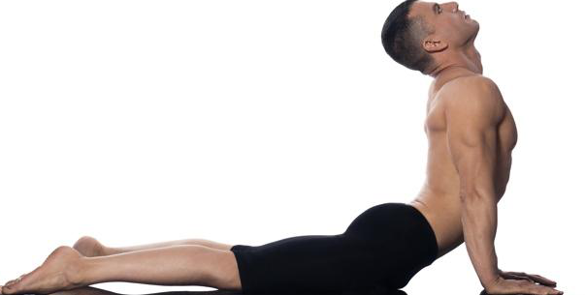
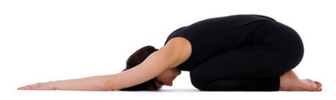
Input and output
Input for our project is various images of multiple yoga asanas as shown to the left.
Output for this project is prediction/ classification of a yogasana image as the right yogasana using a deep learning model like CNN.
Image 1 when given as input, the yoga aasana camatkarasana is returned as output. Similarly, image 2 is bhujangasana and image 3 is balasana.

Slide 4
Dataset Description
The dataset was obtained from Kaggle. The data was collected in a way so that they represent different yoga poses performed by people of different genders and age groups.
The dataset that we will be operating on will contain a total of 107 asanas. This dataset is one of the rare datasets with such a large variety shown in the type of asanas.
In total 5994 images are present in the dataset for all the asanas combined. Each asana on average contains over 50 images with a maximum of 90 images.
The image of an asana along with the label of the asana is provided so that it can be used for classification. The images individually have different backgrounds and surrounding features which will require different preprocessing tasks.

Slide 5
Methodology
Gaussian Blurring
Gaussian kernel is applied on image to perform smoothing of the image.
A gaussian kernel is approximation of the gaussian function.
It is done with the function, cv2.GaussianBlur(). We should specify the width and height of the kernel which should be positive and odd.
Median Filter
Here, the function cv2.medianBlur() computes the median of all the pixels under the kernel window and the central pixel is replaced with this median value.
This is highly effective in removing salt-and-pepper noise.
The central element is always replaced by some pixel value in the image.

Slide 6
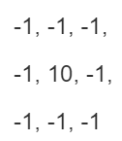
Methodology
Sharpening filter
Digital unsharp masking is a flexible and powerful way to increase sharpness.
The typical blending formula for unsharp masking is
sharpened = original + (original − blurred) × amount.
Edge enhancement filter
An Edge Enhancement Filter works by increasing the contrast of the pixels around the specific edges, so that the edges are visible prominently after applying the filter.
Kernel used for ImageFilter.EDGE_ENHANCE

Slide 7
Methodology
Step-2: Pose Detection using OpenPose
Detecting the key points of an image using OpenPose.
OpenPose Identifies major parts of the body such as foot, hand, face and 135 such key points.
Step-3: Classification
For the purpose of classification, Deep learning models will be used
The following four different ML models will be trained and its accuracy will be noted to perform a comparative analysis:
Without OpenPose and Filters
With OpenPose but without Filters
Without OpenPose but with Filters
With OpenPose and with Filters

Slide 8
Methodology
The Deep learning model used for prediction is Densenet.
The model structure consists of the following:
Dropout layer with parameter as 0.25
Dense layer with 512 units and relu (Rectified Linear Unit) activation
Dense layer with 128 units and relu activation
Dropout layer with parameter as 0.20
Dense layer with 20 units and softmax activation

Slide 9
Literature Review
1] INFINITY YOGA TUTOR : YOGA POSTURE DETECTION AND CORRECTION SYSTEM
Fazil et al. have developed an application which detects the yoga pose of the user and suggesting corrections to the user if it is an improper pose.
The authors have taken up two different approaches for identifying the pose of the user: One involves using OpenPose and the other involves using Mask RCNN.
Once the pose has been identified, they then move onto to detecting the pose of the user using a combination of CNN and LSTM models.
The application is used for continuous real time monitoring of the yoga pose and subsequent detection.

Slide 10
[2] Yoga Pose Detection and Classification using Deep Learning
In this paper the authors create a system that gets the image of a person doing a yoga position and compares it to the right way by comparing the angles the bodies create and tells correction to be made to improve the pose.
Keypoints in the body of the image can be estimated using different methods Openpose, Posenet and PIFPAF. The Openpose method is used, and the pose is extracted with it indicating 18 keypoints (ear, nose and etc.) on the body.
For classification of pose the image is fed to SVM model then plain CNN and then finally a CNN and LSTM combined model which is then passed through a Softmax layer to make prediction. The best prediction model turned out to be the CNN and LSTM combined model which gave an accuracy of 0.99 for classification of 6 yoga asanas

Slide 11
[3] A Proposal of Yoga Pose Assessment Method Using Pose Detection for Self Learning
This work has the objective of ensuring a person learning yoga is doing it correctly. This is a rare work that takes similarity measurements into account by comparing the posture of the learner and the instructor. The input is taken from a webcam.
It initially uses Openpose to detect the key points that are finding the body parts of a person. A CNN model is then trained to estimate the pose. The similarity measurement is based on the angles of the specified body parts of the learner and instructor. These specified body parts are known as coordinated points.
This is to estimate how much a learner can follow the instructor and most importantly it must be regardless of body size or age. A key feature of this work is that it can indicate which part of the yoga pose is incorrect.
If the angle of deviation is larger than 45 degrees, then that point is displayed red and otherwise it is in green. This helps to ensure that the learner can correct his mistakes. The output of this model is based on the average angle deviation.

Slide 12
[4] Implementation of Machine Learning Technique for Identification of Yoga Poses
In [4], the authors have compared the predictive capabilities of several machine learning algorithms for yoga pose detection. The dataset used by the authors was self-created and contained around 400-900 images for each of the 10 yoga poses. The dataset contained a total of 5459 images. The first step in identifying the yoga pose involved increasing brightness of the images and resizing them to a uniform size of 500x500 resolution. Then the pose-estimation algorithm provided by Tensorflow was used to mark each joint of the body and connect them with a stick diagram. The coordinates of the joints were used to calculate 12 different angles that were used as features to detect the yoga poses. The features were extracted and stored in a CSV file with labels. The dataset was then split in 80:20 ratio for training and testing of the machine learning models that were used for prediction, namely Logistic Regression, Random Forest, SVM, Decision Tree, Naive Bayes and KNN. The authors reported that an accuracy of 94.28% was obtained from all of the machine learning algorithms.

Slide 13
References
[1] F. Rishan, B. De Silva, S. Alawathugoda, S. Nijabdeen, L. Rupasinghe and C. Liyanapathirana, "Infinity Yoga Tutor: Yoga Posture Detection and Correction System," 2020 5th International Conference on Information Technology Research (ICITR), 2020, pp. 1-6, doi: 10.1109/ICITR51448.2020.9310832.
[2] - Kumar, Deepak & Sinha, Anurag. (2020). Yoga Pose Detection and Classification Using Deep Learning. International Journal of Scientific Research in Computer Science Engineering and Information Technology. 10.32628/CSEIT206623.
[3] - M. C. Thar, K. Z. N. Winn and N. Funabiki, "A Proposal of Yoga Pose Assessment Method Using Pose Detection for Self-Learning," 2019 International Conference on Advanced Information Technologies (ICAIT), 2019, pp. 137-142, doi: 10.1109/AITC.2019.8920892.
[4] Agrawal, Yash, Yash Shah, and Abhishek Sharma. "Implementation of machine learning technique for identification of yoga poses." 2020 IEEE 9th International Conference on Communication Systems and Network Technologies (CSNT). IEEE, 2020.

Slide 14
THANK YOU

