Slide 1


Slide 2
Abstract
The main aim of this project is to provide efficient help to every individual suffering with abnormal health issues.
We provide the user with some detailed pre-medical tests before consulting doctor ,based upon the symptoms user had mentioned earlier.
Technically called disease diagnosis becomes very easy in this case, which gives knowledge to the user how to tackle a particular situation in a better way.
If the user is unable to handle the situation on his own, he is provided with an appointment to a specialized doctor.

Slide 3
In busy schedules of present days, it became hard for every individual to have minimum concern about most valuable asset called ‘HEALTH’.
It’s good walking healthy than to get cured at regular periods as we often say “Prevention Is Better Than Cure”, the only mantra from ages we try to follow.
Thus, website also helps in providing general health tips for every user to ensure the soundness of their mind and physical system to gain a HEALTHY and WEALTHY WORLD.

Slide 4
Existing System
"We can just Google it!" is becoming our standard response to unanswered questions in life.
We usually do a Google search on a symptom, drug or health condition when we want to research regarding health.
Also we have lots of websites regarding medical information.
Some will take the symptoms of the user and just prescribe the medicine required.
Eg: Symptom Checker
Some will just show the information of medicines ‘A-Z’. On choosing one it will give the description of the medicine for which it can be used.
Eg: Drugs.com

Slide 5
Problems with Existing Systems
The medical information provided by web may not be confidential.
Also the symptoms to be provided are limited to one or two.
The previous information of the user is not provided.
Updated medical opportunities may not be available.
Many websites recommend drugs based upon symptoms given by user ,which was not appreciable as this must be done by doctor.

Slide 6
Proposed System
In view of the present conditions, this website was developed in such a way so as to rectify the previous issues.
The data related to the user is confidential as we have provided secure login for each and every user.
The number of symptoms to choose is not limited.
Thus, we will able to guide the user about the problem he is suffering from.

Slide 7
And also the website will be able to record the previous list of his health issues of the users.
In addition, we will give some medical tips to the users of the site.
Finally, we were able to keep the trust of the users, as we suggest highly specialized doctor other than prescribing the drug in the website itself will give the treatment.

Slide 8
Hardware Requirements
System : Windows 7(Basic),8,8.1,10
Hard Disk : 250 GB
Floppy Drive : Not required
Ram : 2 GB

Slide 9
Software Requirements
Operating system : Windows 10
Coding Language : HTML 5, CSS, BOOTSTRAP, JSP(Java
Server Pages), Java, MySQL, Servlets.
IDE : Eclipse , MySQL Workbench 6.3

Slide 10
Introduction
The project mainly comprises of three modules namely,
Admin.
User / patient.
doctor.
Admin Module:
In this, firstly the admin should login. Then he can do any of the following things:
Adding a doctor.
Deleting a user.
Generate an appointment if needed by the user.
Doctor module:
In this, firstly the doctor should login. Then he can view the appointments for the day he selected.

Slide 11
Patient/User Module:
In this, the user first needs to register to access the site. Then only he can login to do any of the following things:
Check the list of symptoms we provide with those he is suffering from.
Generate his report.
View the medical tips.
Book an appointment with specialized doctor if needed.
In this we will show how we are capable of identifying the disease of any person by specified symptoms following some suitable pre-medical tests were advised for the user before the appointment with the doctor.

Slide 12
The needy or the user need to register into the website with some personal details ( email , contact no.). A page is displayed with the options –
SYMPTOMS
MY REPORT
TIPS
This is made easier through this website as all the process could be handled within little duration of time.

Slide 13
UML
UML stands for Unified Modeling Language.
UML was created by the Object Management Group (OMG).
UML is a standard language for specifying, visualizing, constructing, and documenting the artifacts of software systems.
UML is different from the other common programming languages such as C++, Java, COBOL, etc.
UML is a pictorial language used to make software blueprints.
Although UML is generally used to model software systems, it is also used to model non-software systems as well.
Eg: Process flow in a manufacturing unit, etc.

Slide 14
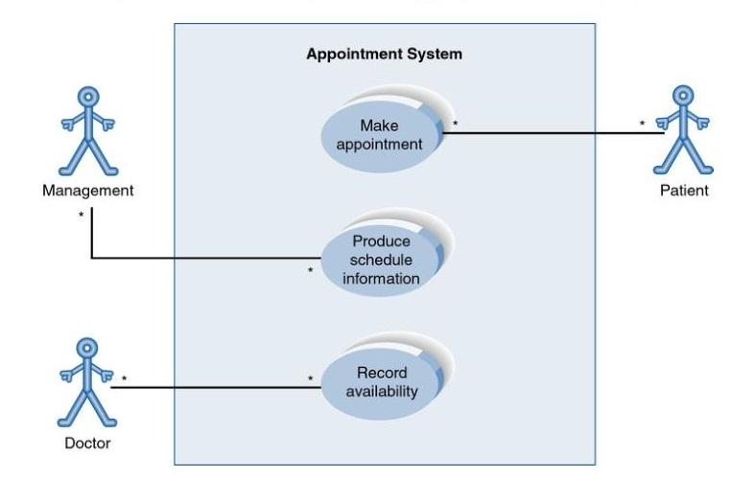
Use case Diagram

Slide 15
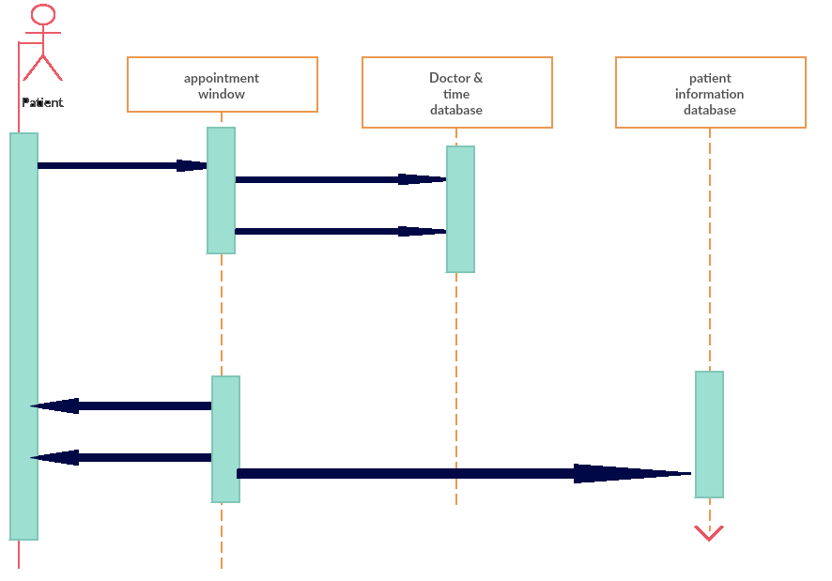
Sequence Diagram

Slide 16
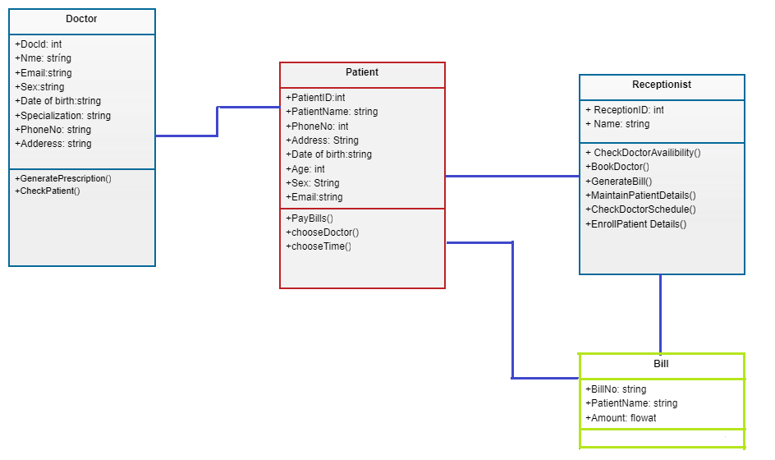
Class Diagram

Slide 17
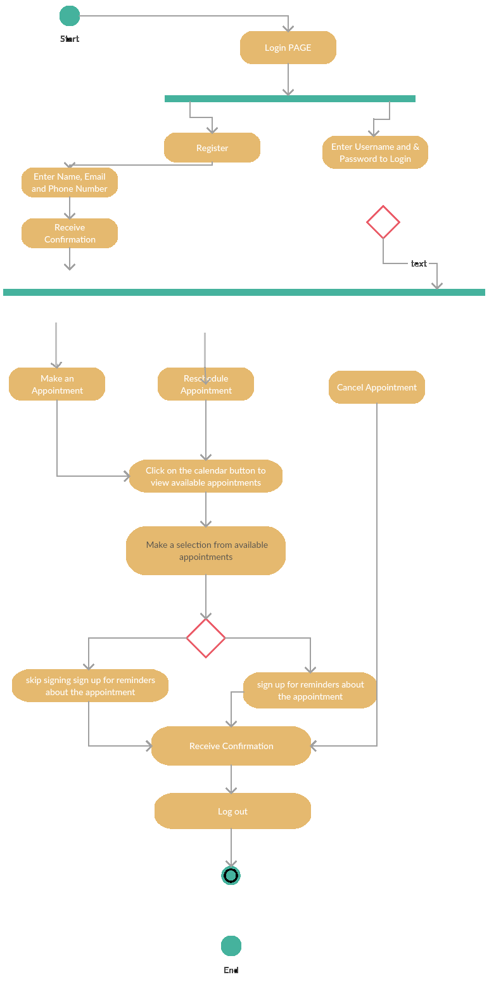
Activity Diagram

Slide 18
Sample Code
Index.html
<!DOCTYPE html>
<html lang="en">
<head>
<title>Dr.Online</title>
<!-- custom-theme -->
<meta name="viewport" content="width=device-width, initial-scale=1">
<meta http-equiv="Content-Type" content="text/html; charset=utf-8" />
<meta name="keywords" content="Medicate Responsive web template, Bootstrap Web Templates, Flat Web Templates, Android Compatible web template,
Smartphone Compatible web template, free webdesigns for Nokia, Samsung, LG, SonyEricsson, Motorola web design" />
<script type="application/x-javascript"> addEventListener("load", function() { setTimeout(hideURLbar, 0); }, false);
function hideURLbar(){ window.scrollTo(0,1); } </script>
<!-- //custom-theme -->
<script type="text/javascript" src="js/jquery-1.11.1.min.js"></script>
<script type="text/javascript" src="js/bootstrap.js"></script>
<!-- stylesheet -->
<link href="css/bootstrap.css" rel="stylesheet" type="text/css" media="all" />
<link href="css/easy-responsive-tabs.css" rel='stylesheet' type='text/css'/>
<link href="css/style.css" rel="stylesheet" type="text/css" media="all" />
<link href="css/gallery.css" rel="stylesheet" type="text/css" media="all" /> <!-- gallery css -->
<!-- //stylesheet -->
<!-- online fonts -->

Slide 19
<link href="//fonts.googleapis.com/css?family=Titillium+Web:200,200i,300,300i,400,400i,600,600i,700,700i,900" rel="stylesheet">
<link href="//fonts.googleapis.com/css?family=Lato:100,100i,300,300i,400,400i,700,700i,900,900i" rel="stylesheet">
<!-- //online fonts -->
<!-- font-awesome-icons -->
<link href="css/font-awesome.css" type="text/css" rel="stylesheet">
<!-- //font-awesome-icons -->
<script src="js/modernizr.custom.js"></script>
<script type="text/javascript" src="js/modernizr.custom.79639.js"></script>
<link rel="stylesheet" type="text/css" href="css/custom.css" />
<!-- for smooth scrolling -->
<script type="text/javascript" src="js/move-top.js"></script>
<script type="text/javascript" src="js/easing.js"></script>
<script type="text/javascript">
jQuery(document).ready(function($) {
$(".scroll").click(function(event){
event.preventDefault();
$('html,body').animate({scrollTop:$(this.hash).offset().top},1000);
});
});
</script>

Slide 20
<!-- banner -->
<div class="w3_banner">
<div class="container">
<div class="slider">
<div class="callbacks_container">
<ul class="rslides callbacks callbacks1" id="slider4">
<li>
<div class="banner_text_w3layouts">
<h3><font color="black">USER</font></h3>
<p><font color="black">You are the most important persons of our site.Your satisfaction is our satisfaction.</font></p>
</div>
</li>
<li>
<div class="banner_text_w3layouts">
<h3><font color="black">DOCTOR</font></h3>
<p><font color="black">You may not be able to read a doctor's handwriting and prescription, but you'll notice his bills are neatly typewritten.</font></p>
</div>
</li>
<li>

Slide 21
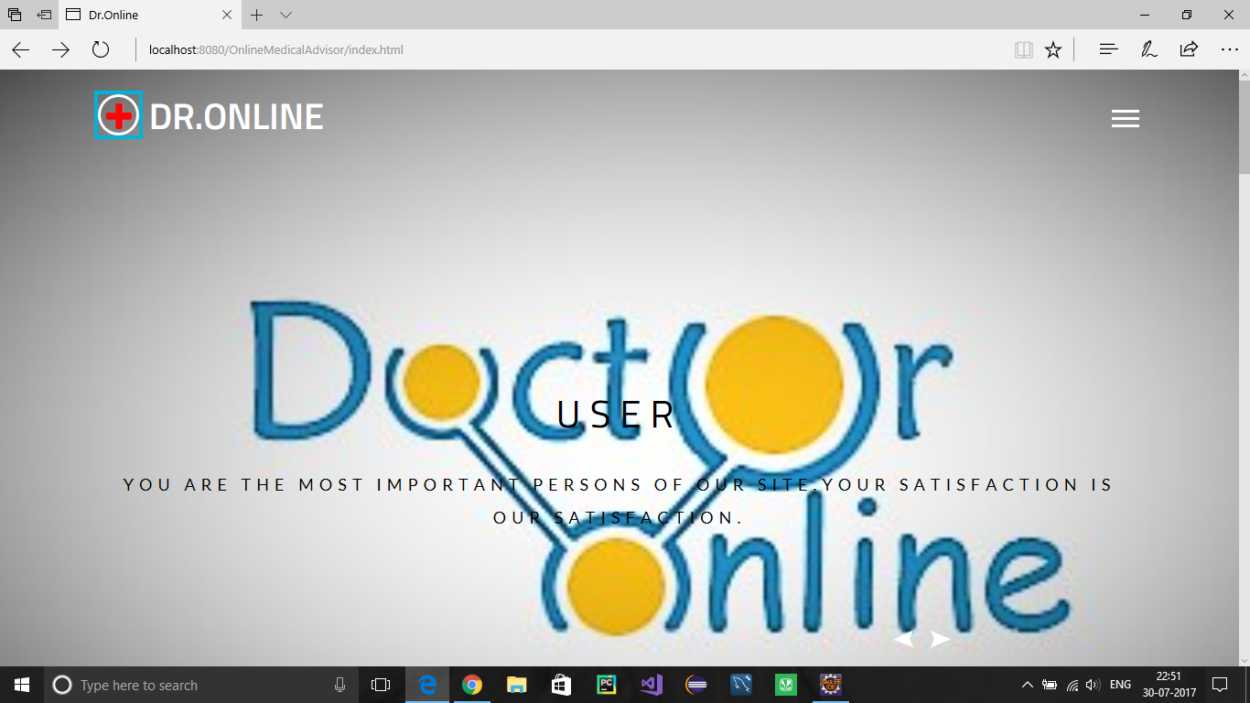
Output Screenshots

Slide 22
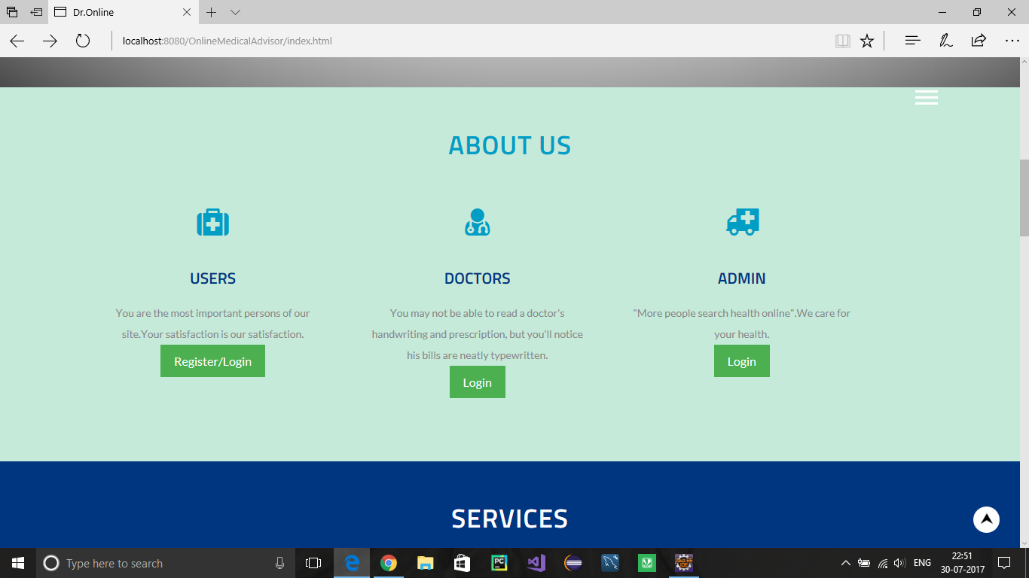

Slide 23
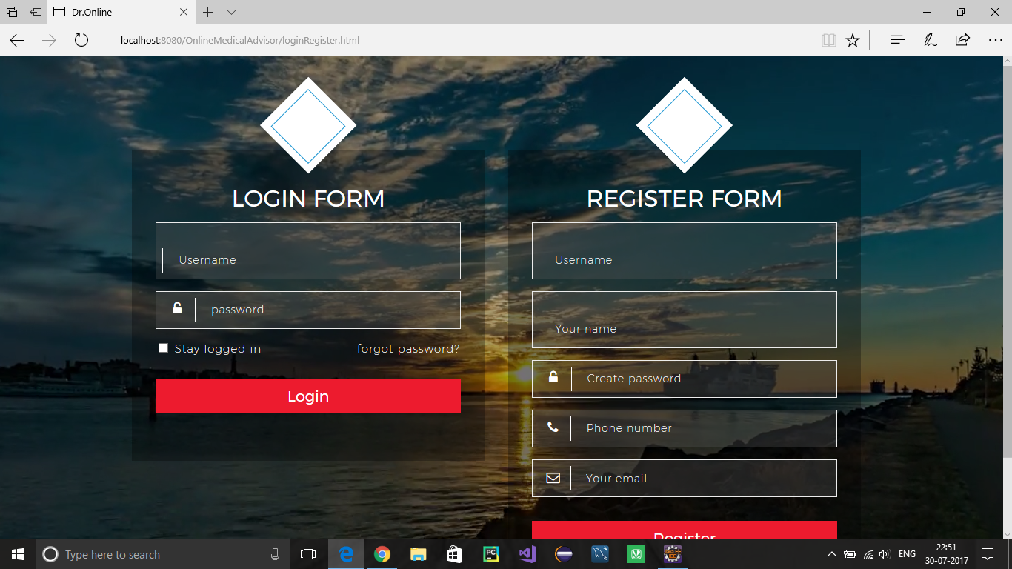

Slide 24
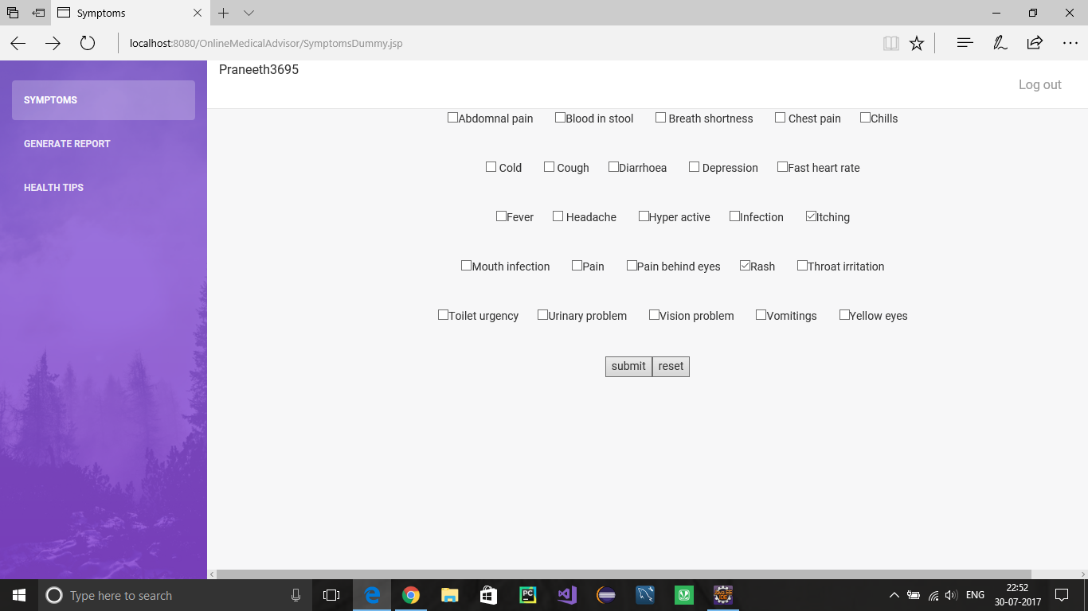

Slide 25
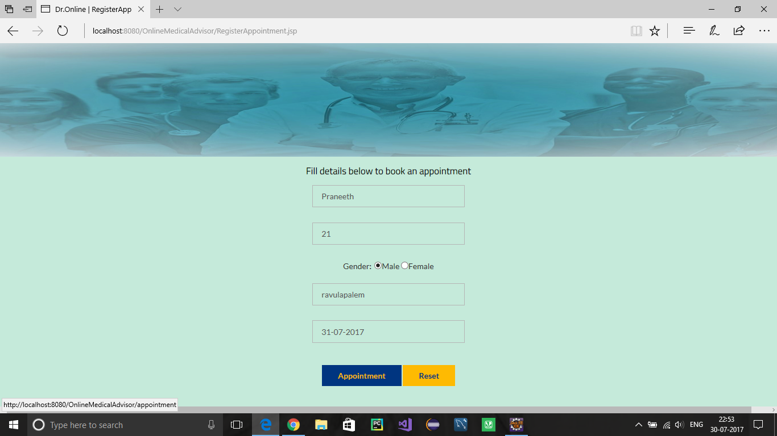

Slide 26
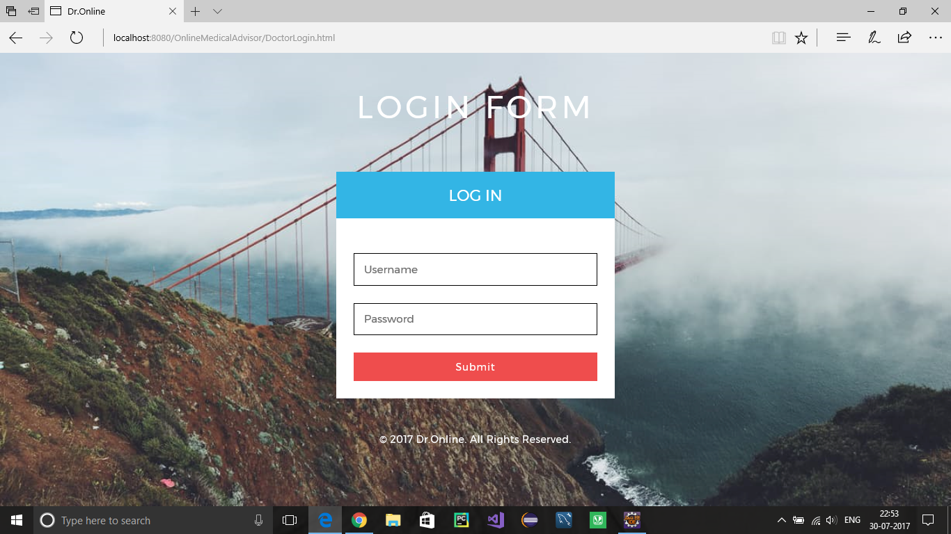

Slide 27
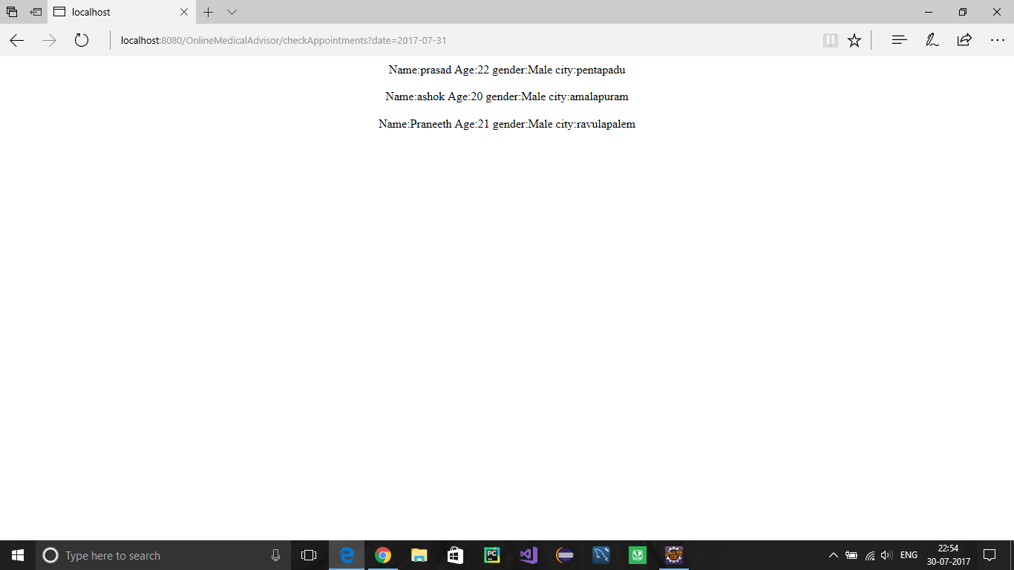

Slide 28
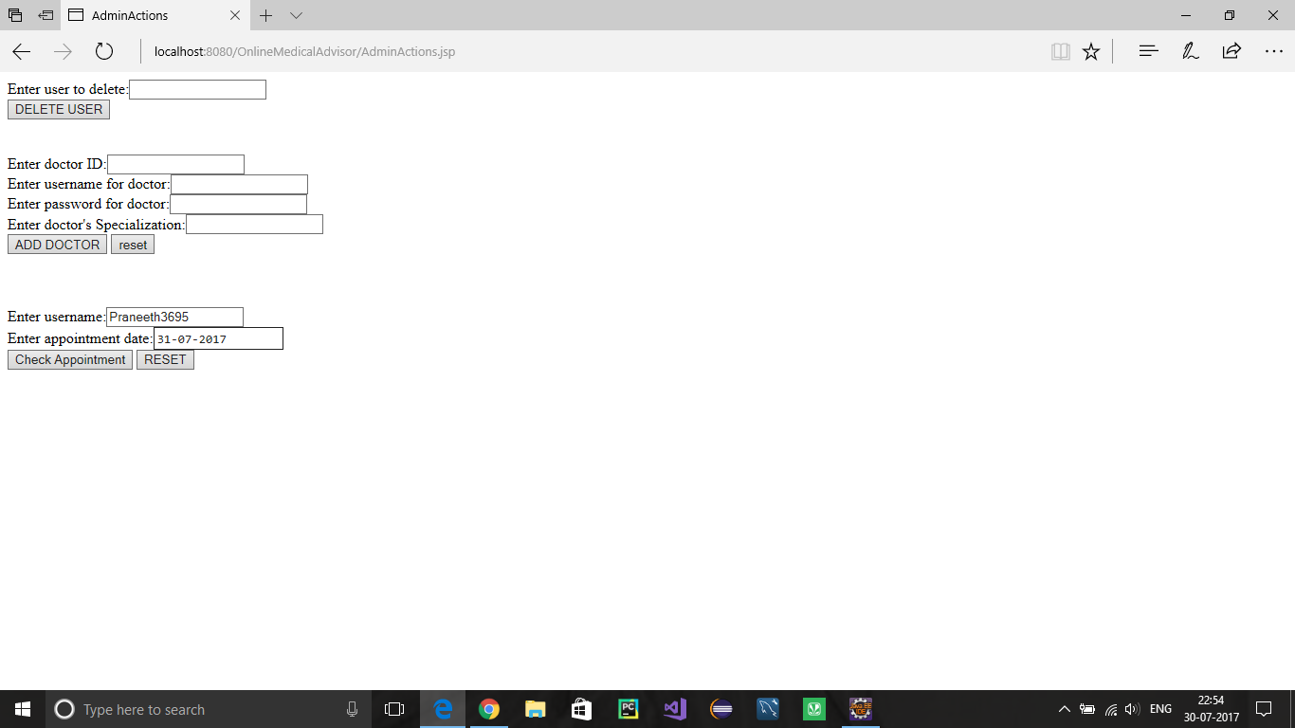

Slide 29
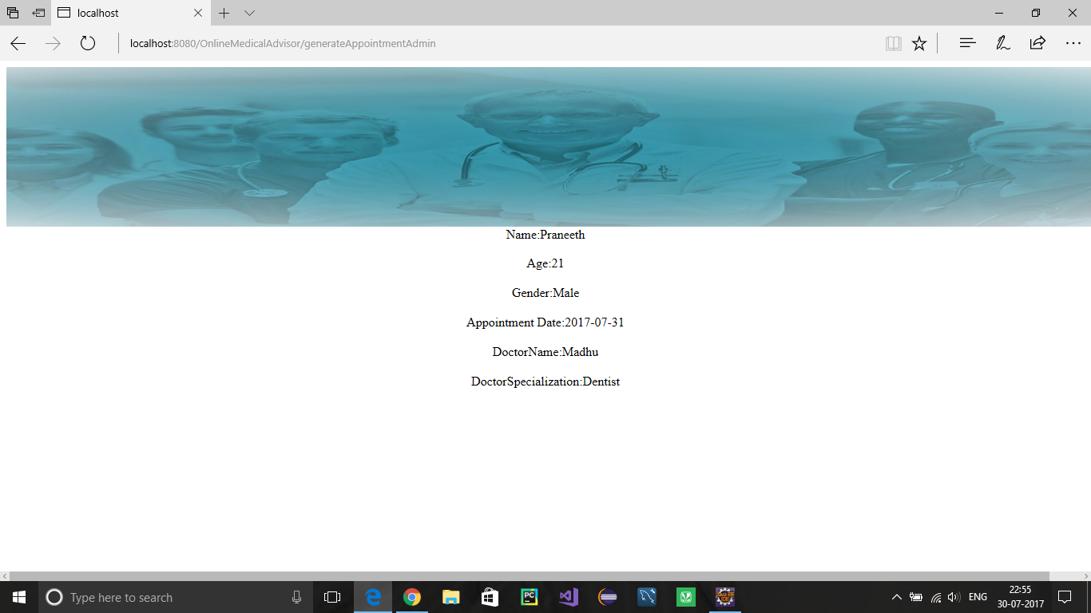

Slide 30
Conclusion
The proposed Online Medical Advisor system is basically a website that provides a lot of useful information to the general public on a wide variety of health and health related issues.
Such as, detailed report of user’s condition and pre-medical tests to be taken before consulting a doctor.
The site will also facilitate its users to direct their health related questions to medical experts.
Interesting health tips to keep up a healthy life will also be available on the site.

Slide 31
Benefits through our site
Creating public awareness of diagnosis and their general treatment.
Redirecting them to medical professionals for any other queries by providing an option of booking an appointment.
The user can view his previous health reports if any.
Generating an over all report of user when he needs.
Updating the information from time to time.

Slide 32

Clinical information is best than the information on online.
This project aims at making the user to come to know that health is a very valuable.
In case of any abnormal health issues, he can simply concern the specialized doctor suggested by the site.

Slide 33
References
Drugs.com
Symptomchekcer.com

Slide 34


