Slide 1
IOT-BASED Flood monitoring system
Aniket Bansal, Shaunak Biswas, Mukthapuram Chaitrika, Gopal Garg, Praneeth Jain, Namish Mamidipalli, Archit Pethani, Rohan Naidu, Ashwin Rudraraju, Saideekshith Vaddineni​

Slide 2
Motivation
The current state of flood monitoring is based mainly on radars, satellite data and manual human analysis and intervention (Source). Not only is this a time consuming process, it is extremely costly and prone to human error.
Through this project, we aim to utilize IoT to monitor floods accurately using cost-effective and reliable sensors, and analyze the data we gather to predict floods before they occur, allowing for warnings to be sent and effective management strategies be utilized.

Slide 3
PROJECT OVERVIEW

Slide 4
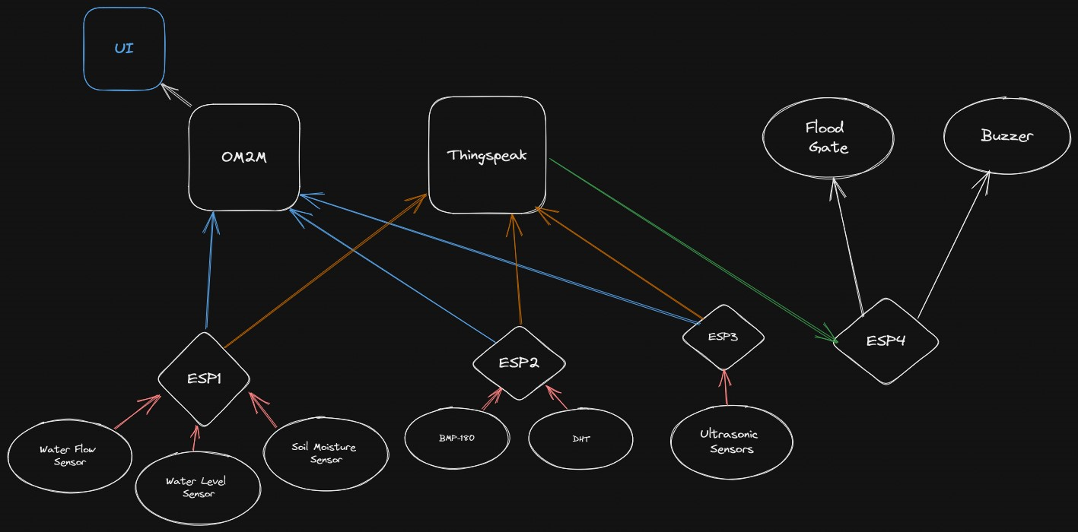

Slide 5
Data points & sensors
Water level
Using Ultrasonic and Water Level Sensors, we calculate the current water level. This is the primary indicator of flooding.
MOISTURE
The DHT and Soil Moisture Sensors detect moisture content in the air and soil respectively.
Temperature and pressure
The DHT and BMP-180 Sensors detect temperature and pressure respectively. Low pressure and high temperatures indicate a thunderstorm.
Water flow
The water flow sensor measures the rate of flow of water. This will indicate the severity of the flood and also help in predicting it.

Slide 6
Actuators
FLOOD GATES
Whenever the probability of a flood occurring crosses a specified threshold (currently set to 80%), the flood gate automatically goes down, hence minimizing the damage.
BUZZER
Similarly, on crossing the threshold, the buzzer will go off. This will warn people that a flood is highly probably, giving them a chance to evacuate.

Slide 7
Data collection
Over the course of two weeks, we have simulated a total of 15 floods. The data collected during these simulations in plotted in the admin dashboard. Through analysis of these data points, we can calculate and assign weights to each of the factors to find out the probability of a flood occurring.

Slide 8
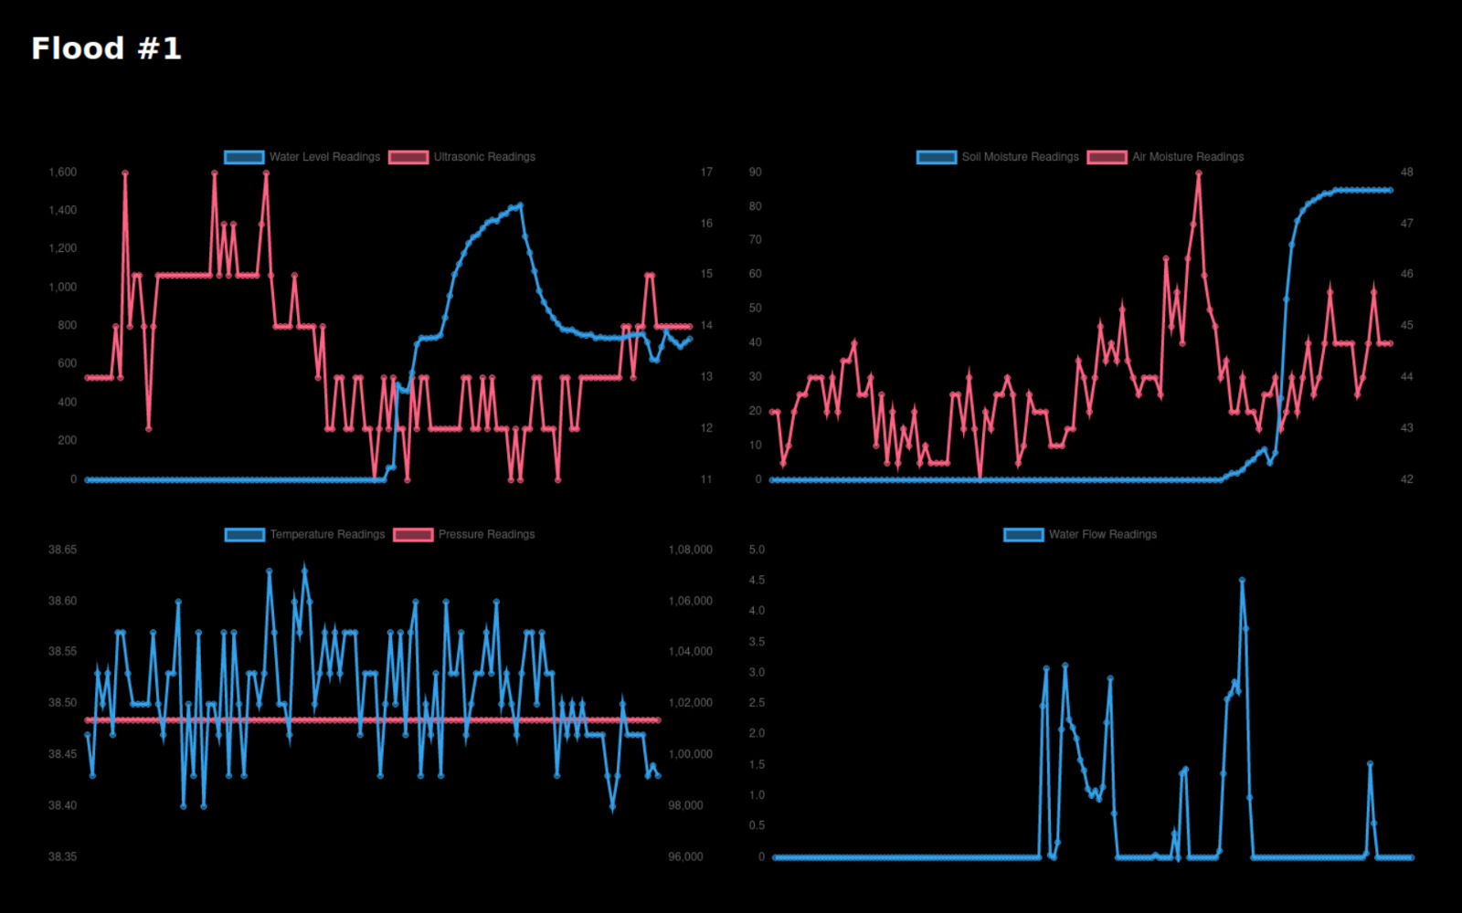

Slide 9
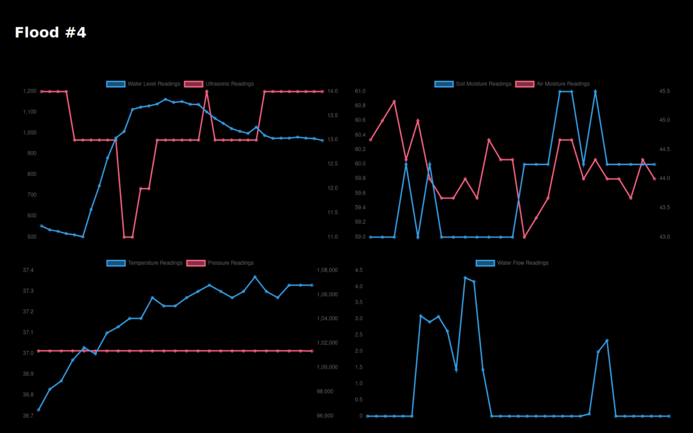

Slide 10
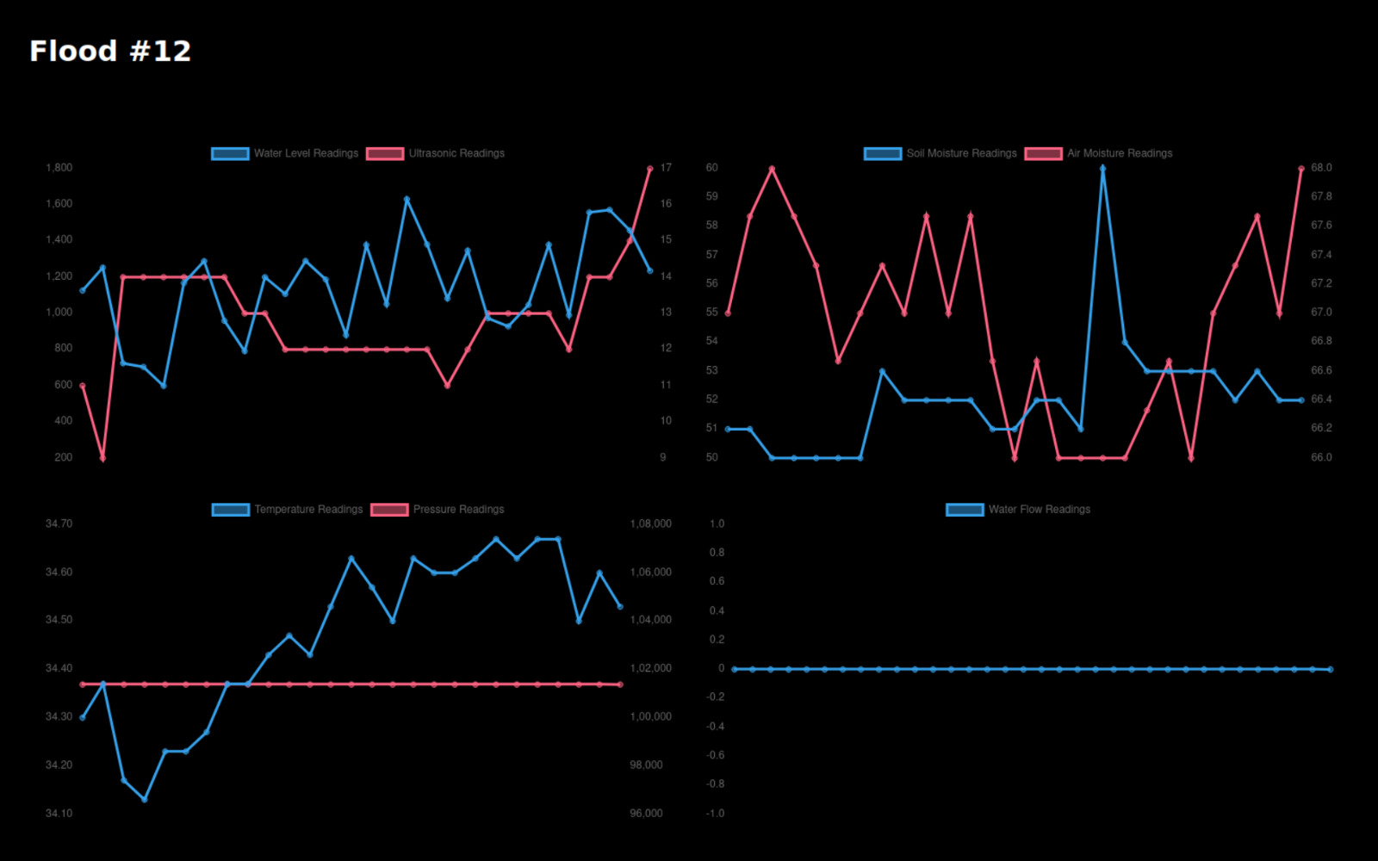

Slide 11
Failure analysis
A
B
c
Sanity checking
Data redundancy
Manual actuation
All the data being uploaded is checked to be within reasonable ranges, which avoids garbage values being uploaded.
Multiple sensors for the same data point are used and their average is taken to ensure correct values are read.
In case there is some latency, admins can manually force the flood gates and buzzers to activate.

Slide 12
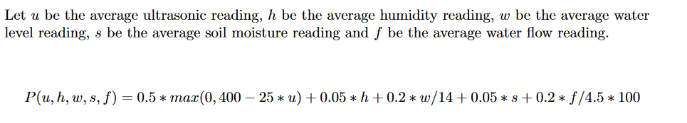
PROBABILITY CALCULATIONS
After thoroughly analysing the collected data, we assign weights to the important factors accordingly. Then, we convert each data point to a percentage, and take its weighted average to get the final probability.

Slide 13
LIVE DEMO

Slide 14
Contributions
ESP 1 (Soil Moisture, Water Level, Water Flow) : Archit Pethani, Namish Mamidipalli, Shaunak Biswas, Ashwin Rudraraju
ESP 2 (DHT 11, BMP 180): Saideekshith Vaddineni, Gopal Garg, Aniket Bansal
ESP 3 (Ultrasonic): Rohan Naidu, Mukthapuram Chaitrika, Moida Praneeth Jain
ESP 4 (Flood Gate and Buzzer): Ashwin Rudraraju
Tabletop Model: Shaunak Biswas, Namish Mamidipalli, Ashwin Rudraraju, Mukthapuram Chaitrika
Data Collection: Aniket Bansal, Archit Pethani, Rohan Naidu, Shaunak Biswas, Gopal Garg
Data Analysis and Probability Calculation: Moida Praneeth Jain
Thingspeak Integration: Moida Praneeth Jain
OM2M Integration: Archit Pethani, Moida Praneeth Jain
User Interface: Moida Praneeth Jain, Shaunak Biswas

