Slide 1
CASE STUDY PRESENTATION
Satellite Telemetry Anomaly Detection Using Machine Learning in R
Case Study Presentation
Student Name: B. Praneeth Reddy
Roll Number: 160124771028
Class / Section: I-1
Department: AI & DS
College: Chaitanya Bharathi Institute of Technology

Slide 2
Background
Satellite Telemetry
Abnormal Behavior
Generated by spacecraft sensors and subsystems to report the health and behavior of the satellite.
Telemetry segments may contain unusual or abnormal signal behavior that needs attention.
Manual Monitoring
Machine Learning
Reviewing large volumes of telemetry by hand is time-consuming.
ML can help classify telemetry segments as nominal or anomalous.

Slide 3
Problem Statement
“To identify anomalous satellite telemetry segments from nominal telemetry using machine learning in R.”
Telemetry Features
Machine Learning Model
Nominal / Anomalous
Task: telemetry-segment anomaly classification (not future failure forecasting).

Slide 4
Objectives
To understand and analyze the official OPSSAT-AD satellite telemetry dataset.
1
To clean and preprocess the telemetry features using R.
2
To develop machine-learning models for detecting anomalous telemetry segments.
3
To evaluate and visualize model performance using suitable classification metrics.
4

Slide 5
Dataset: OPSSAT-AD
2,123
23
9
18
Rows (segments)
Columns
Channels
Handcrafted features
1,594
529
1,689
434
Training
Testing
Nominal
Anomalous
Source & Target
Why It Is Suitable
OPSSAT-AD – anomaly detection dataset for satellite telemetry, Zenodo Record 12588359, Version 1.
DOI: 10.5281/zenodo.12588359
Target: anomaly (0 = Nominal, 1 = Anomalous)
Real telemetry from ESA’s OPS-SAT CubeSat
Ground-truth anomaly labels
Official train/test split
Telemetry-derived features for ML
Official v1 file checksum verified in notebook

Slide 6
Important Variables
Metadata
Target
Telemetry Features (18)
segment
train
channel
sampling
anomaly
0 = Nominal
1 = Anomalous
duration, len
mean, var, std
kurtosis, skew
n_peaks
Smoothed peak-count features
Difference-based peak features
Difference-variance features
Gap-related features
Length-derived features
Variance-derived features

Slide 7
Data Preparation in R
Workflow
data$anomaly <- factor(data$anomaly,
levels = c(0, 1),
labels = c("Nominal", "Anomalous"))
data$channel <- factor(data$channel)
train_data <- data[data$train == 1, ]
test_data <- data[data$train == 0, ]
predictor_cols <- setdiff(names(data),
c("segment", "anomaly", "train"))
Load data
Inspect structure
Missing-value check
Duplicate check
Non-finite-value check
Factor conversion
Official train/test split
Training-only median imputation (if required)
Remove identifier/split columns from predictors
Key Rules & Check Results
segment and train excluded from predictors
anomaly → factor; channel → categorical
Checks: 0 missing, 0 duplicate, 0 non-finite
Training-only median imputation: nothing to fill
Train 1,594 (321 anomalous); Test 529 (113 anomalous)

Slide 8
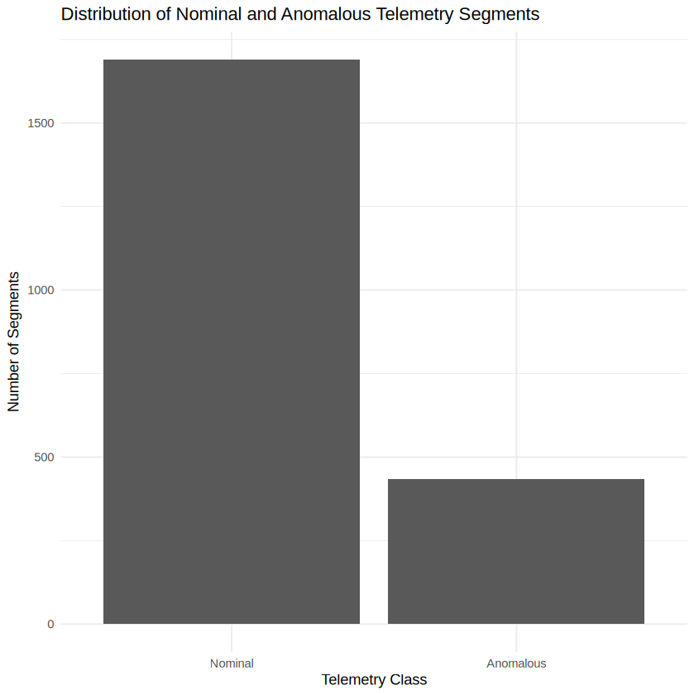
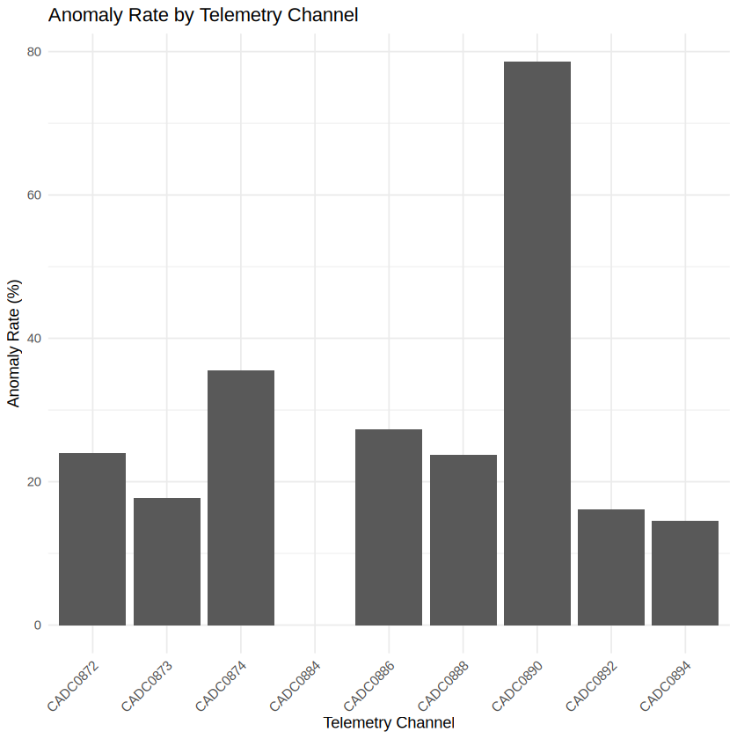
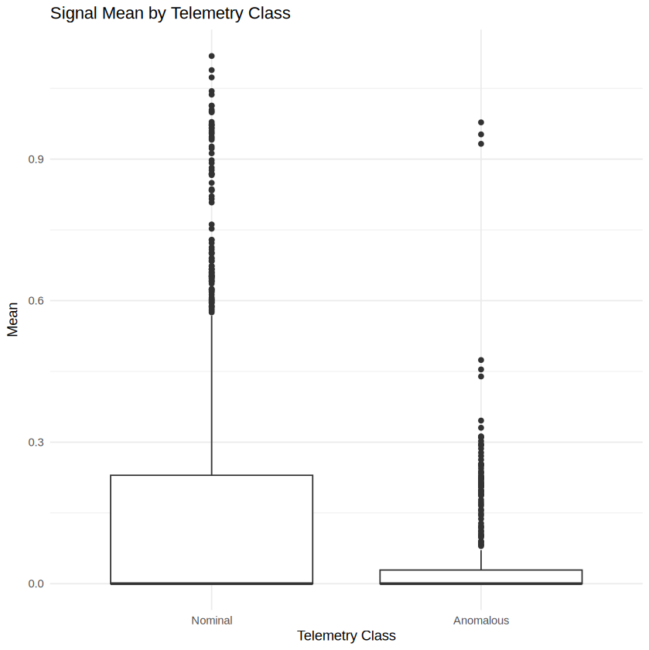
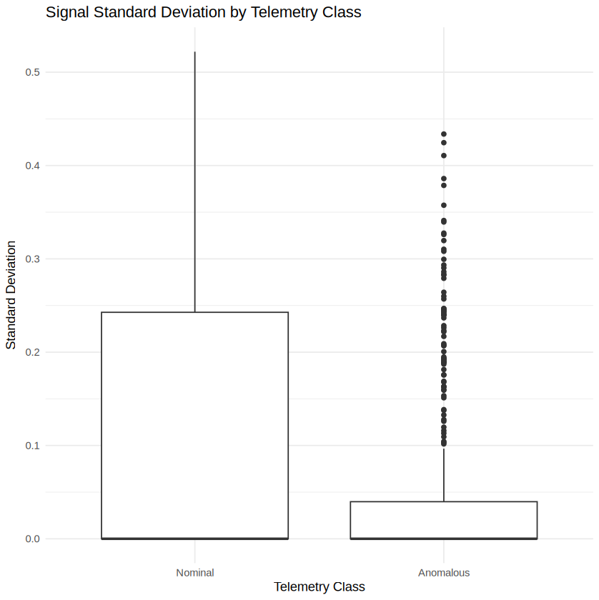
Data Analysis & Visualization
Class distribution
Nominal 1,689 vs anomalous 434: about 4:1, so the classes are imbalanced and accuracy alone is not enough.
Anomaly rate by channel
Rates differ by channel: CADC0890 is highest (78.6%, only 14 segments); CADC0884 has none; CADC0874 is 35.6%.
Signal mean by class
Both medians are near zero. Nominal means spread wider (75th percentile ≈ 0.23 vs ≈ 0.03 for anomalous).
Signal std by class
Same pattern: nominal std spreads wider (75th percentile ≈ 0.24 vs ≈ 0.04); both medians are near zero.

Slide 9
Machine Learning Method
Primary: Random Forest
Comparison: Logistic Regression
Captures nonlinear relationships
Combines many decision trees
Suited to classification
Robust across many telemetry features
Provides feature importance
500 trees, 4 variables tried per split
Interpretable statistical baseline
Useful for model comparison
Simpler linear classification model
Supervised binary classification: OPSSAT-AD provides ground-truth anomaly labels.

Slide 10
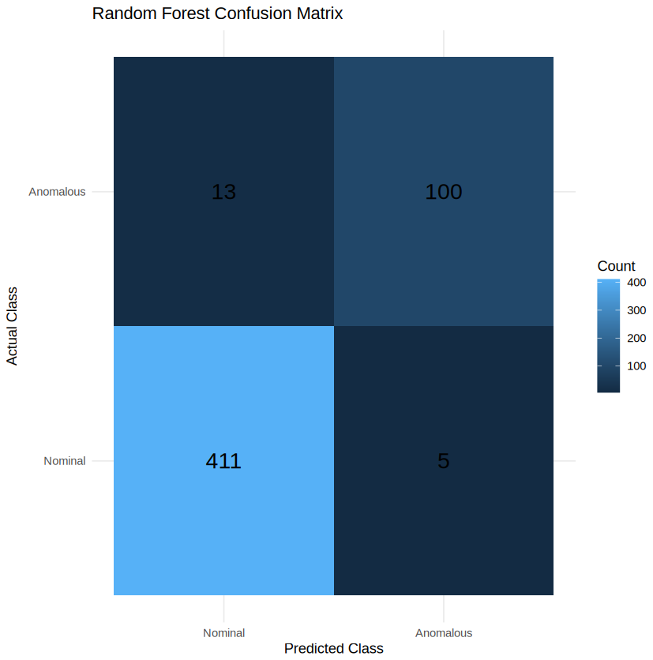
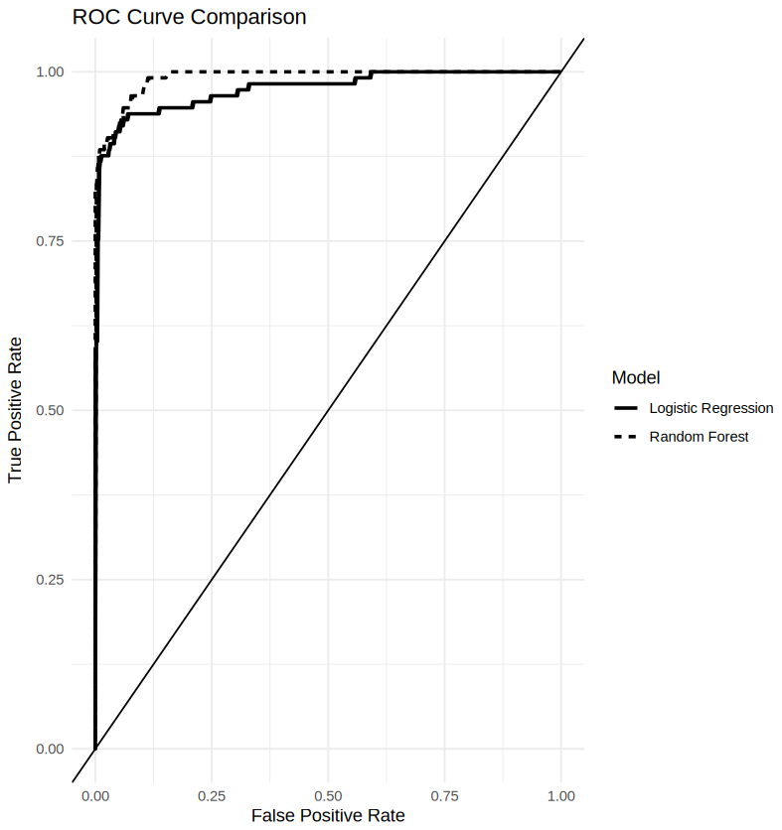
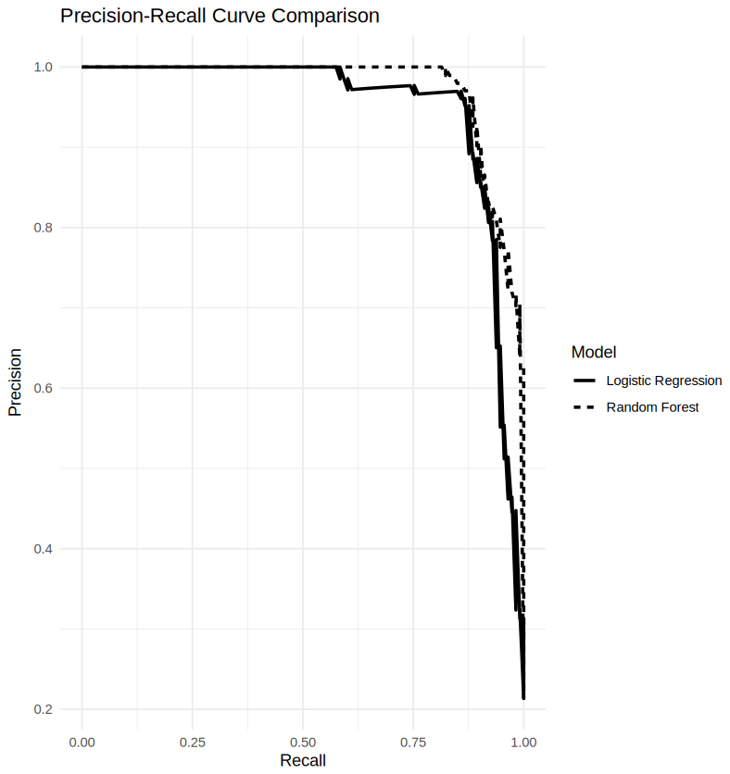
Model Evaluation
Metric | Random Forest | Logistic Regression
Accuracy | 0.9660 | 0.9641
Precision | 0.9524 | 0.9700
Recall | 0.8850 | 0.8584
F1-score | 0.9174 | 0.9108
MCC | 0.8970 | 0.8910
ROC-AUC | 0.9914 | 0.9743
PR-AUC | 0.9747 | 0.9489
Reading the Results (test set, 529 segments)
RF confusion matrix: 411 true nominal, 5 false alarms, 13 missed anomalies, 100 detected anomalies
RF is higher on 6 of 7 metrics; Logistic Regression has higher precision (0.9700 vs 0.9524)
ROC-AUC: 0.9914 (RF) vs 0.9743 (LR); PR-AUC: 0.9747 vs 0.9489
MCC of 0.8970 shows strong agreement despite class imbalance
Selected: Random Forest
Best F1 and PR-AUC in the notebook. Green = better model per metric.

Slide 11
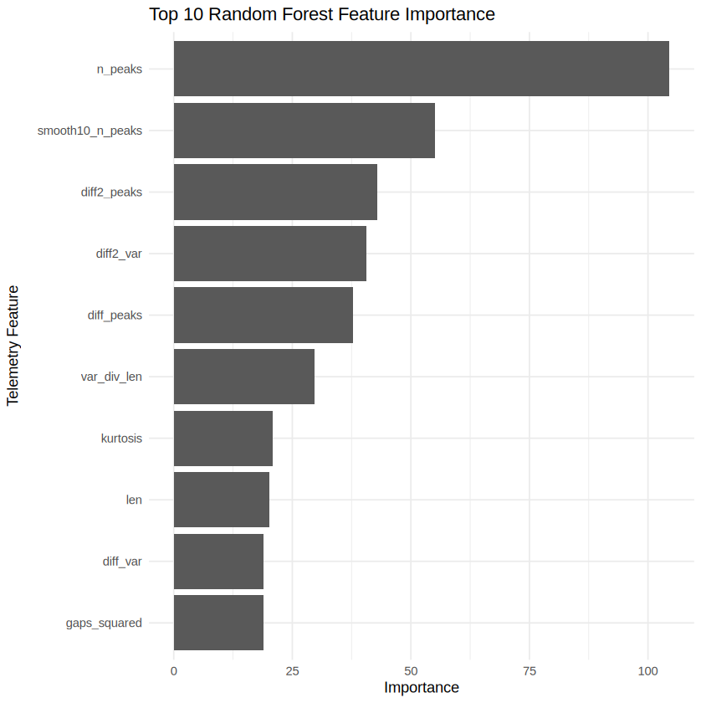
Feature Importance & Findings
What the Random Forest Uses
n_peaks ranks first (importance 104.5), almost twice the next feature, smooth10_n_peaks (55.1)
Peak-count features lead; diff2_var ranks 4th and diff_peaks 5th
mean and std are not in the top 10
Importance = mean decrease in Gini (500 trees)
False positives: 5 nominal segments flagged as anomalous (false alarms)
False negatives: 13 anomalous segments missed
More misses than false alarms, matching recall 0.8850 < precision 0.9524

Slide 12
Conclusion, Reproducibility, Version Control & References
Conclusion
R Markdown & Reproducibility
Official OPSSAT-AD dataset analyzed
R-based cleaning and preprocessing performed
EDA and visualization completed
Random Forest and Logistic Regression evaluated
Imbalance-aware metrics used; Random Forest best (F1 0.9174, PR-AUC 0.9747)
Result: a telemetry-segment classifier, not future-failure forecasting
Code, outputs, tables, graphs organized in R Markdown
Run in Google Colab (R runtime); rerun to reproduce
Version Control
v1_initial_dataset_and_problem
v2_preprocessing_and_eda
v3_model_development • v4_final_results
References
1. Ruszczak et al. (2025). The OPS-SAT benchmark for detecting anomalies in satellite telemetry. Scientific Data. DOI: 10.1038/s41597-025-05035-3
2. OPSSAT-AD, Zenodo Record 12588359, v1. DOI: 10.5281/zenodo.12588359
3. KP Labs OPS-SAT-AD GitHub repository.

