Slide 1


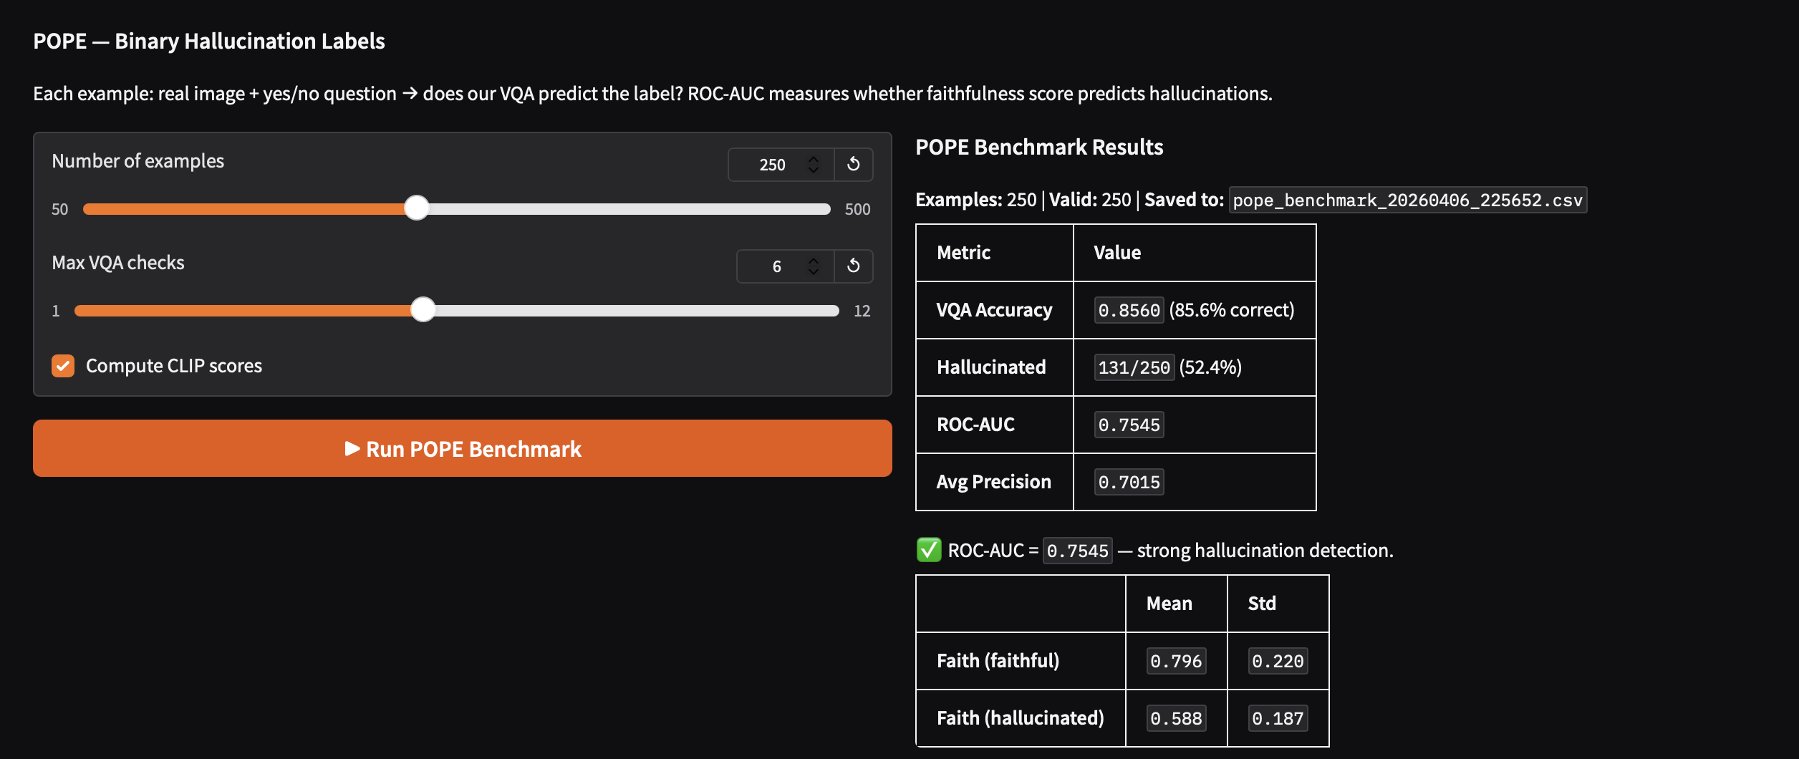
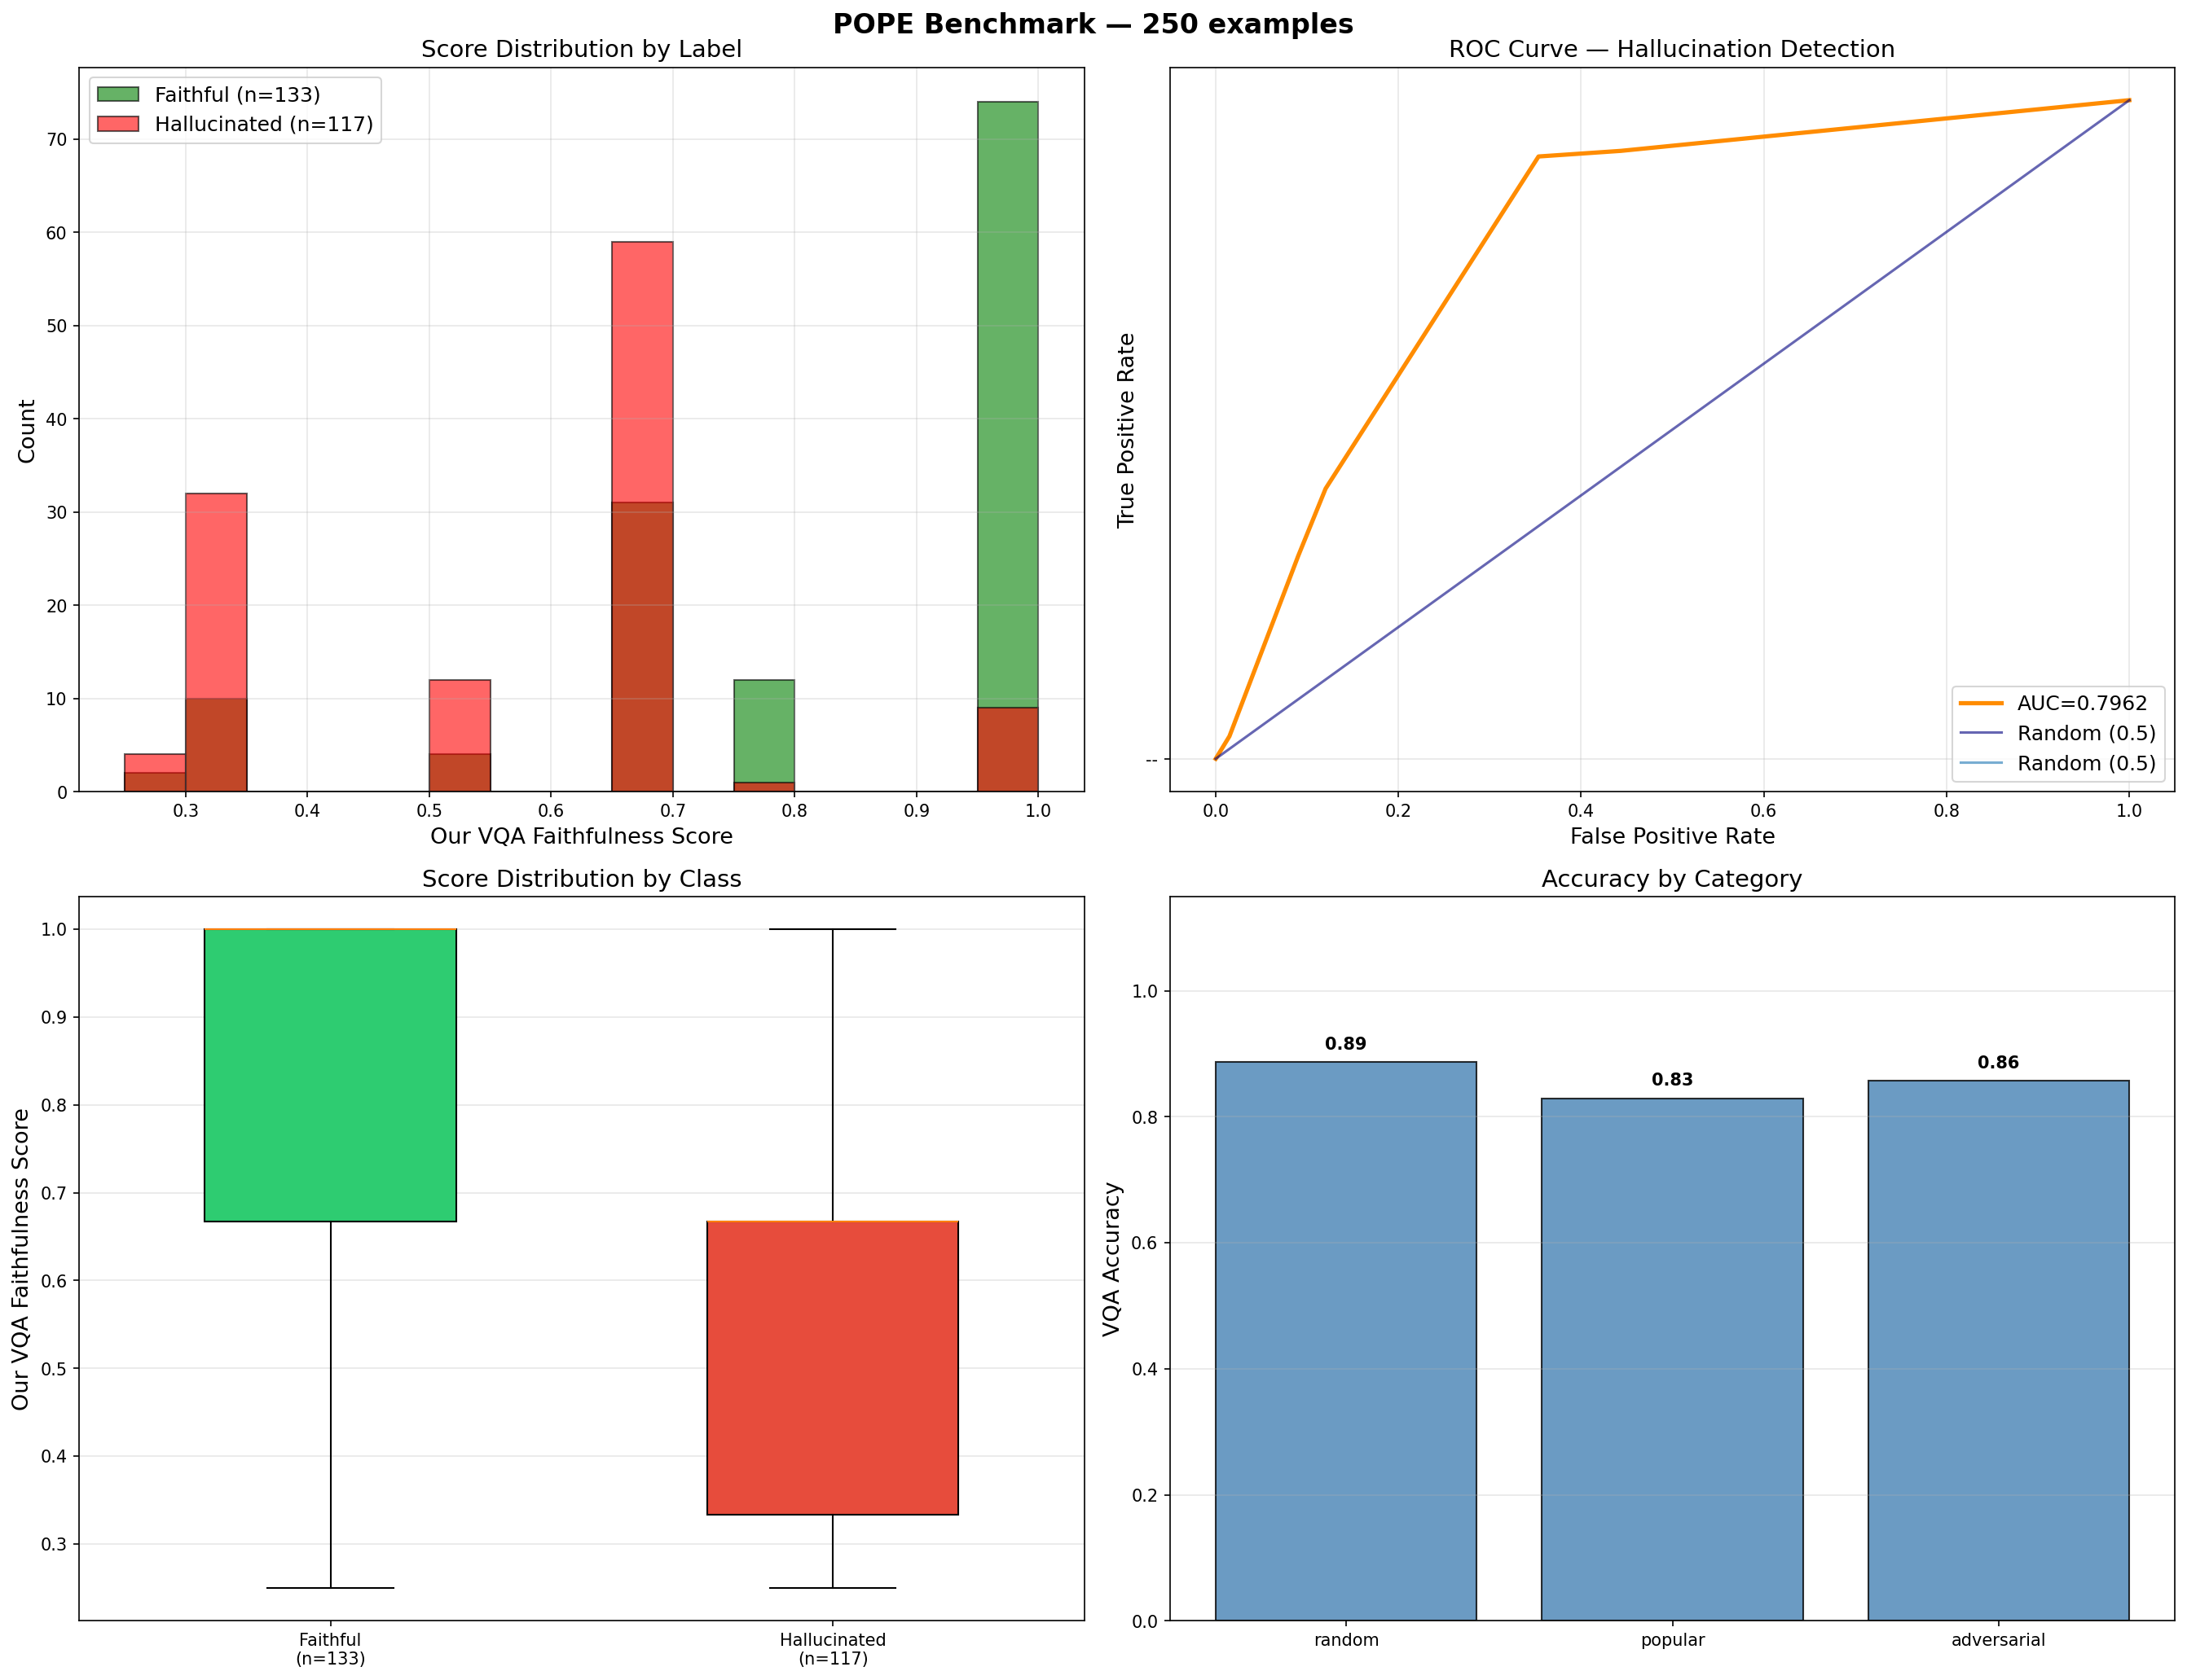

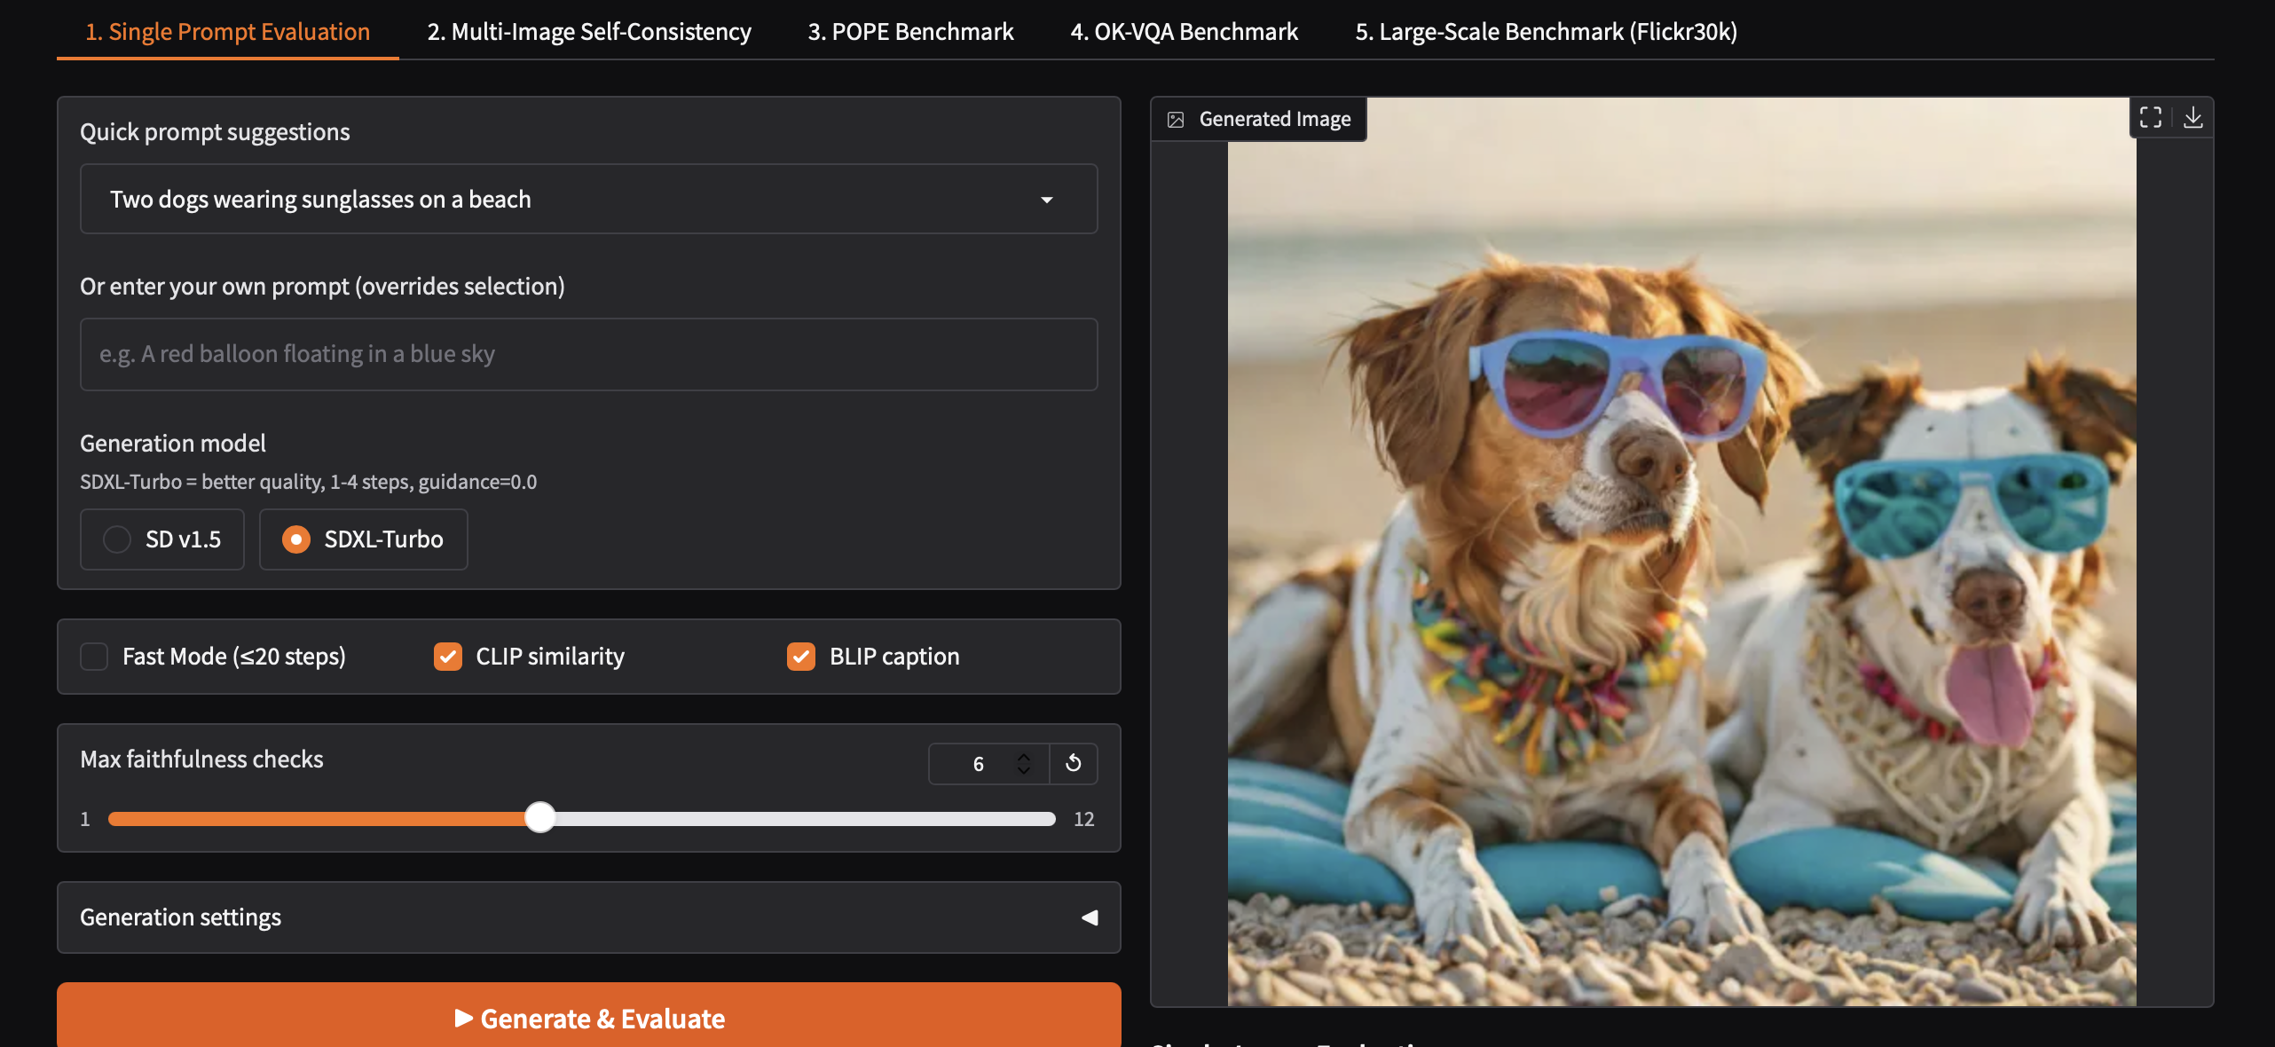
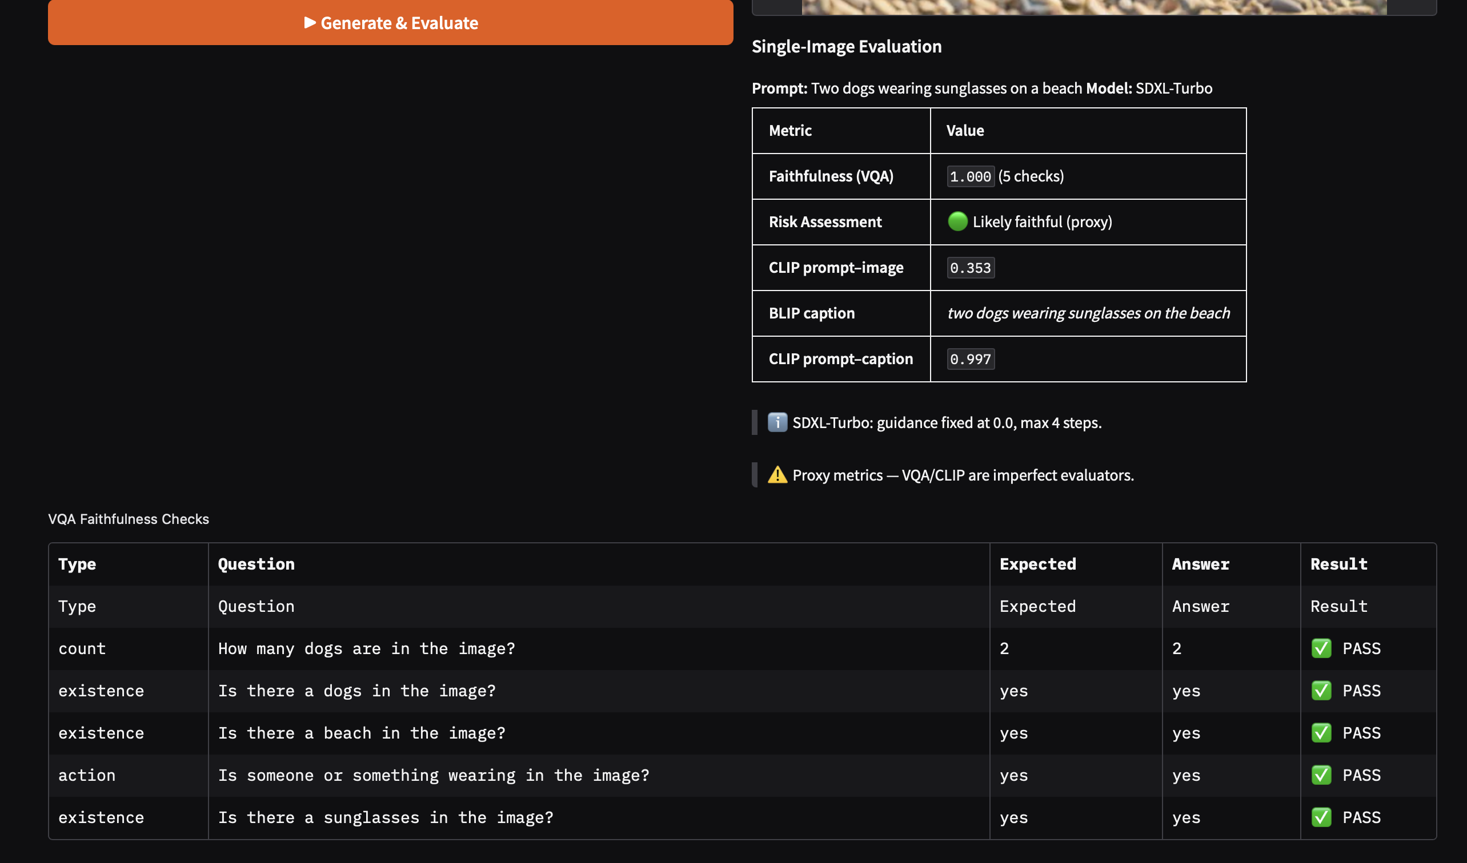
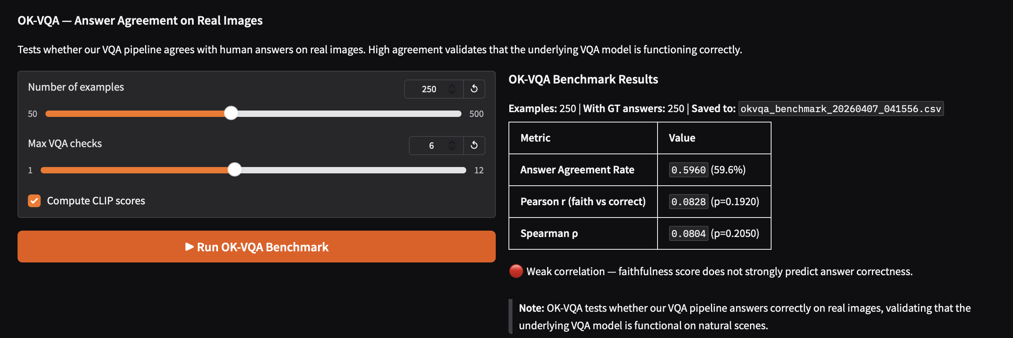
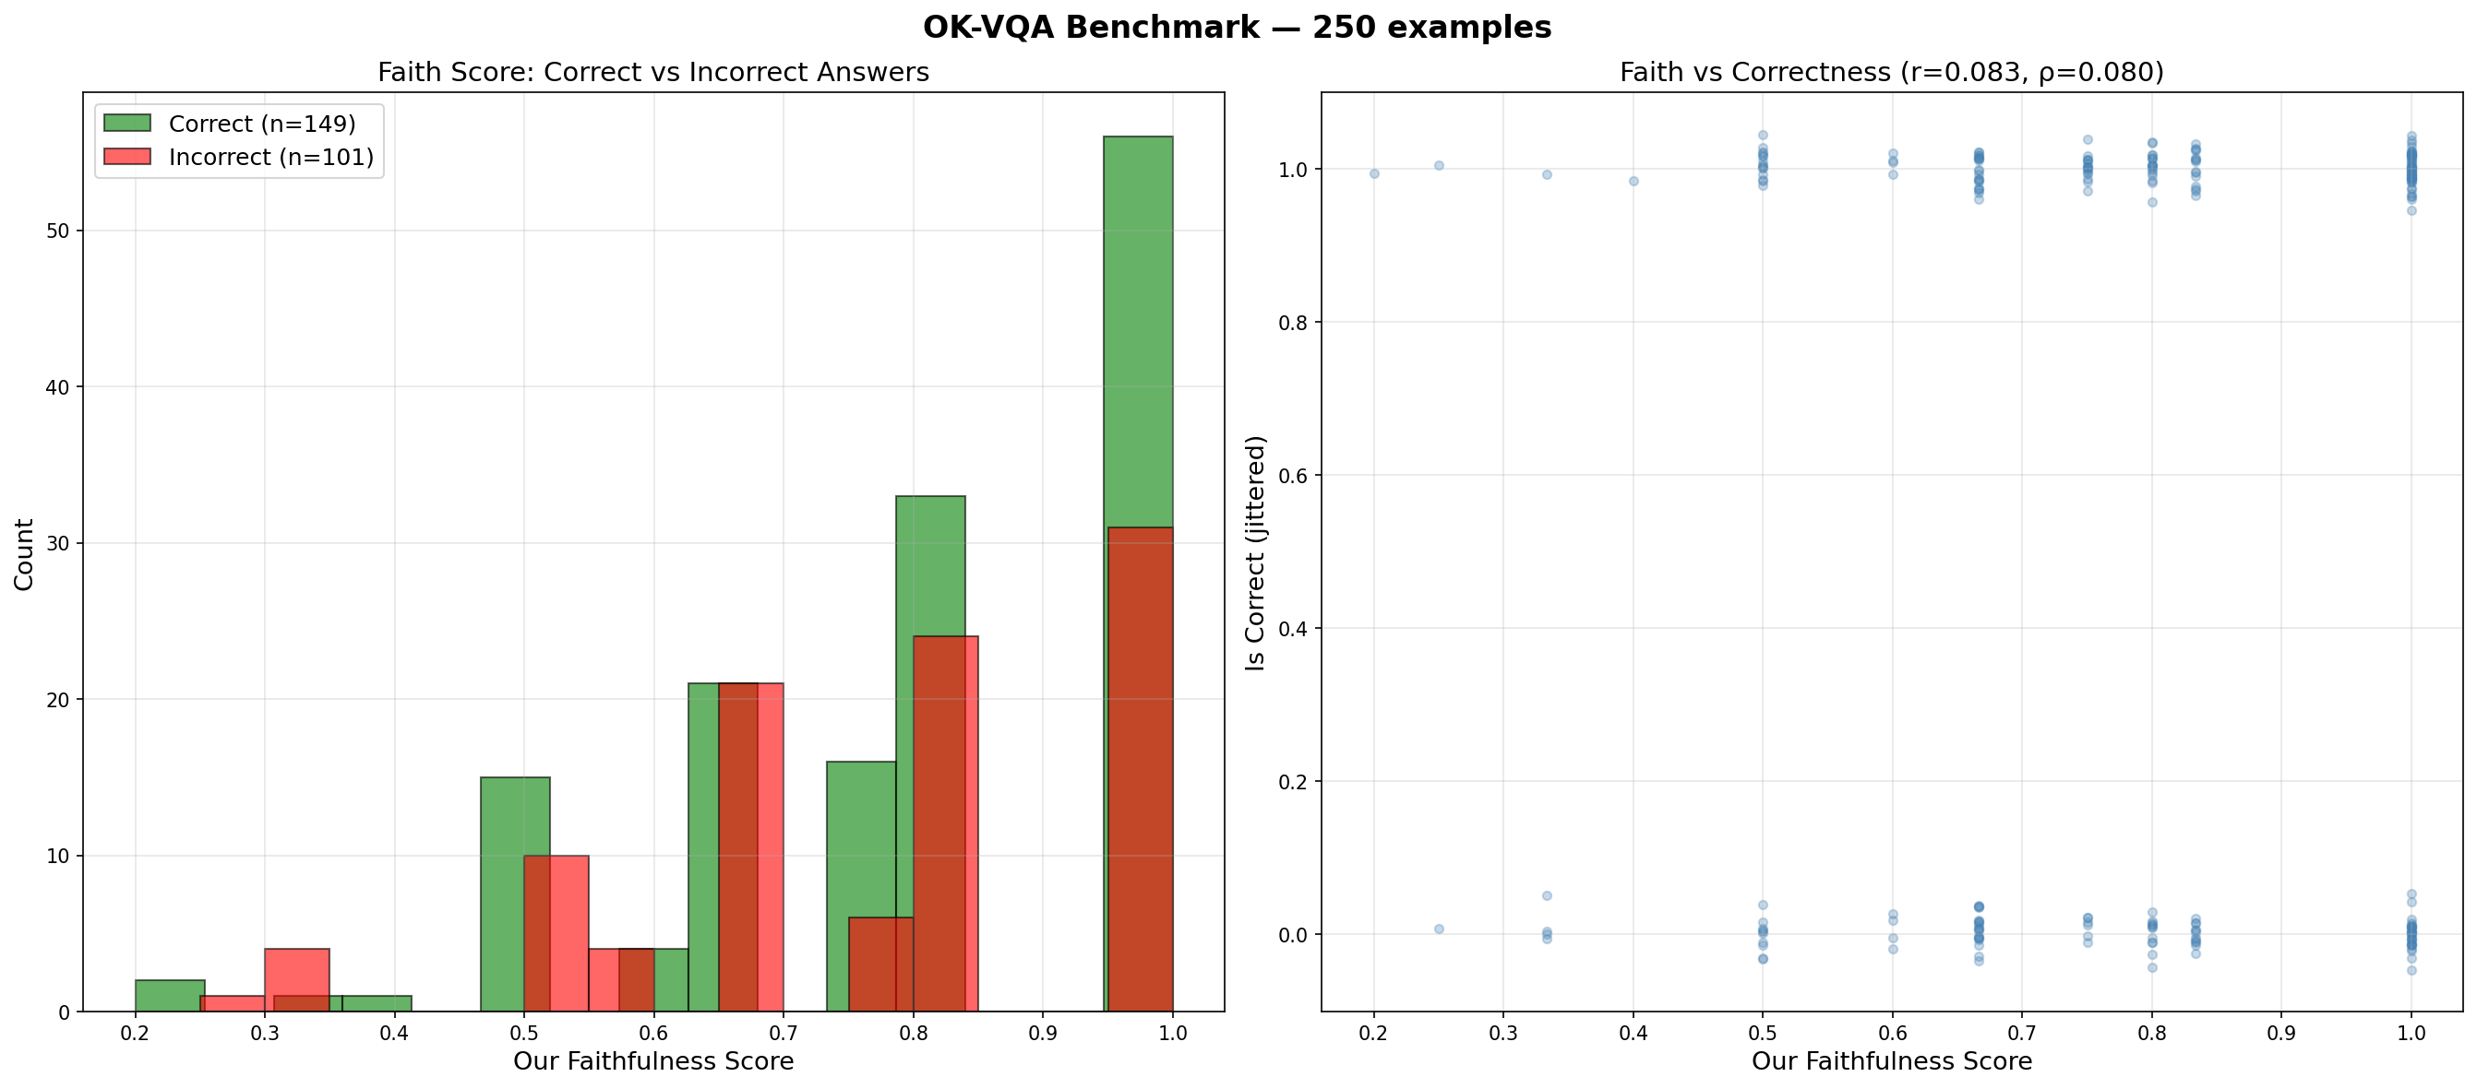
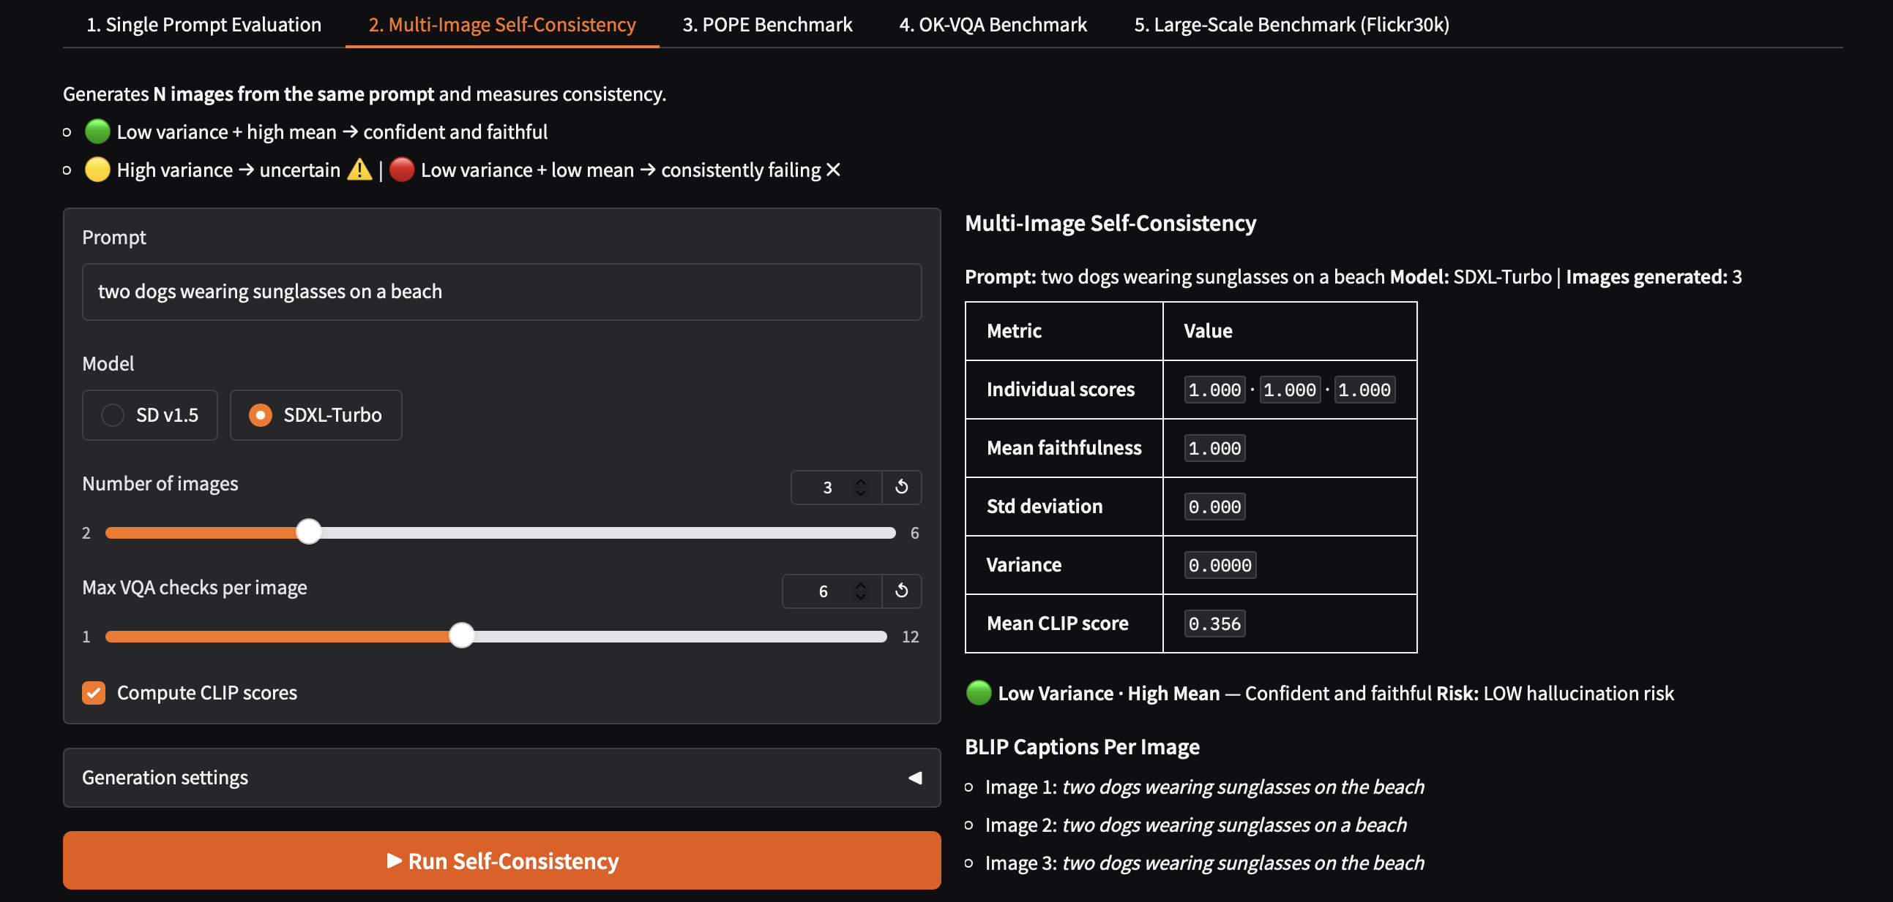
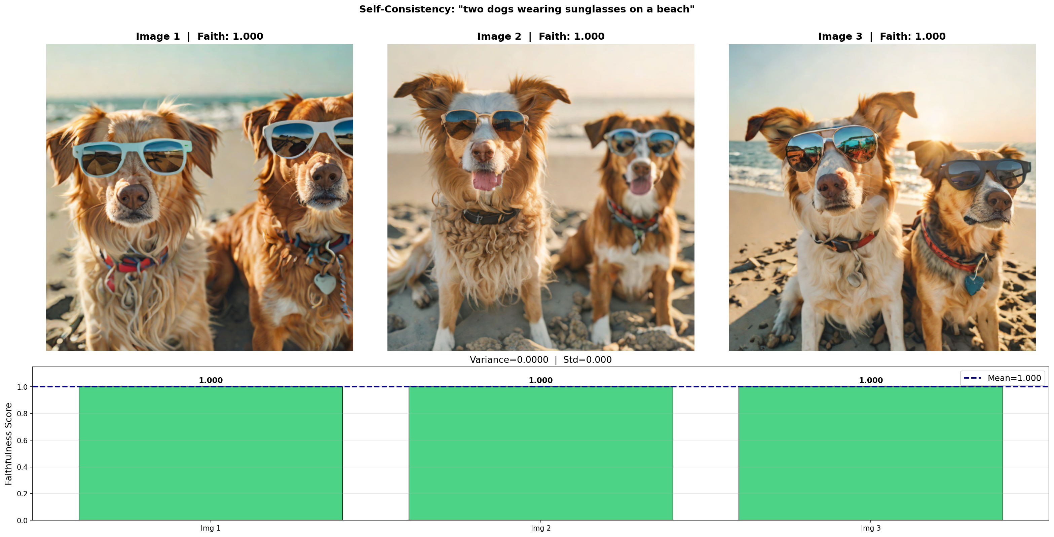
Faithfulness-Based Evaluation for Detecting Hallucinations in Text-to-Image Generation
Praneeth Vempati
pvempati@ufl.edu
Introduction
Methods
Discussion
Text-to-image models generate photo-realistic images but frequently violate prompt semantics — producing wrong colors, missing objects, or broken spatial relations. These semantic failures are called visual hallucinations. Human evaluation does not scale, and no standardized automated solution exists.
This work builds a training-free, model-agnostic faithfulness evaluation pipeline that automatically detects hallucinations by decomposing prompts into verifiable visual claims and checking them against the generated image using VQA.
Generated images using Stable Diffusion v1.5 / SDXL-Turbo
Parsed prompts into atomic checks — objects, colors, counts, spatial relations, actions
Verified each check using BLIP-VQA → computed faithfulness score (0–1)
Computed CLIP prompt–image semantic similarity as a secondary signal
Validated metric on Flickr30k ground-truth pairs (GT vs Generated)
Evaluated against POPE binary hallucination labels and OK-VQA answer agreement
Measured self-consistency by generating N images per prompt and computing score variance
The faithfulness metric captures a non-trivial signal — GT images score higher than generated images on average, confirming the metric is non-random
ROC-AUC on POPE benchmark confirms the score has discriminative power for hallucination detection
The modest gap (~0.063) on Flickr30k indicates the metric is functional but not yet decisive — prompt parsing and VQA reliability remain the primary bottlenecks
Self-consistency variance across N generations provides a complementary uncertainty signal beyond single-image scoring
Future work: LLM-based question generation (TIFA-style), stronger VQA model (BLIP-2), failure case taxonomy
Data
References
Flickr30k — 1,500+ real caption–image pairs used for paired GT vs Generated benchmark validation
POPE — 9,000 binary hallucination labels (yes/no object presence) for predictive validity testing
OK-VQA — 9,009 real images with human-annotated answers for VQA agreement validation
Results
Hu et al., TIFA: Text-to-Image Faithfulness Evaluation with QA. ICCV 2023.
Ghosh et al., GenEval: Object-Focused T2I Alignment. NeurIPS 2023.
Radford et al., CLIP: Learning Transferable Visual Models. ICML 2021.
Liu et al., Survey on Hallucination in Vision-Language Models. arXiv 2024.
Results

