Slide 1
UNIVERSITY OF FLORIDA · MID-PROJECT REVIEW
Faithfulness-Based Evaluation for Detecting Hallucinations in Text-to-Image Generation
Praneeth Vempati | pvempati@ufl.edu
Mid-Project Review · Hallucination Evaluation in Generative Vision Models
Notes:
Hi, I'm Praneeth Vempati, and this is my mid-project review presentation.
My project sits at the intersection of generative AI and evaluation methodology. The core question I'm trying to answer is: when a text-to-image model generates an image, how do we know if it actually captured what the prompt asked for? That failure — where the image looks realistic but misrepresents the prompt — is what I'm calling a visual hallucination, and my work is about building an automated system to detect it.
In this presentation I'll walk you through the problem, what I originally planned to build, how and why that evolved, what I've built so far, preliminary results, and where I'm heading next.

Slide 2
MOTIVATION
The Problem
▸ Text-to-image models generate photo-realistic images
KEY GAP
▸ But they frequently violate prompt semantics
Models are stochastic — they produce
▸ Wrong colors, missing objects, broken spatial relations
different outputs every run.
▸ These semantic failures are called visual hallucinations
Yet most evaluations inspect only ONE
▸ Human evaluation doesn't scale — automation is needed
image and ignore consistency entirely.
Example
Prompt: "a red cat on a blue chair" Model output: brown cat · green sofa
Notes:
Let me start with the problem.
Text-to-image diffusion models — like Stable Diffusion — are remarkable. They can generate images that are visually indistinguishable from photographs. But there's a catch: they regularly get the semantics wrong. You ask for a red cat on a blue chair and you might get a brown cat on a green sofa. The image looks perfectly fine, but it doesn't match the prompt.
These are visual hallucinations — and the reason they're hard to catch automatically is that we usually don't have a ground-truth image to compare against. Human evaluation is accurate but doesn't scale. And almost all existing automatic metrics only look at one generated image, ignoring the fact that these models are stochastic — they'll give you a different output every single time you run them. That stochasticity is actually a signal we can exploit, and that's the key insight driving this project.

Slide 3
ORIGINAL PROPOSAL
What I Originally Planned
CORE IDEA
ADVANTAGES
If a model is uncertain about a prompt,
✦ Training-free
its multiple generations will disagree.
✦ Model-agnostic
Disagreement = uncertainty = hallucination signal.
✦ No ground-truth images required
✦ Scales to any diffusion model
Approach
✦ Interpretable uncertainty scores
▸ Generate N images per prompt
▸ Measure semantic agreement via CLIP embeddings
▸ Treat inter-sample disagreement as uncertainty
▸ Cross-reference with TIFA / GenEval faithfulness checks
Notes:
My original proposal centered on self-consistency as an uncertainty signal.
The intuition is elegant: if a diffusion model truly understands a prompt, it should generate consistent images across multiple runs — same objects, same colors, same composition. But if it's uncertain or confused by a prompt, its outputs will vary wildly. So if I generate, say, five images from the same prompt and measure how much they disagree with each other using CLIP embeddings, that disagreement score becomes a proxy for hallucination likelihood.
The key advantages of this approach are that it requires no training, no labeled data, no ground-truth images. It's purely observational. I was also planning to combine this with structured faithfulness checks inspired by TIFA and GenEval to get a richer evaluation signal.

Slide 4
SCOPE REFINEMENT
What Changed — and Why
Component
Original Plan
Updated Plan
Rationale
Core Idea
Self-consistency across N images
Single-image faithfulness eval
Advisor: establish clear baseline first
Generation
Multiple images per prompt
One image per prompt
Reduces compute, simplifies analysis
Evaluation
Cross-sample agreement
VQA checks + CLIP similarity
More interpretable & validatable
Dataset
Small custom prompt set
Flickr30k benchmark
Grounds scores empirically
Interface
Not defined
Gradio app
Testing, demo & visualization
Notes:
So why did the scope change?
After early implementation work and a conversation with my advisor, it became clear that jumping straight to multi-image self-consistency without a validated per-image evaluator was risky. If my faithfulness metric is noisy, then the variance across images is also noisy — and I'd have no way to distinguish real uncertainty from measurement error.
The recommendation was to first build and validate a robust single-image faithfulness evaluator, and then layer the self-consistency experiments on top of it. That's exactly what I've done. The self-consistency approach is absolutely still coming — it's the planned next phase — but this intermediate step makes the whole system more rigorous.
I also switched from a small custom prompt set to Flickr30k, which gives me real caption-image pairs to benchmark against. And I built a Gradio interface to make the system interactive and demonstrable.

Slide 5
TECHNICAL DESIGN
System Pipeline
Prompt
Image Generation
Prompt Parsing
Structured Checks
BLIP-VQA Verification
Faithfulness Score
→
→
→
→
→
Image Generation
Semantic Similarity
Captioning
VQA Verification
Stable Diffusion v1.5
CLIP
BLIP
BLIP-VQA
512×512 · 20–30 steps Guidance scale 7.5
Prompt–image cosine similarity score
Optional secondary semantic signal
Yes/No claim checks per object & attribute
Implementation Stack
PyTorch · Diffusers · Transformers · Gradio · HuggingFace Datasets · GPU notebook
Notes:
Let me walk through the technical architecture.
The pipeline starts with a text prompt. Stable Diffusion generates a 512×512 image using 20 to 30 diffusion steps and a guidance scale of 7.5. That image then goes through prompt parsing, where I extract structured claims — things like 'is there a man in the image' or 'what color is the shirt.' Those claims are passed to BLIP-VQA, which answers each yes/no or attribute question by looking at the image. The fraction of checks that pass becomes the faithfulness score.
Running in parallel, CLIP gives a coarser but complementary score by measuring the cosine similarity between the prompt embedding and the image embedding. And optionally, BLIP can generate a caption for the image, which I then compare back to the original prompt as a third signal.
The whole system runs on PyTorch with Hugging Face's Diffusers and Transformers libraries, inside a GPU-enabled notebook.

Slide 6
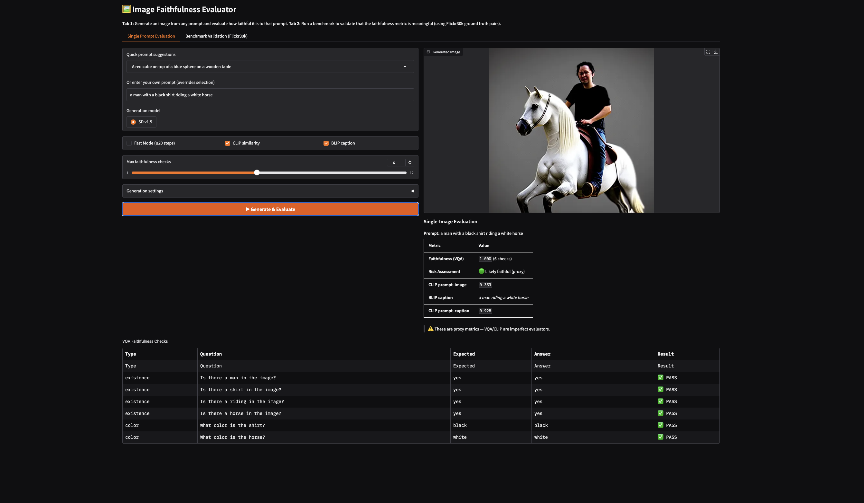
IMPLEMENTATION
What Has Been Built
✅ Stable Diffusion text-to-image generation
✅ Heuristic prompt parser (objects, colors, attributes)
✅ BLIP-VQA claim verification module
✅ CLIP prompt–image semantic similarity
✅ BLIP captioning + prompt–caption comparison
✅ Interactive Gradio evaluation interface
✅ Benchmark validation pipeline on Flickr30k
Fig 1. Single-prompt evaluation interface — generated image, metric summary, and per-check VQA pass/fail table.
Notes:
Here's everything that's been implemented and working.
The screenshot on the right is the live Gradio interface for single-prompt evaluation. In this example, I typed 'a man with a black shirt riding a white horse.' The system generated the image you see, then automatically ran six VQA checks — existence checks for man, shirt, horse, and so on, plus color checks for the shirt being black and the horse being white. Every single check passed, giving a faithfulness score of 1.0. The CLIP prompt-image similarity came in at 0.353, and BLIP captioned the image as 'a man riding a white horse,' which matched the prompt well.
This interface is really useful for building intuition about when the evaluator works and when it doesn't — and I've used it extensively for debugging.

Slide 7
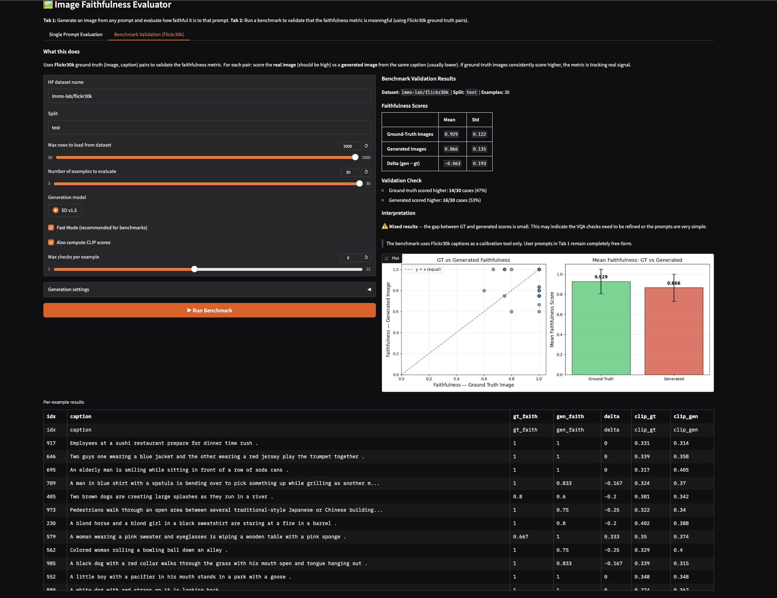
BENCHMARK PIPELINE
Benchmark Validation — Flickr30k
For each caption in Flickr30k, the evaluator scores BOTH the real image AND a Stable Diffusion image generated from the same caption. A valid metric should consistently score real images higher.
Fig 2. Benchmark validation tab — dataset controls, aggregate statistics table, and per-example results.
Notes:
The second major component is the benchmark validation pipeline.
The idea here is straightforward: if my faithfulness metric is measuring something real, it should score real photographs higher than AI-generated images for the same caption. So I take Flickr30k caption-image pairs, run my evaluator on the real image, then generate a new image from that same caption using Stable Diffusion and run the evaluator again.
This screenshot shows the full benchmark interface. On the left are the controls — you can set which dataset to use, how many examples to evaluate, and which generation model to use. On the right you get an aggregate statistics table showing mean and standard deviation for ground-truth images versus generated images, a validation check showing how often each condition won, and the scatter and bar plots I'll show on the next slides. Below that is a per-example results table with every caption, its faithfulness scores, and CLIP scores.

Slide 8
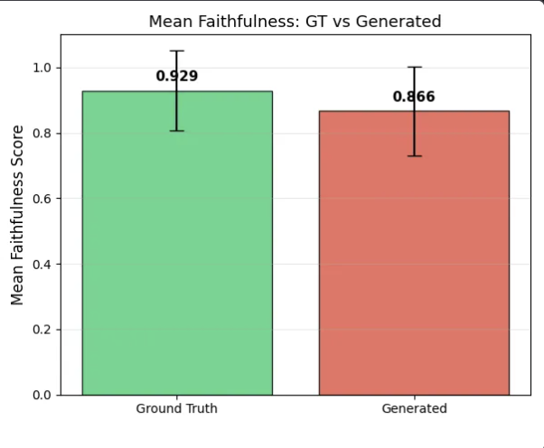
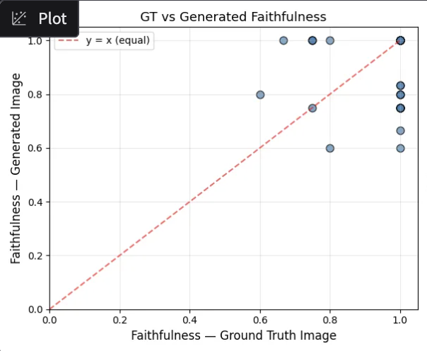
PRELIMINARY RESULTS
Benchmark Results on Flickr30k
Ground-Truth Images
Generated Images
Delta (GT − Gen)
0.929
0.866
+0.063
Fig 3. Mean faithfulness scores with std dev error bars.
Fig 4. Per-example GT vs Generated faithfulness. Points below diagonal = real image scored higher.
Notes:
Now let's look at the results.
Running the benchmark on 30 Flickr30k examples, ground-truth images scored a mean faithfulness of 0.929, while generated images scored 0.866 — a delta of about 0.063. The bar chart on the left shows this gap clearly with standard deviation error bars.
The scatter plot on the right is where things get interesting. If the evaluator were perfect, every single point would fall below the red diagonal line — meaning the real image always outscores the generated one. What we actually see is mixed behavior. Many points are below the line, which is good. But some generated images score at parity with, or even above, their real counterparts. There's also a cluster of points at the top-right corner where both images scored 1.0 — a ceiling effect caused by very simple captions where VQA checks are easy to pass for any reasonable image.
So the honest interpretation is: the metric captures a real signal, but it's not yet strong enough to be a reliable hallucination detector on its own.

Slide 9
ANALYSIS
Interpretation & Limitations
What the results tell us
✦ Metric is non-random — GT images score higher on average
✦ Signal is real but modest — gap of ~0.063 is not yet decisive
✦ Ceiling effect at score = 1.0 suggests checks are too easy
Prompt Parser
VQA Reliability
Compute Cost
Only extracts objects & colors
BLIP-VQA errors propagate
Repeated generation +
Misses spatial relations,
into faithfulness scores
VQA inference is slow
counts, complex scenes
Hard to separate from hallucination
Limits iteration speed
Notes:
Let me be honest about what these results mean and where the system falls short.
On the positive side, the metric is demonstrably non-random. Ground-truth images score higher on average, which validates the basic approach. But three concrete limitations are holding back stronger performance.
First, the prompt parser is too simple. It only extracts existence and color checks. It completely misses spatial relationships — like 'the dog is to the left of the cat' — counting constraints, and more abstract descriptors. These are precisely the kinds of claims most likely to hallucinate.
Second, BLIP-VQA is not a perfect oracle. When it makes an error, that error propagates directly into the faithfulness score. So some of the noise in my results comes from the evaluator itself, not the generated image.
Third, scale is a constraint. Generating images and running VQA over hundreds of examples is slow, which limits how quickly I can experiment and iterate.

Slide 10
NEXT PHASE
Self-Consistency as Uncertainty Signal
The original multi-image self-consistency idea is the planned next phase, now built on a validated per-image baseline.
Prompt
Generate N images
Per-image Faithfulness
Score Variance
Uncertainty Signal
→
→
→
→
N = 3–5 images per prompt · variance across faithfulness scores = uncertainty proxy
Low Variance · High Mean
High Variance
Low Variance · Low Mean
Model is confident & faithful
Model is uncertain about the prompt
Model consistently fails checks
Consistent, prompt-matching outputs
Outputs are inconsistent
Systematic, not stochastic failure
→ LOW hallucination risk
→ HIGH hallucination risk ⚠
→ DEFINITE hallucination ✗
Notes:
This brings me back to the original vision — and the most exciting part of what's coming next.
Now that I have a working per-image faithfulness evaluator, I can implement the self-consistency experiments I originally proposed. The idea is: generate N images — I'm planning 3 to 5 — from the same prompt, compute a faithfulness score for each one, and then look at the variance of those scores.
Three outcomes are possible. If variance is low and the mean score is high, the model is confident and consistently faithful — low hallucination risk. If variance is high, the model is uncertain — it sometimes gets the prompt right and sometimes doesn't — which is a red flag. And if variance is low but the mean is also low, the model is systematically failing the checks, which points to a definitive hallucination rather than random noise.
This framing turns self-consistency from a qualitative intuition into a quantitative, measurable signal — which is exactly what I set out to do.

Slide 11
ROADMAP
Next Steps & Timeline
Week 1
Larger Flickr30k benchmark runs
Expand to 1000+ examples, collect richer statistics
Week 2
Score distribution analysis
Additional plots, confidence intervals, failure categorisation
Week 3
Improved prompt parsing
Add spatial relation, count, and attribute checks
Week 4
Failure case analysis
Systematic review of cases where metric disagrees with human judgment
Week 5
Self-consistency experiments
Multi-image generation, variance scoring, uncertainty signal validation
Week 6
Final report & presentation
Consolidate all results, write up, rehearse
Notes:
Here's the plan for the remaining six weeks.
Week one is about scale — running the benchmark on over a thousand Flickr30k examples to get statistically meaningful results. Week two is analysis — proper score distributions, confidence intervals, and failure categorisation. Week three is the parser upgrade — adding spatial relation checks, counting, and richer attribute extraction to make the VQA checks harder to trivially pass. Week four is failure case analysis — carefully looking at the examples where my metric disagrees with what a human would say, to understand where and why it breaks. Week five is the big one — implementing the self-consistency multi-image experiments. And week six is final report and presentation preparation.
The project is on track, the foundation is solid, and the most interesting experiments are ahead.

Slide 12
SUMMARY
Where Things Stand
✅ DONE
🔧 IN PROGRESS
🔜 PLANNED
End-to-end faithfulness pipeline
Larger benchmark experiments
Self-consistency experiments
BLIP-VQA + CLIP evaluation
Parser improvements
Uncertainty score analysis
Interactive Gradio interface
Failure case documentation
Combined faithfulness +
Flickr30k benchmark validation
consistency framework
Preliminary results collected
Final report & presentation
The faithfulness baseline is validated and working. Self-consistency experiments are the immediate next milestone.
Notes:
To close — let me give you a clear picture of where things stand.
On the done side: I have a fully working end-to-end faithfulness evaluation system, validated on Flickr30k, with an interactive interface and preliminary results showing the metric captures a real signal.
In progress: scaling up the experiments, improving the parser, and documenting failure cases.
Planned: the self-consistency multi-image experiments that were always the long-term goal of this project, followed by combining both signals into a unified hallucination evaluation framework.
The foundation is solid. The most interesting experiments are ahead. Thank you — I'm happy to take any questions.

