Slide 1

Structured MVC Framework
Siddique Hameed
April 18, 2013

Slide 2
Highlights...
Synchronized Model-View-Controller (MVC)
Directive/Declarative based
Out-of-box client-side HTML templating
Extends HTML vocabulary by adding more syntax & semantics (tags, attributes, classnames, comments etc.)
Dependency Injection (DI). Do not get confused by AMD or require.js script file lazy loading. They both can exist side-by-side.
Designed with CRUD/RESTful apps in mind.
Glories of TDD with all the bells & whistles!
Powerful two-way/bidirectional data binding (demo on this will come shortly...)

Slide 3
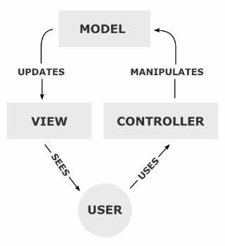
Traditional MVC...
Source: http://en.wikipedia.org/wiki/Model-view-controller
Dependency hierarchy
...
The View however, knows about the Model. It will poll the Model about the state, to know what to display. That way, the View can display something that is based on what the Model has done. But the View knows nothing about the Controller.
...

Slide 4
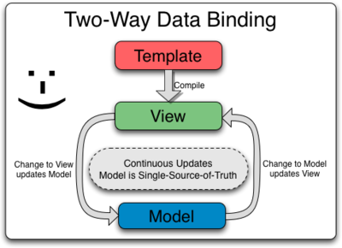
MVC in AngularJS
Transforms static DOM to dynamic DOM
Compiles directives & produce linking functions hence making the DOM live view of the model & vice-versa.

Slide 5
Some Key Concepts...
Directives are ways to...
enhance HTML syntax/semantics. For ex. <book isbn=""/>, <screenshot url=""/>
Transform HTML markup to Domain Specific Language (DSL)
Build reusable widgets/components

Slide 6
Model
Represented in JSON data & JS functions
Scopes (scope object) represents application model
function GreetingController($scope) {
$scope.greetings = 'Hello';
$scope.user = {firstName:'John',lastName:'Doe'};
$scope.reverseGreetings = function (){
return $scope.greetings.split('').reverse().join('');
};
}
<div>{{greetings}} {{user.firstName}}, {{user.lastName}}!</div>

Slide 7
View
This is what the user sees and responds to
Dynamic DOM or live view generated after compiling directives & applying templates, filters etc.
Manages event handlers & delegates to controller & model internally(No more event handlers/callback recursions or chaining!)

Slide 8
Controller
Think of as starting point connecting Model & View
Initializes state of Scope
Adds behavior to the scope object
Invoke services to perform reusable or externalized operations

Slide 9
Services
Borrowed phrase from server-side technology
Encapsulated object for commonly performed operations
Wired up using DI injection
Not necessarily used only for client/server interactions or async operations
Examples include $http, $q, $window, $timeout etc.

Slide 10
Filters
Helps formatting data
Can also be used to limit or control what is displayed like in pagination etc.
Unix lovers pipe(|) expression to chain filter calls
Examples
{{amount | currency:"USD$"}}
myArray | orderBy:'timestamp':true | limitTo:10

Slide 11
Routing
Used for routing to multiple views (or Template files)
Provides deep-linking URLs
Example
$routeProvider.when('/questions', {templateUrl: 'templates/questions.html', controller: QuestionsController});
$routeProvider.when('/questions/:questionNo', {templateUrl:'templates/questions.html', controller:QuestionsController});
$routeProvider.when('/results', {templateUrl:'templates/results.html', controller:ResultsController});

Slide 12
Why Dependency Injection?
function Driver{
driveCar: function () {
}
}
function Car{
drive: function() {
}
}
There are 3 ways Driver can drive the Car
1.) driveCar: function () {
var car = new Car();
car.drive();
}
2) var car = new Car(); //as global or shared state
driveCar: function () {
car.drive();
}
3.) driveCar: function (car) { //dependency injected to the driver
car.drive();
}
depends on

Slide 13
TDD in Angular
TDD in Client side JS is lot harder especially dealing with XHR & browser based components (DOM, document, window etc.)
Strong emphasis on both Unit Testing & E2E (End-to-End testing)
Based on Jasmine BDD
Based on Karma (formerly called Testacular) Test runner
Angular supplied Mock & Test harness classes

Slide 14
Are you sure, it's all good?
Oh no, yet another framework to learn!
Very comprehensive framework, so lot to absorb :(
Poor documentation. But, doesn't seem to be hard to find answers online.
Declarative/directive style may not be everyone's favorite!
No UI widgets/skins/styling. May be its good that way?
Templating doesn't support conditional or iterative expressions
Use of $variables all over within Angular. So, watch for any global variables with $ prefixes

Slide 15
Not suited for...
Game development
Online IDE/content editors
Heavy UI/pixel based operations
Anything involving excess DOM manipulation
Visualization (charts, graphs etc.)
Obviously, we can use other libraries on top or along with Angular.

Slide 16
OK, show me the code!

Slide 17
Q&A

