Slide 1
S4 : Remote Robot Management
Cloud System
Team Tech Titans:
Vasista Prabhakar Mukthinuthalapati (MS/EVC-CE2-XC)
Shaik Reshma (MS/EVC-CE2-XC)
Tejesh Gowd Gollapalli (MS/EVC-CE2-XC)
Durga Praneetha Appana (MS/EBS2-SWC)

Slide 2
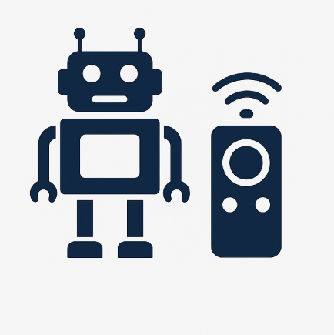
Problem Statement
Mobile Friendly Website with full monitoring of the Robot functions
Remote Robot operations using Tele-operated Driving
Remote updates
Kinematics assessment and path logging
Health parameters logging with cycle counter, battery status
2

Slide 3
Solution Overview
We developed S4 – Remote Robot Management System, a web-based control center that provides:
Real-time telemetry (position, battery, health, speed)
Robot path visualization
Tele-operation controls (Forward, Backward, Right, Left)
Webots virtual robot integration
Mobile-friendly dashboard
Live logs & system events
3

Slide 4
Solution Approach
Built a Webots virtual robot (Python controller)
Developed a Node.js WebSocket backend for bi-directional communication
Built a React + Tailwind frontend for a clean control dashboard
Implemented orientation-based movement (human-like robot motion)
Integrated logs, health, telemetry, and path tracking
Ensured clean UI layout for easy monitoring
4

Slide 5
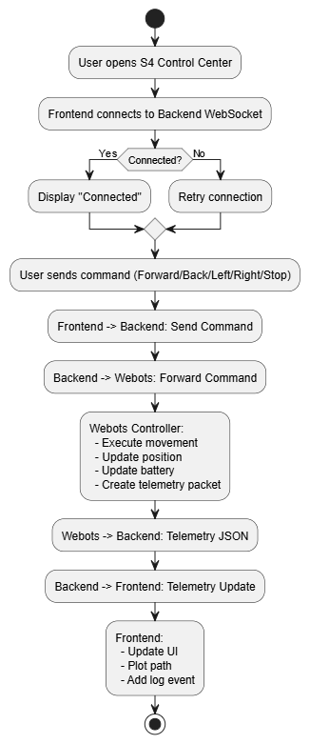
Flow Chart
5

Slide 6
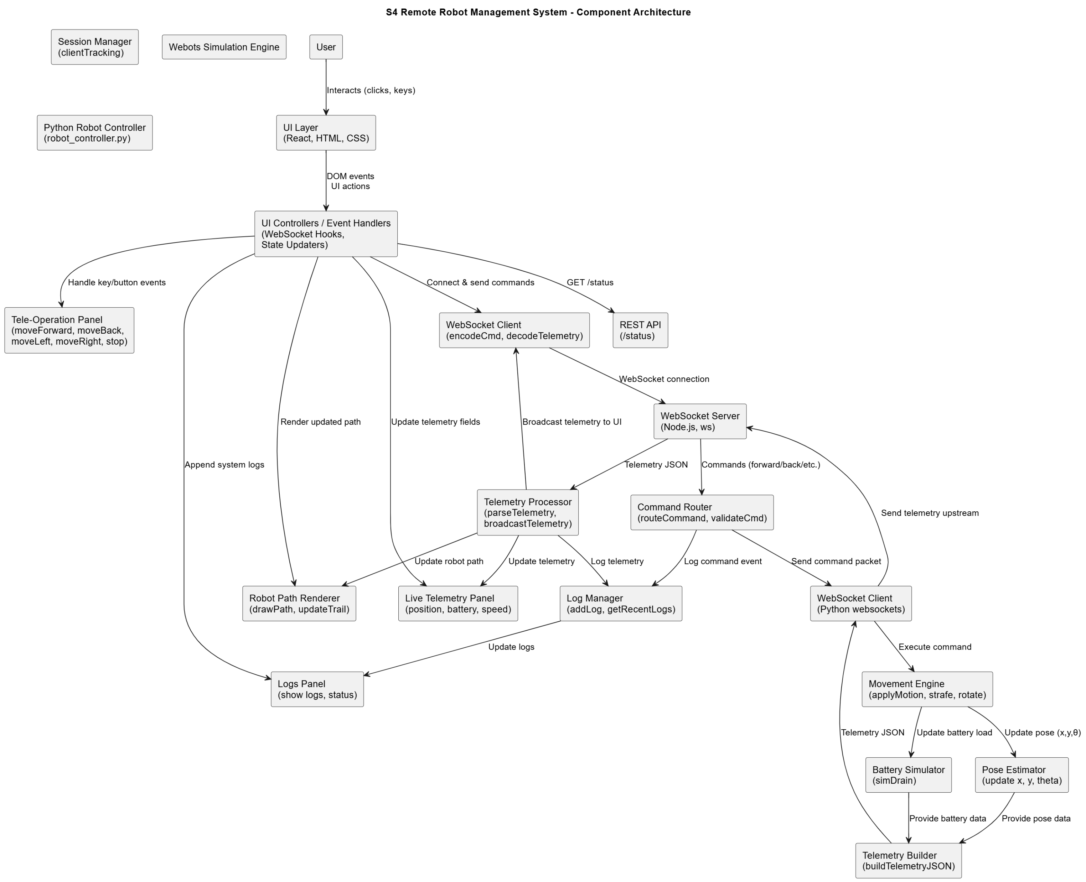
Architecture Diagram
6

Slide 7
Solution Artifacts
Webots Robot Simulation
  TurtleBot3/E-Puck robot
  Custom Python Controller
  Realistic orientation-based motion
Backend System
  Node.js + WebSocket server
  Telemetry + Command routing
  Log management
Frontend Dashboard
  Live Telemetry Panel
  Robot Path Map
  Tele-Operation Controls
  Live Logs Panel
  Mobile-friendly UI
Integration Components
  JSON data schemas
  WebSocket message models
  End-to-end synchronized robot loop
Documentation & Diagrams
  README
  Architecture design
  Flowchart (PUML)
  System explanation
7

Slide 8
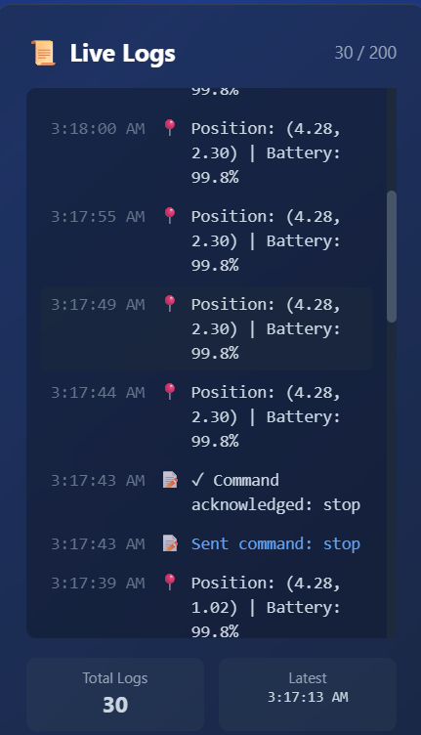
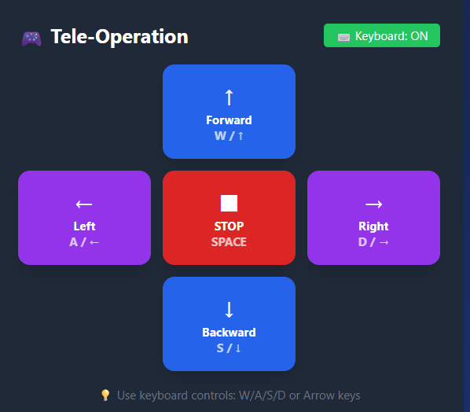
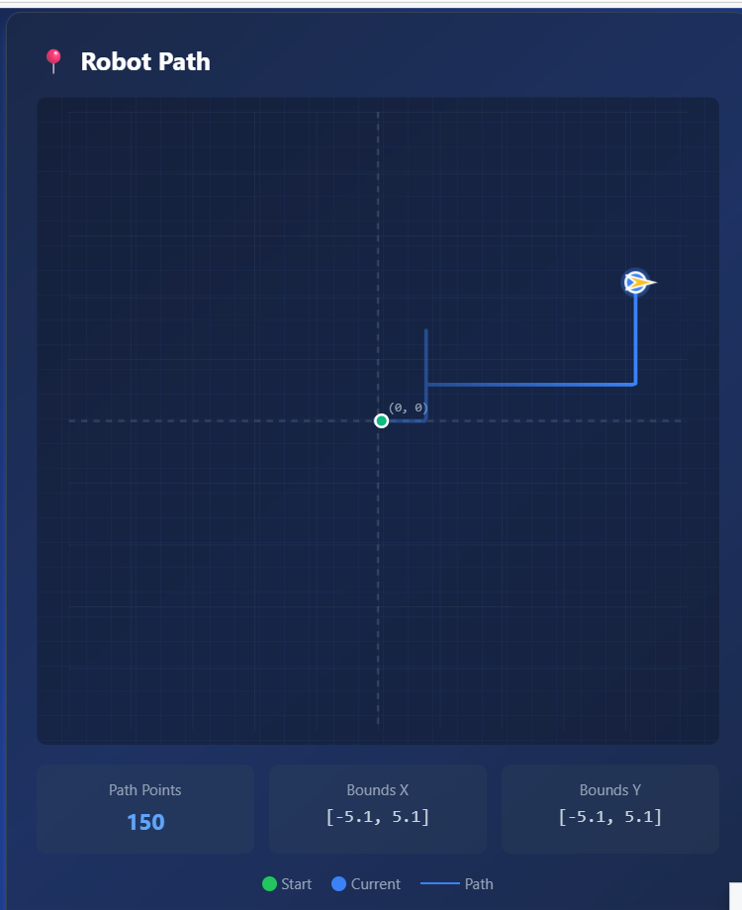
Implementation Results
8

Slide 9
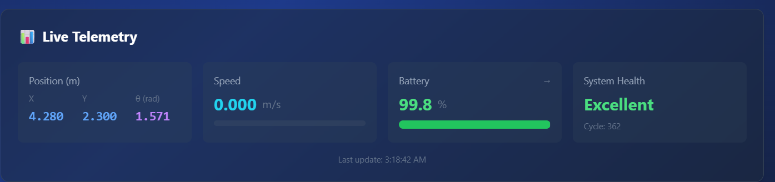
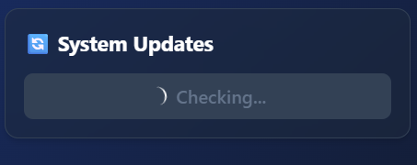
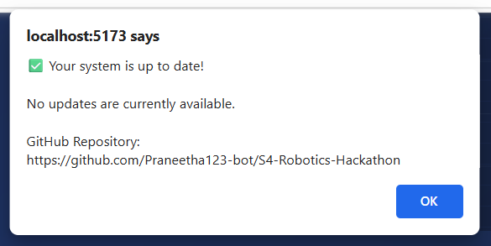
Implementation Results
9

Slide 10
Challenges Faced
Real-time synchronization:
Ensuring Webots → Backend → Frontend updates without lag.
Orientation-based movement:
Converting world-axis movement to realistic robot-local movement.
WebSocket reliability:
Managing dropped connections, reconnection logic, and message ordering.
Path visualization scaling:
Ensuring robot trail renders accurately on varying UI sizes.
Responsive UI:
Making complex telemetry panels mobile-friendly.
Testing in simulation:
Simulating sensor data, cycles, and battery drain consistently.
10

Slide 11
THANK YOU
11

