Slide 1
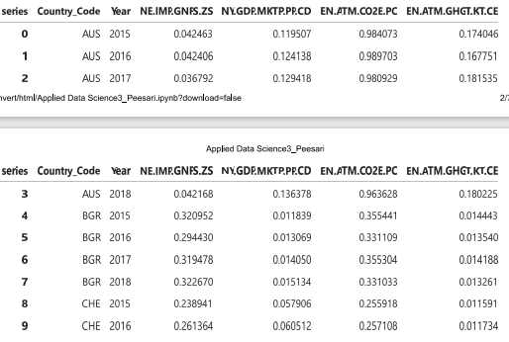
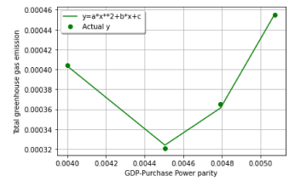
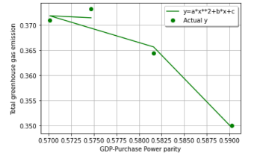
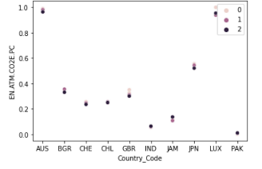
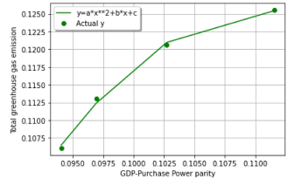
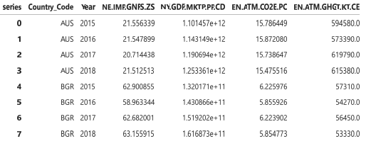
Applied Data Science – Assignment 3
Introduction
Clustering in simple terms can be understood as grouping of similar data that has been gathered for the purpose of further analysis. It depends on the unsupervised machine learning process. It helps in undertaking better comparison (Google Developers, 2022)
Fitting is mainly used for enhancing the accuracy of the data that has been gathered so that the relationship between the elements can be identified. Both these techniques have been used in this research (Data Robot, 2022)
Luxemburg has high carbon dioxide emission; hence curve fit has been implemented for further analysis
Method
Data achieved after normalization of the data set used in this project.
Countries selected includes Japan, Australia, Jamaica, Pakistan, Switzerland, India, Chile, Great Britain, Luxemburg, and Bulgaria.
Indicators selected are as follows:
NE.IMP.GNFS.ZS: Import
NY.GDP.MKTP.PP.CD: GDP, PPP basis
EN.ATM.CO2E.PC: CO2 emissions calculated in metric tons per capita
EN.ATM.GHGT.KT.CE: Greenhouse gas emission
Curve fit function has been implemented for the country Japan which has medium carbon dioxide emission
Curve fit has been used for the country Pakistan which has low carbon dioxide emission
Results
Above image depicts the clustering of all the countries related to carbon dioxide emission. It has highest in the countries Australia and Luxemburg as compared to the other countries selected.
Conclusion
Countries with high carbon dioxide emission reflects an indirect relationship between total greenhouse emission and GDP, PPP but after a certain value of GDP, PPP the relationship becomes direct.
Country with medium carbon dioxide emission reflect direct relationship between indicators of greenhouse emission and GDP, PPP
Countries with low carbon dioxide emission reflect direct relationship between greenhouse emission and GDP, PPP.
References
Data Robot, 2022. Model Fitting. [Online] Available at: https://www.datarobot.com/wiki/fitting/ [Accessed 14 May 2022].
Google Developers, 2022. What is Clustering? [Online] Available at: https://developers.google.com/machine-learning/clustering/overview [Accessed 14 May 2022].
Above image depicts that data that has been achieved after merging the data frames.
,

