Slide 1

SUMMER INTERNSHIP PROJECT REPORT
On
FINLOGIX
(AI-Powered Personal Finance Management System)
DEPARTMENT OF COMPUTER SCIENCE ENGINEERING
Submitted by:
Rajiv Gandhi University of KnowledgeTechnologies - Nuzvid,
1.N.Harshitha [N200776]
2.S.Praneetha Sai [N200529]
3.Vamsitha venkata anu Kusam [N200683]
Eluru, Andhra Pradesh – 521202.

Slide 2
Abstract
FinLogix is a comprehensive, full-stack AI-powered personal finance management system.
It is designed to provide individuals with advanced tools for tracking income,expenses and budgeting behaviour.
With increasing complexity in personal financial planning, many users seek intelligent systems that not only record
transactions but also analyze trends and provide actionable insights.
Modern Tech Stack:
React, Flask, MySQL, Google's Gemini API
Unique Features: User Experience:
Voice memo attachments, real-time updates via WebSockets
Intuitive interface, personalized insights, visual analytics
Admin Dashboard:
System-wide user data and category management
This project exemplifies how AI and real-time computing can be combined to improve user engagement, financial literacy, and personal savings discipline.

Slide 3

Introduction
Motivation for the Work
The motivation behind FinLogix stems from the increasing need for effective personal finance tools that cater to the dynamic lifestyles of users today.
Many individuals face challenges in budgeting, overspending, and saving due to a lack of real-time feedback
Traditional tools like spreadsheets or basic budgeting apps often lack automation, AI assistance, and user-centric design
Real-World Applications
Students: Managing allowances and educational expenses Working Professionals: Tracking monthly budgets
Families: Monitoring household income and bills
Freelancers: Categorizing multiple income sources
Financial Educators: Demonstrating budgeting techniques
NGOs: Maintaining transparent financial logs

Slide 4
Related Works / Existing Systems
Limitations in Existing Systems
Manual Data Entry: Time-consuming and error-prone Lack of Personalized Insights: Generic recommendations
No Voice memos & AI Features: Limited advanced technologies
Feature
Comparison with FinLogix
Existing Tools
FinLogix
Real-time updates AI-based suggestions
Voice memo integration
Limited Absent
Flask-SocketIO
Gemini API
Supported
Not supported
Admin analytics
Minimal
Full dashboard
Customization
Basic
Interactive UI

Slide 5

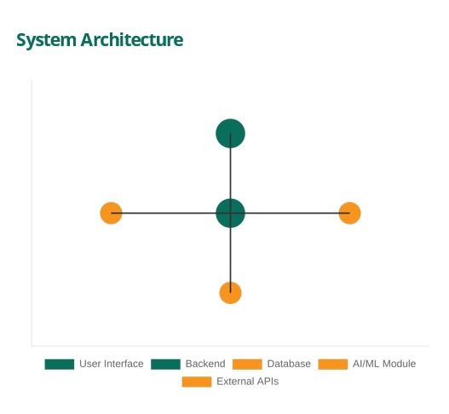
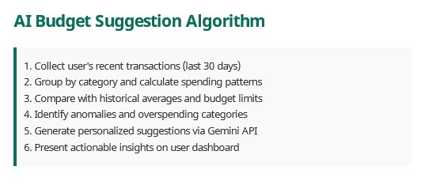
Proposed Method
System Components
User Interface:
React-based dashboard with transaction entry, reports, and visualizations
Backend:
Flask API layer with business logic, authentication, and data processing
AI/ML Module:
Gemini API integration for budget suggestions and spending analysis
Database:
MySQL for secure storage of financial data and user preferences

Slide 6

Experimental Setup
Software Requirements
Frontend Development
Backend Development
React (v18+) TypeScript Tailwind CSS Chart.js
Python 3.10+ Flask Flask-JWT-Extended Flask-SocketIO
SQLAlchemy & MySQL
Platform and Tools
Visual Studio Code Postman for API Testing
Git & GitHub Google Gemini API
Deployment
Railway.app (Database)
Vercel (Frontend)

Slide 7
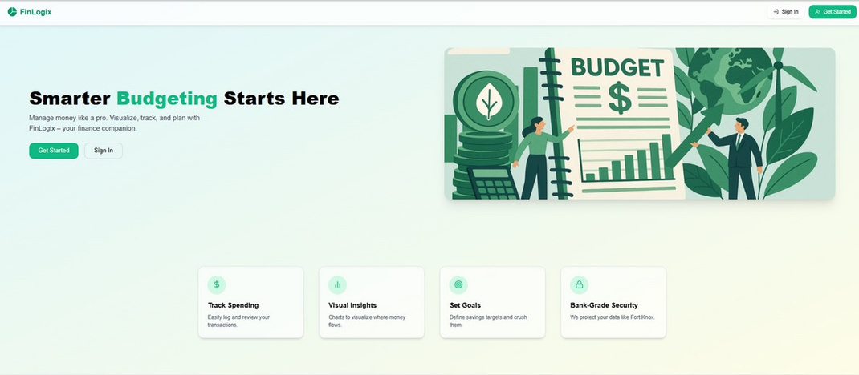
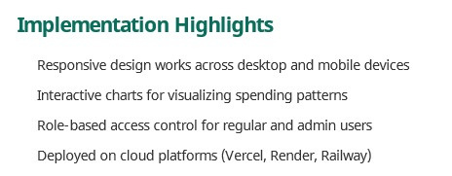
Results and Screenshots
Key Features Implemented
Secure Authentication: JWT-based login system with role management.
Transaction Management: Add, update, and delete financial transactions.
Real-time Updates:
WebSocket integration for instant dashboard refreshes.
AI-driven Insights:
Personalized budget suggestions via Gemini API.
Visualisation of Budget:
Bar graph and pie graph in the customised range or given range.
Voice Memos:
Audio attachments for transaction context

Slide 8
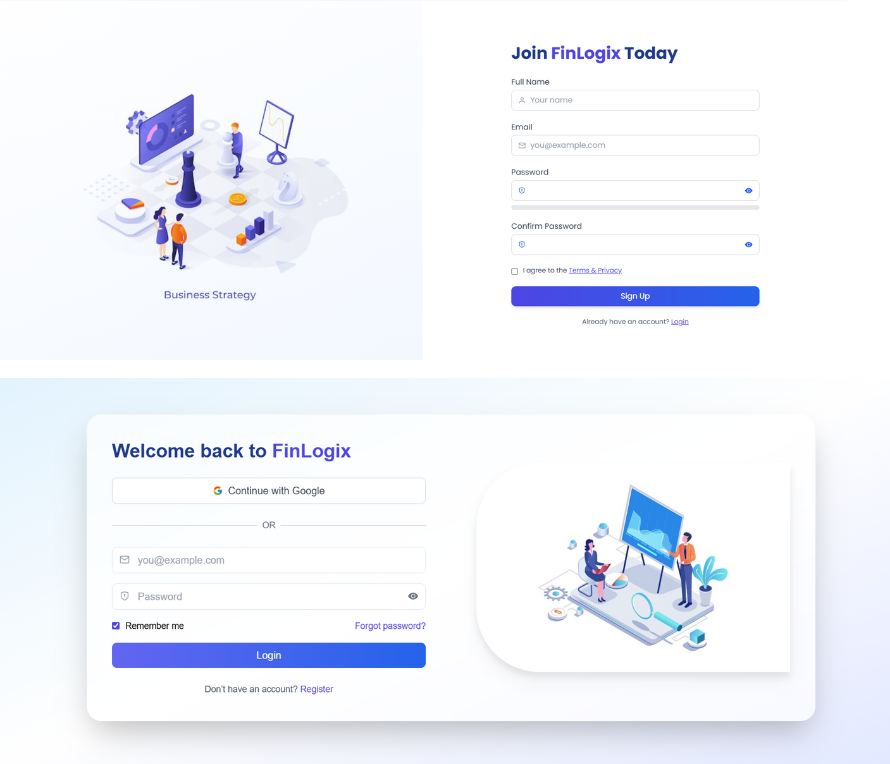

Slide 9
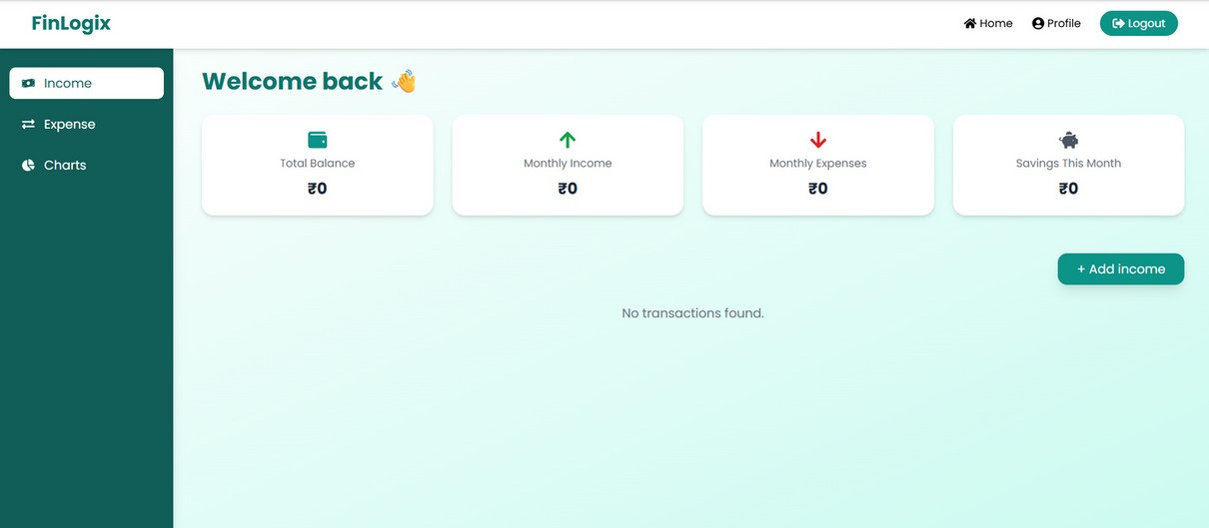
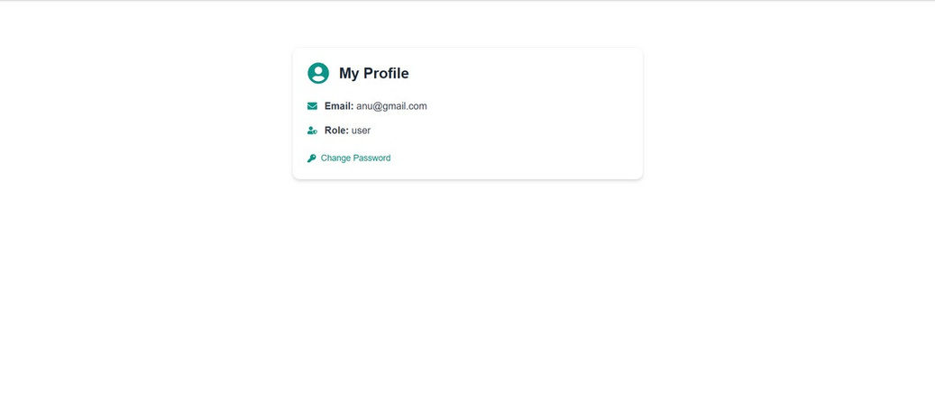
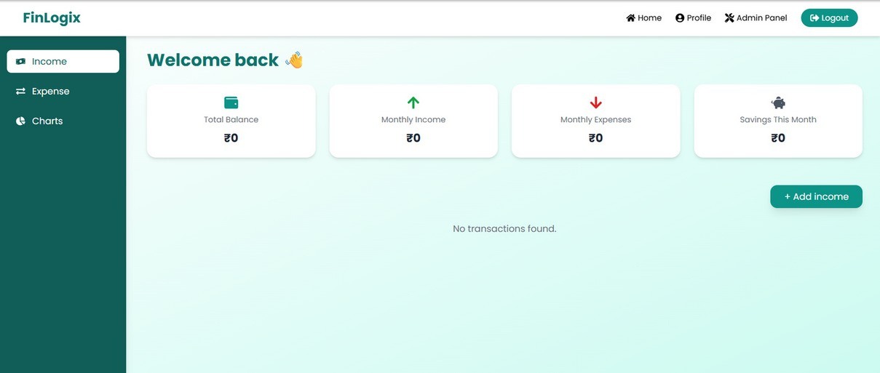


Slide 10
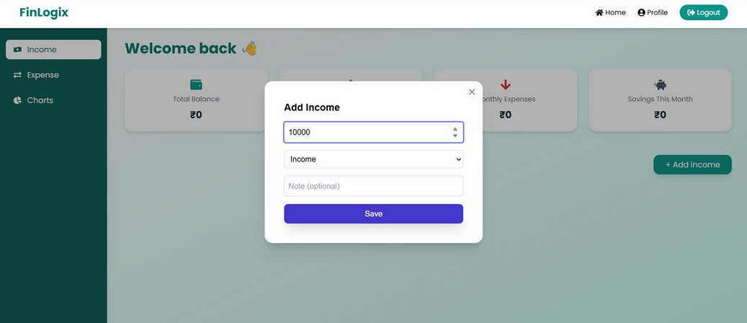
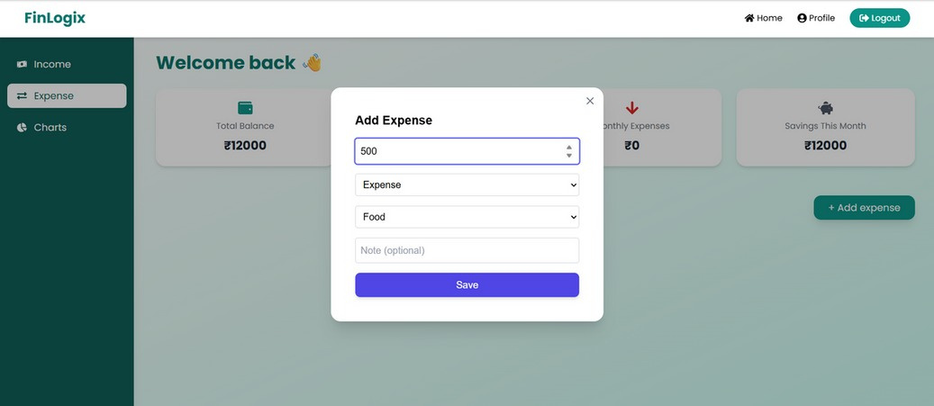
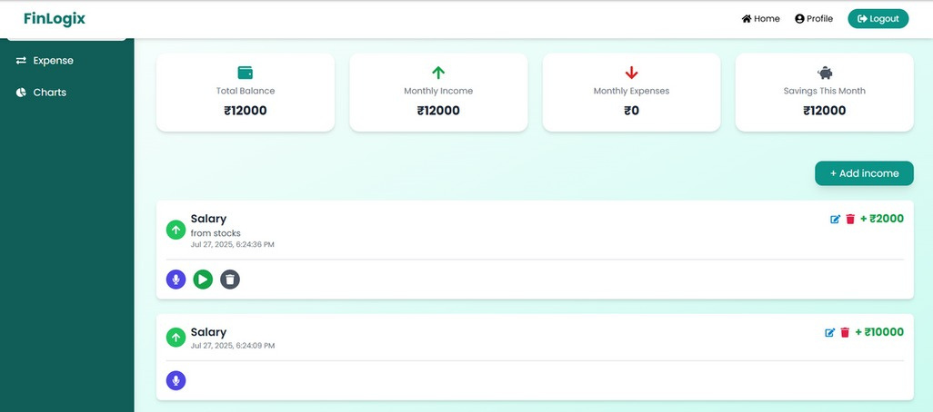
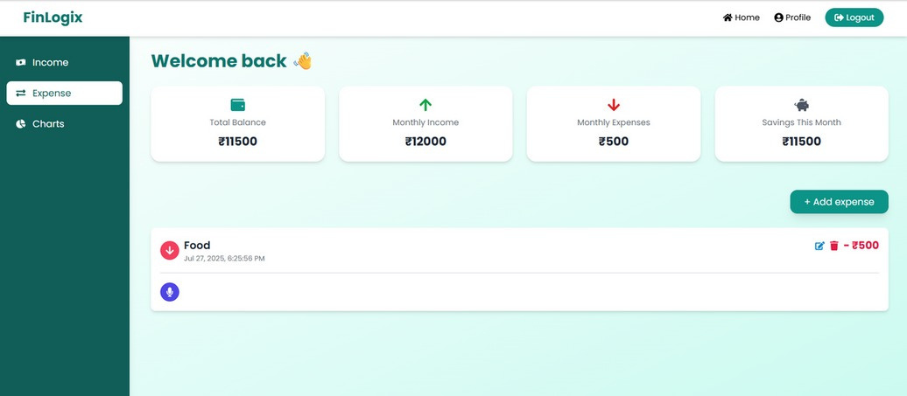

Slide 11
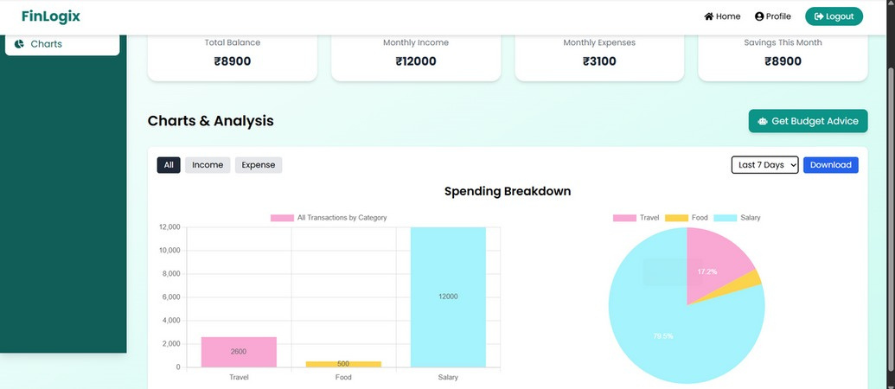
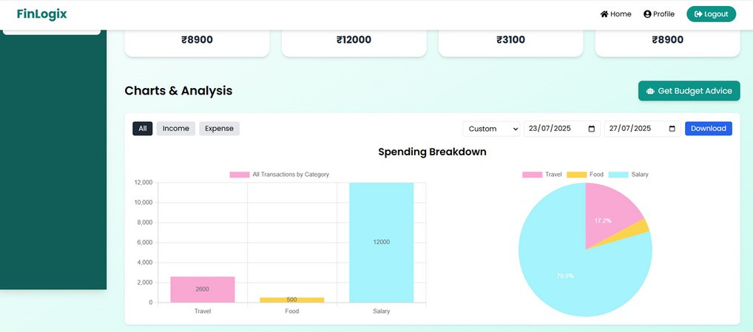
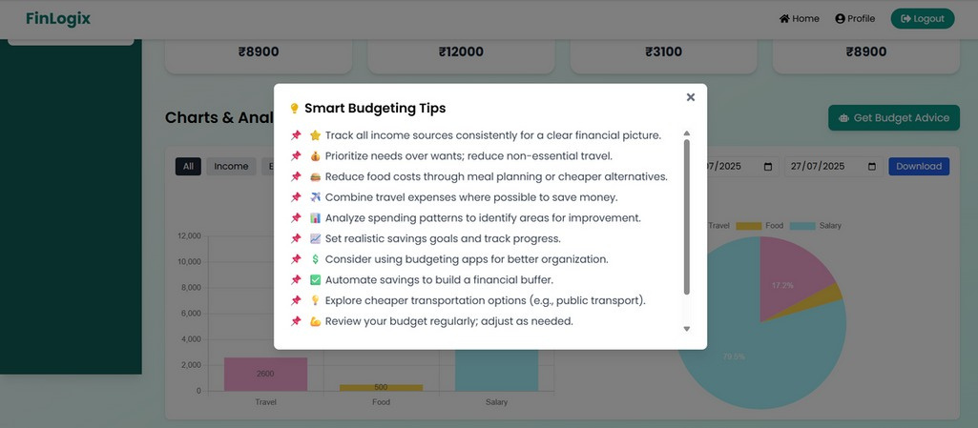
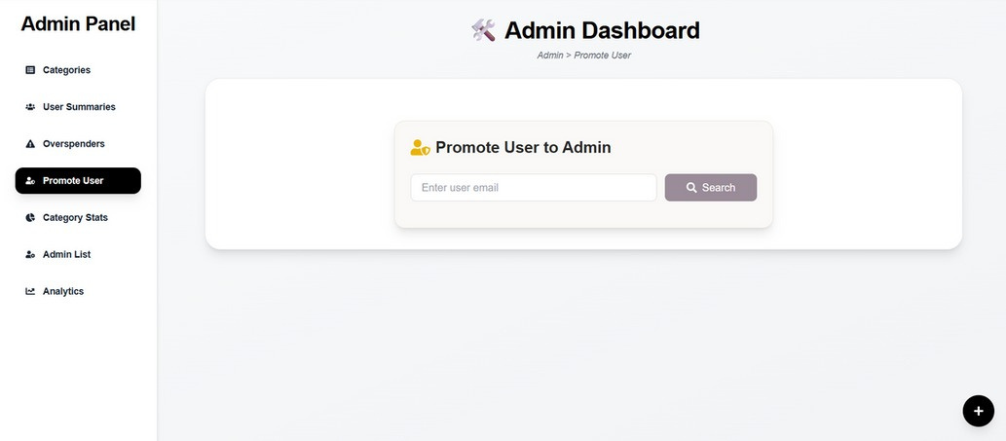

Slide 12
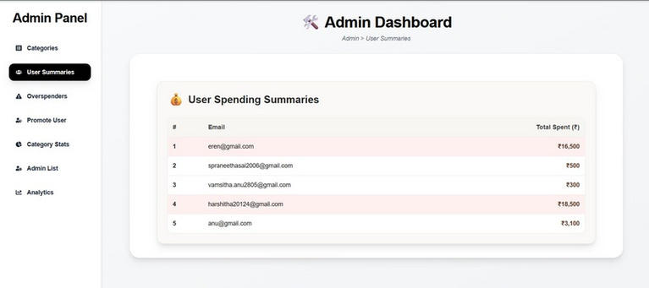
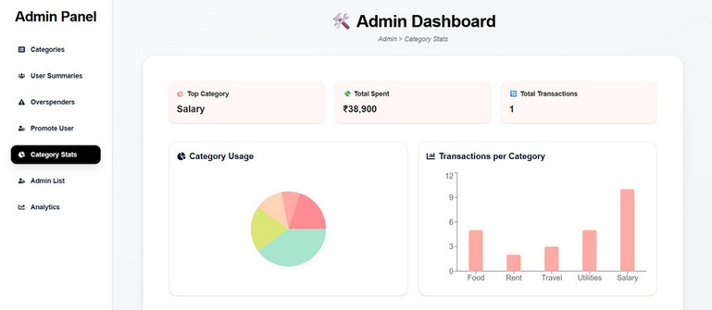
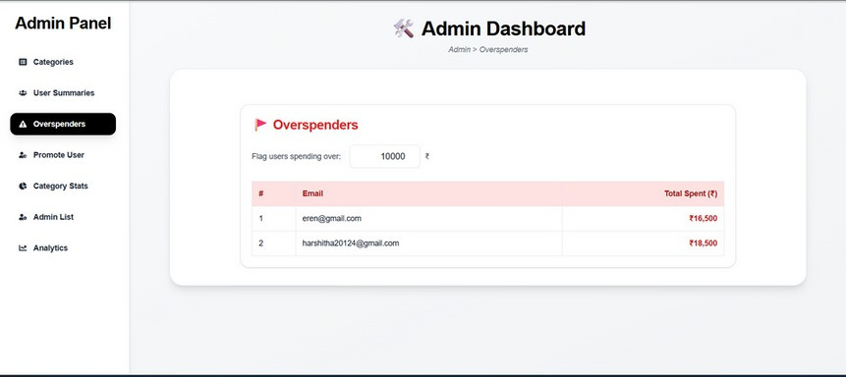
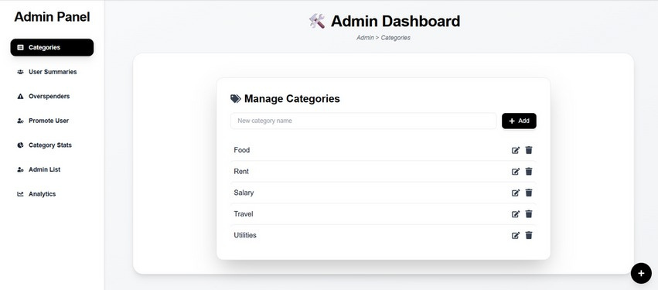
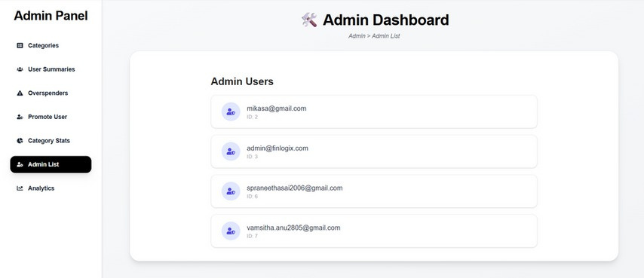
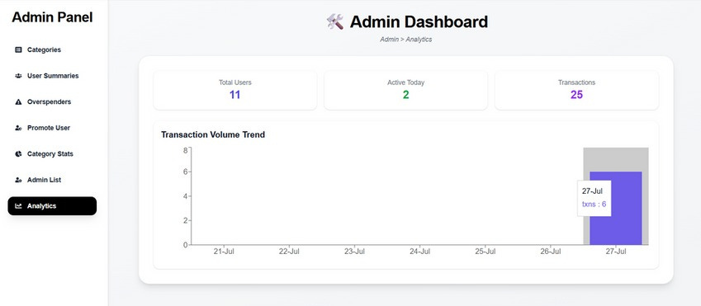

Slide 13
Conclusion
The development of FinLogix provided a comprehensive learning experience in full-stack web development, real-time systems, and AI
integration. The project successfully met its objectives by enabling users to manage their finances with ease through an intuitive interface, categorized transactions, and personalized budget advice.
Key Achievements
Successfully implemented a responsive and scalable application with real-time updates.
Integrated AI-powered insights using Google's Gemini API.
Created an intuitive user interface with rich visualizations.
Developed secure authentication and role-based access control.
Key Takeaways
Improved understanding of system design and backend logic.
Enhanced skills in state management and API integration.
Gained experience in deployment and security practices.
Learned how to combine modern web technologies with AI capabilities.
This project demonstrates how modern web technologies and AI can be combined to create intelligent, user-centric financial applications that address real-world needs.

Slide 14




Future Scope
While FinLogix successfully achieves its core objectives, there are several potential enhancements that could further improve the system's capabilities:
Voice-Based Input
Integrate speech recognition to allow users to dictate transactions hands-free, enhancing accessibility and convenience.
Mobile App Version
Develop native Android and iOS applications with push notifications, biometric authentication, and offline capabilities.
Predictive Budgeting
Apply machine learning models to analyze spending patterns and predict future expenses, enabling proactive financial planning.
Banking API Integration
Connect with UPI platforms and banking APIs to enable automatic transaction import and real-time balance syncing.

