Slide 1
Death Times of Kidney Transplant Patients
Survival Analysis
Praneetha Savali ps1136

Slide 2
Introduction
This project is about the time to death of 863 kidney transplant patients is available on the authors’ web site. All patients had their transplant performed at The Ohio State University Transplant Center during the period 1982– 1992. The maximum follow-up time for this study was 9.47 years.
Patient ages at transplant ranged from 9.5 months to 74.5 years with a mean age of 42.8 years.

Slide 3
Problem Description
This is a trial of 863 kidney transplant patients. We would like to examine categorizing the patients into higher and low-risk groups based on their age at transplant. Below is the separate analyses by race and sex.
Z1 1 if the subject is a black male, 0 otherwise,
Z2 1 if the subject is a black female, 0 otherwise
Z3 1 if the subject is a white male, 0 otherwise.
Z4 1 if the subject is a white female, 0 otherwise.
Also analyzing that there is no difference in survival between patients with different stages of disease, adjusting for the age of the patient.

Slide 4
Survival Definition
Survival analysis is generally defined as a set of methods for analyzing data where the outcome variable is the time until the occurrence of an event of interest
The event can be death, occurrence of a disease, marriage, divorce, etc.
The time to event or survival time can be measured in days, weeks, years, etc.

Slide 5
Terminology and notation
The goal of survival analysis is to estimate and compare survival experiences of different groups.
Survival experience is described by the cumulative survival function.
T is the time of death, and P(T<=t) is the probability that the time of death is less than some time t. S is a probability, so 0≤S(t)≤1, since survival times are always positive (T≥0).

Slide 6
Cox Model
Semi-parametric
A Cox model is a well-recognized statistical technique for exploring the relationship between the survival of a patient and several explanatory variables.
Can take on any form
Notes:
Interpreting a Cox model involves examining the coefficients for each explanatory variable. A positive regression coefficient for an explanatory variable means that the hazard for patient having a high positive value on that particular variable is high. Conversely, a negative regression coefficient implies a better prognosis for patients with higher values of that variable.

Slide 7
Hazard Function
The hazard function is the probability that an individual will experience an event (for example, death) within a small time interval, given that the individual has survived up to the beginning of the interval. It can therefore be interpreted as the risk of dying at time t.
The point is to compare the hazard rates of individuals who have different covariates. Hence, called Proportional hazards

Slide 8
Kaplan-Meier Model
The goal is to estimate a population survival curve from a sample.
A Kaplan-Meier analysis allows estimation of survival over time,
even when subjects drop out or are studied for different lengths of time.
For each interval, survival probability is calculated as no of subjects surviving divided by no of subjects at risk. Subjects who have died, dropped out, or not reached the time yet are not counted as “at risk.” subjects who are lost are considered “censored” and are not counted in the denominator
Notes:
If every patient is followed until death, the curve may be estimated simply by computing the fraction surviving at each time.

Slide 9
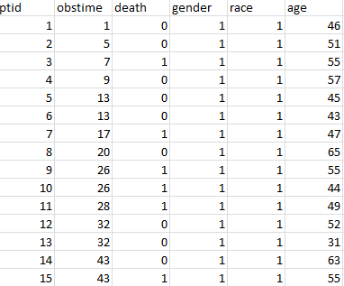
Description of Data
Data set contains 863 kidney transplant patients with data on race (white, black) and gender is described. In this study there were 432 white males, 92 black males, 280 white females, and 59 black females. I treated this as a four variable problem.

Slide 10
Hypothesis for Four Groups
Plot for all four groups
1. (Race=1,Gender=1)
2. (Race=1,Gender=2)
3. (Race=2,Gender=1)
4. (Race=2,Gender=2).
H0:Z1(t) = Z2(t) = Z3(t) = Z4(t), for all t > 0.
Ha:Z1(t) ≠ Z2(t) ≠ Z3(t) ≠ Z4(t) , for all t > 0.

Slide 11
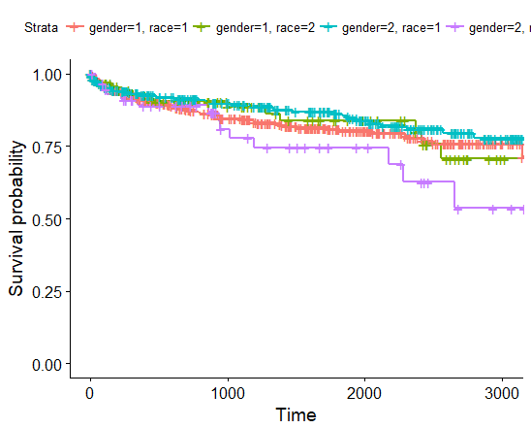
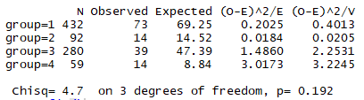
Results for Four Groups
Notes:
Black male
White male
Black female
While female

Slide 12
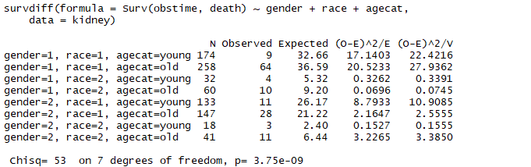
Survival Analysis with age included

Slide 13
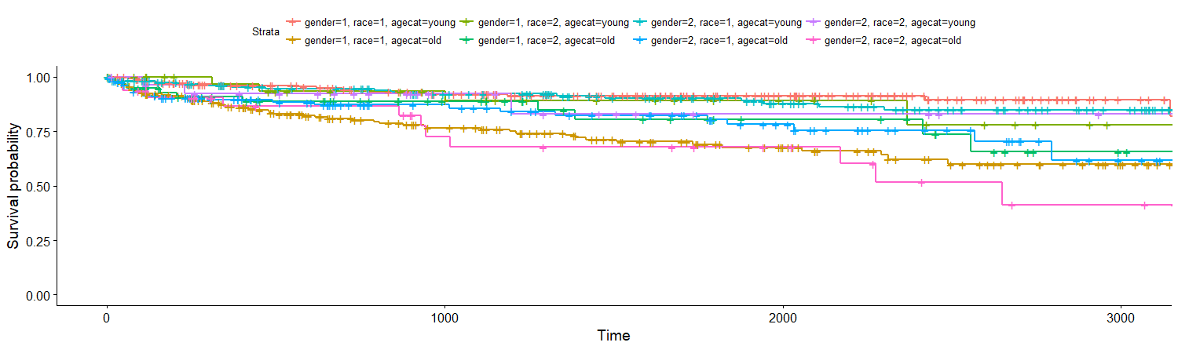
Survival Plot with age included
Notes:
Survival is least for white female old people followed by male black old

Slide 14
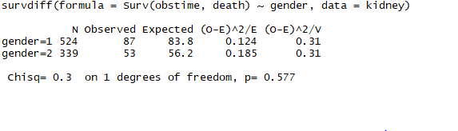
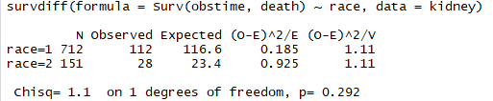
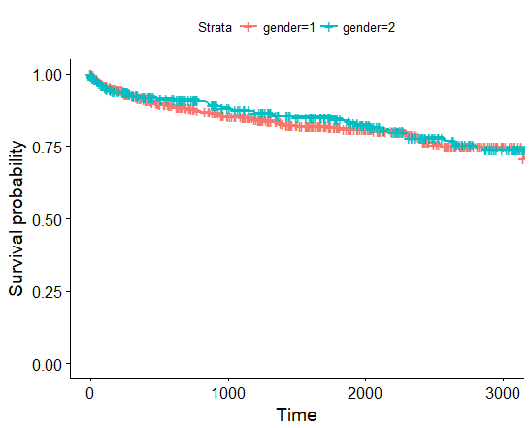
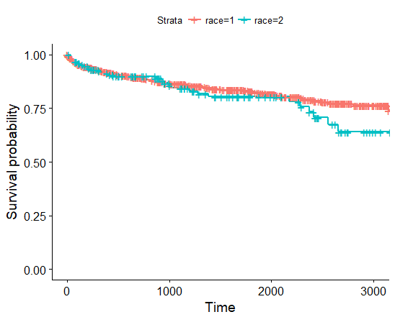
Survival Analysis of Race, Gender.

Slide 15
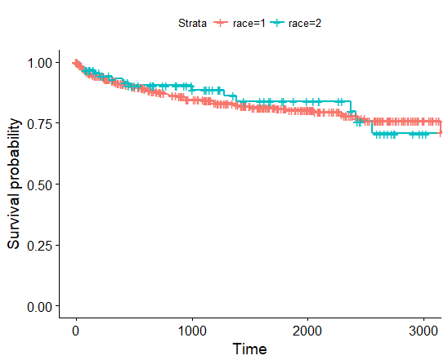
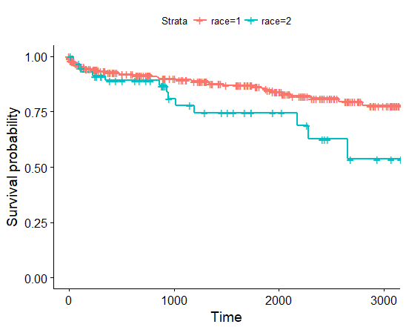


Survival Analysis for Gender 1 and Gender 2
Subgroup=Gender 1(Male) Subgroup=Gender 2(Female)

Slide 16
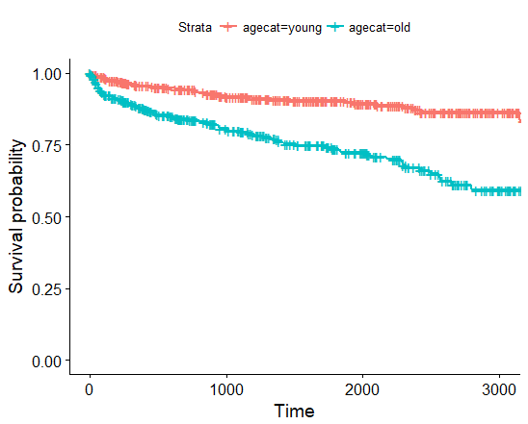
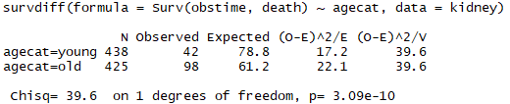
Survival Analysis of Age

Slide 17
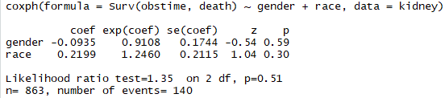
Cox Results for four groups
All Four Groups with respect to gender and race.
(Race=1,Gender=1) ; (Race=1,Gender=2); (Race=2,Gender=1) (Race=2,Gender=2).
Notes:
All the 3 tests show that p value is greater than 0.05. Hence we fail to reject the null hypothesis. The p value for gender is 0.592 with a hazard value of 0.9108 indicating a strong relationship between patients Gender and decreased risk for death.
The p value for race is 0.298 with a hazard value of 0.2460 indicates a strong relationship between the patients race and increased risk of death.
a positive coefficient indicates worse survival and a negative coefficient indicates better survival for the variable in question.

Slide 18
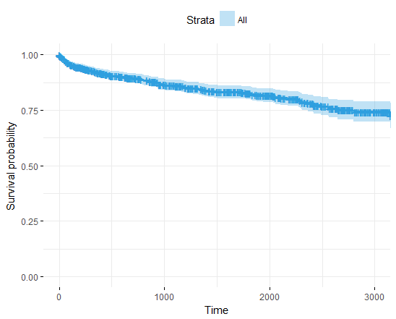
Cox Model Plot for four groups

Slide 19

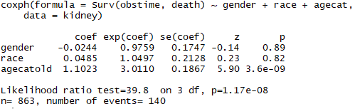
Cox Results with Race, Gender and Age

Slide 20
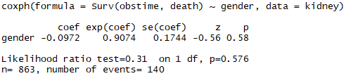
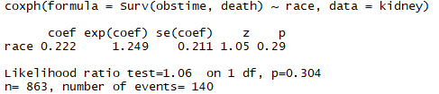
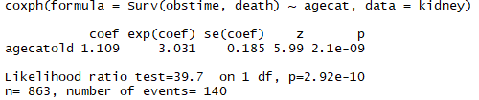
Cox Model for Gender
Cox Model for Race
Cox Model for Age
Notes:
AGE
We reject the null hypothesis. The survival time is different between young and old patients. There is a strong relationship between patients age and an increased hazard(risk of death)
Being old increases the hazard(risk of death) by a factor of 3.3031.

Slide 21
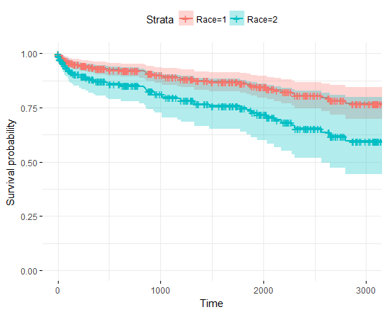
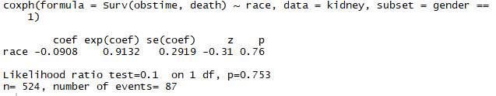
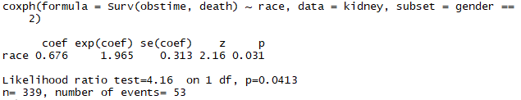
Cox Model Results For Genders.
Subgroup=Gender 1 Subgroup=Gender 2
Notes:
Also when a subset of females is considered. We reject the null hypothesis indicating that the survival times are different between black and white.
Also there a strong relationship between patients race and an increased risk of death. Race(2) are 1.965

Slide 22
Conclusion
The log Rank test statistic with race and gender gives a p-value of 0.192. Hence we failed to reject the Null hypotheses that all the four groups have the same survival function.
The log Rank test statistic with race, gender and age gives a p-value less than 0.05. Hence we reject the Null hypotheses that all the eight groups have the same survival function.
For the individual tests within each Gender We reject the null hypothesis that black women have the same survival function as white women. However, we do not reject the null hypothesis that black men have the same survival function as white men This suggests the association between race and mortality differs with respect to gender.

Slide 23
Cox test for gender provides a strong relationship between patients gender and a decreased hazard(risk of death) rate. Being female decreases the hazard(risk of death) by a factor of 0.9074. Also We fail reject the null hypothesis which means the survival time is same between male and female.
Cox test for Race provides a strong relationship between patients race and an increased hazard(risk of death) rate. Being White increases the hazard(risk of death) by a factor of 1.249. Also We fail reject the null hypothesis which means the survival time is same between white and black.
Also when a subset of females is considered. We reject the null hypothesis. There is a strong relationship between patients race and an increased risk of death. Being race(2) increases the hazard by a factor of 1.965.

Slide 24
Cox test for age provides a strong relationship between patients age and an increased hazard(risk of death) rate. Being old increases the hazard(risk of death) by a factor of 3.3031. Also We reject the null hypothesis which means the survival time is different between young and old patients.

Slide 25
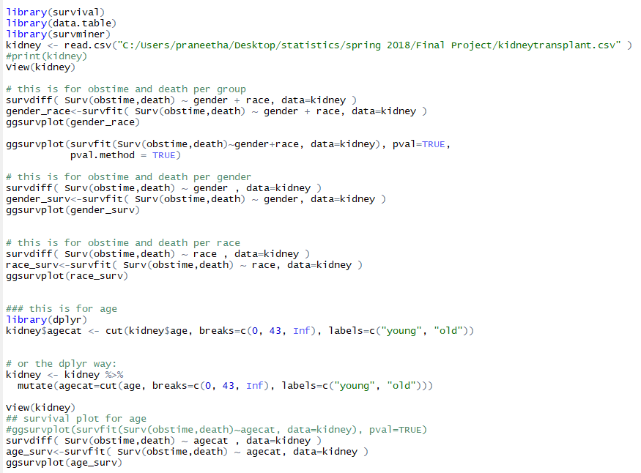
R Code

Slide 26


