Slide 1

Hotel Management system
19CSE314
Software Engineering
Group - 15

Slide 2

D
Hotel Management System
Team Members:
1)D B R S Praneeth Varma (AM.EN.U4CSE19265) {Leader}
2) M .Gowtham (AM.EN.U4CSE19234)
3) Y. Phani Vardhan (AM.EN.U4CSE19241)
4) S S S B Shravanth (AM.EN.U4CSE19250)
SOFTWARE ENGINEERING
19CSE314

Slide 3
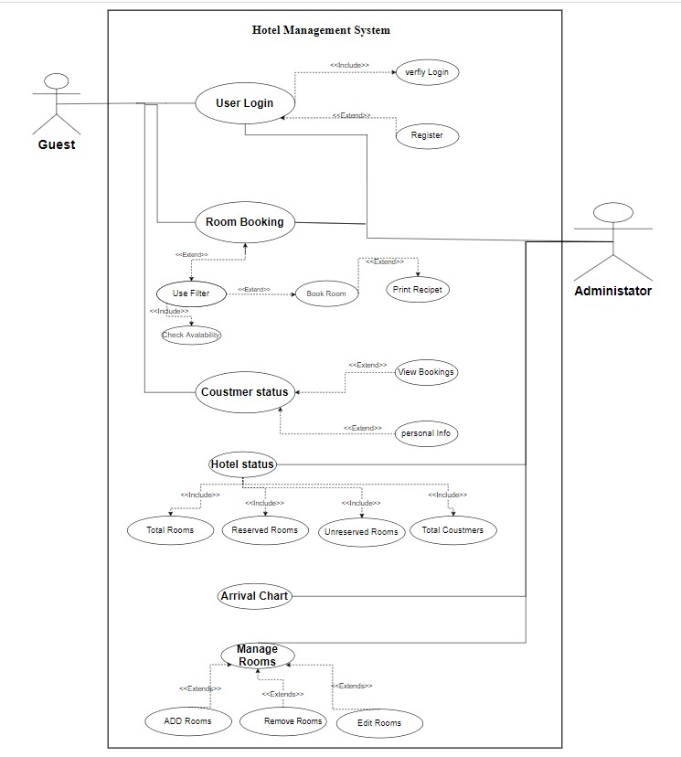
Use case Diagram
Hotel Management
System
D
SOFTWARE ENGINEERING
19CSE314

Slide 4

User Stories
D
Hotel Management System
1
As a customer, I should be able to register and login to the system
As a customer, I should be able to view available rooms.
As a customer, I should be able to reserve available rooms and verify payment details.
As a customer, I should be able to generate payment receipts.
As a customer, I should be able to view all bookings done by me.
As a customer, I should be able to view my personal information.
SOFTWARE ENGINEERING
19CSE314

Slide 5
User Stories
D
Hotel Management System
2
As an administrator, I should be able to manage hotel rooms/ staff details.
As an administrator, I should be able to login to the system.
As an administrator, I can view available rooms.
As an administrator, I can view all booking details.
As an administrator, I can view hotel status.
As an administrator, I can book rooms for customers.
As an administrator, I should be able to generate an arrival chart.
SOFTWARE ENGINEERING
19CSE314

Slide 6
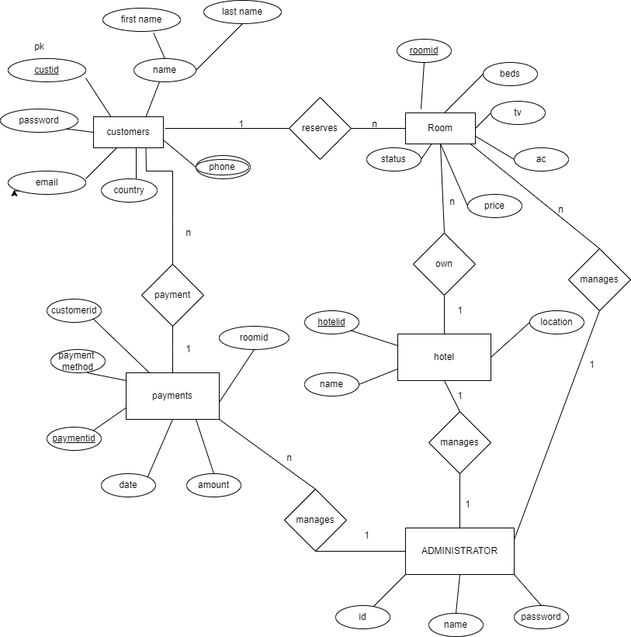
ER Diagram
Hotel Management
System
D
SOFTWARE ENGINEERING
19CSE314

Slide 7

THANK YOU

