Slide 1



BASIC INFORMATION
Team Name: BlackOps
Team Leader Name: Siddharth .M
Domain: Full Stack with ML
Problem Statement:SET-02 5th Problem Statement
Institute Name : Velammal Engineering College

Slide 2

Analysis of Problem Statement:
Old-style farming is increasingly ineffective and inefficient due to modern market changes,
significantly impacting the agricultural sector. Here are the key issues:
1. Communication with Producers: There is a lack of effective communication between farmers and producers,
hindering efficient collaboration and market access.
2. Access to Technology: Farmers struggle to access the internet and modern technologies, limiting their ability to utilize advancements in agriculture.
3. Communication Barriers: Language and literacy barriers further delay in effective communication and access to information.
4. Fertilizers and Pesticides: Incorrect use of fertilizers and pesticides tailored to specific crops can lead to crop loss and new pests. Adhering to guidelines from regulatory bodies like the Central Insecticides Board and Registration Committee (CIBRC) is essential.
5. Market Complexity: The complex and unpredictable market makes it difficult for farmers, especially older ones, to understand pricing, demand, and weather changes.

Slide 3
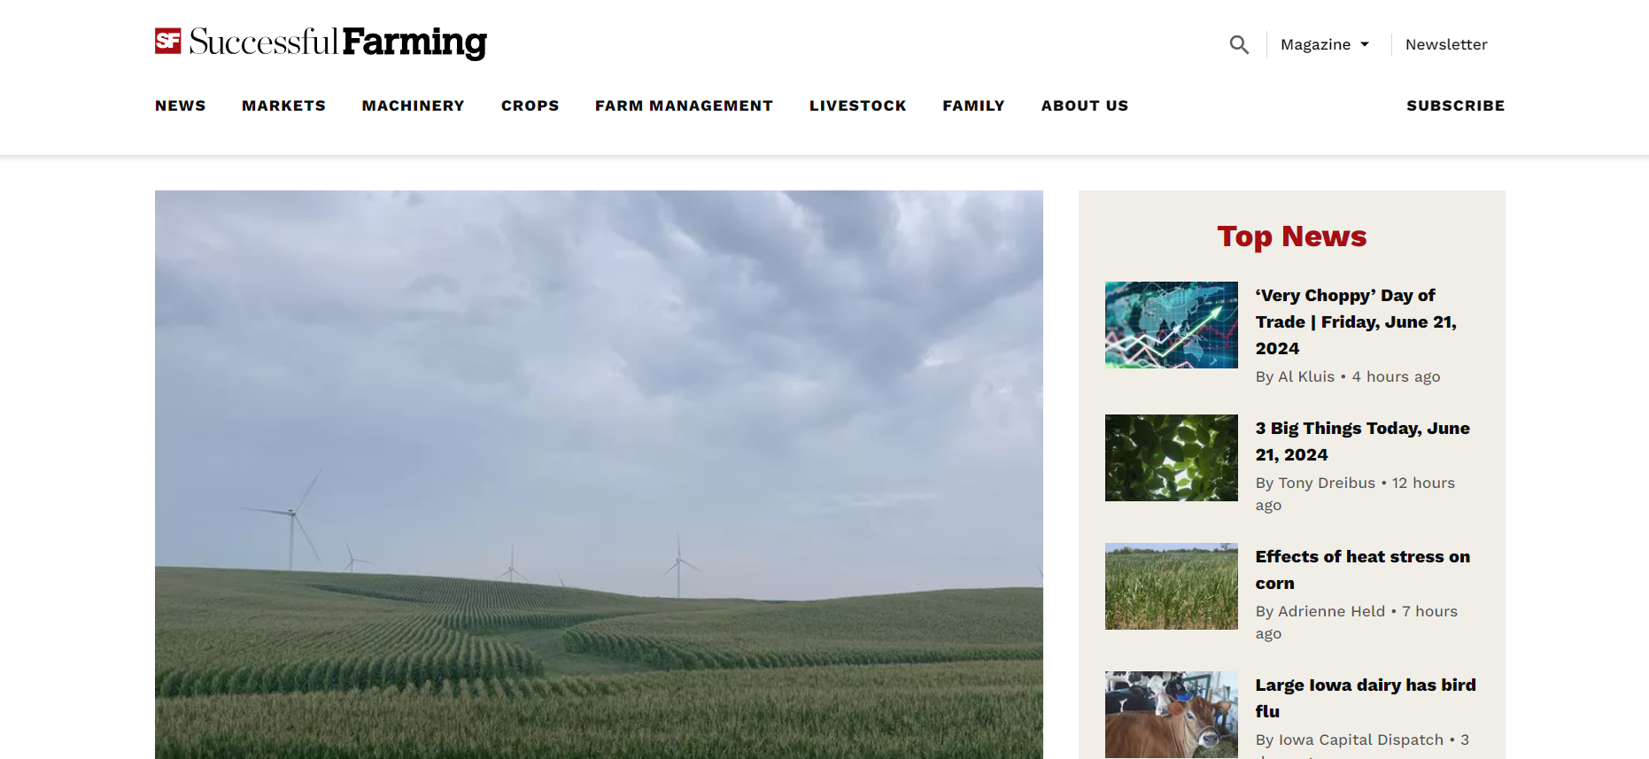
Literature Survey (Study of existing Solutions):
1.eNAM Mobile App : Link:https://enam.gov.in/web/mobile-app
Disadvantages:
There is no implementation of Chatbot and no implementation of crop lens(scanning and identifying the crops).
No page for agriculture insurance and farmers loan.
No hub for farmers
2.Agri Stack : Link:https://agristack.gov.in/#/
Disadvantages:
The website is static
It contains only data of the farmers
No page for agriculture insurance and farmers loan.
No hub for farmers
3.Agri insurance.com : Link:https://agriinsurance.com/#google_vignette
Disadvantages:
It only contains information about agriculture insurance and how to claim insurance ,there is no redirect page for claiming the insurance.
4.Agricom: A communication platform for agriculture sector (research paper):
Disadvantages:
It has a feature instructor, buyer and seller but in our project there is no such medium. No hub for farmers
https://www.agriculture.com/

Slide 4
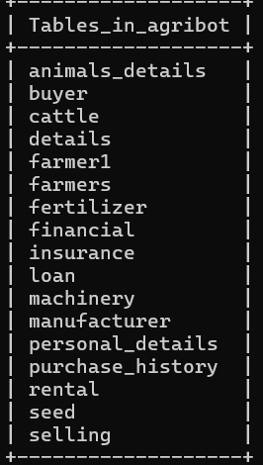
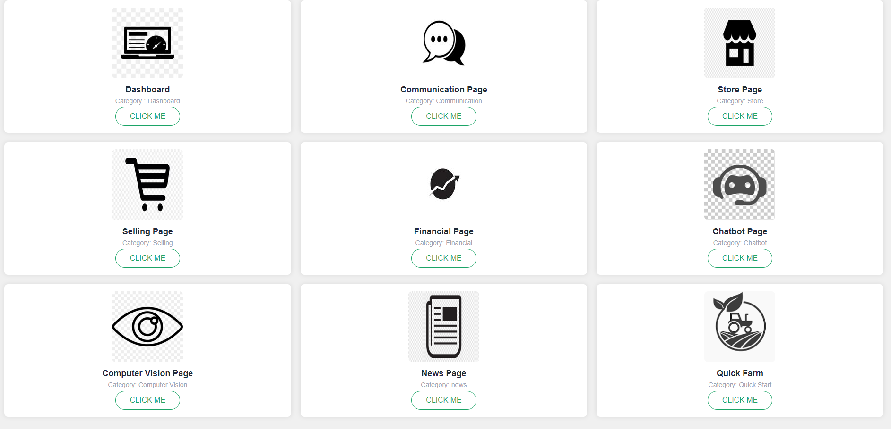
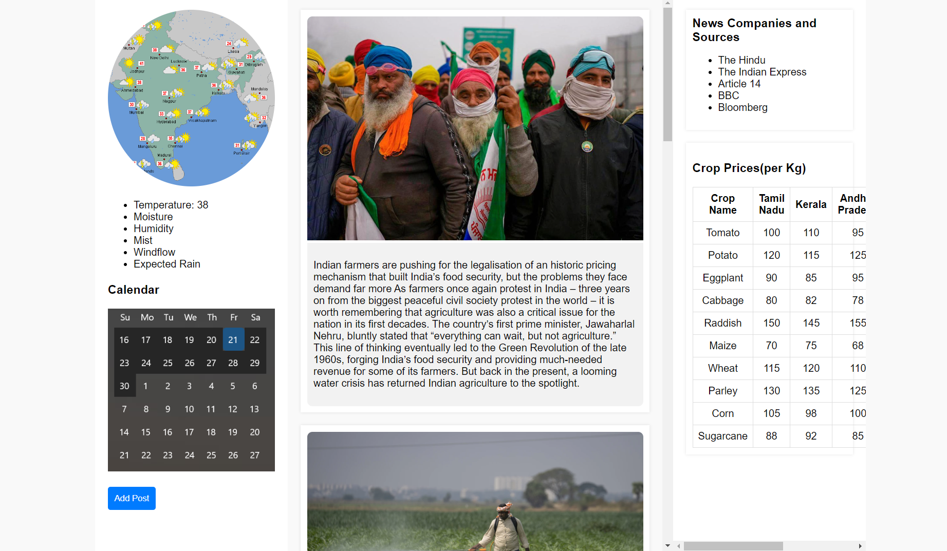
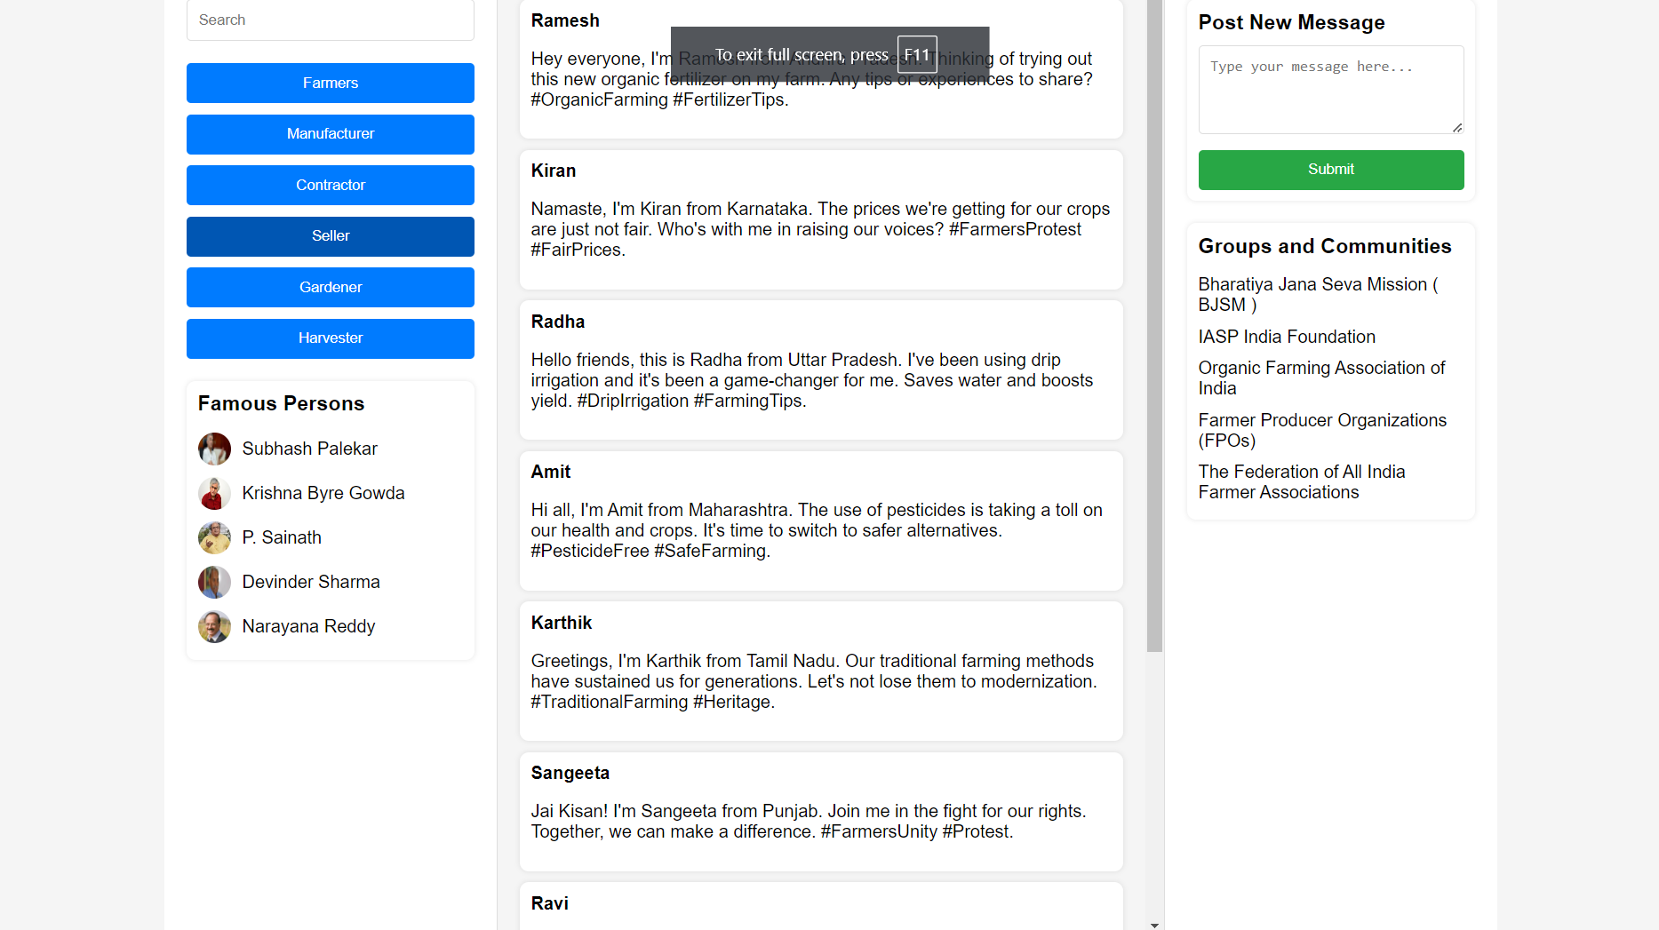
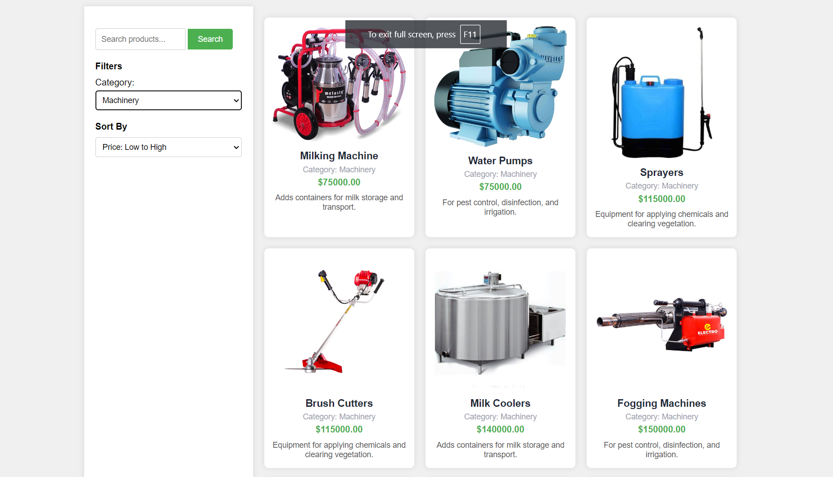
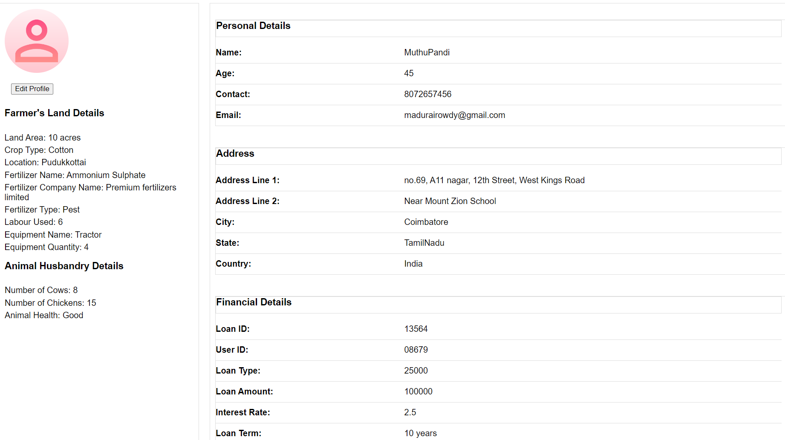
Idea/Approach to solve Problem:
Common Authorised Communication platform
Farmers
Developing a unified online platform that facilitates interaction among farmers, experts, and marketing teams could significantly benefit the agricultural community.
Experts
a selling page where a farmer can able to sell the products directly to the other farmers or to any other companies.
C2C
Third Party Orgs
A dashboard will be available for farmers to monitor all ongoing activities related to farming, including water management, loan payment dates, important cultivation dates, crop status, and available buyers for their products.
Farmers have access to an online platform where they can view authorized products with specifications and use cases, such as fertilizers, equipment, labor, transportation, and animal sources. The platform also facilitates renting arrangements between farmers and cooperatives.
The platform also includes a financial page where farmers can access information about available loans, crop insurance, and animal insurance.
The platform includes a news page, similar to Twitter, that depicts events and updates related to farming.
DATABASE
WEBSITE
NEWS
COMMS
STORE
DASHBOARD

Slide 5
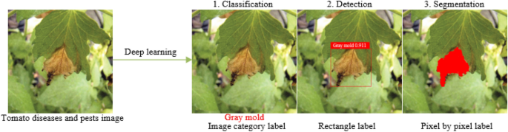
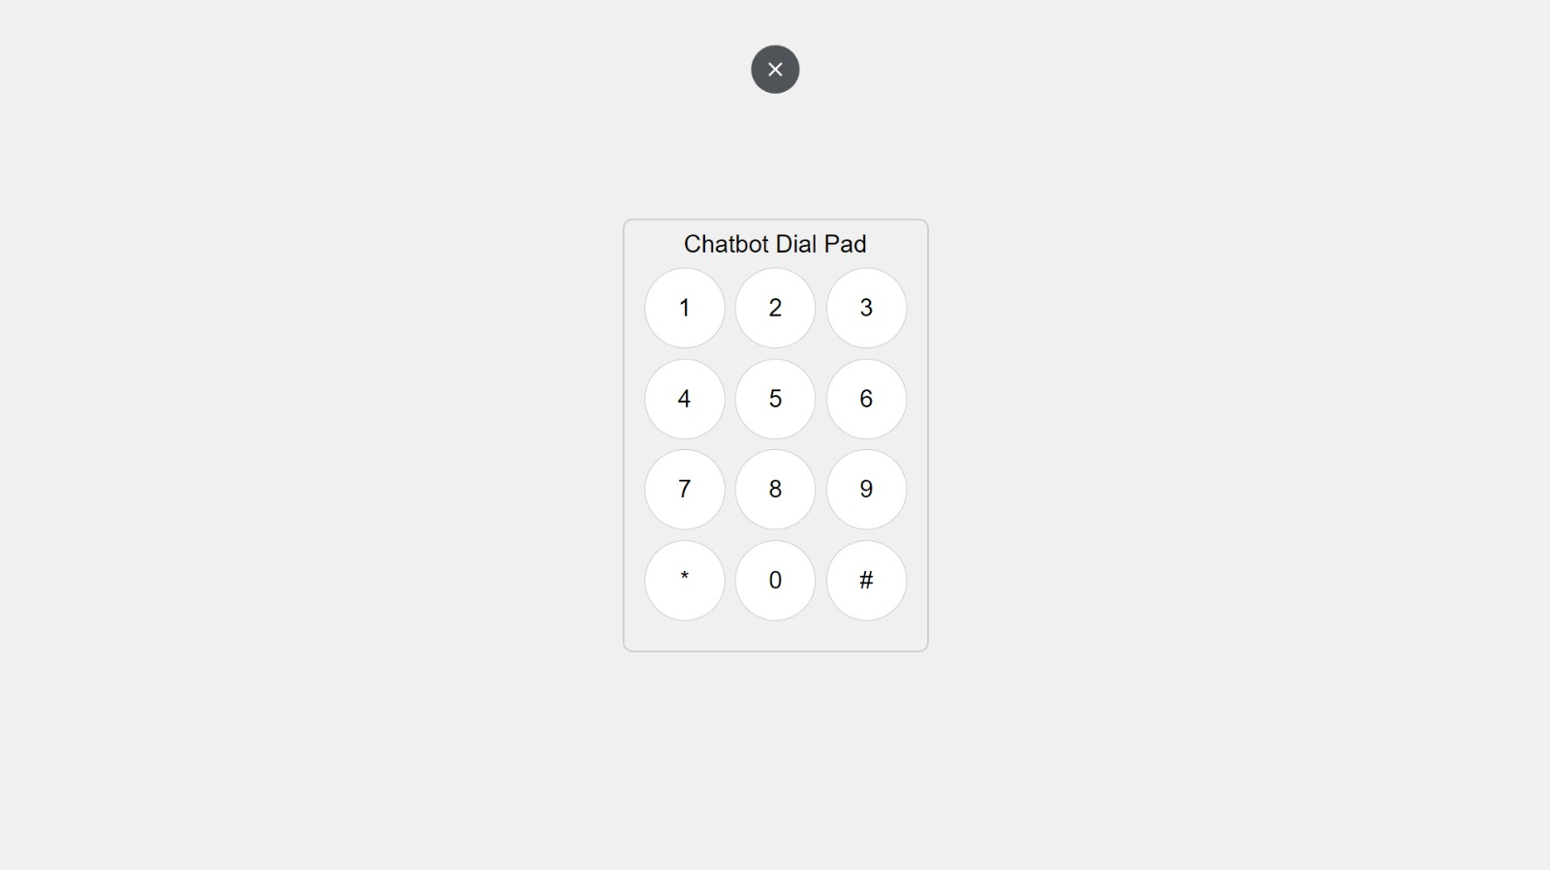
With computer vision technology, we can train the YOLOv8 algorithm to predict crop growth stages, identify diseases, and detect pest activity.
Solving Methodology :
To address modern farming challenges, we developed a comprehensive solution:
1. Integrated Website: Features include:
- Dashboard: Centralized farming information.
- Communication Platform: Connects farmers, producers, and stakeholders.
- Store and Selling Pages: Access and sell agricultural products.
- Finance Page: Financial tools and crop insurance options.
-Chatbot: AI assistant for farming queries.
- CV Page: Manage professional profiles.
- News Page: Latest agricultural news.
- Quick Farm: Essential farming tools and resources.
2. FAISS Vector Store: Efficient data management and retrieval.
3. RAG Technology: Enhanced chatbot responses through information retrieval and generation.
4. Fine-Tuned Tiny LLaMA LLMs: Specialized agricultural knowledge models.
5. Vector Database: Comprehensive information from agricultural books.
6. SQL Query Fine-Tuning: Dynamic database interactions.
7. Dialer System: Access all features via mobile dialing for improved accessibility. This integrated platform aims to enhance productivity, communication, and market understanding for modern farmers.

Slide 6
WORKFLOW
Homepage\Dashboard
Websites
x
Open CV (YOLO)\Chatbot
Vector Database
Articles
Books
RAG
Retrieval QA
(web based retrievers)
zxsx
Loan\Insurance
News\Communication
z
Store\Selling page
LLM- TinyLlama with RAG
Dial Pad
Vector Databases - FIASS
RAG implementation can be done by using this DialPad without using a website gui .

Slide 7
Technology Stack:
Back-end:
Programming Language: Python
Package: PyTorch
API: Flask
Retrieval Augmented Generation (RAG)
Parameter Efficient Fine-tuning(PEFT)
Hugging Face models and datasets
NLP Frameworks: Langchain
Inference Engine: RTX 4050 6GB
LLM Models: Tiny Llama, Flan-T5-Base , Phi-3
Vector Databases: FIASS, My SQL
Memory Optimization: Training-Accelerator, BitsandBytes, LoRA Optimization
Alg For CV : YOLOv8
Front-end:
HTML
CSS
JavaScript
POC : StreamLit

Slide 8
Unique Value Proposition:
Unified Platform:
All necessary functions and websites are consolidated into a single platform.
Access Methods:
Available via internet on electronic devices.
Websites converted into vector data stores for offline access.
Integration with RAG:
Uses RAG (Retrieval-Augmented Generation) technology to enhance functionality.
Dialer Function Integration:
Integrated with a phone dialer function.
User-Friendly Interface:
Designed to eliminate the need for understanding complex GUIs.
Simple OS commands and button clicks facilitate easy navigation.
Essential Requirements Retrieval:
Efficiently retrieves most essential information and services.
Cost of Implementation:
Graphical Processing Unit (GPU) – Training purpose.
Data Collection and Preprocessing.
Storage and Database Management.
Website Hosting.
Application Programming Interface(API) cost.
DevOps.
MLOps.
Dependencies:
Tensorflow
PyTorch
OpenCV
Keras

Slide 9
Project Outcomes:
Through this project specialized hub serves as an social platform to meet the needs of farmers, includes
functionalities such as :
A separate website to facilitate selling and buying of the essential supplies for farming, this comprises of livestock, fertilizer and other necessary resources.
Each individual farmer will be provided with a personalized dashboard that showcases overview of progress/career about the crops that they are currently cultivating.
Additionally, this hub facilitates farmers in financial assistance, that includes loans and insurance options for their crops and livestock.
It is incorporated with a independent section for news related to the farming such as price hike for a crop, weather forecast, protest and many other.
All necessary functions and websites are consolidated into a single platform, accessible online or offline via vector data stores. Using Retrieval-Augmented Generation (RAG) technology, the platform integrates with a phone dialer, allowing users to access services without direct website use or programming knowledge. Simple OS commands and button clicks enable easy navigation and retrieval of essential information.

Slide 10
Team Details:
Team Name: BlackOps
Team Leader : Siddharth M 2022-2026 Artificial Intelligence
Team Member 1: Pranesh kumar V 2022-2026 Artificial Intelligence
Team Member 2: Arjun V L 2022-2026 Artificial Intelligence
Team Member 3: Waatson J 2022-2026 Artificial Intelligence

