Slide 1
Comprehensive executive analysis

Slide 2
Agenda
01
Tailored guidance for institutional investors navigating ai risk | Monetary policy implications

Slide 3
Tailored guidance for institutional investors navigating ai risk
1
This section translates the report’s bubble risk indicators, valuation and financing dynamics,
2
Recommendations prioritize measurable controls, governance, and disclosure practices that can be implemented
3
Portfolio construction and exposure controls.
4
Treat AI exposure as a factor cluster rather than a sector

Slide 4

Monetary policy implications of ai-driven asset inflation
1
An AI bubble, if it forms, is most likely to transmit to
2
For central banks and financial authorities, the key challenge is to distinguish
3
Recent official sector assessments emphasize that stretched valuations and market concentration can
4
AI driven asset inflation can complicate monetary policy by loosening financial conditions

Slide 5
Safeguards for retail and institutional investors in ai
1
2
3
4
Investor protection in AI linked markets should be treated as a market
Because AI narratives can amplify valuation dispersion and because AI business models
In practice, this requires coordinated action across securities regulators, self regulatory organizations,
Retail investor safeguards should focus on preventing mis selling, limiting exposure to

Slide 6
Historical examples of successful bubble avoidance or mitigation
1
2
3
4
This section translates historical bubble mitigation experience into practical lessons for the
The case studies emphasize three recurring success factors.
- Early action that targets amplification mechanisms such as leverage, maturity mismatch,
- Rules that improve comparability of risk and reduce information asymmetry, especially

Slide 7
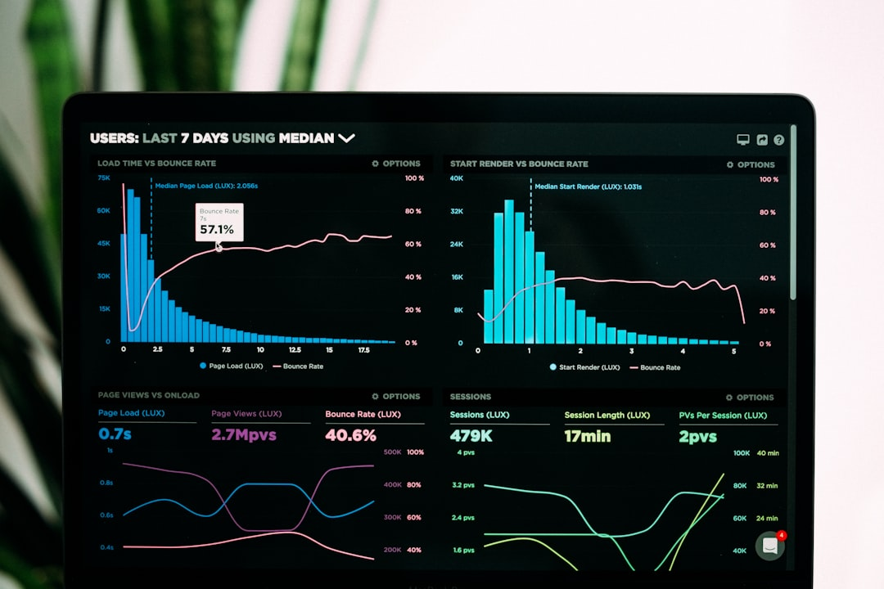
Valuation multiples in context of historical benchmarks
1
This section consolidates measurable market signals and structural fragilities that, taken together,
2
The goal is not to assert that AI lacks long run economic
3
Quantitative warning indicators tend to cluster in three places: public market pricing,
4
The most reliable overheating signal is not any single extreme, but a

Slide 8

Spillover effects on adjacent tech sectors and global
1
An AI bubble burst would most plausibly transmit to the real economy
2
The key mechanism is a rapid repricing of high duration growth assets,
3
The macro impact would likely be nonlinear because AI investment is increasingly
4
Across advanced economies, the most material near term downside risks are a

Slide 9
Data sources

Slide 10
Public versus private ai valuation dynamics

Slide 11
Stress-testing frameworks tailored to ai infrastructure and business
1
2
3
4
This section translates the earlier risk indicators and investor due diligence findings
The recommendations are designed to be globally interoperable, so that disclosures and
Reduce mispricing risk by making AI specific value drivers auditable and comparable
Recommended disclosure baseline for public markets.

Slide 12
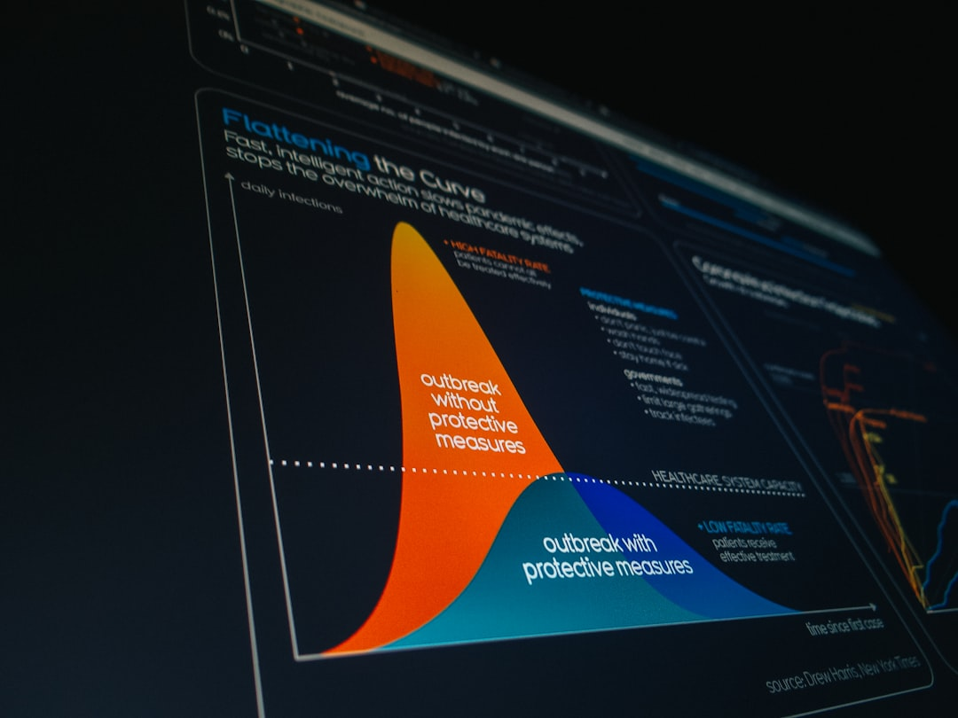
Technical scalability and adoption challenges across industries
1
This section translates the valuation and financing signals identified earlier into a
2
It focuses on where frontier and enterprise AI are genuinely delivering value
3
These technical constraints matter for bubble risk because they can delay revenue
4
Current capabilities are strongest where tasks are language centric, pattern heavy, and

Slide 13
Key Insight: Comprehensive executive analysis

Slide 14
Questions?

