Slide 1
Comprehensive executive analysis

Slide 2
Executive summary
Current State
Target State
1
The report frames the AI bubble through financial stability and
1
Technical assessments reveal gaps between AI capabilities and hype, exacerbated
2
Global investments concentrate in frontier models and infrastructure, with regional
2
, EU AI Act), and infrastructure bottlenecks
3
, Europe, and China signaling overheating risks and valuation-cash flow

Slide 3
Table of contents
Current State
Target State
1
Introduction to the AI Bubble Concept](#1
1
Historical tech bubble analogues and their modern relevance](#1
2
Economic bubble theory applied to AI investment dynamics](#1

Slide 4
Economic bubble theory applied to ai investment dynamics
• Economic bubble theory describes a recurring pattern in which asset
• In the AI context, bubble like dynamics can emerge even
• The investable surface area spans chips, cloud infrastructure, model providers,
• This combination can produce valuations that embed optimistic adoption curves

Slide 5
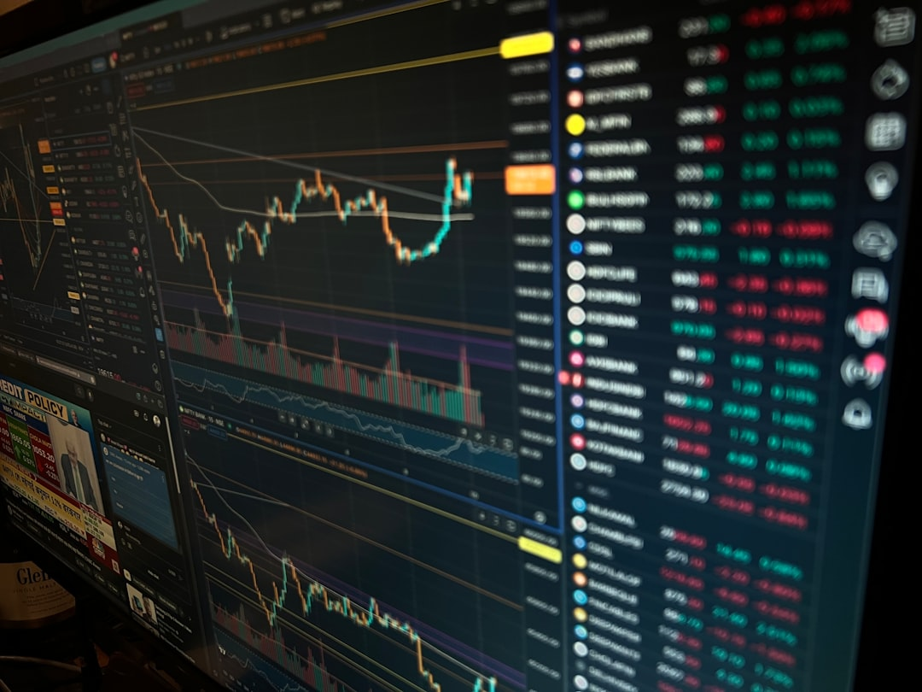
Safeguards for retail and institutional investors in ai markets
1
Retail investor safeguards should focus on preventing mis selling, limiting
2
Retail focused safeguards
3
Require that any AI themed product marketing be clearly identifiable
4
This is particularly important for AI thematic ETFs, AI tokenized

Slide 6

Tailored guidance for institutional investors navigating ai risk
1
Portfolio construction and exposure controls
2
Treat AI exposure as a factor cluster rather than a
3
Set explicit concentration limits for single name and single platform
4
Use a barbell approach that pairs high duration AI growth

Slide 7
Designing early warning systems for ai market overheating
Current State
Target State
1
Early warning systems should combine market based signals, balance sheet
1
Prefer indicators that are hard to game and can be
2
Core design principles
2
Build cross border comparability by anchoring at least one layer
3
Use a layered indicator stack that separates valuation heat from

Slide 8
Monetary policy implications of ai-driven asset inflation
Current State
Target State
1
AI driven asset inflation can complicate monetary policy by loosening
1
This can support consumption and investment, increase risk taking, and
2
The primary transmission mechanisms are the wealth effect and the
2
The IMF has explicitly warned that asset prices can become
3
When equity valuations rise in AI exposed firms, household net

Slide 9
Historical examples of successful bubble avoidance or mitigation
1
2
3
4
5
Hong Kong property market macroprudential tightening as a leverage brake
Context and risk channel
- Hong Kong faced repeated property upcycles with high household
- The policy objective was not to set prices, but
- Loan to value caps and debt servicing ratio limits

Slide 10
Spillover effects on adjacent tech sectors and global markets
1
An AI bubble burst would likely propagate through three spillover
2
1) Adjacent technology sectors with direct revenue dependence
3
Semiconductors and semiconductor equipment
4
A pullback in hyperscaler and frontier model developer capital

Slide 11
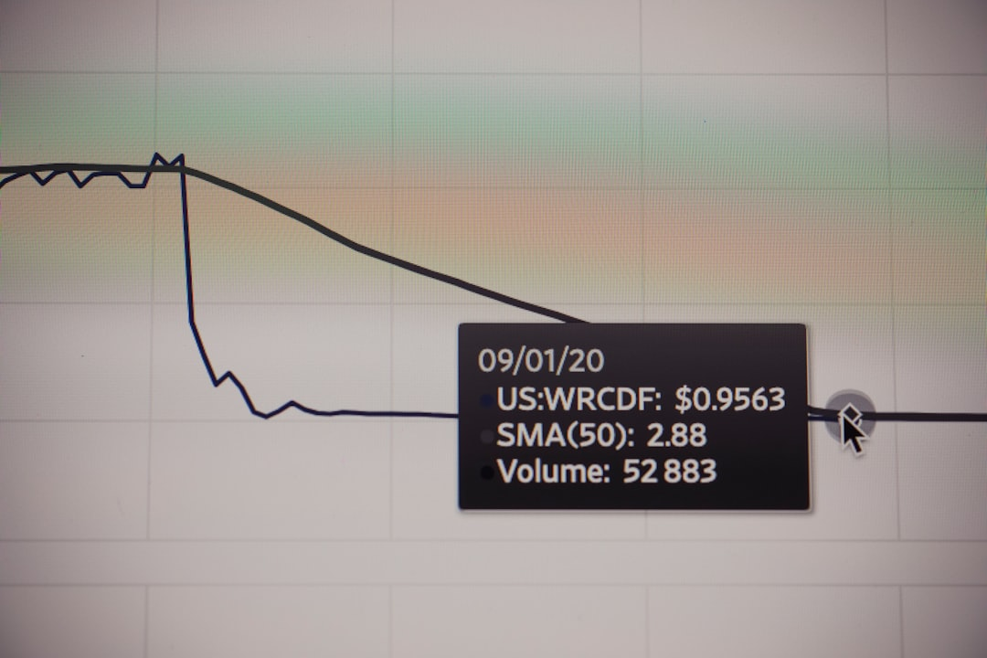
Valuation multiples in context of historical benchmarks
1
Valuation multiples are most informative when anchored to historical regimes
2
Narrative intensity that shifts investor focus from near term cash
3
Capital availability that lowers the penalty for uncertainty and extends
4
The dot com era remains the closest analogue for a

Slide 12
Data sources
Current State
Target State
1
Core market and investment datasets used
1
- Stanford HAI AI Index 2025 for global and regional
2
AI private investment and adoption
2
Venture capital and deal activity

Slide 13
Stress-testing frameworks tailored to ai infrastructure and business models
Current State
Target State
1
Policy objective
1
Systemically relevant AI infrastructure operators, including large data centre developers
2
Develop repeatable, comparable stress tests that capture AI specific fragilities
2
Large cloud and platform firms where AI capital expenditure and
3
Prioritise compute supply shocks, power and grid constraints, and rapid

Slide 14
Public versus private ai valuation dynamics
Current State
Target State
1
Public and private AI valuations are diverging in ways that
1
This concentration can lift index level valuations even when the
2
Public market dynamics
2
Nvidia remains a key bellwether for AI infrastructure pricing and
3
Public market AI exposure remains highly concentrated in a small

Slide 15
Differentiating speculative hype from durable ai value creation
Current State
Target State
1
Speculative phases often share a pattern of narrative dominance, rapid
1
Valuations justified primarily by total addressable market narratives without evidence
2
Durable value creation is more consistently associated with measurable customer
2
Growth driven by subsidies, free credits, or promotional pricing that
3
Signals of speculative hype

Slide 16
Technical scalability and adoption challenges across industries
Current State
Target State
1
Scaling AI from pilots to enterprise wide and economy wide
1
Cross industry adoption barriers
2
These frictions can slow diffusion relative to market expectations, even
2
Data quality, access, and rights
3
In practice, the binding constraint is often organizational and regulatory

Slide 17
Key Takeaways

