Slide 1
Transforming Our Future
Comprehensive executive analysis overview.

Slide 2

Agenda

Slide 3
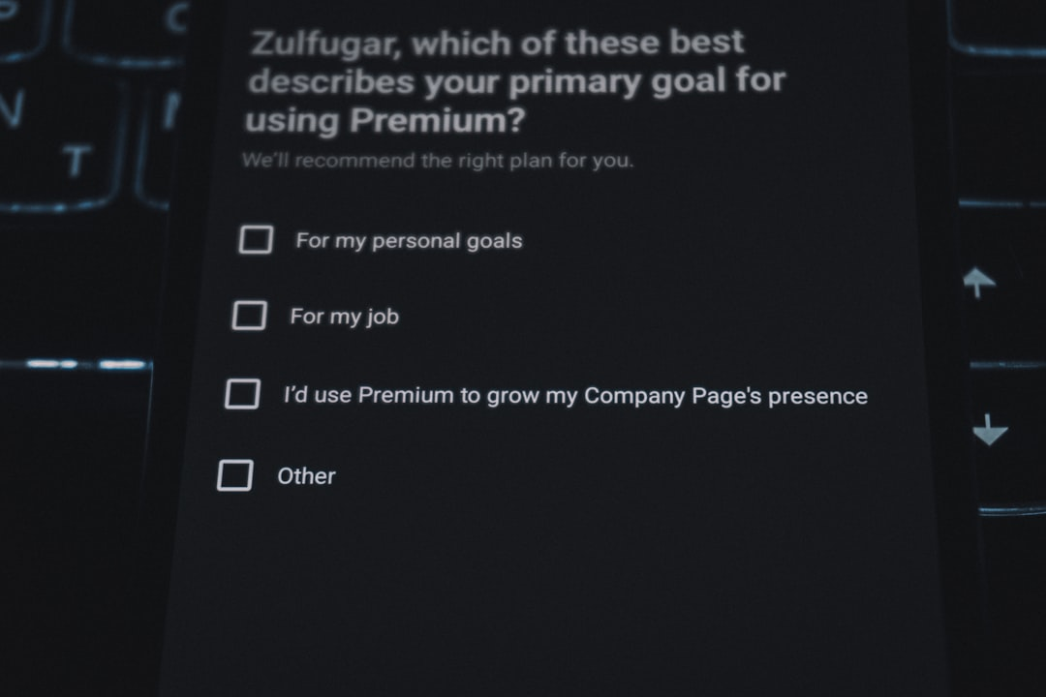
Executive Summary

Slide 4
Key Metrics

Slide 5
Identifying Challenges

Slide 6
Our Process

Slide 7
Future Roadmap

Slide 8
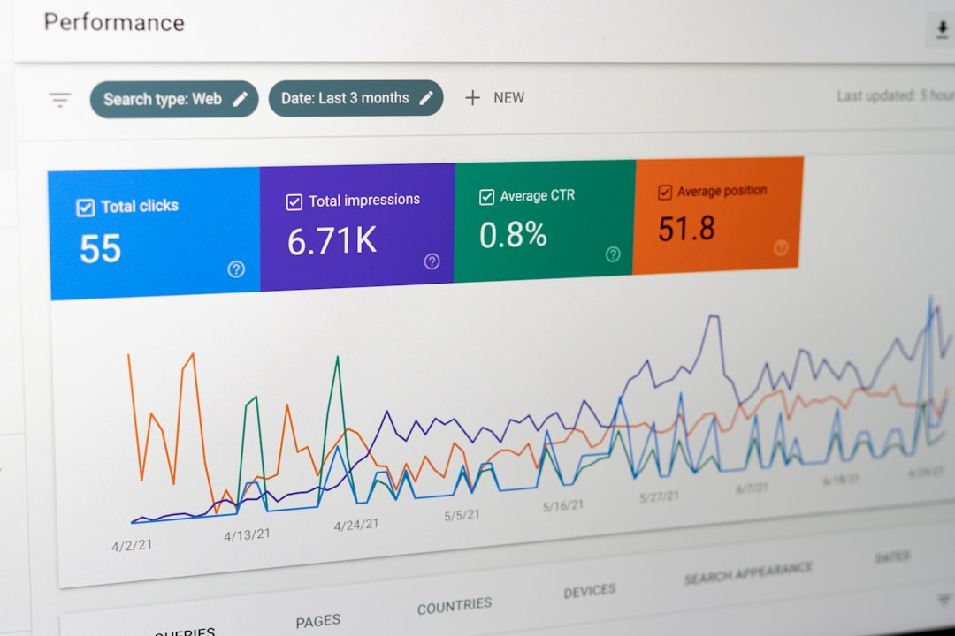
Current vs Target

Slide 9
Key Takeaways

Slide 10

Next Steps

Slide 11
High-level Q&A session.
Focus on executive analysis.

