Slide 1
Transforming Our Future
Comprehensive executive analysis.

Slide 2
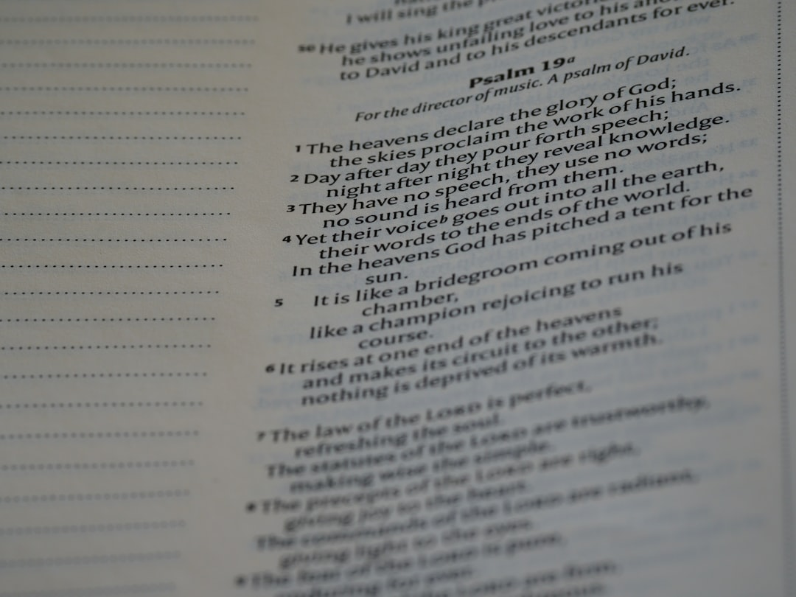
Today's Agenda

Slide 3

Executive Summary
Comprehensive executive analysis summary.

Slide 4
Key Metrics Overview

Slide 5
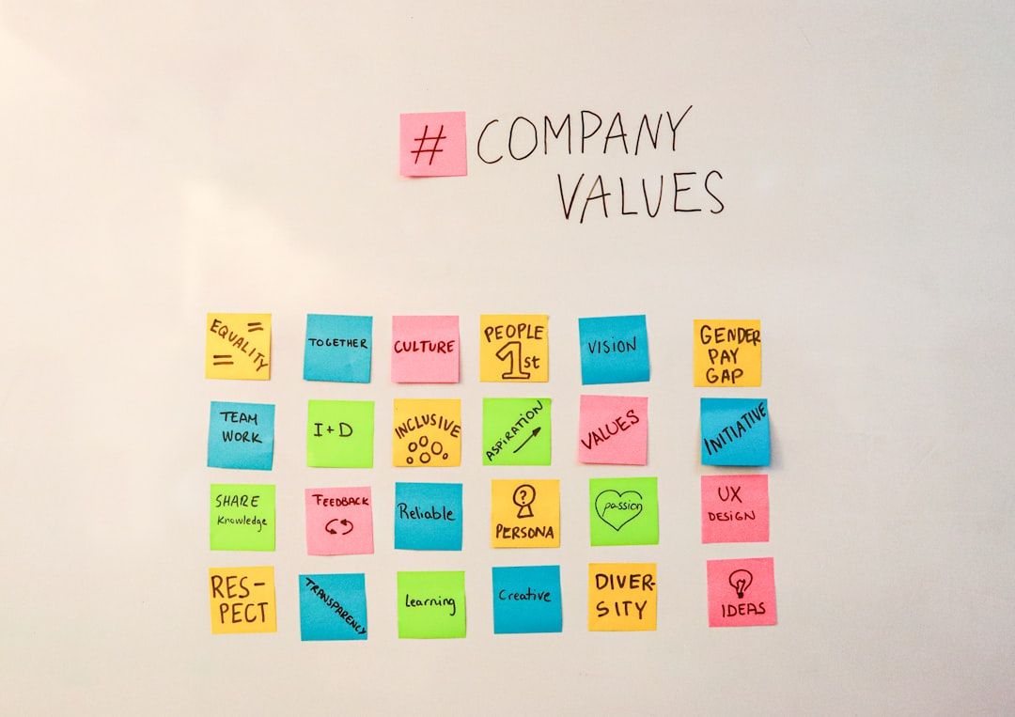
Current Challenges
- Current challenges in analysis.
- Executive Analysis Complexity: High
- Axis: Challenges Overview

Slide 6
Strategic Processes
- Comprehensive executive analysis
- Phase: High-level
- Axis: Strategic Processes

Slide 7
Future Roadmap
Future roadmap overview.
- Comprehensive executive analysis.

Slide 8

Performance Comparison
Performance comparison overview.
- Executive Analysis Score: 85%
- Axis: Performance Metrics

Slide 9
Key Takeaways

Slide 10

Next Steps
Comprehensive executive analysis concluded.
Next Steps Count: 3
Axis: Next Steps

Slide 11
High-level executive analysis

