Slide 1
Transforming Our Future
Comprehensive executive analysis.

Slide 2

Agenda Overview
- Comprehensive executive analysis agenda.

Slide 3
Executive Summary
summary
Comprehensive executive analysis summary.

Slide 4
Key Metrics
- High-level executive analysis metrics.

Slide 5
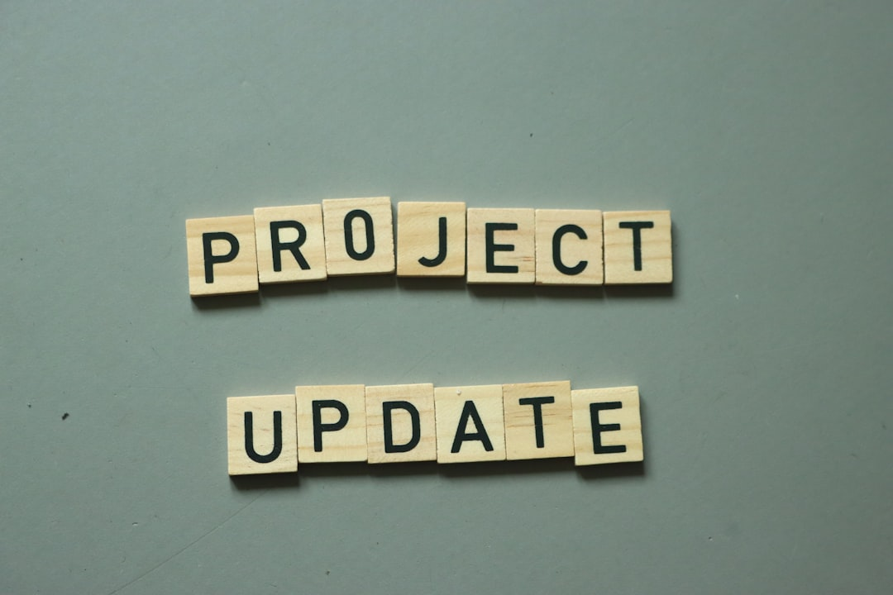
Identifying Challenges
- Identifying executive analysis challenges.

Slide 6
Our Strategic Process

Slide 7
Future Roadmap
- Future roadmap for executive analysis.

Slide 8

Before vs After analysis

Slide 9
Key Takeaways
Conclusion
- Comprehensive executive analysis completed.
- Final Analysis Score: 92%
- Axis: Executive Summary

Slide 10

Next Steps
Conclusion
- Comprehensive executive analysis completed.
- Next Steps Count: 3
- Axis: Next Steps

Slide 11
Questions & Thank You
High-level executive analysis.
Questions and thank you.

