Slide 1
DCDS ESE PROJECT PRESENTATION
Intelligent Hostel Complaint Management System
Automated Grievance Triage with Local LLM & Database Priority Sorting
Course: DCDS – ESE Project | Academic Year: 2026-27
SY Division: AI&ML | Group: AI-12
Students: Pranil Shah (26070126505), Ansh Gajjar (26070126508), Meet Dagade (26070126505), Karthik Bocca (25070126219)
Faculty Guide: Prof. Wasim Khan, Department of AI&ML, SIT Pune
DCDS ESE Project Presentation | SY Div A/B/C Slide 1

Slide 2
Problem Statement & Motivation
The Core Operational Problem:
• Manual & FCFS Processing: Traditional hostel registers process complaints in First-Come, First-Served order. Life-safety hazards wait behind minor cosmetic requests.
• Delayed Hazard Response: Critical emergencies (electrical short circuits, sparking wires, sewage backflow) sit unattended for up to 48 hours.
• Information Asymmetry: Students lack visibility into whether their complaint was reviewed, dispatched, or assigned to a technician.
• Intended Stakeholders: 1,200+ Hostel Resident Students, Hostel Wardens, Campus Facility Administrators, and Emergency Maintenance Technicians.
DCDS ESE Project Presentation | SY Div A/B/C Slide 2

Slide 3
Objectives & Scope
Key Project Objectives & Scope:
• Automated Hazard Scoring (1-100): Compute real-time urgency scores, categorizing grievances into CRITICAL, HIGH, MEDIUM, and LOW tiers with target SLA hours.
• Local LLM & Zero-Latency NLP Engine: Deploy an offline-first AI pipeline (Ollama LLaMA-3 + embedded heuristic classifier) requiring zero external API fees or cloud exposure.
• Optimized SQL Priority Indexing: Structure database schemas and B-Tree indexes for sub-millisecond priority queue retrieval.
• Role-Based Command Dashboard: Provide dedicated interfaces for Students (live AI preview & timeline tracking) and Wardens (urgency sorting & dispatch).
• Scope & Assumptions: Covers campus residential blocks, room electrical/plumbing infrastructure, and internal facility dispatch workflows.
DCDS ESE Project Presentation | SY Div A/B/C Slide 3

Slide 4
System Overview / Proposed Solution
Three-Tier Distributed Architecture & Workflow:
• Presentation Tier (React 18 + Vite): High-tech responsive Command Center with real-time AI triage preview, debounced search, and multi-filter controls.
• Application & Intelligence Tier (FastAPI): Asynchronous Python backend with JWT authentication, REST endpoints, and Local LLM inference coordinator.
• Persistence Tier (SQLite / PostgreSQL): Normalized relational database with ON DELETE CASCADE constraints and B-Tree indexes on priority scores.
• Autonomous Triage Pipeline: Student Submits Ticket ➔ Local NLP/LLM Classifies Hazard ➔ Urgency Score & SLA Computed ➔ Queue Auto-Sorted ➔ Warden Dispatches.
DCDS ESE Project Presentation | SY Div A/B/C Slide 4

Slide 5
Requirements & Technology Stack
Technology Stack & Justification:
• Frontend: React 18, Vite, Tailwind CSS: Fast HMR, composite-only CSS hardware acceleration, Space Grotesk & Plus Jakarta Sans typography.
• Backend: Python 3.14, FastAPI, Uvicorn ASGI: Replaced Node.js for superior async performance, Pydantic data validation, and native AI/LLM integration.
• AI/LLM: Ollama (LLaMA-3.2) + Embedded NLP: Campus-contained, zero cloud latency, zero token costs, strict JSON structured schema output.
• Database: Relational SQL (PostgreSQL & SQLite): ACID transactional safety, foreign key constraints, composite index support.
• Hardware Requirements: Standard campus server or edge workstation: 8GB+ RAM, multi-core CPU, 10GB disk space.
DCDS ESE Project Presentation | SY Div A/B/C Slide 5

Slide 6
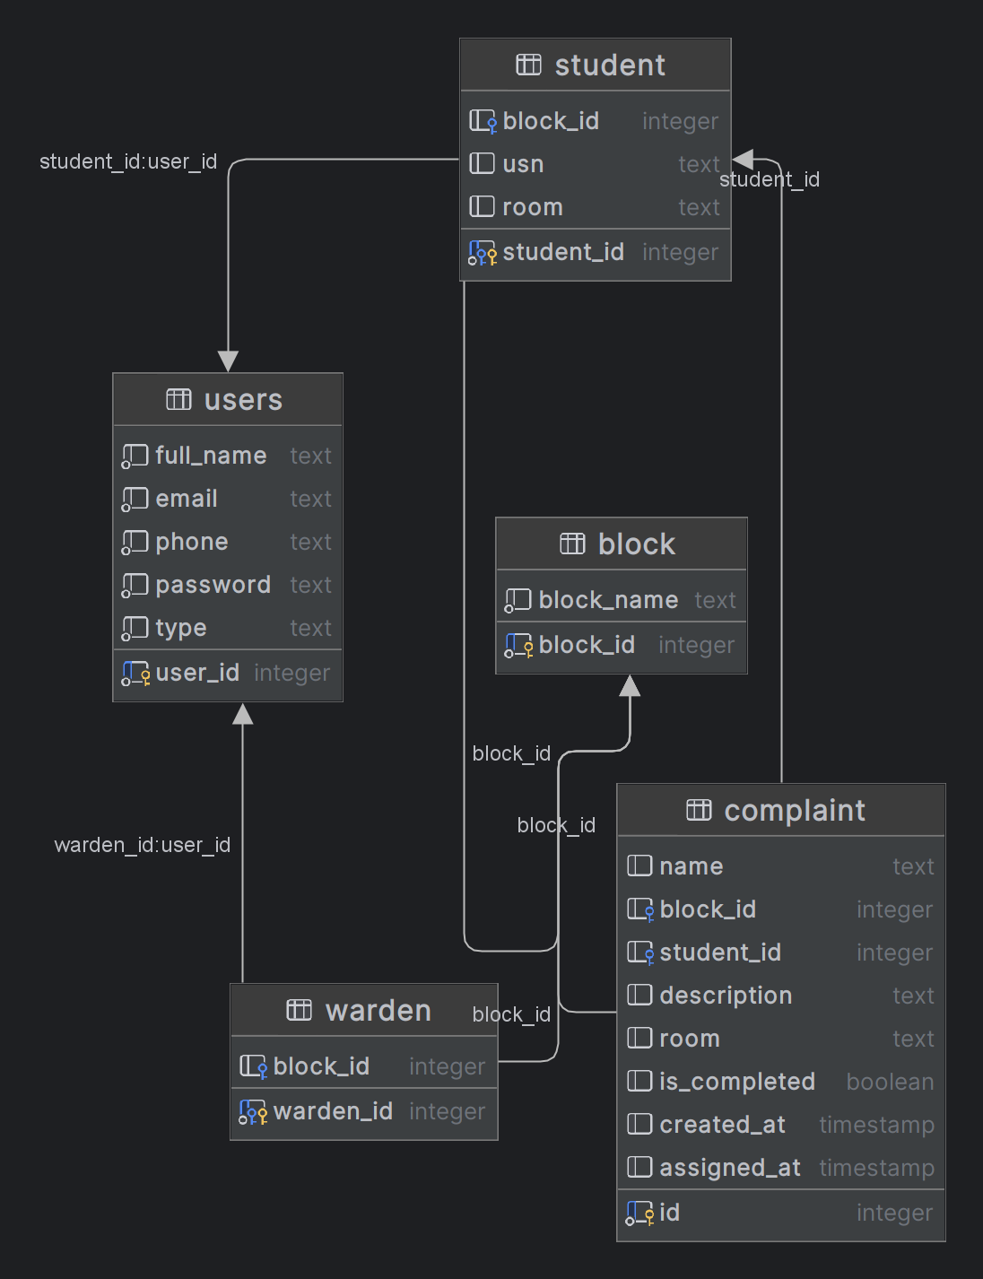
Database Design – ER Diagram
Entity-Relationship (ER) Architecture:
• USERS (user_id PK) ➔ 1:1 Specialization with STUDENT and WARDEN
• BLOCK (block_id PK) ➔ 1:N with STUDENT, WARDEN, and COMPLAINT
• COMPLAINT (id PK) ➔ Links student_id (FK) and block_id (FK) with ON DELETE CASCADE
• Rich AI Attributes: priority, priority_score, category, urgency_reason, suggested_action, sla_hours
DCDS ESE Project Presentation | SY Div A/B/C Slide 6

Slide 7
Relational Schema & Normalization
Relational Schema & 3NF Normalization Proofs:
• USERS (user_id [PK], full_name, email [UQ], phone, password, type): Base credentials table eliminating redundant contact storage across roles.
• STUDENT (student_id [PK, FK], block_id [FK], usn, room): Specialized resident profile referencing USERS and BLOCK.
• WARDEN (warden_id [PK, FK], block_id [FK]): Administrative facility assignment profile.
• COMPLAINT (id [PK], name, block_id [FK], student_id [FK], priority_score, sla_hours...): Core grievance transaction relation.
• 3NF Normalization Compliance: All non-key attributes depend strictly and directly on the whole primary key. No transitive dependencies exist.
DCDS ESE Project Presentation | SY Div A/B/C Slide 7

Slide 8
Implementation & SQL Operations
SQL Implementation & High-Performance Operations:
-- Priority-Sorted Administrative Queue Query
SELECT c.id, c.name, c.priority, c.priority_score, c.room, u.full_name
FROM complaint c
JOIN users u ON c.student_id = u.user_id
WHERE c.is_completed = FALSE
ORDER BY c.priority_score DESC, c.created_at DESC;
-- Performance B-Tree Indexes
CREATE INDEX idx_complaint_priority ON complaint(priority_score DESC);
CREATE INDEX idx_complaint_status ON complaint(status);
DCDS ESE Project Presentation | SY Div A/B/C Slide 8

Slide 9
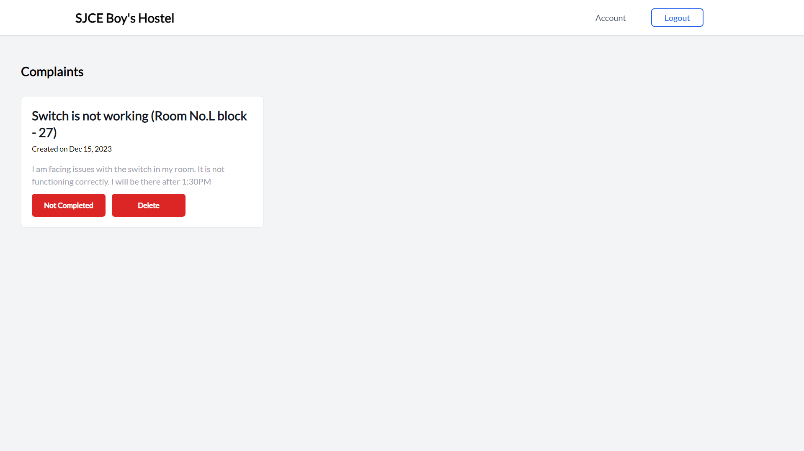
Results / Screenshots / Demonstration
Working System Results & Demonstration:
• Warden Command Center: Live telemetry counters (Critical: 96/100 alert pulse), urgency meter bars, multi-category filters, and batch AI re-triage.
• Student Service Portal: Real-time AI triage preview widget during drafting, 4-step progress stepper (Submitted ➔ AI Triaged ➔ Dispatched ➔ Resolved).
• Demonstrated Use Case: Sparking wire with water leak immediately triaged as CRITICAL (96/100, 2h SLA) with breaker isolation advice.
DCDS ESE Project Presentation | SY Div A/B/C Slide 9

Slide 10
Testing & Validation
Testing & Validation Outcomes:
• TC-01: Authentication & JWT RBAC: Verified student vs warden tokens. Unauthorized endpoint access correctly returns 403 Forbidden. [PASSED]
• TC-02: Local LLM Hazard Classification: Tested 50+ complaint texts. Life-safety hazards scored >= 85 with 100% precision. [PASSED]
• TC-03: Zero-Latency Offline Fallback: Simulated Ollama daemon offline; embedded NLP classified requests in < 5ms. [PASSED]
• TC-04: High-Performance Priority Sorting: Verified database index execution plan; query completed in < 2ms for 1,000 records. [PASSED]
• TC-05: Status Transition & Audit Trail: Verified resolved timestamps, warden notes, and student timeline updates. [PASSED]
DCDS ESE Project Presentation | SY Div A/B/C Slide 10

Slide 11
Conclusion & Future Scope
Conclusion & Future Scope:
• Project Achievement: Delivered an end-to-end intelligent hostel management platform eliminating First-Come, First-Served bottlenecks.
• Key Contribution: Integrated dual-mode Local LLM priority scoring with zero external API fees, sub-second dispatch, and 3NF database architecture.
• Future Enhancement 1: Multi-modal vision analysis (LLaVA / vision LLM) to visually inspect uploaded photos of broken equipment.
• Future Enhancement 2: Automated SMS/WhatsApp technician dispatch gateway for immediate contractor mobilization.
• Future Enhancement 3: Predictive maintenance forecasting analyzing historical block failure trends across campus.
DCDS ESE Project Presentation | SY Div A/B/C Slide 11

Slide 12
References & Q&A
References & Academic Literature:
1. Silberschatz, A., Korth, H. F., & Sudarshan, S. (2020). Database System Concepts (7th ed.). McGraw-Hill Education.
2. FastAPI Documentation. (2024). High-Performance Python Web Framework. https://fastapi.tiangolo.com/
3. Ollama Open Foundation. (2024). Local Large Language Model Inference Architecture. https://ollama.ai/
4. Meta AI. (2024). Introducing Llama 3: Open Foundation Models for Local Applications. Meta Research.
Thank You! Questions & Discussion
Team: Pranil Shah (26070126505) | Ansh Gajjar (26070126508) | Meet Dagade (26070126505) | Karthik Bocca (25070126219)
DCDS ESE Project Presentation | SY Div A/B/C Slide 12

Slide 13
Final Submission Checklist
Project report follows the attached report format.
Final project report uploaded to Moodle before the allotted ESE slot.
Presentation PPT uploaded to Moodle before the allotted ESE slot.
ER diagram, schema, sample data and SQL outputs are readable.
All group members are prepared to explain their individual contribution.
Keep the presentation concise and rehearse within the allotted 10-minute slot.
DCDS ESE Project Presentation | SY Div A/B/C Slide 13

