Slide 1
AI-Powered Transcription & Documentation Platform for Law Enforcement
Leap Hackathon
(Law Enforcement and Policing)
Name – Pranishraj Atul Nigade
Course – B.E. (Artificial Intelligence and Data Science)
Year – Third Year
Address – Pune, Maharashtra

Slide 2
Problem statement
Law enforcement officers rely on manual documentation, which is slow, error-prone and time-consuming.
FIR filing and case documentation involve extensive paperwork, delaying investigations.
Lack of real-time transcription, multilingual support and seamless integration affects operational efficiency.
Officers need a faster, more reliable and accessible documentation solution.

Slide 3
Solution overview
An AI-powered platform that enables real-time transcription, automated FIR logging, and video transcription.
Supports 13 languages, works offline, and synchronizes across mobile and web platforms.
Reduces paperwork, improves efficiency, and enhances documentation accuracy.
Provides a secure, easy-to-use, and scalable solution tailored for law enforcement.

Slide 4
Key features
On-Scene Real-Time Transcription – Officers can dictate reports instantly, eliminating manual note-taking.
Multilingual & Offline Support – Transcription available in 13 languages with offline capabilities for remote areas.
File Management System – Organize, edit, save, delete, and download transcripts and recordings.
Web Dashboard Integration – Access 30+ advanced editing tools for refining & managing transcriptions.
Automated FIR Logging – Convert voice inputs into structured FIRs, reducing paperwork.
Video Transcription Support – Transcribe video evidence with timestamped documentation.
Seamless Mobile to Web Synchronization – Real-time updates ensure accessibility from any device.
High-Speed & Accurate AI Transcription – Optimized speech recognition for law enforcement needs.

Slide 5
Technology stacks
AI/ML : Whisper API, Open AI/GCP Speech-to-Text for transcription.
Frontend : React (Web), React Native/Flutter (Mobile) for user-friendly interfaces.
Backend : FastAPI/Node.js for API processing and logic handling.
Database : PostgreSQL/Firebase for structured and real-time data management.
Cloud Storage : AWS S3/GCP for secure storage of audio, video & transcriptions.
Security : End-to-End Encryption, Role-Based Access Control for data protection.

Slide 6
Workflow
User records audio/video using the mobile app.
AI engine processes speech-to-text transcription in real-time.
Transcribed text is synced to a secure cloud database.
Web dashboard provides editing & management tools for refinement.
Final documents can be downloaded, shared or used for FIR logging.

Slide 7
Expected impact
✅ Reduces administrative workload – Less paperwork, faster documentation.
✅ Enhances investigation speed – Instant transcription and FIR filing.
✅ Improves accessibility – Offline functionality for remote areas.
✅ Ensures accuracy – AI-driven, noise-filtered transcription.
✅ Seamless integration – Works across mobile and web for uninterrupted workflow.

Slide 8
Expected impact
NLP-based Summarization – Generate concise reports from lengthy transcripts.
Biometric Authentication – Secure login for authorized officers only.
Integration with National Crime Databases – Auto-fetch suspect details.
AI-driven Speech Analysis – Detect stress, emotions, and anomalies in statements.

Slide 9
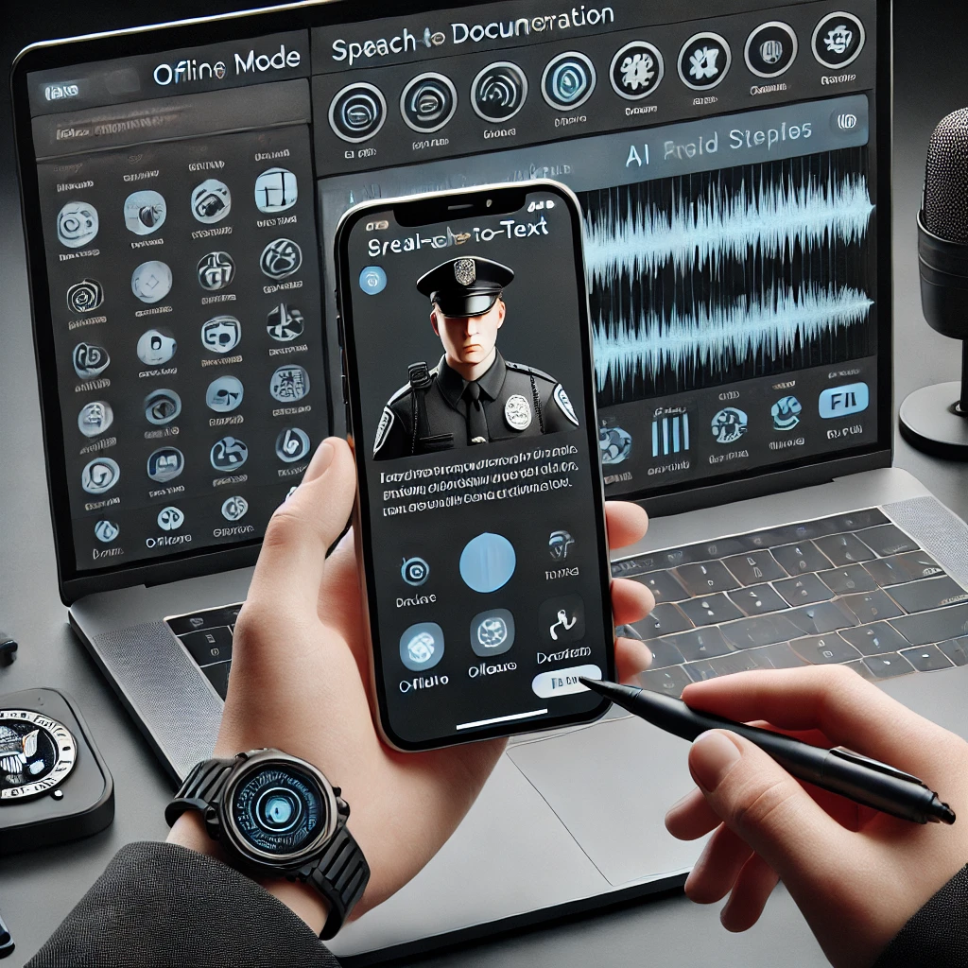
Demo image ( this is an AI based image)

Slide 10
conclusion
Our AI-powered platform is set to revolutionize law enforcement documentation, reducing workload, enhancing accuracy, and streamlining workflows. With real-time transcription, FIR automation and multilingual support, our solution is built to address the pressing needs of officers in the field.

Slide 11
THANK YOU

