Slide 1
SWARM INTELLIGENCE BASED MAZE SOLVER
Project Members
Digya Acharya(069BEX412)
Pranish Bhagat(069BEX425)
Pratik Bhandari(069BEX427)
Sijan Bhattarai(069BEX438)
Project Supervisor
Mr. Dinesh Baniya Kshatri

Slide 2
OUTLINE
Motivation
Introduction
Methodology
Result
Tools used
Conclusion
Limitations

Slide 3
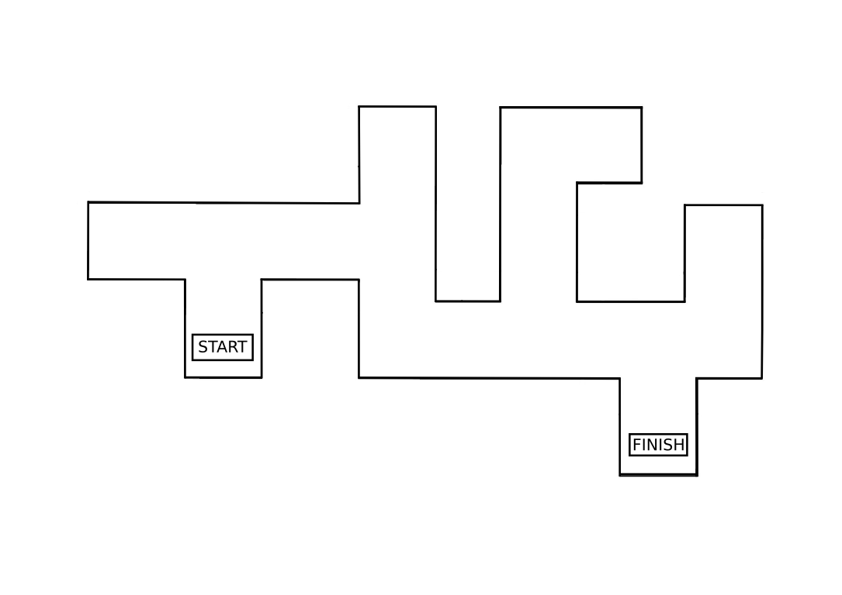
MOTIVATION How can a robot find the shortest path?

Slide 4
PROBLEM STATEMENT
To demonstrate the concept of Swarm Intelligence
To solve a maze using swarm robotics
To develop an effective communication between two robots

Slide 5
INTRODUCTION
Group of robots operate without any form of centralized control
Using local methods of control and communication
Local control – autonomous operation
Local communication – avoids bottlenecks
Scalable – new robots can be added, or fail without need for recalibration
Simplicity – cheap, expendable robots
Self-organization

Slide 6
APPLICATIONS OF SWARM
Search And Rescue ( SAR) Operation.
Disaster Relief
Landmine Detection and further operations

Slide 7
PURPOSE OF SWARM INTELLIGENCE
Efficient use of resource
Autonomous navigation
Work Division
De-centralization
Unknown terrain navigation

Slide 8
METHODOLOGY
Obstacle Detection
Maze Traversal and Target Detection
Path Deduction
Communication
Output

Slide 9
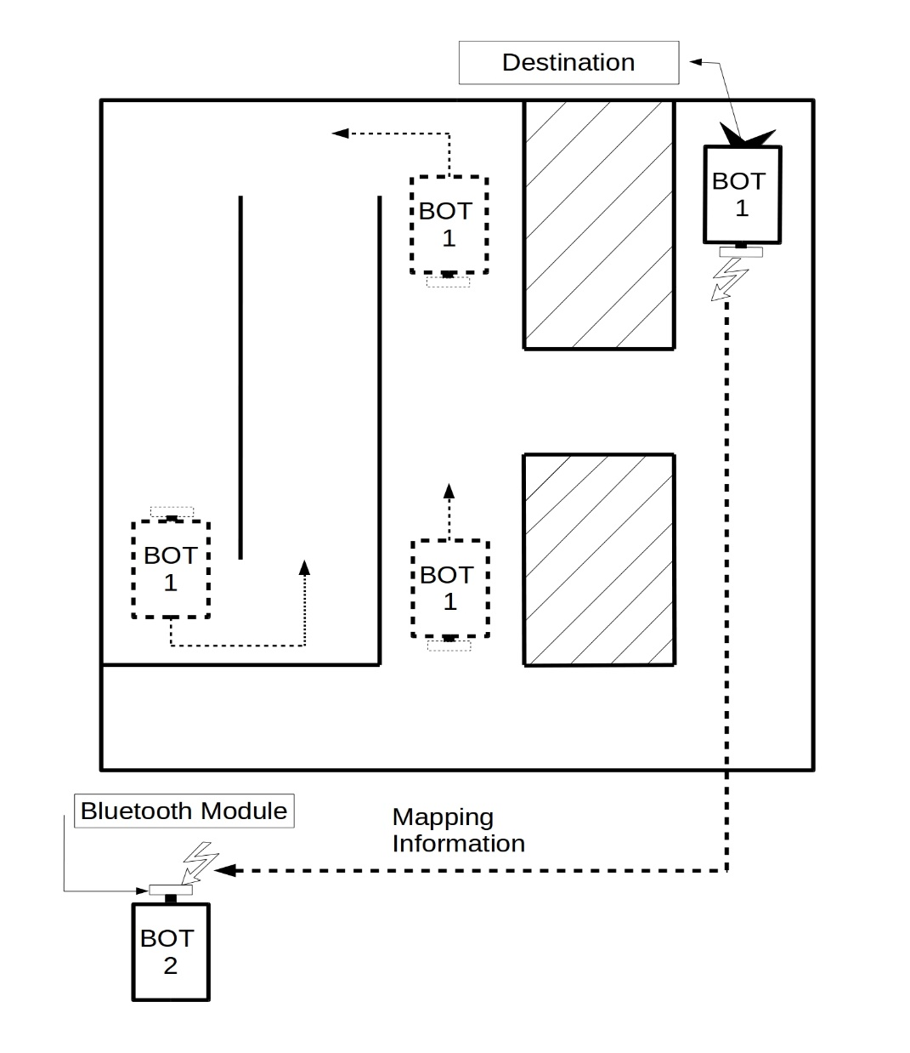
METHODOLOGY System Overview
First Robot
Traverses the whole maze from start to finish implementing the left wall algorithm
Relay maze mapping information
Second Robot
Traverse in shortest possible path
SYSTEM ARCHITECTURE

Slide 10
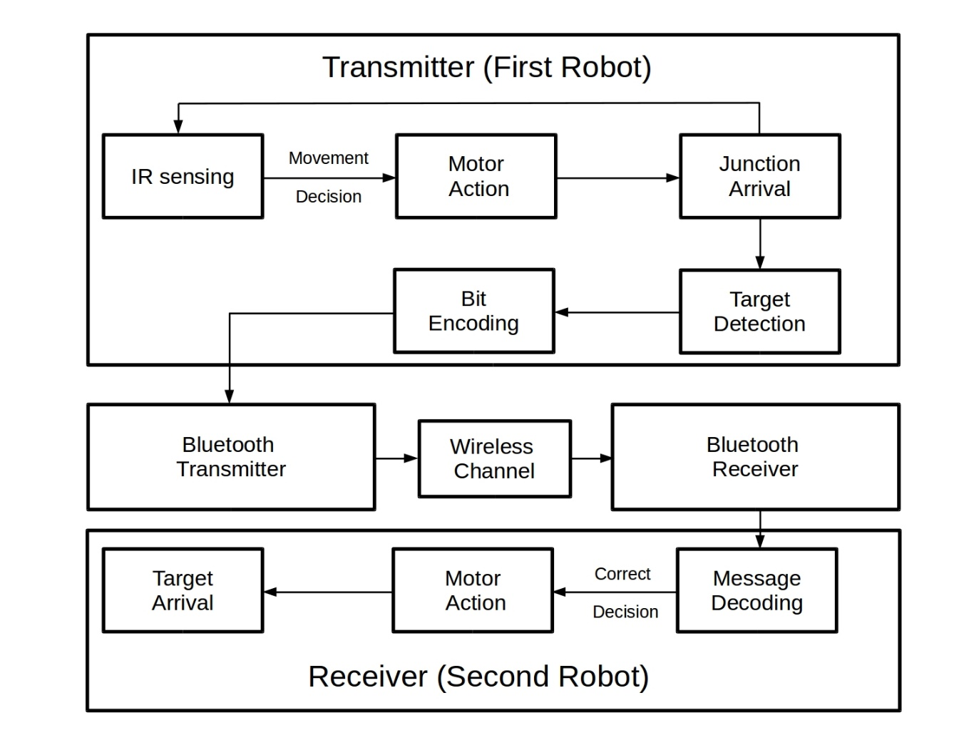
METHODOLOGY Functional Block Diagram

Slide 11
METHODOLOGY Functional Overview-First Robot
The first robot traverses the entire maze. (non-optimal path)
Implementing left wall algorithm.
Detects the target.
Sends the optimized path to the second robot.

Slide 12
METHODOLOGY Functional Overview-Second Robot
The second robot receives the optimized path from the second robot.
Traverses the maze in the shortest path possible.

Slide 13
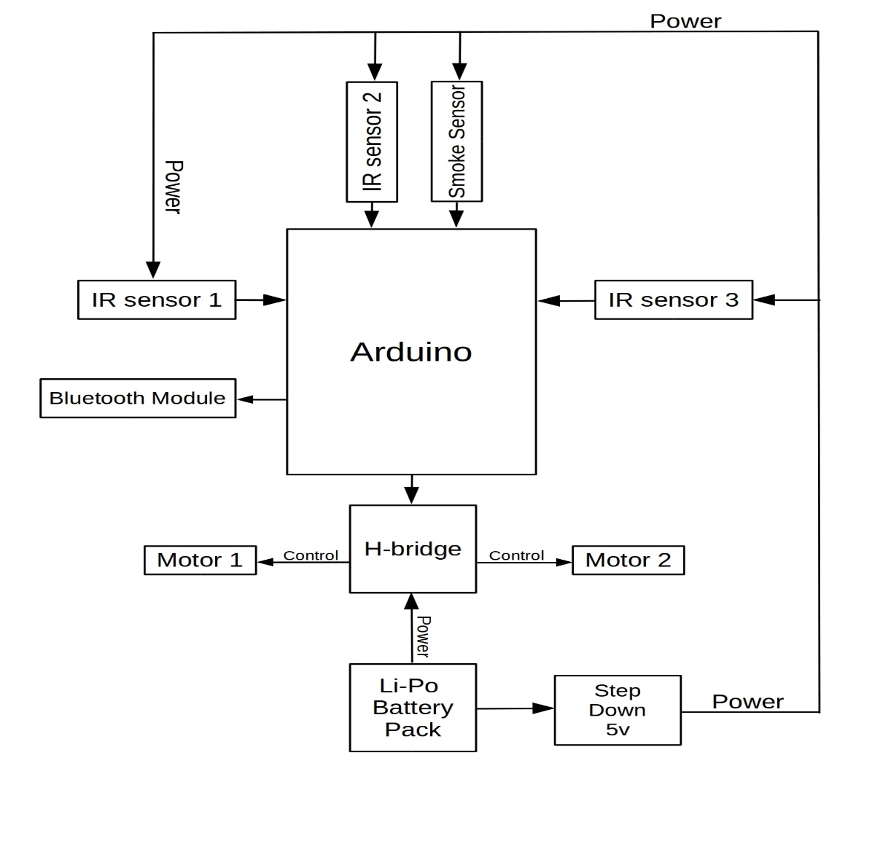
METHODOLOGY First Robot Schematic

Slide 14
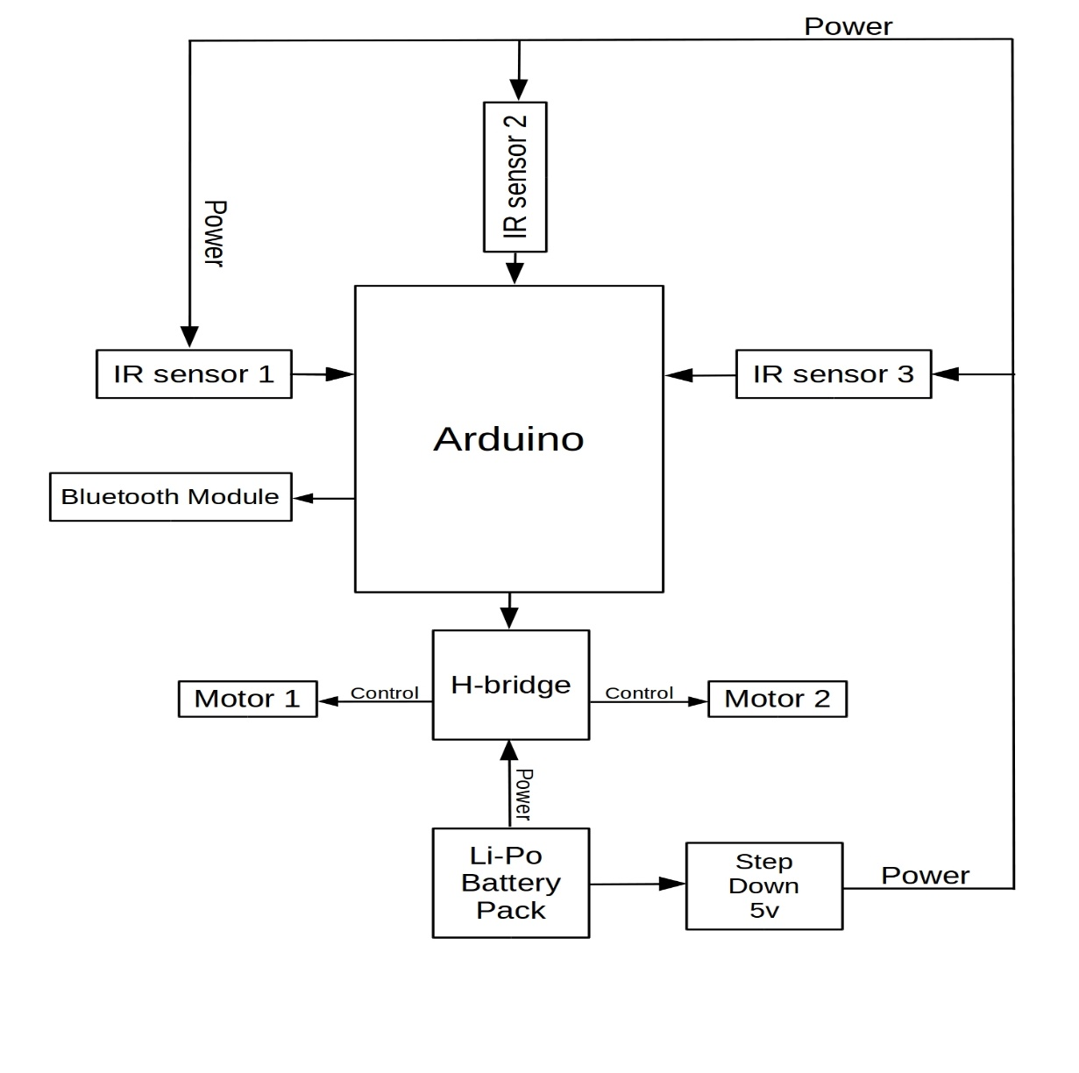
METHODOLOGY Second Robot Schematic

Slide 15
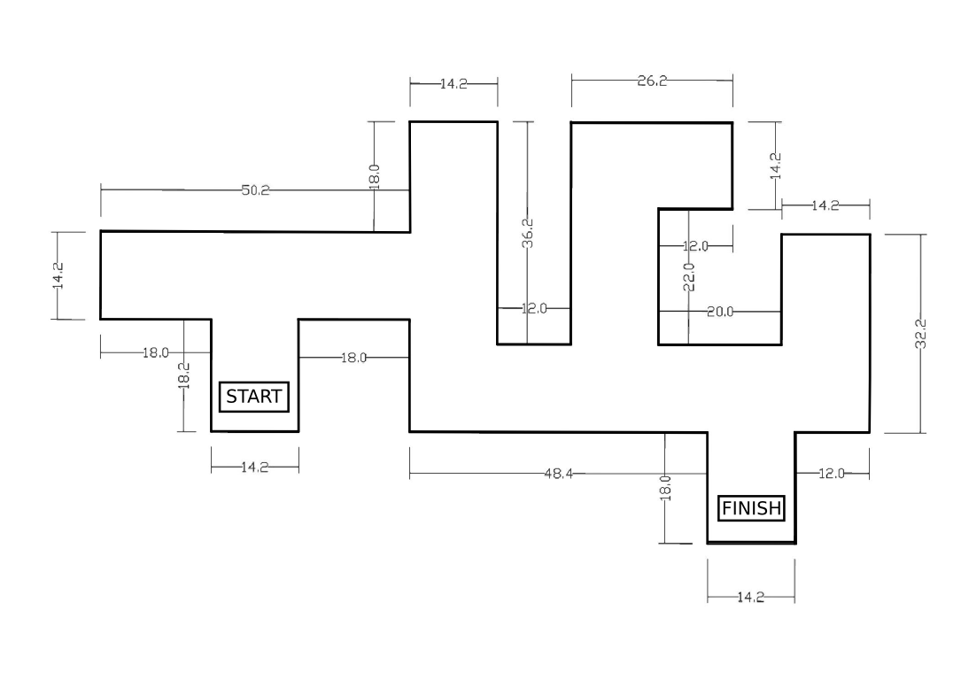
METHODOLOGY Structure of The Maze
Height: 8 inches

Slide 16
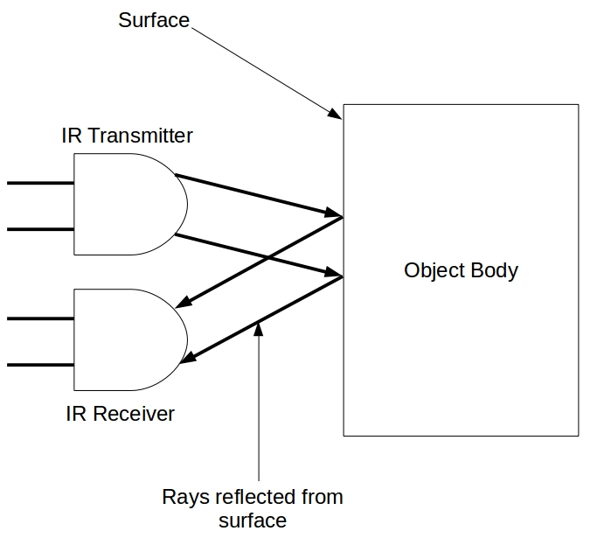
METHODOLOGY Obstacle Detection
Detection Carried Out Through IR Sensors FC-51
IR Transmitter
IR Receiver

Slide 17
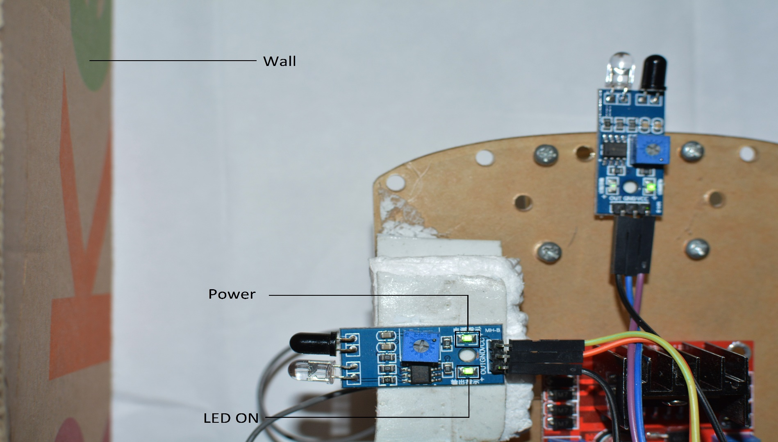
METHODOLOGY Obstacle Detection-Left Wall

Slide 18
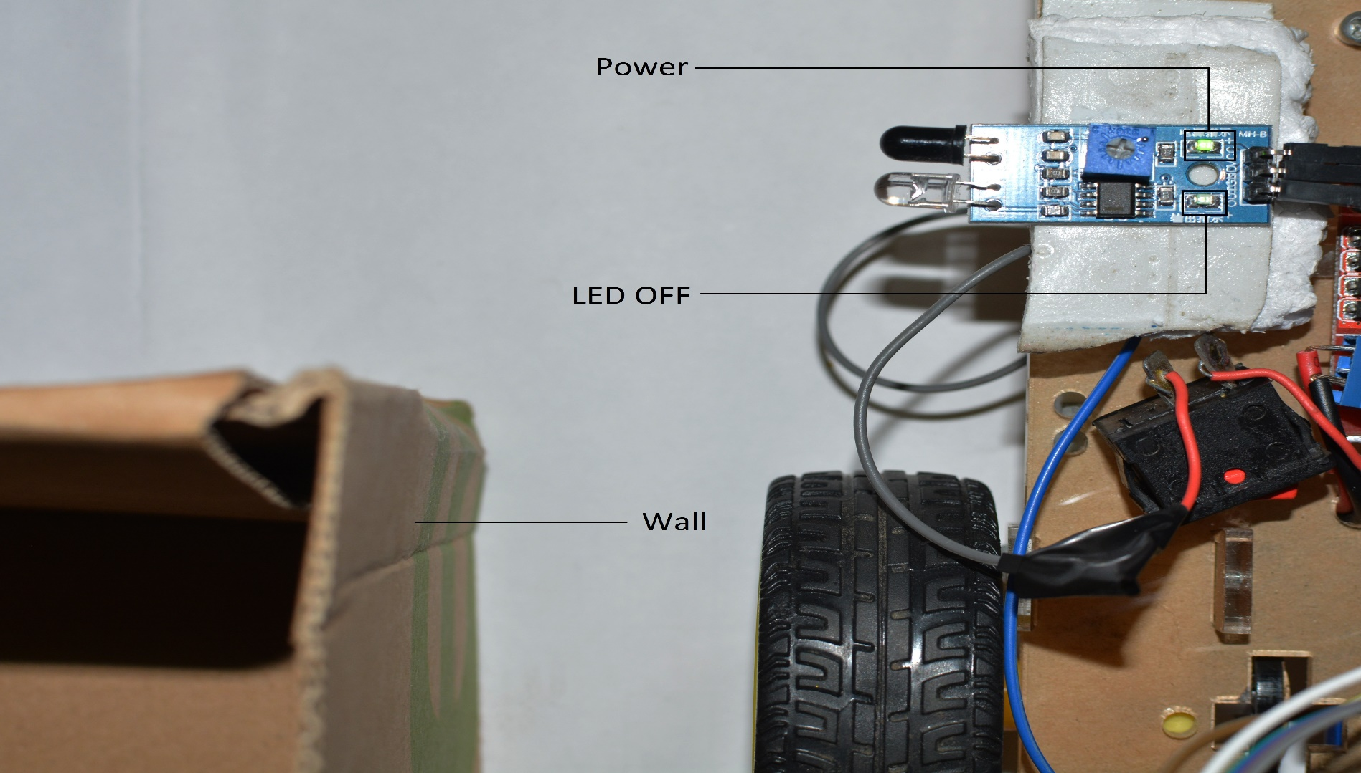
METHODOLOGY Obstacle Detection-Left Wall

Slide 19
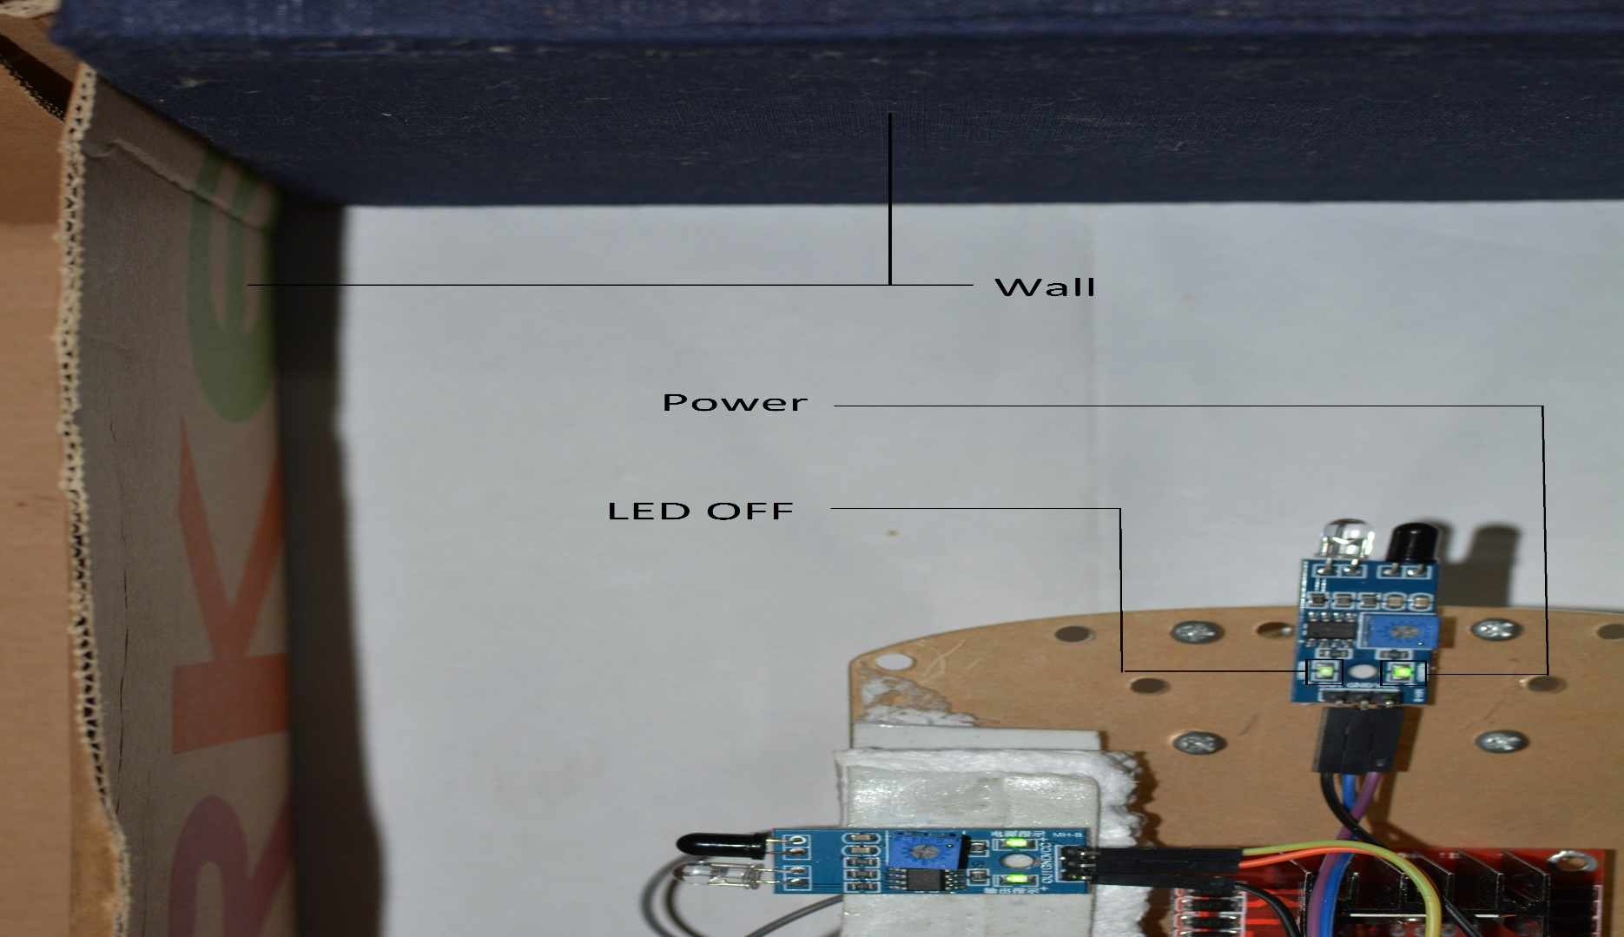
METHODOLOGY Obstacle Detection-Front Wall

Slide 20
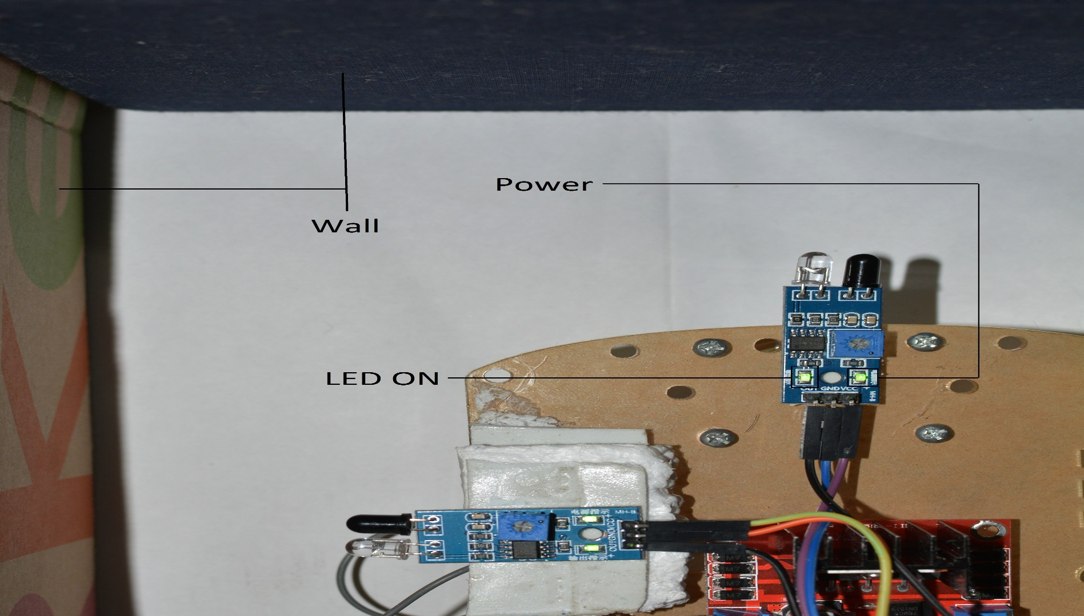
METHODOLOGY Obstacle Detection-Front Wall

Slide 21
METHODOLOGY Maze Traversal-First Robot
Left Wall Algorithm
Robot will reach the target by keeping track of the left wall
Priorities | Direction
1 | Left
2 | Straight
3 | Right
4 | U-Turn

Slide 22
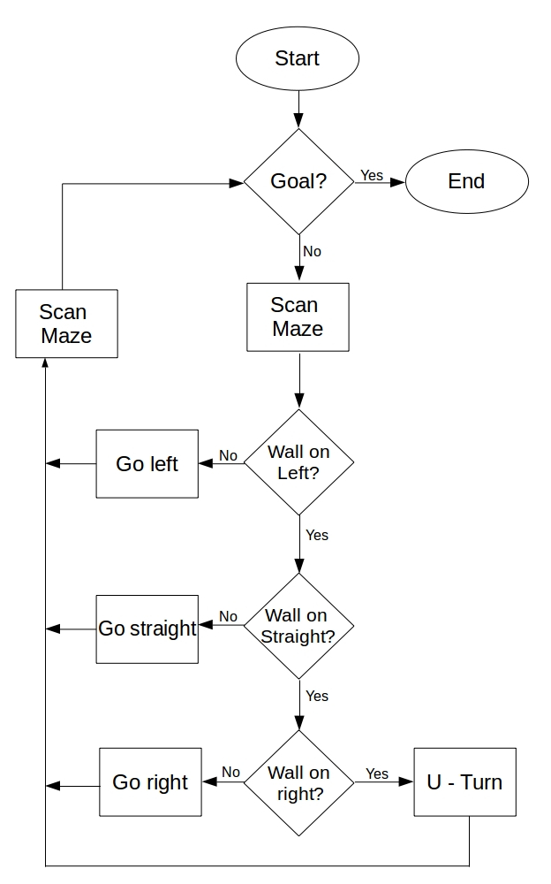
METHODOLOGY Maze Traversal-First Robot
Algorithm

Slide 23
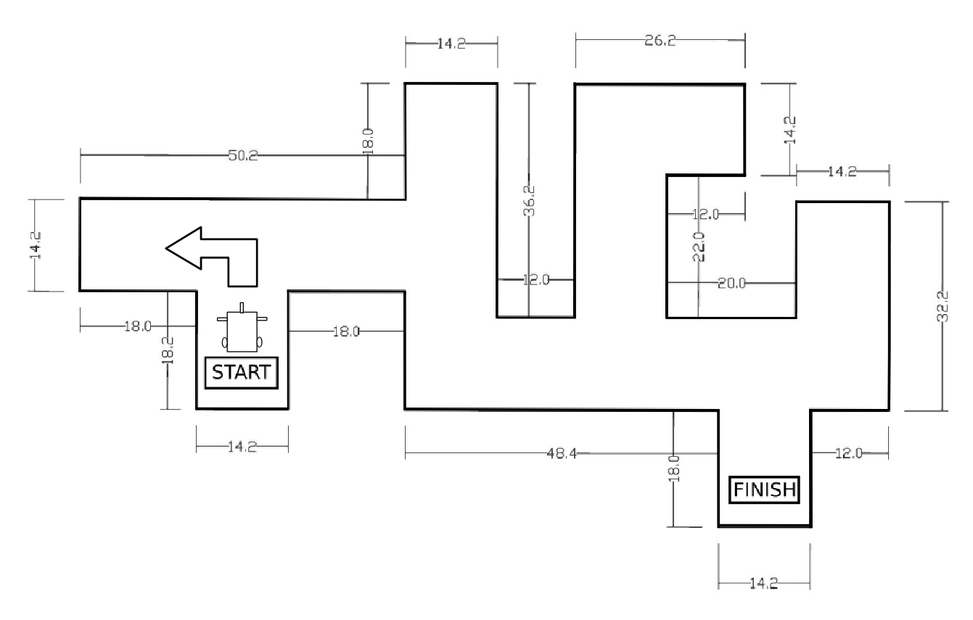
METHODOLOGY Maze Traversal-First Robot

Slide 24
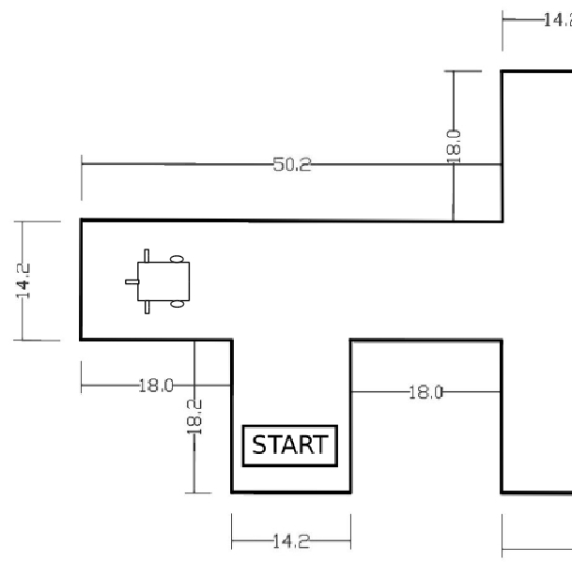
METHODOLOGY Maze Traversal-First Robot

Slide 25
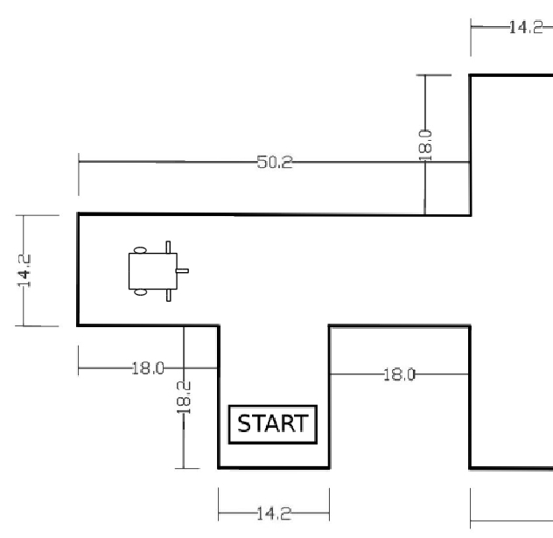
METHODOLOGY Maze Traversal-First Robot

Slide 26
METHODOLOGY Target Detection
Target : Smoke
Target detected using MQ-2 Smoke Sensor
Smoke generated using incense.

Slide 27
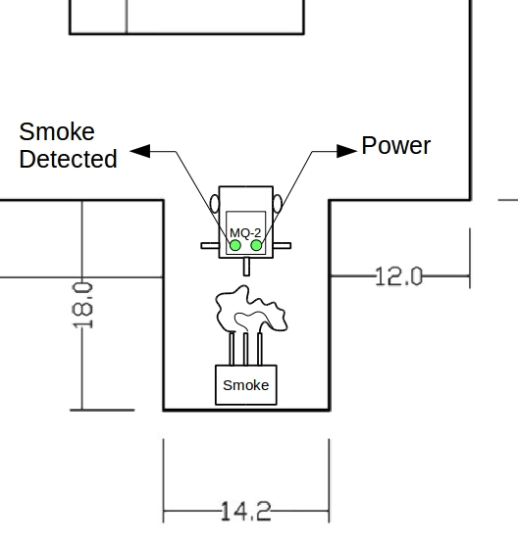
METHODOLOGY Target Detection

Slide 28
METHODOLOGY Path Deduction
The path followed by the first robot.
S | L | U | S | L | U | S | L | U | L | S | U | L

Slide 29
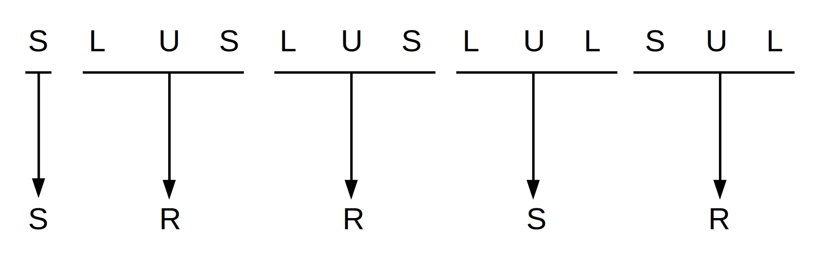
METHODOLOGY Path Deduction
The optimal decisions required for shortest path.

Slide 30
METHODOLOGY Path Deduction
The deduced path stored in an array.

