Slide 1

Project Review-II Medical Abstract Segmentation
Guide: Dr. Emmanuel Markappa Group Id: 63
Reviewer: Dr. Anant M. Bagade Members: 43366 Saifuddin Shaikh Mr. Sandip R. Warhade 43373 Rishikesh Suryavanshi 43382 Pranish Warke

Slide 2
Abstract
Randomized control trials (RCTs) are essential for evaluating the effectiveness of medical interventions, but their results are often buried within lengthy and complex documents. Efficiently extracting and organizing critical information from RCT abstracts can significantly impact evidence-based decision-making and healthcare research. The automated segmentation of medical abstracts is a vital component of medical information retrieval and analysis, significantly impacting clinical decision-making, healthcare research, and knowledge discovery. This paper presents an innovative approach to segmenting abstracts of RCTs through the application of natural language processing (NLP) and neural networks. The practical applications of NLP and neural network-based text segmentation in the context of RCTs are exemplified, ranging from systematic reviews and meta-analyses to the development of clinical guidelines. Case studies are presented to showcase the impact of this technology in improving the accessibility and utilization of RCT results. This paper serves as a valuable resource for researchers, healthcare professionals, and data scientists, offering a glimpse into the future of RCT abstract segmentation. It underscores the pivotal role of NLP and neural networks in unlocking the potential of RCT data, ultimately advancing the field of evidence-based medicine and healthcare decision-making.
Index Terms — medical abstract, text segmentation, randomized control trial (RCT),natural language processing(NLP),neural networks.

Slide 3
Introduction
Medical practice too often fails to incorporate recent medical advances.
The two main reasons for this failure are :
That over 25 million scholarly medical articles have been published
Medical practitioners do not have the time to perform literature reviews
Systematic reviews aim at summarizing published medical evidence but writing them requires tremendous human efforts.
Several natural language processing methods based on artificial neural networks try to facilitate the completion of systematic reviews.
In particular, we focus on short-text classification, to help authors of systematic reviews locate the desired information.

Slide 4
Literature Survey
A comprehensive study has been done on text classification in the domain of medical research papers. Some of the most recent and prominent ones have been used for this literature survey.
In [1] the dataset consists of approximately 200,000 abstracts of randomized controlled trials, totaling 2.3 million sentences. Each sentence of each abstract is labeled with its role in the abstract using one of the following classes: background, objective, method, result, or conclusion, and [2] suggests a novel uniform deep learning architecture and multi-task learning approach for cross-domain sequential sentence classification in scientific texts, similarly [3] Adopted a deep learning neural network model and pretrained the network on PubMed non-RCT dataset. Transfer Learning with fine-tuning was done on the hand-labeled dataset they created from scratch. In [4] The model is composed of four components: the word embedding layer, the sentence encoding layer, the context enriching layer, and the label sequence optimization layer. The sequence of embedding vectors is first processed by a bi-directional RNN (bi-RNN) or CNN layer. In [5] The model consists of two novel components: supervised local attention and an auxiliary span-based classification task. The proposed model aims to capture the latent segment structure of the document by considering the coherent semantics of contiguous sentences. It utilizes dynamic local attention to explicitly capture the structural information.

Slide 5
Literature Survey
In [6] paper, a Machine Learning approach that aims to classify sentences according to the PIBOSO scheme is presented. A discriminative set of features that do not rely on any external resources to achieve results is used. In [7] The algorithm implemented is based on the following four steps: Medical concepts are extracted from free-text descriptions of an interview and examination, a new representation of identified concepts is derived using concept embedding, concept embeddings are transformed into visit embeddings and clustering is performed on visit embeddings. They used two of the most common: k-means and hierarchical clustering with Ward’s method for merging clusters. These algorithms cover two different clustering approaches. The algorithms are memory and time-efficient, so no need to use more advanced methods. The papers [8] and [9] propose a few-shot prompt learning-based approach to classify sentences in medical abstracts of randomized clinical trials (RCT) and observational studies (OS) to subsections of Introduction, Background, Methods, Results, and Conclusion. 5 manually designed templates in a combination of 4 BERT model variants were tested and compared to a previous Hierarchical Sequential Labeling Network architecture and traditional BERT-based sentence classification method. Four deep learning models, namely RNN, LSTM, GRU, and BLSTM are used. Data pre-processing steps are applied that include: text cleaning, tokenization, stemming, as well as lemmatization to remove and stop words. In [10] ULMFiT stands as a game-changer in NLP, it delivers remarkable error reductions of 18-24 percent across six text classification tasks. Its open-sourced pre-trained models and code empower the NLP community with powerful tools for diverse applications.

Slide 6
Concept
Randomized Controlled Trial (RCT) is a specific type of study design commonly used in medical research to evaluate the effectiveness of a treatment or intervention. In an RCT, participants are randomly assigned to different groups to compare the outcomes of those who receive the treatment or intervention with those who do not. Randomization: Participants are randomly assigned to groups to reduce selection bias. Blinding: Double-blind or single-blind methods may be used to prevent biases in both participants and researchers. Control Group: A group that does not receive the treatment or receives a placebo, allowing for comparison. Treatment Group: The group that receives the experimental treatment or intervention. Existing models based on artificial neural networks (ANNs) for sentence classification often do not incorporate the context in which sentences appear and classify sentences individually. However, traditional sentence classification approaches have been shown to greatly benefit from jointly classifying subsequent sentences, such as with conditional random fields. In the work proposed by the paper, it presents an ANN architecture that combines the effectiveness of typical ANN models to classify sentences in isolation, with the strength of structured prediction. The model achieves state-of-the-art results on two different datasets for sequential sentence classification in medical abstracts.

Slide 7
Proposed Methodology
Dataset
The PubMed 20K RCT dataset was used in this study. The dataset is available at
https://github.com/Franck-Dernoncourt/pubmed-rct . The collection includes 2.3 million phrases from almost 200,000 abstracts of randomized controlled trials. Each abstract’s sentences are assigned a class based on their role in the abstract, such as background, objective, method, result, or conclusion. For the specified problem of medical abstract segmentation, PubMed dataset is publicly available. It consists of following five labels and the number of samples are as follows: 1. METHODS 59353 2. RESULTS 57953 3. CONCLUSIONS 27168 4. BACKGROUND 21727 5. OBJECTIVE 13839

Slide 8
Proposed Methodology
B. Types of Classification
Sentence classification is a common task in natural language processing (NLP) and can be categorized into various types, depending on the specific problem or goal. Here are some common types of sentence classification:
1. Text Classification
2. Language Understanding
3. Document Summarization
4. Question Answering
C. Data import and Cleaning
The dataset was cloned from the publicly available GitHub repository of [1]. The cloned PubMed RCT dataset consisted of four different sub-datasets within it.

Slide 9
Proposed Methodology
D. Feature Engineering
The data should be transformed into a format that the model can comprehend after being cleaned and pre-processed. Feature engineering is a crucial step in the process of sequential sentence classification, a task commonly encountered in natural language processing (NLP) and text analysis. Sequential sentence classification involves assigning one or more labels to each sentence in a sequence, such as in sentiment analysis, named entity recognition, or text categorization. Effective feature engineering can significantly improve the performance of machine learning models used for this purpose. There are various key aspects of Feature Engineering in Sequential Sentence Classification :
Text Representation
Preprocessing
Tokenization
Feature Extraction
Sequence Encoding
Domain-Specific Knowledge
Model Selection

Slide 10
Data Flow Diagram
Data Collection: Gather RCT documents.
Pre-processing: Clean and pre-process text data.
Tokenization: Divide text into words or subunits.
Feature Extraction: Convert text to numerical features.
Labelling Criteria: Define RCT classification criteria.
Machine Learning Models: Train supervised models.
Evaluation Metrics: Assess model performance.
Interpretation: Analyze and refine model results.
Continuous Improvement: Update and enhance the model.
Deployment: Deploy for automated RCT classification.
Integration: Link with information retrieval systems.

Slide 11
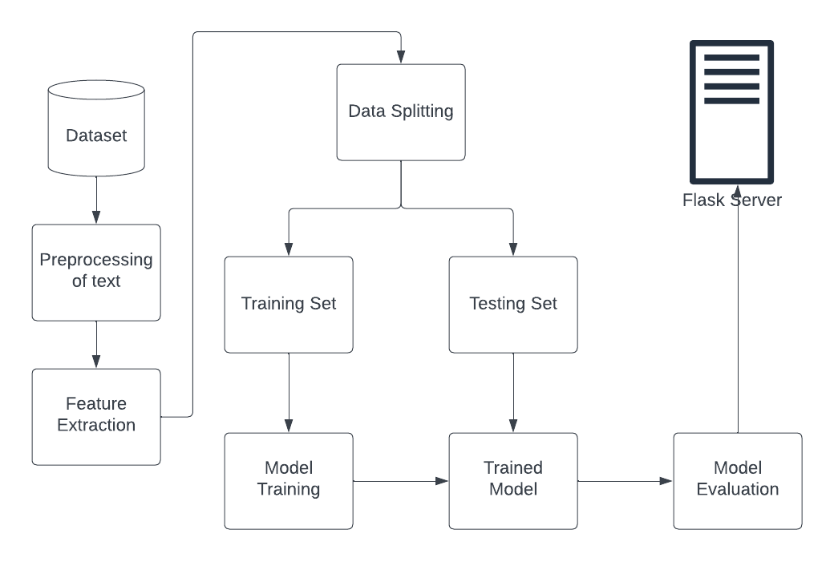
Flow Chart Diagram

Slide 12
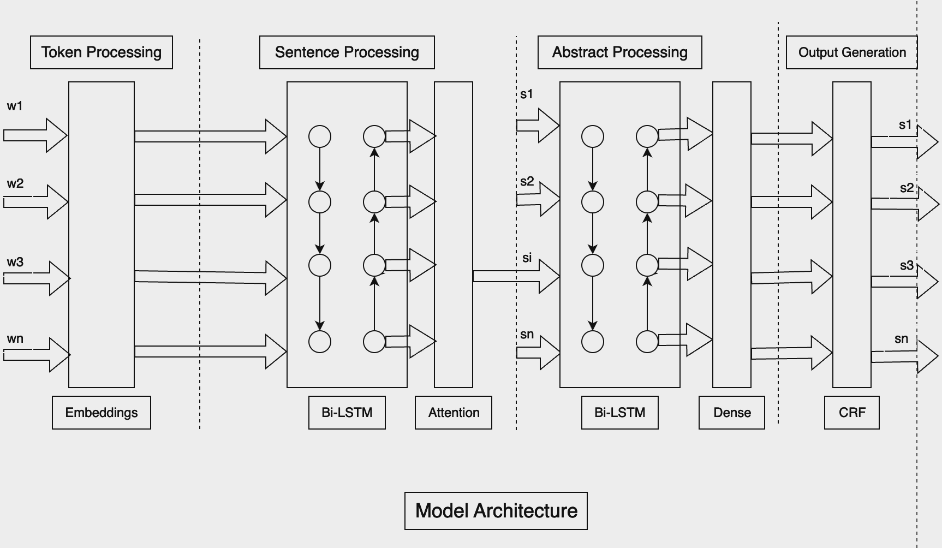
Model Architecture

Slide 13
System Requirements
Hardware Requirements –
i5 7th Gen Intel Core Processor,
8 GB Ram,
GPU instances.
Software Requirements –
Python
Jupyter Notebook
TensorFlow
SciKit Learn.

Slide 14
Future Scope
For future enhancements, the following considerations merit attention: Replacement of Universal Sentence Encoder (USE) with Biomed NLP-PubMed BERT-base-uncased-abstract : Biomed NLP-PubMed BERT-base-uncased-abstract presents a compelling alternative to USE in terms of performance and accuracy.
Text Preprocessing: The absence of text preprocessing in our proposed architecture was a deliberate choice, aimed at minimizing feature dependencies during model training, following a similar approach for the ”current line” feature.
Nevertheless, to further enhance model performance, it is recommended to consider text preprocessing techniques, such as the removal of stop words, punctuation, special characters, and webpage links, conversion to lowercase, as well as the application of stemming and lemmatization. These strategies can contribute to more refined and accurate model predictions.

Slide 15
Conclusion
Our work here contributes to the ongoing efforts for implementation of a Natural Language Processing (NLP) model designed for the segmentation of text lines in medical research paper abstracts. In this paper we extensively carried out empirical study of various deep learning models and explored particularly the bio-medical domain. The proposed model can be regarded as an initial benchmark, marking the starting point of an ongoing effort to construct an enhanced model.

Slide 16
References
[1] Franck Dernoncourt and Ji Young Lee, ”PubMed 200k RCT: a Dataset for Sequential Sentence Classification in Medical Abstracts,” 2017 In Proceedings of the Eighth International Joint Conference on Natural Language Processing (Volume 2: Short Papers), pages 308–313, Taipei, Taiwan. Asian Federation of Natural Language Processing. [2] A. Brack, A. Hoppe, P. Buschermohle and R. Ewerth, ”Cross-Domain Multi-Task Learning for Sequential Sentence Classification in Research Papers,” in 2022 ACM/IEEE Joint Conference on Digital Libraries (JCDL), Cologne, Germany, 2022 pp.1-13. [3] Soumya Banerjee, Debarshi Kumar Sanyal, Samiran Chattopadhyay, Plaban Kumar Bhowmick, and Partha Pratim Das. 2020. Segmenting Scientific Abstracts into Discourse Categories: A Deep Learning-Based Approach for Sparse Labeled Data. In Proceedings of the ACM/IEEE Joint Conference on Digital Libraries in 2020 (JCDL ’20). Association for Computing Machinery, New York, NY, USA, 429–432. https://doi.org/10.1145/3383583.3398598 [4] Di Jin and Peter Szolovits,”Hierarchical Neural Networks for Sequential Sentence Classification in Medical Scientific Abstracts,” 2018 In Proceedings of the 2018 Conference on Empirical Methods in Natural Language Processing, pages 3100–3109, Brussels, Belgium. Association for Computational Linguistics. [5] Xichen Shang, Qianli Ma, Zhenxi Lin, Jiangyue Yan, and Zipeng Chen, ”A Span-based Dynamic Local Attention Model for Sequential Sentence Classification,” 2021 In Proceedings of the 59th Annual Meeting of the Association for Computational Linguistics and the 11th International Joint Conference on Natural Language Processing (Volume 2: Short Papers), pages 198–203, Online. Association for Computational Linguistics.

Slide 17
References
[6] Hassanzadeh H, Groza T, Hunter J. Identifying scientific artefacts in biomedical literature: the Evidence Based Medicine use case. J Biomed Inform. 2014 Jun;49:159-70. Doi: 10.1016/j.jbi.2014.02.006. Epub 2014 Feb 14. PMID: 24530879. [7] Adam Gabriel Dobrakowski, Agnieszka Mykowiecka, Małgorzata Marciniak, Wojciech Jaworski, Przemysław Biecek, ”Interpretable segmentation of medical free-text records based on word embeddings.” in Journal of Intelligent Information Systems, 2021, https://doi.org/10.1007/s10844-021-00659-4. [8] Yan Hu, Yong Chen, Hua Xu, ”Towards More Generalizable and Accurate Sentence Classification in Medical Abstracts with Less Data” Springer (Journal of Healthcare Informatics Research), 2023. https://doi.org/10.1007/s41666-023-00141-6 [9] Arman Cohan, Iz Beltagy, Daniel King, Bhavana Dalvi, Daniel S. Weld. ”Pretrained Language Models for Sequential Sentence Classification.” Proceedings of the 2019 Conference on Empirical Methods in Natural Language Processing and the 9th International Joint Conference on Natural Language Processing (EMNLP-IJCNLP) (2019). https://doi.org/10.48550/arXiv.1909.04054
[10] Jeremy Howard, Sebastian Ruder, ”Universal Language Model Finetuning for Text Classification.”, Computation and Language (cs.CL); Machine Learning (cs.LG); Machine Learning (stat.ML), ACL 2018. https://doi.org/10.48550/arXiv.1801.06146
[11] Xuelian Deng, Yuqing Li, Jian Weng and Jilian Zhang. ”Feature selection for text classification: A review.” Multi med Tools Appl 78, 3797–3816 (2019). https://doi.org/10.1007/s11042-018-6083-5
[12] Jason Wei, Kai Zou. "EDA: Easy Data Augmentation Techniques for Boosting Performance on Text Classification Tasks" EMNLP-IJCNLP 2019 short paper. https://doi.org/10.48550/arXiv.1901.11196
[13] Shervin Minaee, Nal Kalchbrenner, Erik Cambria, Narjes Nikzad, Meysam Chenaghlu, Jianfeng Gao. "Deep Learning Based Text Classification: A Comprehensive Review" Computation and Language (cs.CL); Machine Learning (cs.LG); Machine Learning (stat.ML), 2021. https://doi.org/10.48550/arXiv.2004.03705

Slide 18
Thank you!!!!!!
Any questions or suggestions are welcome.

