Slide 1

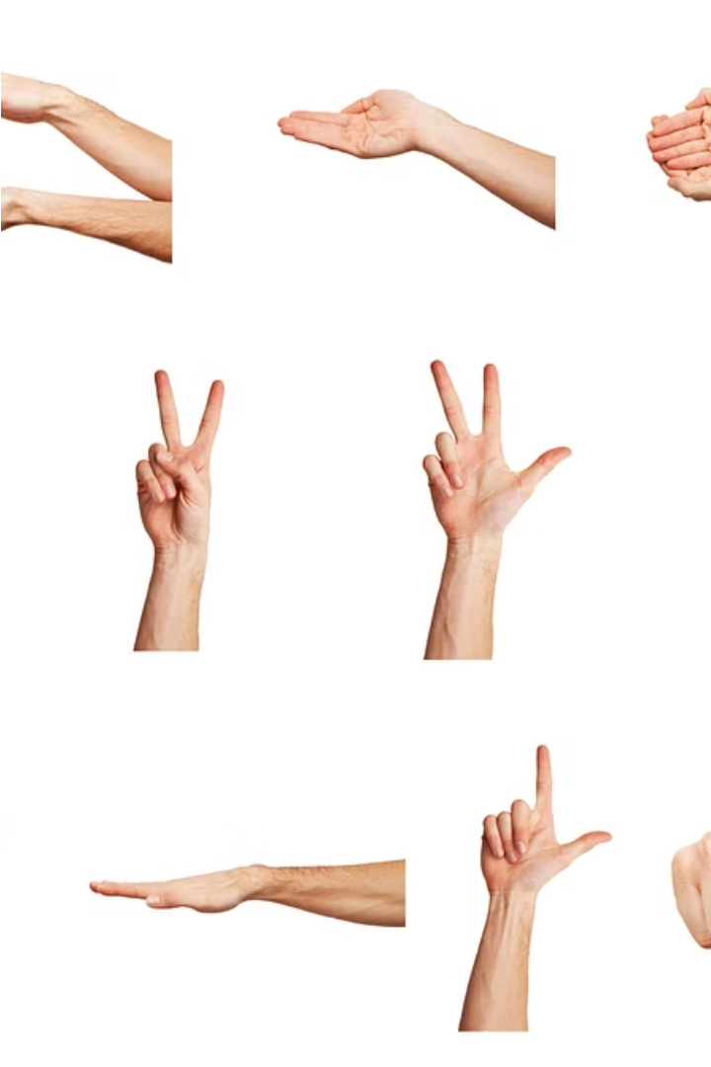
Introduction to the Python Finger Gesture Game
Explore the captivating world of finger gesture recognition using Python. This game-changing project combines computer vision, machine learning, and interactive gameplay to create an engaging and immersive user experience.

Slide 2
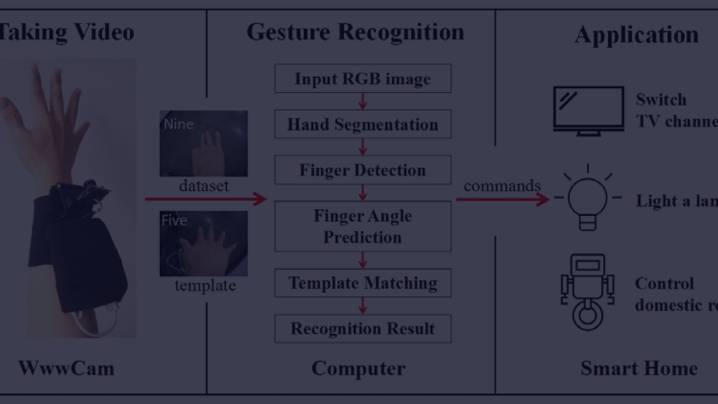
Gesture Recognition Fundamentals
Sensing
1
Utilize computer vision techniques to capture and analyze hand movements in real-time.
2
Processing
Apply machine learning algorithms to identify and classify distinct finger gestures.
Interpretation
3
Translate the recognized gestures into meaningful commands for interactive gameplay.

Slide 3
Capturing Hand Movements with OpenCV
Camera Setup
Hand Detection
Tracking Landmarks
Leverage OpenCV's powerful computer vision capabilities to set up a camera and capture live video feed.
Implement algorithms to detect and segment the user's hand from the background, enabling gesture recognition.
Utilize OpenCV's hand landmark detection to identify key points on the hand, such as fingertips and joints.

Slide 4
Implementing Gesture Classification
Feature Extraction
Model Training
Real-time Prediction
Analyze the hand landmark data to extract relevant features that can be used to classify gestures.
Train a machine learning model, such as a neural network or support vector machine, to recognize and categorize different finger gestures.
Deploy the trained model to perform real-time gesture recognition on the live video feed, enabling seamless gameplay interactions.

Slide 5



Designing the Game Interface
Game Elements
Gesture Mapping
Responsive Feedback
Incorporate intuitive game elements, such as a score display, timer, and visual cues, to create an engaging and user-friendly experience.
Assign specific finger gestures to various game actions, ensuring a natural and intuitive interaction between the player and the game.
Provide clear and immediate feedback to the player, such as visual effects or audio cues, to reinforce the connection between their gestures and the game's responses.

Slide 6
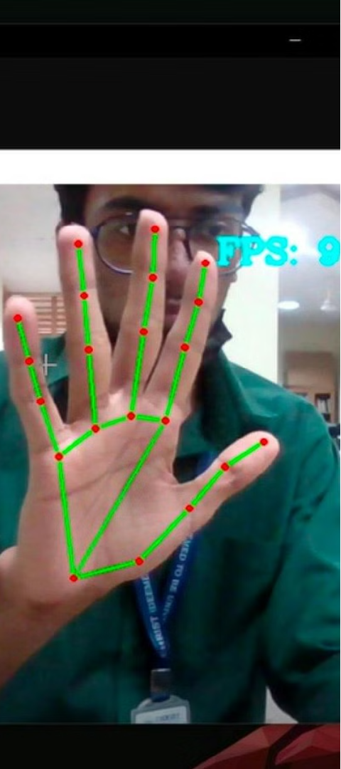



Integrating Gameplay Logic
Game Objectives
Define the game's objectives, such as scoring points, avoiding obstacles, or completing challenges, to create a compelling and rewarding experience for the player.
Gesture-based Actions
Translate the recognized finger gestures into corresponding game actions, ensuring a seamless and intuitive interaction between the player and the game.
Dynamic Gameplay
Implement game mechanics that respond to the player's gestures, creating a dynamic and engaging gameplay loop that keeps the player immersed and challenged.

Slide 7
Enhancing User Experience
1
Accessibility
2
Visual Polish
Ensure the game is inclusive and accessible, catering to players with different physical abilities and providing customization options.
Incorporate visually stunning graphics, animations, and special effects to create a polished and immersive gaming experience.
3
Adaptive Difficulty
4
Feedback and Rewards
Implement dynamic difficulty adjustments to challenge players of all skill levels and keep them engaged throughout the gameplay.
Provide meaningful feedback and rewards to the player, reinforcing their progress and achievements, and fostering a sense of accomplishment.

Slide 8
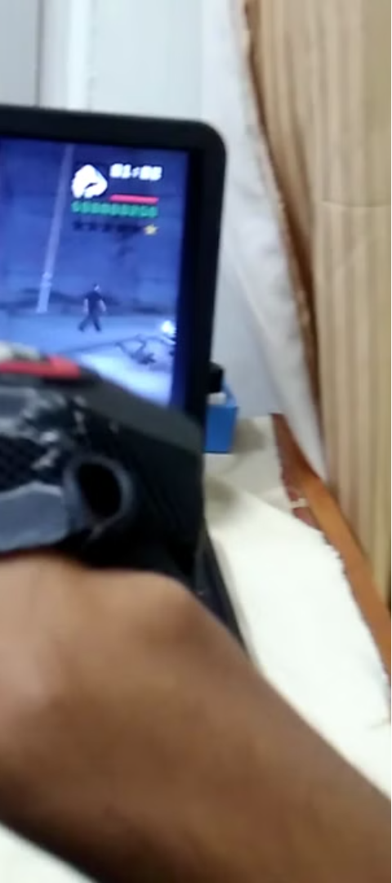
Conclusion and Future Improvements
1
Wrap-up
2
Potential Enhancements
Summarize the key achievements and the overall impact of the Python Finger Gesture Game project.
Explore future avenues for improvement, such as multi-player support, advanced gesture recognition, and integration with other technologies.
3
Inspiring Creativity
Encourage users to experiment, innovate, and contribute to the ongoing development of the Finger Gesture Game, fostering a vibrant community of creators and enthusiasts.

