Slide 1
Evaluator
Gaurav Shekhadiya
Trainer
Asfiya Khan
Bestify You Time
FET Angular Major Project
Group : G7-Angular

Slide 2
Mentor and Team Members
Mentor : Vignan Gajula
Employee ID | Team member
24594 | Nikhil Bharatlal Bisen
24595 | Nirajkumar Sureshrao Ablankar
24596 | Nitin Surendra Wandile
24597 | Onkar Raju Hongekar
24598 | Prafull Dhanraj Shindekar
24599 | Pranit Ravikant Dhage
24600 | Pranita Suresh Salunke

Slide 3
Members Contribution
Member | Tasks worked on | Technology used | Global Tech
Nikhil Bharatlal Bisen (24594) | Home page, Tetris game, match box game, quiz filter and search | Bootstrap5 | MEAN- mongoDb, Express, Angular, Node.js, npm, nodemon, GitHub, Jira, Sonarqube, SonarLint, esLint, SCSS
Nirajkumar Sureshrao Ablankar (24595) | Quiz CRUD rest API, admin dashboard service integration, Favorite rest API, authentication and authorization backend, sendEmail function, backend error handling | mongoose, nodemailer
Nitin Surendra Wandile (24596) | Complete user module UI, navbar, footer, start Quiz, Evaluate Quiz, Quiz Timer, UI theme, loader | Material, Bootstrap5, sweetalert2, ngx ui loader
Onkar Raju Hongekar (24597) | Bounce-ball game, ALM tools – Jira, SonarQube, GitHub, POC tasks | p5.js
Prafull Dhanraj Shindekar (24598) | Leaderboard REST-API, leaderboard integration, login-signup integration, user dashboard | mongoose
Pranit Ravikant Dhage (24599) | User API, authentication API, user admin guard, toaster, my favorites, user integration, password encryption | mongoose, jwt token
Pranita Suresh Salunke (24600) | Login UI, signup UI and complete admin module UI, Login-signup integration | Material; Bootstrap5

Slide 4
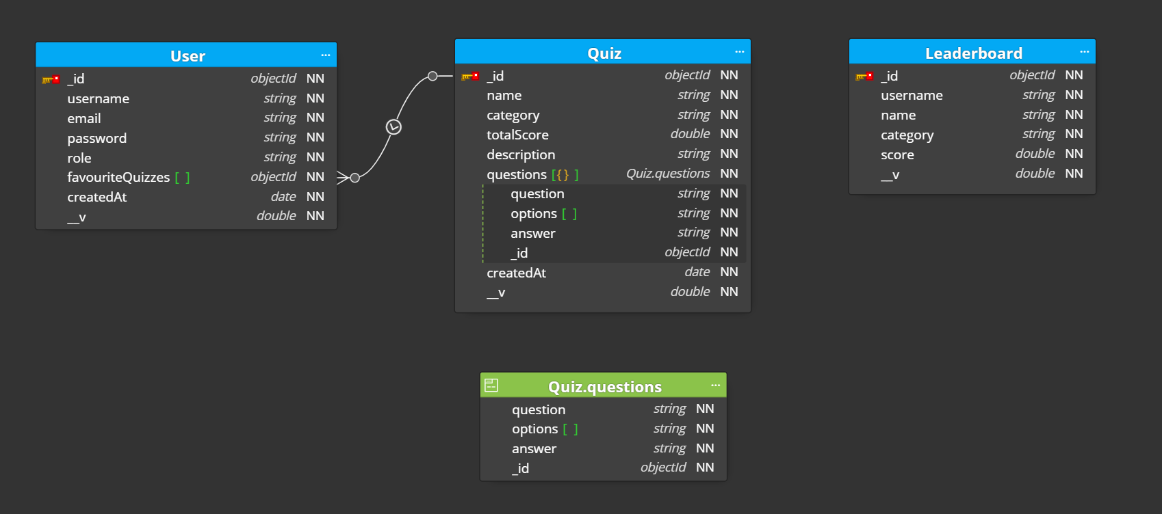
Database Model

Slide 5
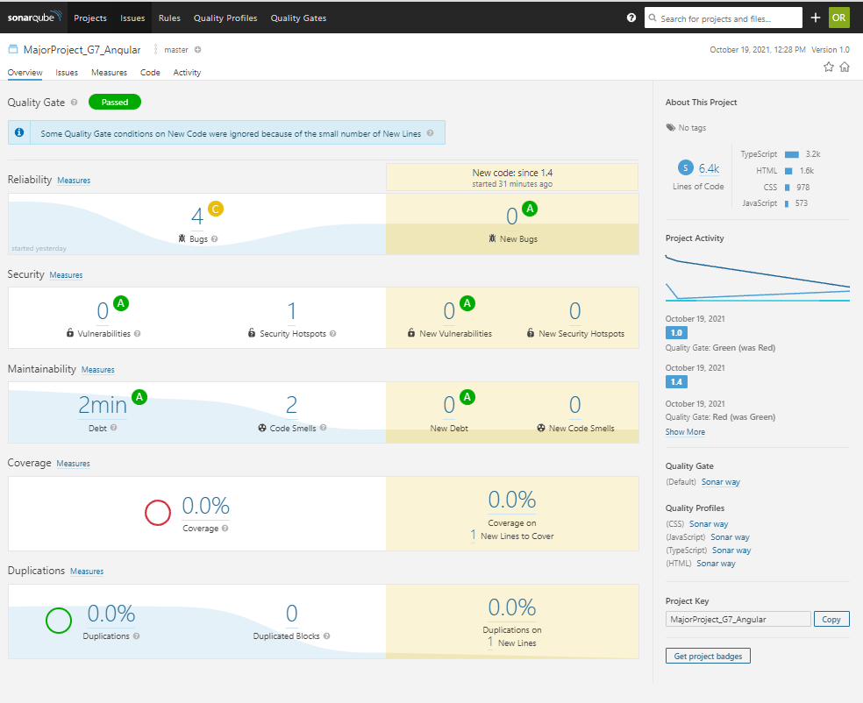
SonarQube Report

Slide 6
Future Scope
Unit Testing
Save state of quiz
Add more maps to Bounce Ball

Slide 7
Thank You!

