Slide 1

Project title: MQTT-Based IoT Fingerprinting: Detection and
Real-World Deployment
Introduction
The rapid growth of Internet of Things (IoT) ecosystems has led to large numbers of devices communicating over lightweight messaging protocols. Among these protocols, the Message Queuing Telemetry Transport (MQTT) protocol has become one of the most widely adopted standards for device-to-device and device-to-cloud communication due to its lightweight design, publish–subscribe architecture and efficient bandwidth usage.
Different IoT vendors implement MQTT across multiple protocol versions such as MQTT 3.1, MQTT 3.1.1, and MQTT 5.0 depending on device capability, firmware architecture and backend cloud integration requirements. Although MQTT is standardized, vendor-specific implementations vary in session management, topic structure, Quality of Service (QoS) policies, metadata usage and protocol features.
This work focuses on studying how different IoT vendors implement MQTT across different versions and how observable communication patterns can be used to identify device behavior and implementation characteristics using a controlled experimental setup with simulated IoT devices and an MQTT broker.
Motivation
Modern IoT networks contain devices from multiple vendors operating simultaneously with different MQTT versions and implementation strategies. Understanding these implementation differences is essential for improving device interoperability, network monitoring and security analysis.
Many IoT security and management systems require the ability to identify devices based solely on their communication behavior. However, vendor-specific MQTT implementations introduce variations in session parameters, topic hierarchies and message handling mechanisms that are not fully documented.
Therefore, there is a need to experimentally analyze and demonstrate how different vendors implement MQTT protocol versions in practice and how these implementation differences are observable in network communication patterns.
Name: Pranita Mahajan
Roll No: 2301151
Supervisor: Dr. Rakesh Matam

Slide 2
Existing work / Literature review:
Existing Work
References:
Baena, E., Yang, H., Koutsonikolas, D., & Haque, I. (2025). A Comprehensive Survey on Smart Home IoT Fingerprinting: From Detection to Prevention and Practical Deployment. arXiv preprint arXiv:2510.09700.
Soni, D., & Makwana, A. (2017). A Survey on MQTT: A Protocol of Internet of Things (IoT). International Conference on Telecommunication, Power Analysis and Computing Techniques (ICTPACT).
Key Ideas
Baena et al. survey various IoT device fingerprinting techniques used for identifying smart home devices based on network communication behavior.
The work highlights detection and prevention mechanisms to improve security and monitoring in smart home IoT environments.
Soni and Makwana present an overview of the MQTT protocol architecture, publish–subscribe communication model, and its importance in IoT systems.
Gaps in Existing Work
Existing studies generally analyse MQTT protocol performance and scalability but do not examine how different IoT vendors implement MQTT versions differently at the firmware or device level.
There is limited experimental work demonstrating vendor-specific MQTT behaviour, such as variations in session parameters, topic hierarchy design, Quality of Service policies, and protocol feature usage across MQTT versions.
Additionally, current literature lacks controlled experimental frameworks that simulate multiple vendor devices operating with different MQTT versions in order to observe and analyse their communication patterns.
Name: Pranita Mahajan
Roll No: 2301151
Project Title: MQTT-Based IoT Fingerprinting: Detection and Real-World Deployment

Slide 3
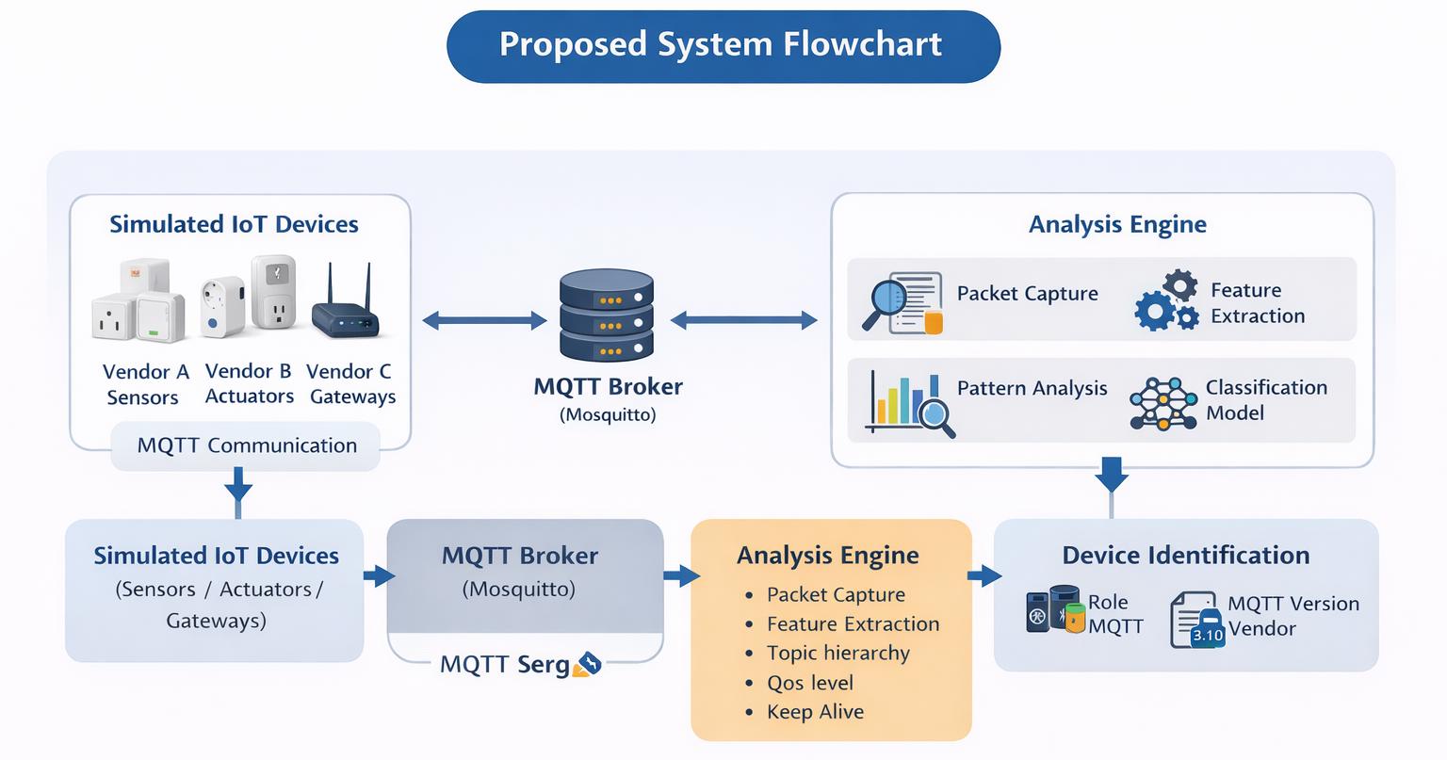
Work Done till date:
Details of Proposed Work / Solution
Develop a virtual IoT environment using Docker where multiple simulated devices represent different vendors operating with different MQTT protocol versions.
Capture and analyse MQTT communication between devices and a central broker using mosquito to extract protocol-level features such as CONNECT parameters, topic hierarchy, QoS usage, and publish–subscribe behaviour.
Use the extracted communication patterns to identify device roles, MQTT protocol versions, and vendor-specific implementation characteristics in a software-only environment.
Name:
Name: Pranita Mahajan
Roll No: 2301151
Roll No:
Project Title: MQTT-Based IoT Fingerprinting: Detection and Real-World Deployment
Project Title:

