Slide 1


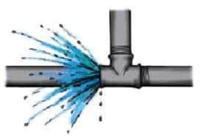




S.A.P.D.J. Pathshala’s
Walchand Institute of Technology
An Autonomous Institute
Comprehensive Inspection and Analysis of Water Supply
Pranita Annaldas
Ketaki Bidkar
Rumesha Khan
Samruddhi Chobharkar
Padamaja Alase
Leakage Don’t Worry Water Line Defenders got it

Slide 2

Content
Idea of the project
Background of Project
Methodology
System Logic
Software required
Technology Stack
Real Time Dashboard
Work Distribution
References

Slide 3

Idea of the project:
Global water depletion underscores need for better water management.
Priority: Reducing water leaks and upgrading distribution networks.
Challenge: Inspecting 100 - 200mm diameter water lines thoroughly.
Solution: Cloud-based dashboard for analytics, visualization, and reporting.
Benefits: Improved service, faster repairs, and less water loss.
Priorities: Rapid response to contamination and early leak detection.
Vital: Streamlining pipeline assessments and enabling GIS mapping.

Slide 4

Background of Project :
Literary survey :
Collect information about the Water supply and Distribution lines from Municipal Corporation.
Existing system:
Supervisiory Control And Data Acquisition (SCADA System).
Limitations of SCADA system:
Existing systems struggle to scale with increasing data volumes and device connections.
Limited ability to process real-time data efficiently.
Basic visualization and analytics capabilities hinder advanced analysis.
Lack of mobile-friendly interfaces restricts remote monitoring.
Limited support for AI, ML hampers automation potential.

Slide 5

Methodology :
Prototype Functionality:
Incorporates water flow measuring sensors across the distribution pipeline.
Sensors collect real-time data as water flows.
Data transmitted to the aggregation node, serving as the main communication hub.
The data is then trained using the Machine Learning Analysis and the accuracy and precision , Mean Absolute error, etc are analysed.
Admin Panel:
Real Time Dashboard ensuring swift response to prevent water loss.
GIS mapping for pinpointing leaks and optimizing repair efforts
Complaint Management :
Complaint provider feature available on website/dashboard.
Engineers investigate complaints and take necessary actions.

Slide 6

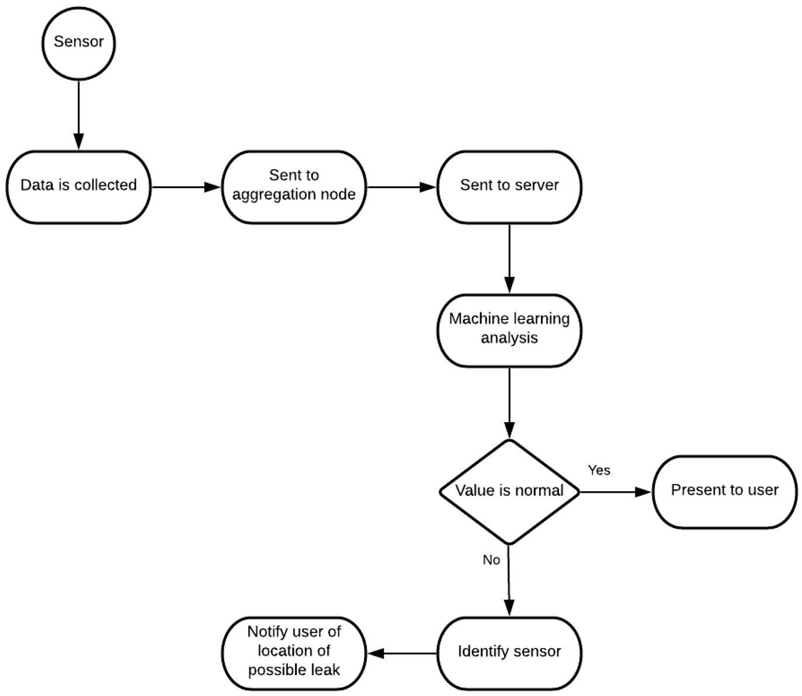
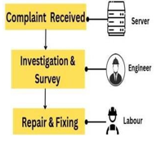
System Logic :
Contamination
Complaint Flow :

Slide 7

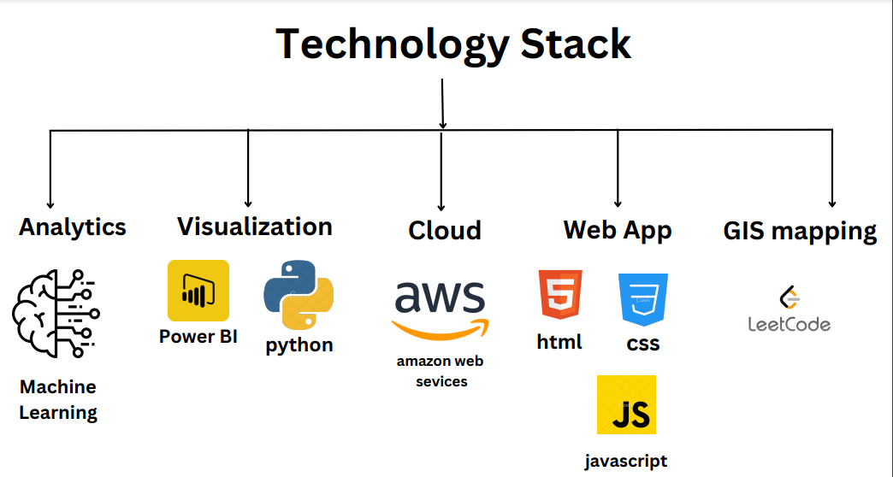
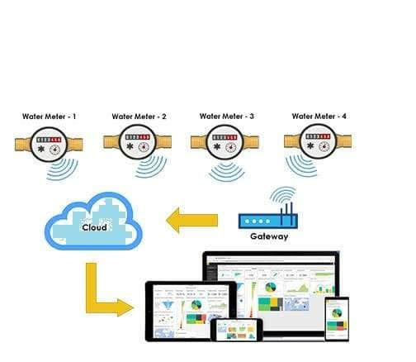
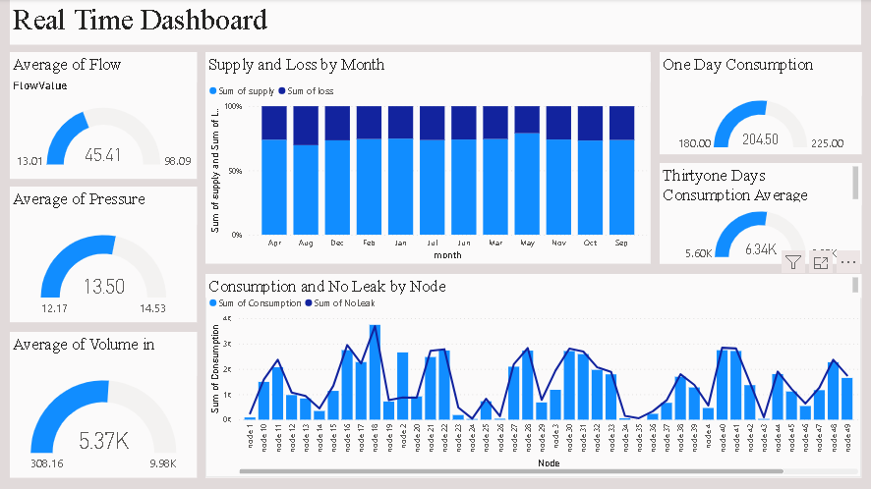
Software Required :
Pandas
scikit-learn
Power bi
AWS Command line Interface

Slide 8

Work Distribution :
Pranita :
Machine Learning Analysis, Real Time Dashboard.
Ketaki :
Data Collection from Municipal Corporation, Machine Learning Analysis, Real Time Dashboard.
Rumesha :
Admin Panel, Mobile Application
Samruddhi:
Admin Panel, Mobile Application
Padamaja :
GIS Mapping.
References :
https://www.mdpi.com/2624-831X/1/2/26
www.google.com
www.wikipedia.com
https://www.myscada.org/
https://chat.openai.com/

Slide 9


Question and Answe﻿r...
Thank you

