Slide 1
COMP 8347 – Internet Applications and Distributed Systems
CampusConnect
Campus Event Board
Discover, Post, and RSVP to Events Happening Around Campus.
Group 8 · Hemit Rana · Sarvesh Solanke · Jasmeen Kaur · Charmiben Patel
Master of Applied Computing · University of Windsor

Slide 2
Problem & Motivation
THE PROBLEM
THE SOLUTION
Students miss events because information is scattered across:
CampusConnect: a single centralized hub where students can:
📧 Email announcements
Discover events relevant to their interests
📌 Notice boards
Create and promote their own events
💬 WhatsApp groups
RSVP and track event attendance
📱 Instagram & Facebook
Upload event posters & materials
🌐 Student society websites
Receive reminders & view history

Slide 3
Mandatory Requirements
✓
Models & Views
✓
Search Bar + Dropdown
✓
Registered vs Guest UI
Event, Category, RSVP, Comment, UserProfile, FavoriteEvent, EventHistory
Keyword search by title/organizer + category dropdown filter
Guests: browse & search only · Members: create, RSVP, comment
✓
Templates & Forms
✓
Sessions & Cookies
✓
Footer Section
13 Bootstrap pages · Registration, Login, EventForm, CommentForm
Visit counter per day · Recently viewed events · User prefs
About Us · Contact Us · Terms · Useful links
✓
Class-Based Views
✓
User History Section
✓
Bootstrap Styling
ListView, DetailView, CreateView, UpdateView in views.py
RSVP history · Browsing history · Dashboard view
Responsive layout · Event cards · Sidebar · Color palette
✓
User Authentication
✓
File Upload
✓
JSON Fixtures & GitHub
Login · Logout · Forgot Password (Django auth system)
Event poster upload via Django ImageField + MEDIA settings
Sample events/categories/users · Feature-branch commits

Slide 4
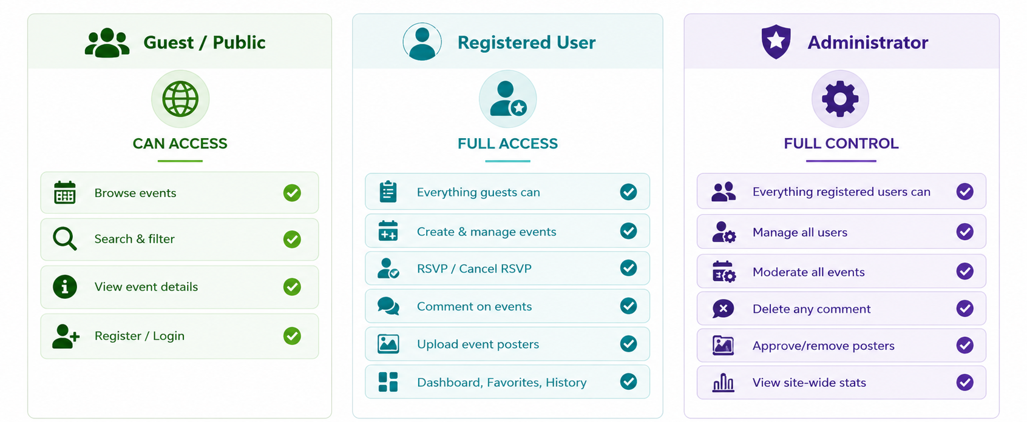
User Views : Guest vs Registered vs Admin
👤 Guest / Public
✅ Registered User
🛡️ Administrator
CAN ACCESS
FULL ACCESS
FULL CONTROL
✓ Browse events
✓ Everything guests can
✓ Everything registered users can
✓ Search & filter
✓ Create & manage events
✓ Manage all users
✓ View event details
✓ RSVP / Cancel RSVP
✓ Moderate all events
✓ Register / Login
✓ Comment on events
✓ Delete any comment
✓ Upload event posters
✓ Approve/remove posters
✓ Dashboard, Favorites, History
✓ View site-wide stats

Slide 5
User Views : Guest vs Registered vs Admin
campusconnect.ca
campusconnect.ca
campusconnect.ca
CampusConnect
CampusConnect
Hi, Hemit ▾
CampusConnect
Admin Panel ▾
🔍 Search events...
🔍 Search events...
Users
Manage Users
Category ▾
Category ▾
alice@uwindsor.ca
Events
Edit
Delete
Workshop: AI Basics
+ Create Event
bob@uwindsor.ca
View Details →
Edit
Delete
Workshop: AI Basics
Comments
Hackathon 2025
RSVP
★ Save
carol@uwindsor.ca
View Details →
Edit
Delete
Hackathon 2025
Posters
Cultural Night
42
18
96
View Details →
RSVP
★ Save
Users
Events
RSVPs
🔒 Login to RSVP or Create Events
👤 Guest / Public
✅ Registered User
🛡️ Administrator

Slide 6
Core Features & Django Implementation
🔐 Authentication
📋 Models & Forms
Sign Up · Login · Logout · Forgot Password · Role-based (Guest / User / Admin)
7 models: Event, Category, RSVP, Comment, UserProfile, FavoriteEvent, EventHistory
🔍 Search & Filter
📤 File Upload
Keyword search bar (title, organizer) + category dropdown — both on every page
Event poster via Django ImageField; profile picture via UserProfile model
🕐 Sessions & Cookies
💬 Comments & RSVP
Visit counter per day · Recently viewed events stored in session/cookie
Registered users can discuss events and join / cancel attendance
📊 Class-Based Views
⭐ Dashboard & History
ListView · DetailView · CreateView · UpdateView replacing function views
My Events · RSVP history · Saved favorites · Profile info — all in one place

Slide 7
Tech Stack & Pages
Technology Stack
Pages
Backend
Python + Django
Home Page
Frontend
HTML / CSS / Bootstrap
Event Listing
Database
SQLite + JSON Fixtures
Event Detail
Version Control
GitHub (comp8347proj)
Login / Register / Forgot Password
IDE
PyCharm
Create / Edit Event
User Dashboard
Favorites & History
About Us / Contact Us

Slide 8
Group Roles & Responsibilities
01
Hemit Rana
Project Lead
Auth & Security
Database models (Event, Category, RSVP) · GitHub repo setup · Deployment · Registration forms & views
02
Sarvesh Solanke
Sessions & QA
Sessions · Cookies · User history tracking · Testing & fixtures
03
Jasmeen Kaur
Events & Interaction
Event creation forms · RSVP system · Comment model & views
04
Charmiben Patel
UI / Frontend
Bootstrap templates · Responsive design · Footer · About/Contact pages

Slide 9
Thank You!
CampusConnect – Campus Event Board
✓ Django: models, views, forms, sessions, cookies, auth, uploads
✓ Bootstrap UI · JSON fixtures · Class-Based Views · GitHub
✓ 3 user roles with distinct interfaces and permissions
Bonus: Email reminders · Trending events · Google Maps · Calendar export
Group 8 · COMP 8347 · University of Windsor

