Slide 1
Problem Statement
To identify each customer’s real time transaction and based on that risk rating is done.
INPUTS:
4 CSV FILES
Customer_info.csv
Customer_account.csv
Customer_transactions.csv
Countries_info.csv

Slide 2
Proposed Solution
Retrieving the data from database created using the given excel sheets and based on the queries display the different risk rates transactions on the user interface using DB Browser
Connecting the backend with front-end using Java Servlets on TomCat server

Slide 3

Working
The excel sheets data is converted into tables in DB browser and Sql queries are executed for retrieving different risk ratings and display them on front end using servlets. The user interface is designed using html, css and java script

Slide 4
Working
The excel sheets data is converted into tables in db browser and Sql queries are executed for retrieving different risk ratings and display them on front end using servlets. The user interface is designed using html, css and java script

Slide 5
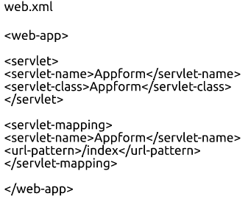
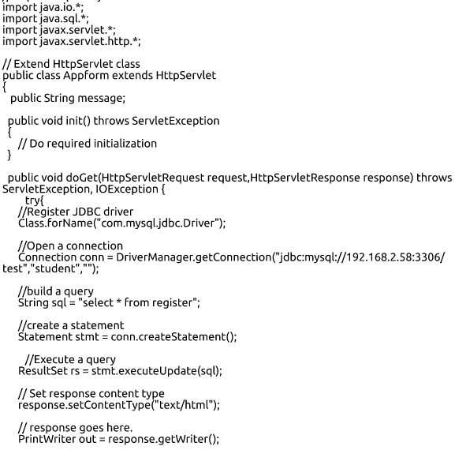
Sample Screen-Shots (jdbc)

Slide 6
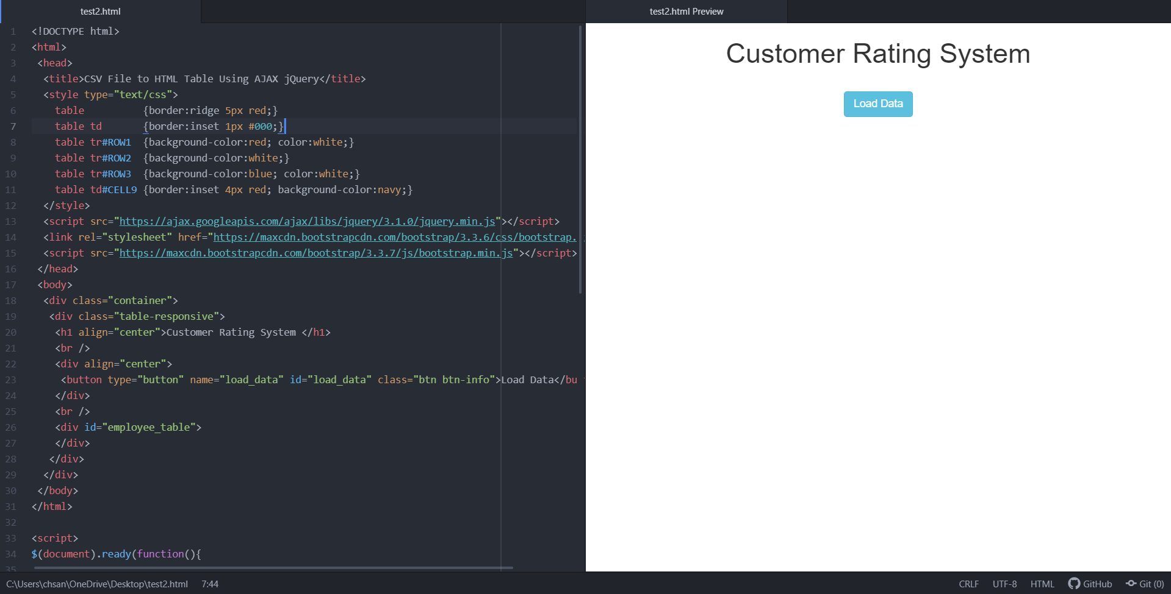
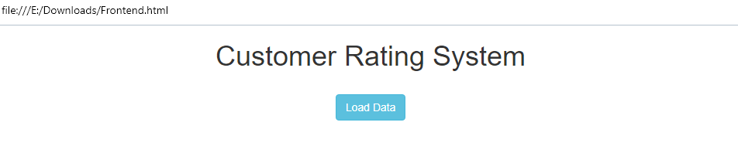
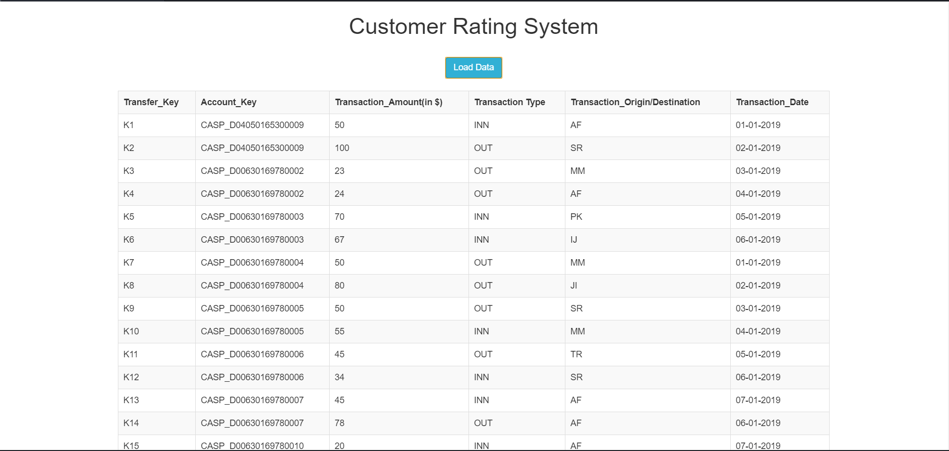
Sample Screen-Shots (front-end)

Slide 7
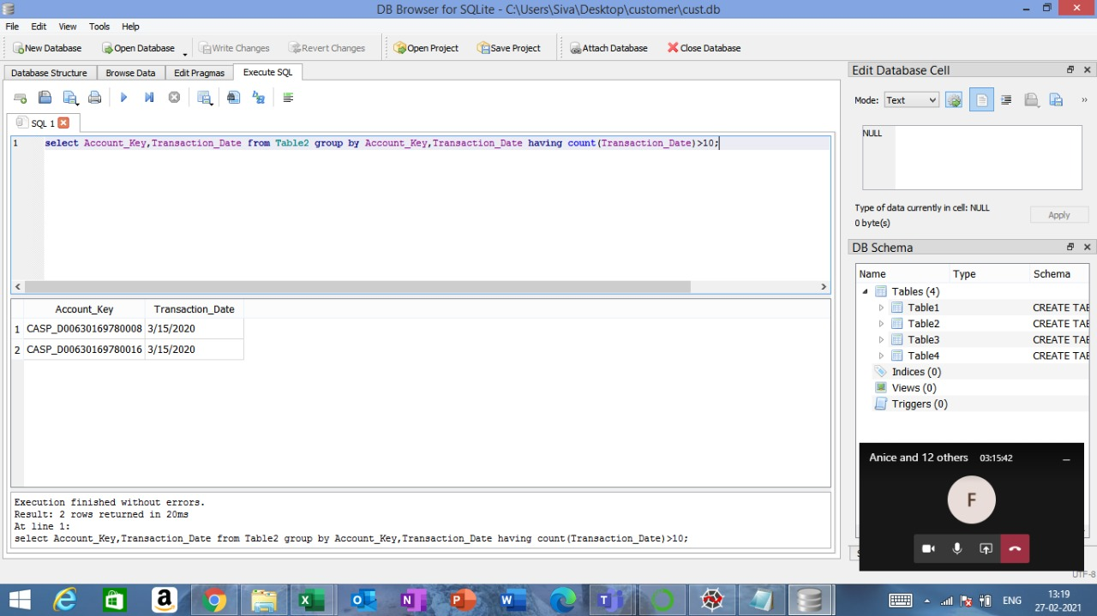
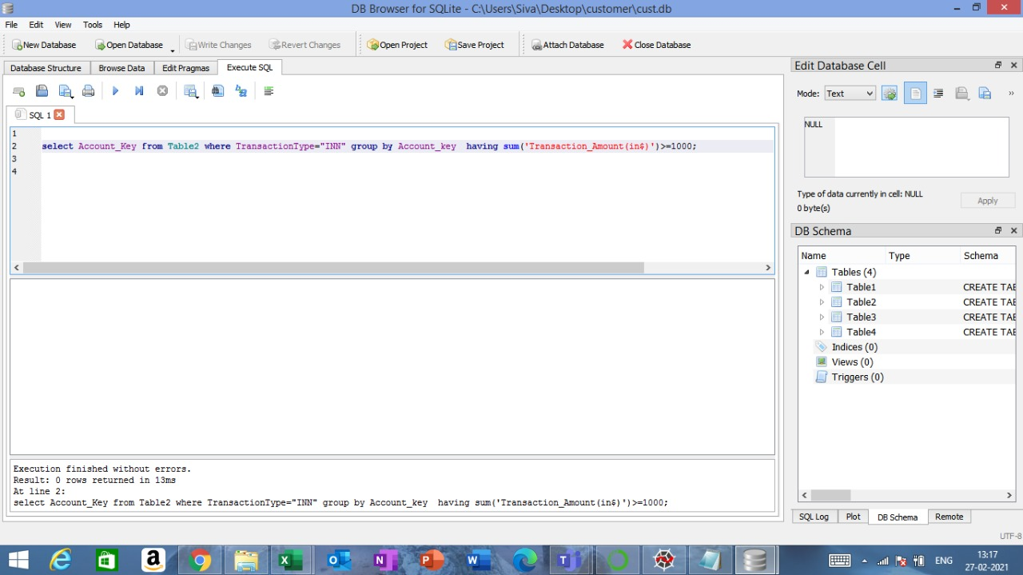
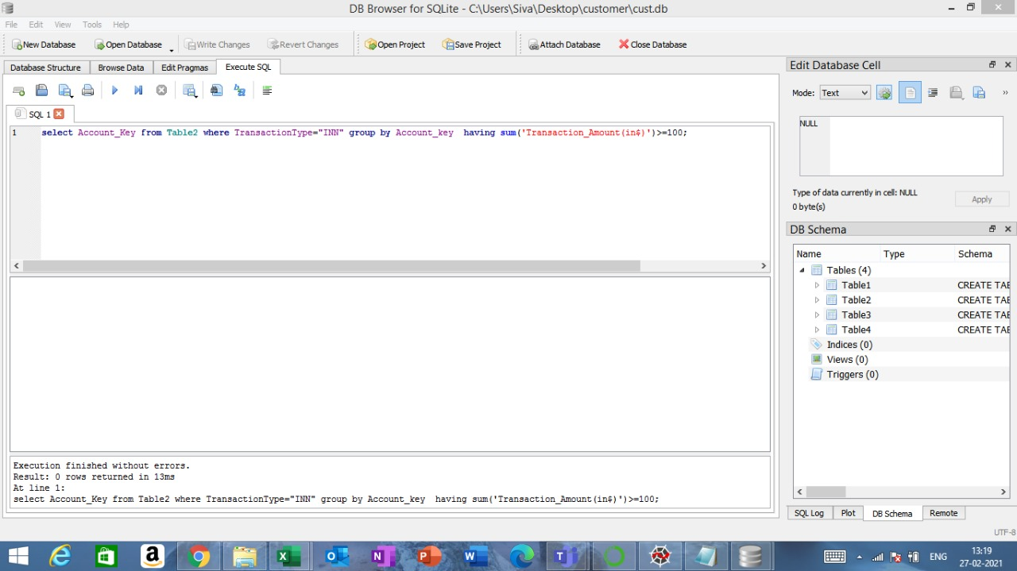
Sample Screen-Shots (back-end)

Slide 8
Conclusion
In overall, the DBS Hack2Hire was one the very best experiences that brought about the spirit of collaboration in us in order to make Customer Rating System by working together as a team with 1 goal to achieve.
We implemented the technologies that we had hands on practice but we also got to learn more from our team-mates.
In the previous slides, you will find the work done by us, and again, thank you all for providing this wonderful opportunity to us.
We are happy to answer any follow up questions.

