Slide 1
General Guidelines for Presentation
Slides should not be too heavy with content. Better to create point wise.
If you require more than one slide for any point, right click on that point slide then select duplicate slide and modify the duplicated slide.
Diagrams must be aligned at centre and clearly visible with caption.
All the mentioned fonts, font size, title content, etc should not change and strictly as per the given format and guidelines.

Slide 2

Obstacle Avoidance Car
Project Guide:- Ms. Charul Singh
Group Member | Moodle ID
Yatish Gharat | 21104050
Anurag Gupta | 21104109
Praniv Warungshe | 21104031

Slide 3
Contents
Introduction
Problem Statement
Objectives
Scope
State Diagram/Workflow
Circuit Diagram
Hardware and Software Requirement
Project Timeline
Conclusion
References

Slide 4
1. Introduction
Problem Identified :
Navigating through environments while avoiding obstacles presents significant challenges for autonomous vehicles.
Existing solutions often struggle to seamlessly integrate obstacle avoidance capabilities into their navigation systems.
Solution Proposed :
An obstacle avoidance robot utilizing Raspberry Pi Pico, aimed at addressing challenges encountered in dynamic environments.
Integrates advanced sensors and control algorithms to autonomously navigate environments while intelligently avoiding obstacles.

Slide 5
2. Problem Statement
Developing an object avoiding robot, aimed at navigating predefined paths autonomously while avoiding obstacles.
The project aims to design a compact and efficient system that integrates sensors for obstacle detection, enabling the robot to navigate its path without collision.
The solution should demonstrate seamless integration of hardware components and algorithmic intelligence to achieve smooth and efficient obstacle avoidance while following predefined paths.

Slide 6
3. Objectives
To design an object avoiding robot with sensors for real-time detection and avoidance of obstacles.
To implement obstacle detection mechanisms enabling the robot to identify and navigate around obstacles encountered during traversal.
To develop intelligent algorithms for seamless integration of object avoidance and navigation functionalities.
To ensure robustness and reliability of the system in diverse environmental conditions.

Slide 7
4. Scope
Implement real-time obstacle detection mechanisms to enable the robot to detect and avoid obstacles encountered during traversal.
Design the system to be versatile and applicable in various domains including warehouse logistics, healthcare operations, and agricultural automation.
Ensure scalability and adaptability of the solution to accommodate different environments and operational requirements.

Slide 8
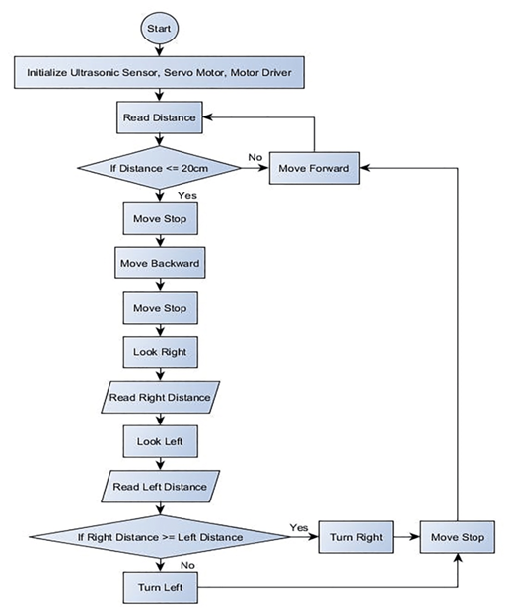
5. State Diagram/Workflow

Slide 9
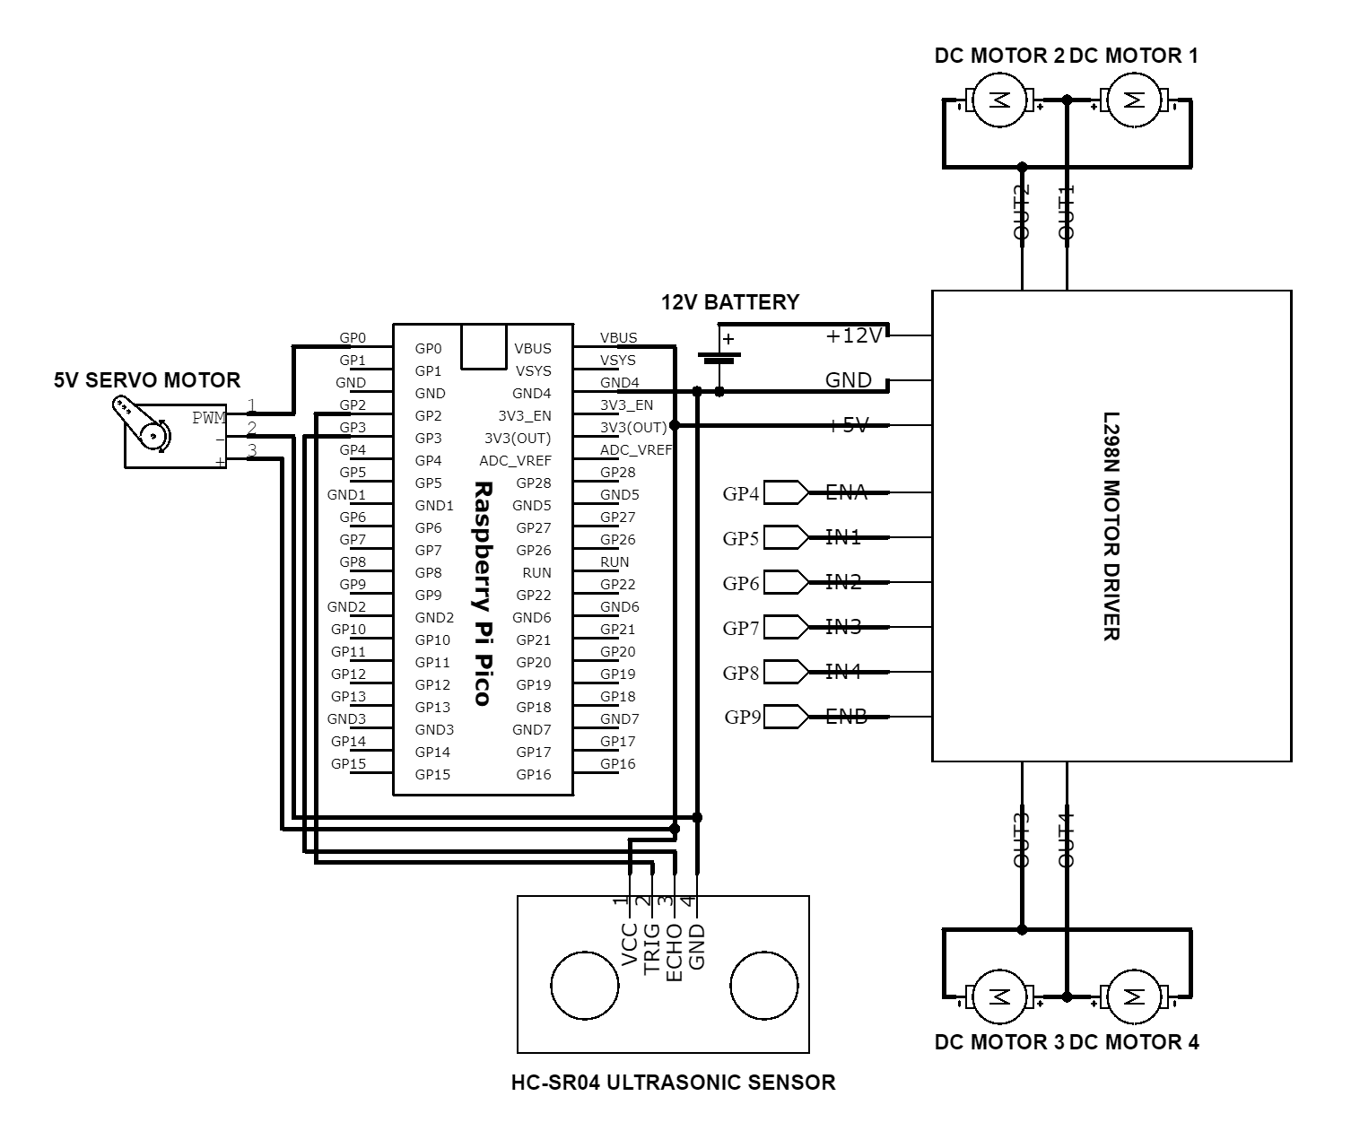
6. Circuit Diagram

Slide 10
7. Hardware and Software Requirement
Raspberry Pi Pico
Ultrasonic Sensor
Breadboard
Motor Driver
Servo Motor
Bo Motor
65mm Wheels
3.7V Battery
Switch
Jumper Wires

Slide 11
8. Project Timeline
Sr No. | Group Members | Time Duration | Work to be Done
1 | Yatish Gharat Anurag Gupta Praniv Warungshe | 3rd and 4th week of January | Topic finalization and requirement gathering
2 |  | 1st and 2nd week of February | Implementing the circuit design on software
3 |  | End of February and 1st week of February | Connecting the components
4 |  | By the end of March | Final testing and resolving issues(if any)

Slide 12
9. Conclusion
Successfully integrates obstacle avoidance capabilities to create a versatile navigation system.
Utilizes ultrasonic sensors for robust navigation.
Demonstrates seamless synergy between hardware and software.
Can offer practical applications in logistics, healthcare and agriculture.
Presents a promising solution for autonomous navigation tasks.

Slide 13
References
[1] Aamir Attar, Aadil Ansari, Abhishek Desai, Shahid Khan, Dipashri Sonawale, “Line Follower and Obstacle Avoidance bot using Arduino”, International Journal of Advanced Computational Engineering and Networking, vol. 5, pp. 18-21, 2017.
[2] Kumaresan P,Priya.G,Kavitha B R, Ramya G and M.Lawanyashri, “A Line Following Robot for Hospital Management”, International Journal of Pure and Applied Mathematics, vol. 116, 2017.

Slide 14
Thank You...!!

