Slide 1


Fake Currency Detection System
Detecting counterfeit currency is crucial for maintaining the integrity of financial systems. This presentation explores the use of machine learning, specifically logistic regression, to identify fake banknotes and combat fraud.
By Pranjal Kumar , Pankaj Kumar and Pradeep Kumar.

Slide 2
Overview of the Problem
The Challenge
Importance of Detection
Key Objectives
Distinguishing genuine currency from counterfeits can be difficult, especially for untrained individuals. Automated detection systems are needed to ensure reliable and accurate identification.
The primary goals are to develop a robust model that can accurately classify banknotes as real or counterfeit, and to enable seamless integration of the solution into real-world applications.
Effective fake currency detection protects businesses, consumers, and the broader economy from the negative impacts of fraud, such as financial losses and eroded trust.

Slide 3
Dataset and Features
1
Banknote Image Data
2
Dataset
3
Data Pre-processing
The dataset in the logistic regression model made by us includes the variance , skew , curtosis and entropy. These values determine the quality of the banknote.
The dataset consists of high-resolution images of genuine and counterfeit banknotes of around 1500 banknotes to provide a vast amount of data for evaluation
Before feeding the data into the machine learning model, it's essential to preprocess it to ensure it's in a suitable format and quality.

Slide 4
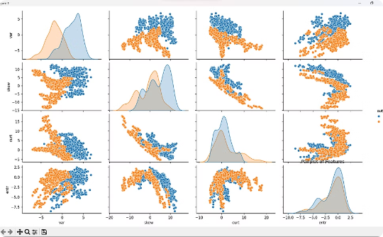
Libraries and Graphs
A pair diagram to get an overview of the relationship between all the entities. The blue for genuine banknotes and orange for counterfeit banknotes:
Libraries Used
Pandas Numpy Matplotlib Scikit-Learn seaborn

Slide 5
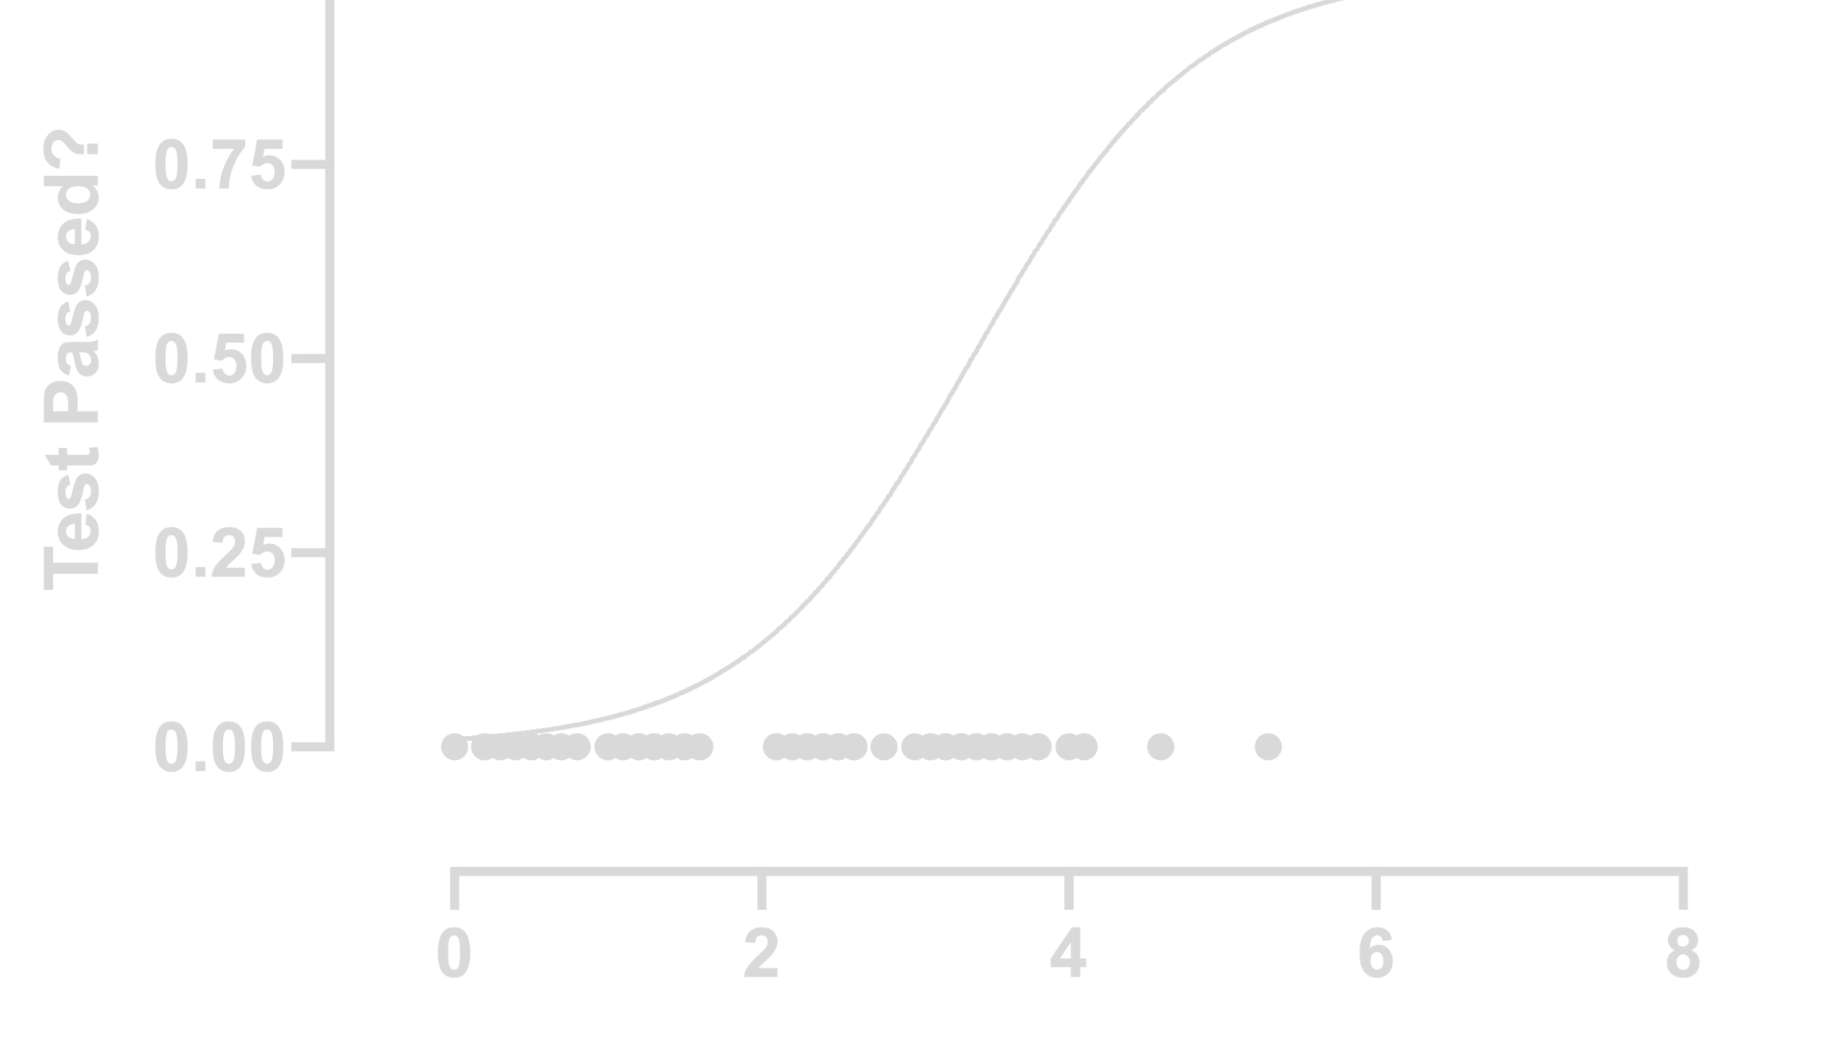
Logistic Regression Model
Model Selection
Feature Importance
Probability Outputs
Logistic regression is chosen for its interpretability, computational efficiency, and suitability for binary classification tasks.
The model's coefficients provide insights into the relative importance of different visual and statistical features in distinguishing genuine from counterfeit banknotes.
The model outputs the probability of a banknote being genuine, enabling users to set appropriate decision thresholds based on their risk tolerance.

Slide 6
Model Training and Evaluation
1
Model Training
The logistic regression model is trained on the labeled dataset, using techniques such as regularization to prevent overfitting.
2
Performance Metrics
The model's accuracy, precision, recall, and F1-score are evaluated on the held-out test set to assess its overall effectiveness.
3
Continuous Improvement
The model is iteratively refined by incorporating additional data, optimizing hyperparameters, and exploring more advanced techniques as needed.

Slide 7



Deployment and Integration
Cloud Deployment
API Integration
Mobile Accessibility
The trained model is deployed to a cloud-based platform, ensuring scalability and accessibility for users.
The solution offers a user-friendly API, allowing seamless integration with existing point-of-sale systems and other applications.
A mobile-friendly interface is developed, enabling users to quickly and conveniently authenticate banknotes on-the-go.

Slide 8
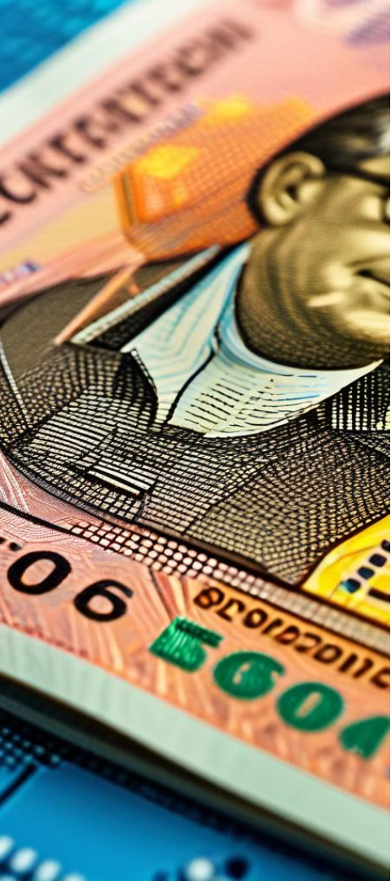



Limitations and Challenges
Evolving Counterfeits
Counterfeiters continually develop more sophisticated techniques, requiring the model to be regularly updated to maintain its effectiveness.
Sensor Accuracy
The reliability of the model depends on the quality and precision of the input data, which can be affected by factors like device resolution and lighting conditions.
Edge Cases
Rare or unusual banknote features may challenge the model's ability to generalize, necessitating ongoing monitoring and adjustments.

Slide 9

More Ways to Develop the Detection System
The system can also be developed using CNN on a larger level and for more accuracy.

Slide 10
Conclusion and Next Steps
Key Takeaways
Future Enhancements
- Logistic regression effectively identifies counterfeit currency - Continuous model improvement is crucial to stay ahead of evolving threats - Seamless integration and accessibility are vital for widespread adoption
- Investigate more advanced machine learning techniques, such as deep learning - Explore multimodal approaches that combine visual and non-visual data - Develop a comprehensive solution for automated currency verification

