Slide 1
IoT Weather Station Telemetry Platform
THE PROBLEM
Environmental telemetry is either costly, closed proprietary hardware or slow batch loggers with high latency.
OUR SOLUTION
Real time atmospheric monitoring with ESP32 microcontrollers, cloud MQTT ingestion, embedded time series storage and reactive web dashboards
An open, production ready IoT station: low-cost sensors stream live microclimate data through a decoupled MQTT broker to embedded storage and a real time web dashboard.
UNDER THE GUIDANCE OF
Dr. Suchismita Chinnara
Mr. Vipul Singh Negi
TEAM MEMBERS
GROUP 8
Pranjal Sahu (124CS0021)
Amar Kumar Sahu (124CS0022)
Dwip Darpon Sarkar (124CS0020)
Notes:
Welcome and introductions. State the problem in one breath: environmental telemetry is either expensive and closed, or slow and batch based. Our answer is an open, end to end station that streams live data from low cost sensors through a cloud MQTT broker into embedded storage and a real time dashboard. Introduce each team member by name and thank our professor and assistant professor for their guidance. Mention the group number. Replace the bracketed professor names before presenting.

Slide 2
How we achieved the project
1
Hardware & signal conditioning
2
Decoupled MQTT transport
ESP32 DevKit V1: dual core Xtensa LX6 @ 240 MHz
DHT22 (temp, humidity) + BMP180 (pressure)
Breakthrough: an interrupt safe µs pulse reader (noInterrupts) with internal pullups eliminated sensor TIMEOUT errors under heavy campus network traffic
Moved from point-to-point HTTP to publish subscribe MQTT (port 1883) on HiveMQ (broker.hivemq.com)
Hierarchical topics: weather/<device_id>/readings
Last Will & Testament on …/status gives instant hardware offline detection
3
Node.js backend & storage
4
Reactive minimalist dashboard
Express engine with dual ingestion: MQTT subscriber + HTTP REST fallback
SQLite in WAL mode, FIFO pruning keeps the newest 5,000 readings per device
SSE hub at /api/stream with 15 s keep alive heartbeats
React 18, Vite and Tailwind CSS with a light design system and General Sans type
Chart.js sliding window charts with gradient fills, no canvas flicker
Live SSE feed with 10 s REST polling fallback
IoT Weather Station Telemetry Platform
02 / 05
Notes:
Walk the four stages in order: hardware, transport, backend, dashboard. Spend the most time on stage 1: the DHT22 timing problem under WiFi load was our hardest bug, and the interrupt safe pulse reader with internal pullups is what removed the TIMEOUT errors. Then explain why MQTT with a Last Will message beat point to point HTTP, and how the backend takes both MQTT and HTTP input into one SQLite store.

Slide 3
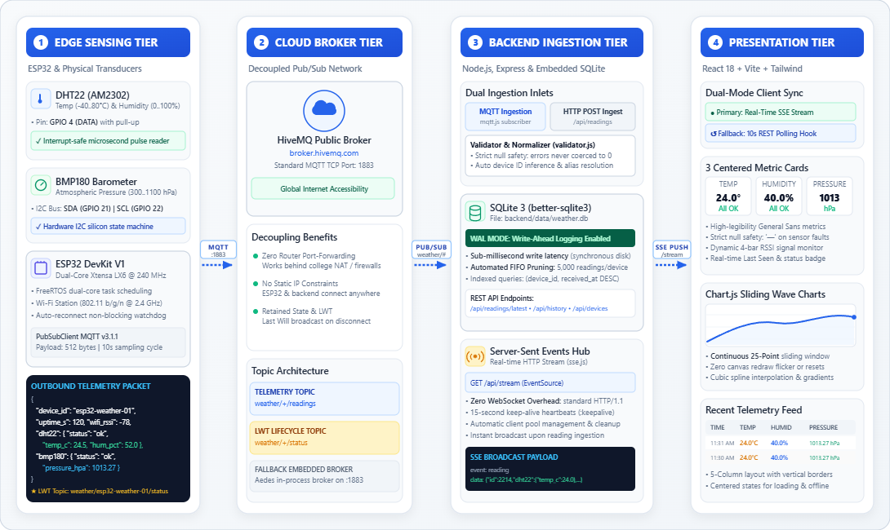
System architecture: four functional tiers
1
Edge tier
Dual sensors: µs bit banged DHT22 pulse train and hardware I2C for the BMP180.
2
Broker tier
Decoupled cloud pub/sub network: no router NAT or port forwarding constraints.
3
Backend tier
Express + SQLite engine with submillisecond insert times.
4
Presentation tier
Browser native EventSource with zero WebSocket handshake overhead.
IoT Weather Station Telemetry Platform
03 / 05
Notes:
Walk the diagram left to right through the four tiers: edge hardware, the MQTT broker, the Node.js ingestion and storage engine, then the browser dashboard. Point out that the broker decouples the device from the backend, so no port forwarding is needed. Mermaid source for the diagram image (paste into mermaid.live, export PNG or SVG, drop it into the dashed frame): flowchart TD subgraph EdgeHardware ["1. Edge Hardware & Microcontroller Layer"] DHT["DHT22 Sensor<br/>(GPIO 4 / Single Wire)"] -->|Pulse Train| ESP["ESP32 DevKit V1<br/>(FreeRTOS Core 1)"] BMP["BMP180 Sensor<br/>(GPIO 21 SDA / 22 SCL)"] -->|Hardware I2C| ESP ESP -->|Payload Serialization| JSON["JSON Document<br/>(Null Safe Schema)"] end subgraph TransportLayer ["2. Global Transport & Broker Layer"] JSON -->|WiFi STA / TCP :1883| PUB["PubSubClient Daemon"] PUB -->|Publish: weather/+/readings<br/>LWT: weather/+/status| MQTT["HiveMQ Cloud MQTT Broker<br/>(broker.hivemq.com)"] end subgraph BackendLayer ["3. Ingestion, Storage & Streaming Engine"] MQTT -->|TCP Subscribe| MSUB["Node.js MQTT Subscriber<br/>(mqtt.js)"] HTTP["HTTP POST /api/readings<br/>(Simulator / Fallback)"] --> VENG["Validation & Normalization Engine"] MSUB --> VENG VENG -->|SQL Prepared Insert| SQL[("SQLite 3 Database<br/>WAL Mode + Auto Pruning")] VENG -->|Broadcast Reading| SSE["Server Sent Events Hub<br/>(GET /api/stream)"] end subgraph ClientLayer ["4. Reactive Client Presentation Layer"] SSE -->|Real Time EventSource| HOOK["useLatestReading Hook<br/>(with 10s Polling Fallback)"] SQL -.->|REST History Queries| HOOK HOOK --> CARDS["Metric Cards<br/>(Temp, Humidity, Pressure)"] HOOK --> CHARTS["Sliding 25 Point Charts<br/>(Chart.js Gradient)"] HOOK --> TABLE["Structured Feed<br/>(Status & RSSI)"] end

Slide 4
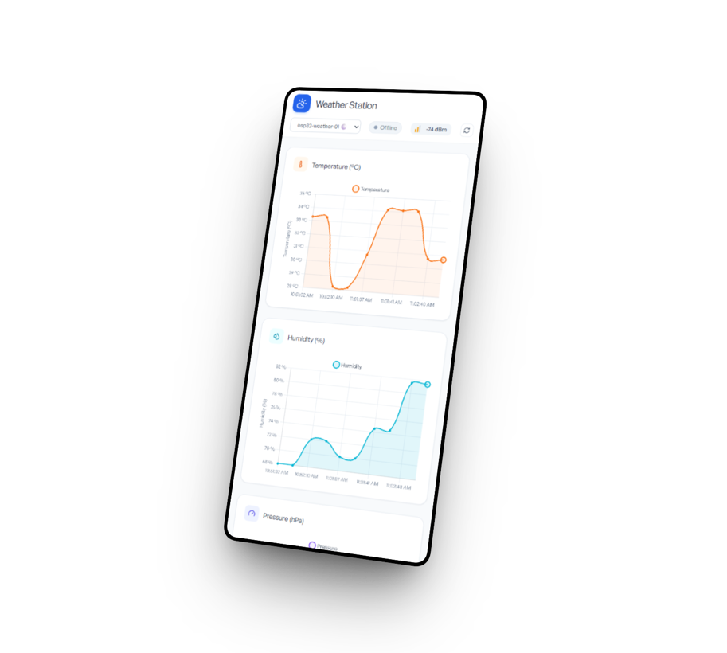
Unique selling points & technical highlights
1
Zero cloud cost, globally decoupled mesh
Public MQTT broker plus embedded SQLite: no AWS IoT Core, DynamoDB or external database fees.
2
Strict hardware to UI null safety
Sensor faults stay null, never a fake 0 °C or 0 %: the UI shows an empty value and a Degraded status pill.
3
Self healing dual mode resiliency
Firmware automatically reconnects WiFi and MQTT; the dashboard fails over from SSE to 10 s REST polling.
4
High performance sliding window charts
Chart.js slides a 25-reading window with spline interpolation and gradient fills, no flicker.
5
Industrial minimalist UI & UX
Pure light mode, centered type, equal 20 % columns and a live 4 bar RSSI signal indicator.
IoT Weather Station Telemetry Platform
04 / 05
Notes:
Five things set this apart. It costs nothing to run in the cloud. It never shows a fake zero when a sensor fails. It heals itself on both the device and the dashboard. The charts slide smoothly without flicker. And the interface stays clean and readable. Use the dashboard screenshot on the right to show the null safe cards, the live charts and the RSSI indicator while you talk through them.

Slide 5
Future scope & what can be improved
1
Edge ML & barometric forecasting
A Zambretti algorithm or TinyML regression predicts rain, storm fronts and cloud cover 6 to 12 h ahead from the pressure rate of change (ΔP/Δt).
2
Deep sleep & solar harvesting
esp_deep_sleep_start() with ULP wake up every 10 to 15 min cuts draw from ~80 mA to ~10 µA for multiyear off grid operation.
3
Enterprise security: MQTTS & tokens
MQTTS on port 8883 (TLS, X.509 certificates) plus JWT/HMAC payload signing to stop unauthorized injection on public topics.
4
Multinode geospatial mapping
Leaflet or Mapbox tile maps to track distributed stations across campuses, farms and smart city districts.
5
Proactive alerting & webhooks
Web Push, Telegram or Discord alerts for heatwaves, sudden barometric drops and prolonged sensor dropouts.
IoT Weather Station Telemetry Platform
05 / 05
Notes:
Five directions for the next phase. Forecasting from pressure trend is the most visible upgrade. Deep sleep and solar make the station deployable off grid. MQTTS and signed payloads close the security gap of the public broker. Mapping scales it to many stations, and alerting turns passive monitoring into action.

Slide 6
Thank you
Explore the project
LIVE DASHBOARD
SOURCE CODE
iot-weather-8.vercel.app
github.com/Pranjal-Sahu21/iot-project
Project at a glance
SENSORS
TRANSPORT
BACKEND
DASHBOARD
DHT22 and BMP180
MQTT on HiveMQ
Node.js and SQLite
React with live updates
Notes:
Thank the audience and invite questions. If possible, switch to the live dashboard for a short demo: show a reading arriving over MQTT and the status indicator reacting.

