Slide 1
Sales & Financial
Performance Dashboard
Task 4 – Dashboard Design | Tableau
Interactive dashboard for exploring sales, profit, orders and cost performance.
Prepared for academic submission
1

Slide 2
1. Objective
• Design an interactive dashboard for business stakeholders.
• Provide a quick summary of key sales and financial KPIs.
• Use charts to identify sales trends, category performance and country-level profitability.
• Allow users to explore the data using Country, Category and Device Type filters.
2

Slide 3
2. Dataset & Dashboard Components
• Dataset: Sales-Export-2019-2020
• Sales transaction data with date, country, category and device information.
• Measures used: Cost, Profit and Order Value (EUR).
• Order ID used for the order count.
• KPI cards: Total Sales, Total Profit, Total Orders and Total Cost.
• Sales Trend Over Time.
• Sales over Category.
• Profit by Country.
• Interactive filters and dashboard navigation.
3

Slide 4
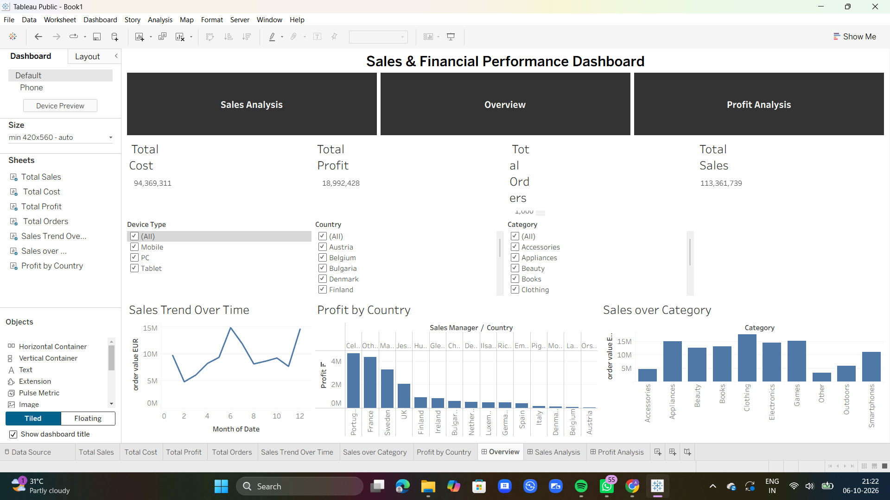
3. Final Tableau Dashboard
Overview dashboard with KPIs, filters, trend analysis, category analysis, country profitability and navigation.
4

Slide 5
4. KPI Summary
TOTAL SALES
TOTAL PROFIT
TOTAL ORDERS
TOTAL COST
€113.36M
€18.99M
1,000
€94.37M
• KPI cards give stakeholders a quick view of overall performance.
• They keep important totals visible without reading every chart.
• They work with the dashboard filters for interactive analysis.
5

Slide 6
5. Key Observations
• Sales vary considerably across the months, with a clear peak around June and another strong value at the end of the displayed period.
• Clothing is the highest-sales category in the displayed category chart.
• Portugal shows the highest profit in the displayed country chart, followed by France and Sweden.
6

Slide 7
6. Interactivity & Navigation
• Country, Category and Device Type filters allow users to focus on specific segments.
• The time-series chart supports month-level sales trend analysis.
• Navigation provides access to Overview, Sales Analysis and Profit Analysis dashboards.
• The dashboard combines summary KPIs with detailed visual analysis.
Overview
Sales Analysis
Profit Analysis
7

Slide 8
Conclusion
• The Tableau dashboard provides an interactive overview of sales and financial performance.
• KPI cards summarize sales, profit, orders and cost.
• Charts help identify trends, category performance and country-level profitability.
• Filters and navigation make the dashboard easier to explore from a business perspective.
Outcome: A dashboard designed to support quick, interactive business analysis.
8

