Slide 1

2024 Travelers University Modeling Competition

Slide 2
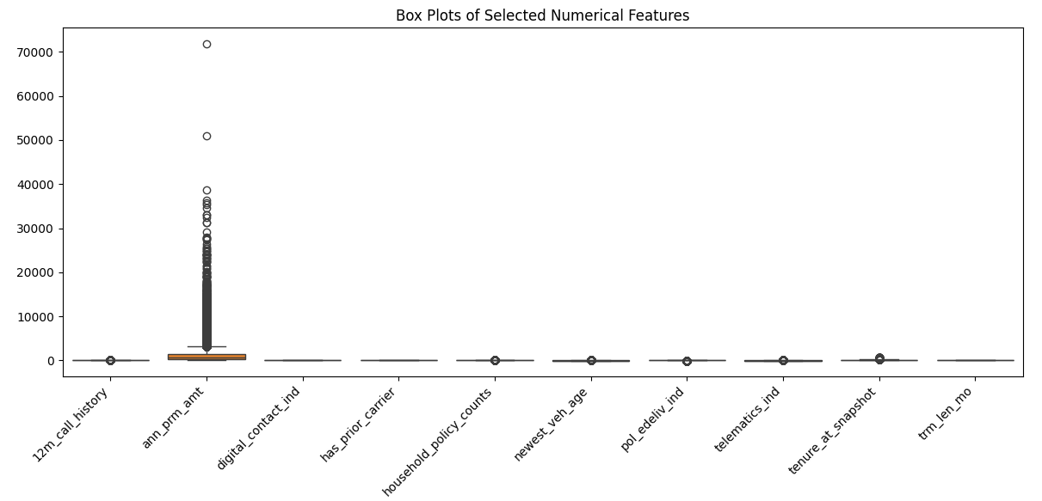
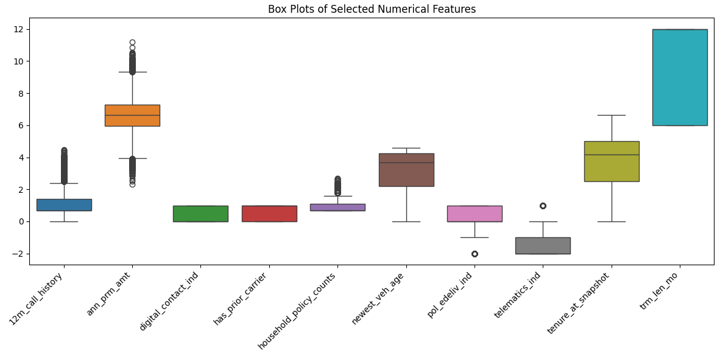
Preprocessing
Transformed the data using log transformation
Used Robust scaler to get all the features on same scale.
Comparison of data distribution before and after log transformation.
Notes:
Helped reduce the skewness of the data
Handled the outliers

Slide 3
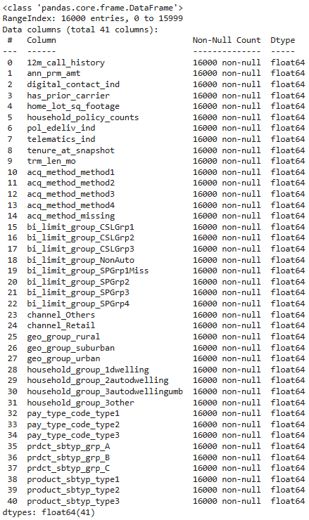
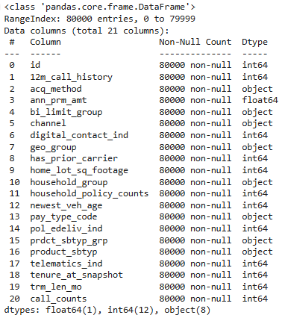
One Hot Encoding

Slide 4
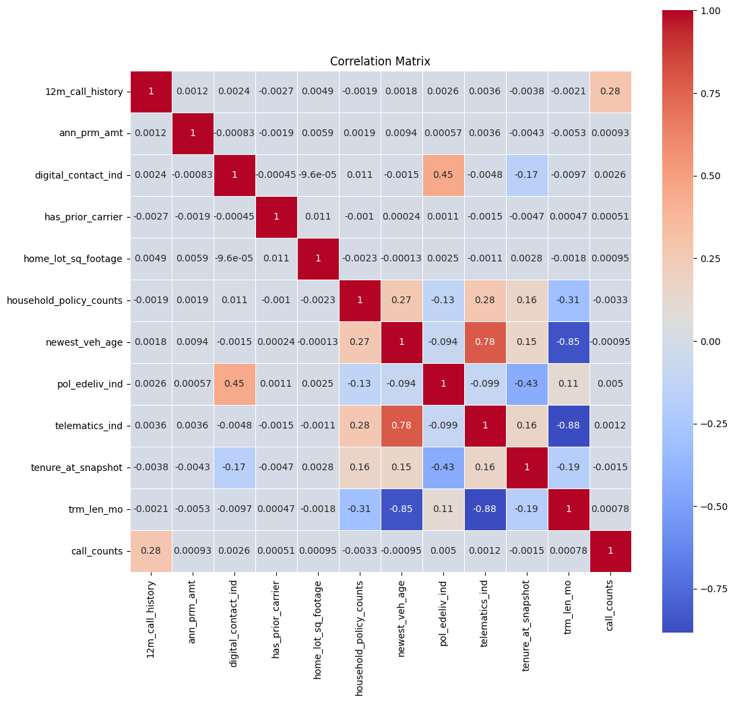
Correlation Matrix

Slide 5
Initial model building
Methods We Considered | Methods We Used
Classification Model Scaling, Sampling GridSearchCV AutoML | Splitting the Dataset in Train-Test Scaling GridSearchCV Relative Gini Function
Model (Regression) | Train RMSE | Train R2 | Test RMSE | Test R2
Linear | 35.91 | 0.101 | 36.06 | 0.091
Lasso | 35.93 | 0.099 | 36.06 | 0.093
Random forest | 13.77 | 0.868 | 36.93 | 0.048
XGBoost | 32.57 | 0.260 | 36.69 | 0.094
LightGBM Benchmark Model: 0.24398
XGBoost Relative Gini Score: 0.24790

Slide 6
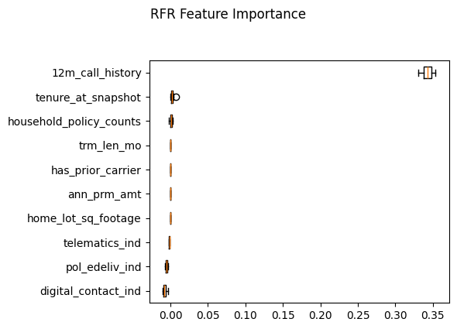
Higher Call Count Higher Frequency Higher Pure Premium

Slide 7
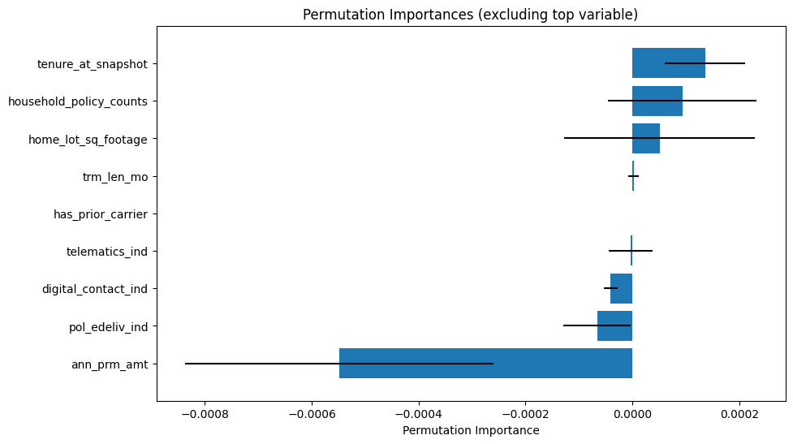
Results
Top 3 Important Features
12m_call_history
tenure_at_snapshot
household_policy_counts
Best Model
XGBoost
Future Improvements
Ensemble Models
Vehicle-Specific Details
Make and Model
Annual Mileage
Vehicle Use Type
Driver Information
Driver Age
Driver Gender
Driving Record
Years of Driving Experience
Claims History
Previous Claims Count
Severity of Past Claims
Claim Frequency
Notes:
from the feature importance graph , we can notice that “The top 3 important features that impact the number of calls are: We excluded the 12month call history variable in the below chart , to show the granularity of how the other factor's importance.
12m_call_history, which represents the number of calls made in the past year. This strongly correlates with future call behavior because frequent past calls indicate higher interaction needs with the company.
Tenure_at_snapshot, Longer tenures suggest a stable relationship with fewer calls, as customers may be more familiar with the policy.
Household_policy_counts, where a higher number of policies in a household could lead to more queries or service requests, increasing call frequency.
Interestingly, features like ann_prm_amt (Annualized Premium Amount) show a negative permutation importance. This suggests that higher premium amounts might be associated with more comprehensive policies, reducing the need for customer service interactions.”
“To improve the model further, we could explore adding more data points:
we could also consider trying ensemble models. By combining multiple models, we could capture diverse patterns in the data and improve prediction accuracy. If we had more time, this would be a great approach to explore.”
Some of the Vehicle-specific details, such as:
Make and Model, which could help anticipate service needs based on the type of vehicle.
Annual Mileage, as higher mileage may result in more claims or service-related calls.
Vehicle Use Type, like commercial or personal use, which can significantly impact call behavior patterns.
Driver information, including:
Driver Age and Gender, since certain demographics might show different service needs.
Driving Record, where a history of accidents or violations could increase inquiries.
Years of Driving Experience, as more experienced drivers might require less assistance.
Claims History, for example:
Previous Claims Count, because frequent past claims often indicate higher interaction needs.
Severity of Past Claims, where larger claims might lead to more post-claim support.
Claim Frequency, since regular claims could suggest customers with higher demands for service.

Slide 8
Thank you!
Questions?

