Slide 1

Cryptography and Cryptographic Protocols:
Notes:
This general model shows that there are four basic tasks in designing a particular security service, as listed.

Slide 2
Cryptography and Cryptographic Protocols:
Cryptography is the process of hiding or coding information so that only the person a message was intended for can read it.
Symmetric key Cryptography
Asymmetric key Cryptography (popularly known as public key cryptography).
Cryptographic protocols provide secure connections, enabling two parties to communicate with privacy and data integrity.
Notes:
This general model shows that there are four basic tasks in designing a particular security service, as listed.

Slide 3
Model for Network Security
This kind of model requires:
A secure algorithm for the security transformation.
A generation of keys (secret information) using an algorithm that will be provided to the principals.
A method of distribution and share of the key.
Notes:
This general model shows that there are four basic tasks in designing a particular security service, as listed.

Slide 4
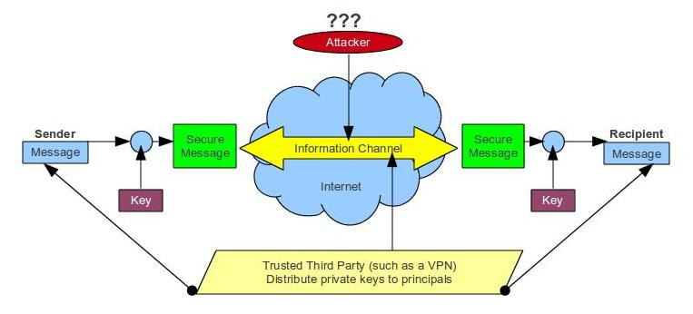
Model for Network Security
Notes:
In considering the place of encryption, its useful to use the following two models from Stallings section 1.6.
The first, illustrated in Figure 1.4, models information being transferred from one party to another over an insecure communications channel, in the presence of possible opponents. The two parties, who are the principals in this transaction, must cooperate for the exchange to take place. They can use an appropriate security transform (encryption algorithm), with suitable keys, possibly negotiated using the presence of a trusted third party. Parts One through Four of this book concentrates on the types of security mechanisms and services that fit into the model shown here.

Slide 5
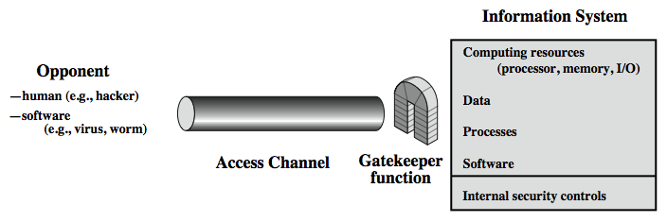
Model for Network Access Security
Notes:
The second, illustrated in Figure 1.5, model is concerned with controlled access to information or resources on a computer system, in the presence of possible opponents. Here appropriate controls are needed on the access to and within the system, to provide suitable security.
The security mechanisms needed to cope with unwanted access fall into two broad categories (as shown in this figure). The first category might be termed a gatekeeper function. It includes password-based login procedures that are designed to deny access to all but authorized users and screening logic that is designed to detect and reject worms, viruses, and other similar attacks. Once either an unwanted user or unwanted software gains access, the second line of defense consists of a variety of internal controls that monitor activity and analyze stored information in an attempt to detect the presence of unwanted intruders. These issues are explored in Part Four.

Slide 6
Model for Network Security (Enemy of our network )
A hacker and/or cracker is a person who will try to break the access security of our network.
A virus is a software that try to multiply itself inside our computer systems by making copies of itself in different programs. It required to be inside a program in order to be executed and/or propagate.
A worm is a program by itself that have the purpose of copy itself and disperse thought the network.
Trojans are programs that have an hidden functionality inside them that is unknown to the user and have nefarious purposes.
Notes:
This general model shows that there are four basic tasks in designing a particular security service, as listed.

Slide 7
Some Basic Terminology
plaintext - original message meet me (Original Data)
ciphertext - coded message PHHW PH
cipher - algorithm for transforming plaintext to ciphertext
key - info used in cipher known only to sender/receiver
encipher (encrypt) - converting plaintext to ciphertext
decipher (decrypt) - recovering ciphertext from plaintext
cryptography - study of encryption principles/methods
cryptanalysis (codebreaking) - study of principles/ methods of deciphering ciphertext without knowing key
cryptology - field of both cryptography and cryptanalysis
Notes:
Briefly review some terminology used throughout the course.

Slide 9
Private-Key Cryptography
traditional private/secret/single key cryptography uses one key
Key is shared by both sender and receiver
if the key is disclosed communications are compromised
also known as symmetric, both parties are equal
hence does not protect sender from receiver forging a message & claiming is sent by sender
Notes:
So far all the cryptosystems discussed have been private/secret/single key (symmetric) systems. All classical, and modern block and stream ciphers are of this form.

Slide 10
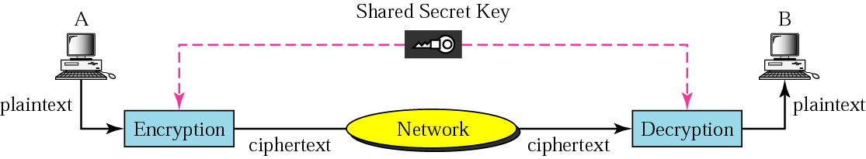
Secret-key encryption
In secret-key encryption, the same key is used by the sender (for encryption) and the receiver (for decryption). The key is shared.
Secret-key encryption is often called symmetric encryption because the same key can be used in both directions.
Secret-key encryption is often used for long messages.

Slide 11
Traditional ciphers
Traditional ciphers used two techniques for hiding information from an intruder: substitution and transposition.
The difference between substitution and transposition is that in:
Substitution: each letter retains its position but changes its identity,
Transposition: each letter retains its identity but changes its position.

Slide 12
Classical Substitution Ciphers
Letters of plaintext are replaced by other letters or by numbers or symbols
Plaintext is viewed as a sequence of bits, then substitution replaces plaintext bit patterns with ciphertext bit patterns
Notes:
In this section and the next, we examine a sampling of what might be called classical encryption
techniques. A study of these techniques enables us to illustrate the basic approaches to
symmetric encryption used today and the types of cryptanalytic attacks that must be anticipated.
The two basic building blocks of all encryption techniques: substitution and transposition.
We examine these in the next two sections. Finally, we discuss a system that combine both
substitution and transposition.

Slide 13
Ciphers
Monoalphabetic ciphers: each letter in the plaintext is encoded by only one letter from the cipher alphabet, and each letter in the cipher alphabet represents only one letter in the plaintext.
Polyalphabetic ciphers: each letter in the plaintext can be encoded by any letter in the cipher alphabet, and each letter in the cipher alphabet may represent different letters from the plaintext each time it appears.

Slide 14
Caesar Cipher
Earliest known substitution cipher
Replaces each letter by 3rd letter on
Example:
meet me after the toga party
PHHW PH DIWHU WKH WRJD SDUWB
Notes:
Substitution ciphers form the first of the fundamental building blocks. The core idea is to replace one basic unit (letter/byte) with another. Whilst the early Greeks described several substitution ciphers, the first attested use in military affairs of one was by Julius Caesar, described by him in Gallic Wars (cf. Kahn pp83-84). Still call any cipher using a simple letter shift a caesar cipher, not just those with shift 3.
Note: when letters are involved, the following conventions are used in this course: Plaintext is always in lowercase; ciphertext is in uppercase; key values are in italicized lowercase.

Slide 15
Monoalphabetic Cipher
Rather than just shifting the alphabet
Could shuffle (jumble) the letters arbitrarily
Each plaintext letter maps to a different random ciphertext letter
Key is 26 letters long
Plain: abcdefghijklmnopqrstuvwxyz
Cipher: DKVQFIBJWPESCXHTMYAUOLRGZN
Plaintext: ifwewishtoreplaceletters
Ciphertext: WIRFRWAJUHYFTSDVFSFUUFYA

Slide 16
Transposition Ciphers
Now consider classical transposition or permutation ciphers
These hide the message by rearranging the letter order, without altering the actual letters used
Can recognise these since have the same frequency distribution as the original text
For example, the message THE GAME IS AFOOT becomes encoded as EHT EMAG SI TOOFA. Such "backward writing" is easy to recognize and decode.
Notes:
Transposition Ciphers form the second basic building block of ciphers. The core idea is to rearrange the order of basic units (letters/bytes/bits) without altering their actual values.

Slide 17
Rail Fence cipher
Write message letters out diagonally over a number of rows
Then read off cipher row by row
E.g., write message out as:
m e m a t r h t g p r y
e t e f e t e o a a t
Giving ciphertext
MEMATRHTGPRYETEFETEOAAT
Notes:
Example message is: "meet me after the toga party" with a rail fence of depth 2.

Slide 18
Alice needs to send the message “Enemy attacks tonight” to Bob. Alice and Bob have agreed to divide the text into groups of five characters and then permute the characters in each group. The following shows the grouping after adding a bogus character (z) at the end to make the last group the same size as the others.
The key used for encryption and decryption is a permutation key, which shows how the character are permuted. For this message, assume that Alice and Bob used the following key:

Slide 19
Continued
The third character in the plaintext block becomes the first character in the ciphertext block, the first character in the plaintext block becomes the second character in the ciphertext block and so on. The permutation yields:
Alice sends the ciphertext “eemyntaacttkonshitzg” to Bob. Bob divides the ciphertext into five-character groups and, using the key in the reverse order, finds the plaintext.

Slide 20
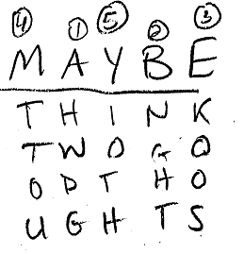

Slide 21
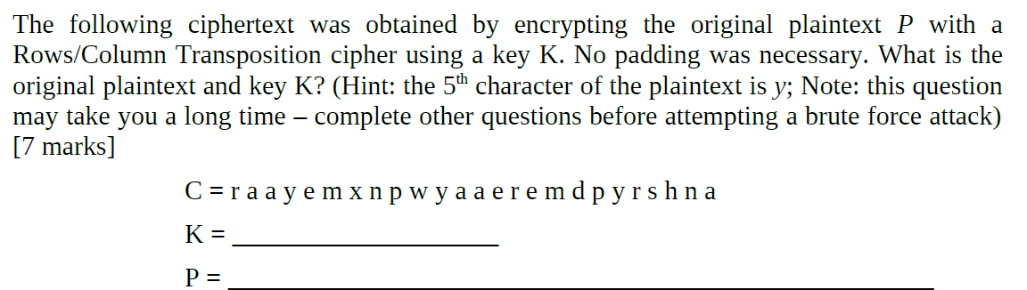

Slide 22
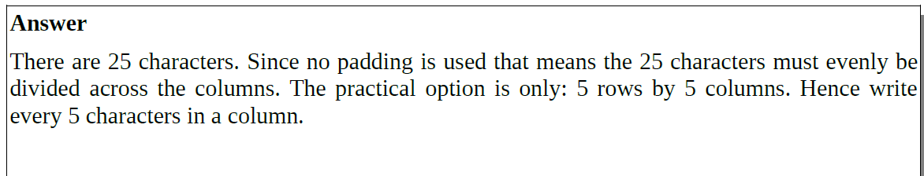

Slide 23
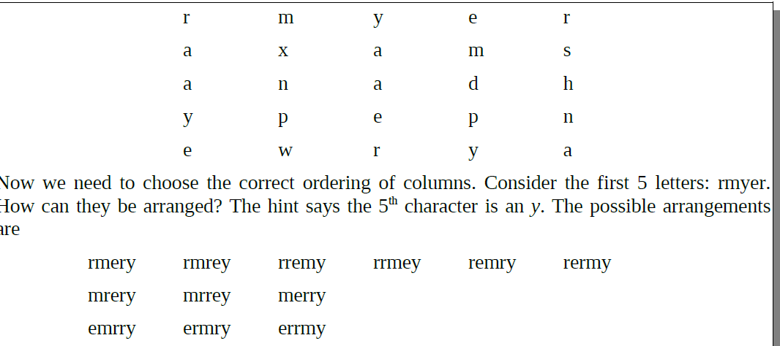

Slide 24
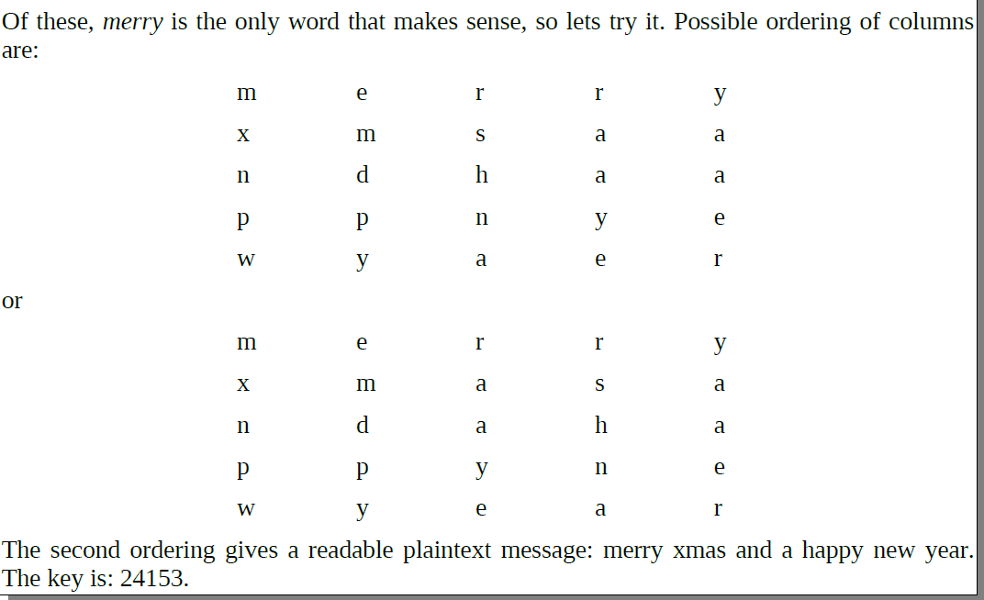

Slide 25

Vigenere cipher
Pick a keyword (for our example, the keyword will be "MEC").
Write your keyword across the top of the text you want to encipher, repeating it as many times as necessary.
For each letter, look at the letter of the keyword above it (if it was 'M', then you would go to the row that starts with an 'M'), and find that row in the Vigenere Table.
Then find the column of your plaintext letter (for example, 'w', so the twenty-third column).
Finally, trace down that column until you reach the row you found before and write down the letter in the cell where they intersect (in this case, you find an 'I' there).

Slide 26
Vigenere table.
ROW
0 | A | B | C | D | E | F | G | H | I | J | K | L | M | N | O | P | Q | R | S | T | U | V | W | X | Y | Z
1 | B | C | D | E | F | G | H | I | J | K | L | M | N | O | P | Q | R | S | T | U | V | W | X | Y | Z | A
2 | C | D | E | F | G | H | I | J | K | L | M | N | O | P | Q | R | S | T | U | V | W | X | Y | Z | A | B
3 | D | E | F | G | H | I | J | K | L | M | N | O | P | Q | R | S | T | U | V | W | X | Y | Z | A | B | C
4 | E | F | G | H | I | J | K | L | M | N | O | P | Q | R | S | T | U | V | W | X | Y | Z | A | B | C | D
5 | F | G | H | I | J | K | L | M | N | O | P | Q | R | S | T | U | V | W | X | Y | Z | A | B | C | D | E
6 | G | H | I | J | K | L | M | N | O | P | Q | R | S | T | U | V | W | X | Y | Z | A | B | C | D | E | F
7 | H | I | J | K | L | M | N | O | P | Q | R | S | T | U | V | W | X | Y | Z | A | B | C | D | E | F | G
8 | I | J | K | L | M | N | O | P | Q | R | S | T | U | V | W | X | Y | Z | A | B | C | D | E | F | G | H
9 | J | K | L | M | N | O | P | Q | R | S | T | U | V | W | X | Y | Z | A | B | C | D | E | F | G | H | I
10 | K | L | M | N | O | P | Q | R | S | T | U | V | W | X | Y | Z | A | B | C | D | E | F | G | H | I | J
11 | L | M | N | O | P | Q | R | S | T | U | V | W | X | Y | Z | A | B | C | D | E | F | G | H | I | J | K
12 | M | N | O | P | Q | R | S | T | U | V | W | X | Y | Z | A | B | C | D | E | F | G | H | I | J | K | L
13 | N | O | P | Q | R | S | T | U | V | W | X | Y | Z | A | B | C | D | E | F | G | H | I | J | K | L | M
14 | O | P | Q | R | S | T | U | V | W | X | Y | Z | A | B | C | D | E | F | G | H | I | J | K | L | M | N
15 | P | Q | R | S | T | U | V | W | X | Y | Z | A | B | C | D | E | F | G | H | I | J | K | L | M | N | O
16 | Q | R | S | T | U | V | W | X | Y | Z | A | B | C | D | E | F | G | H | I | J | K | L | M | N | O | P
17 | R | S | T | U | V | W | X | Y | Z | A | B | C | D | E | F | G | H | I | J | K | L | M | N | O | P | Q
18 | S | T | U | V | W | X | Y | Z | A | B | C | D | E | F | G | H | I | J | K | L | M | N | O | P | Q | R
19 | T | U | V | W | X | Y | Z | A | B | C | D | E | F | G | H | I | J | K | L | M | N | O | P | Q | R | S
20 | U | V | W | X | Y | Z | A | B | C | D | E | F | G | H | I | J | K | L | M | N | O | P | Q | R | S | T
21 | V | W | X | Y | Z | A | B | C | D | E | F | G | H | I | J | K | L | M | N | O | P | Q | R | S | T | U
22 | W | X | Y | Z | A | B | C | D | E | F | G | H | I | J | K | L | M | N | O | P | Q | R | S | T | U | V
23 | X | Y | Z | A | B | C | D | E | F | G | H | I | J | K | L | M | N | O | P | Q | R | S | T | U | V | W
24 | Y | Z | A | B | C | D | E | F | G | H | I | J | K | L | M | N | O | P | Q | R | S | T | U | V | W | X
25 | Z | A | B | C | D | E | F | G | H | I | J | K | L | M | N | O | P | Q | R | S | T | U | V | W | X | Y

Slide 27
Vigenere cipher
Decipherment of an encrypted message is equally straightforward. One writes the keyword repeatedly above the message:
one uses the keyword letter to pick a column of the table and then traces down the column to the row containing the cipher text letter
Key Word M E C M E C
Cipher Text I I P Q I F
Plain Text W E N E E D

Slide 28
One-Time Pad Vernam Cipher
if a truly random key as long as the message is used, the cipher will be secure
called a One-Time pad
is unbreakable since ciphertext bears no statistical relationship to the plaintext
since for any plaintext & any ciphertext there exists a key mapping one to other
can only use the key once though
Notes:
The One-Time Pad is an evolution of the Vernham cipher, which was invented by Gilbert Vernham in 1918, and used a long tape of random letters to encrypt the message. An Army Signal Corp officer, Joseph Mauborgne, proposed an improvement using a random key that was truly as long as the message, with no repetitions, which thus totally obscures the original message. It produces random output that bears no statistical relationship to the plaintext. Because the ciphertext contains no information whatsoever about the plaintext, there is simply no way to break the code, since any plaintext can be mapped to any ciphertext given some key.
The one-time pad offers complete security but, in practice, has two fundamental difficulties:
There is the practical problem of making large quantities of random keys.
2. And the problem of key distribution and protection, where for every message to be sent, a key of equal length is needed by both sender and receiver.
Because of these difficulties, the one-time pad is of limited utility, and is useful primarily for low-bandwidth channels requiring very high security.

Slide 29
One-Time Pad
It produces random output that bears no statistical relationship to the plaintext. Because the ciphertext contains no information whatsoever about the plaintext, there is simply no way to break the code, since any plaintext can be mapped to any ciphertext given some key.

Slide 30
One-Time Pad
The one-time pad offers complete security but, in practice, has two fundamental difficulties:
There is the practical problem of making large quantities of random keys.
2. And the problem of key distribution and protection, where for every message to be sent, a key of equal length is needed by both sender and receiver.
Because of these difficulties, the one-time pad is of limited utility, and is useful primarily for low-bandwidth channels requiring very high security.

Slide 31

One-Time Pad
Let Z_{m} ={0,1,…,m-1} be
the alphabet.
Plaintext space = Ciphtertext space = Key space = (Z_{m})^{n}
The key is chosen uniformly randomly
Plaintext X = (x₁ x₂ … x_{n})
Key K = (k₁ k₂ … k_{n})
Ciphertext Y = (y₁ y₂ … y_{n})
e_{k}(X) = (x₁+k₁ x₂+k₂ … x_{n}+k_{n}) mod m
d_{k}(Y) = (y₁-k₁ y₂-k₂ … y_{n}-k_{n}) mod m

Slide 32
One Time Padding
Suppose Alice wishes to send the message "HELLO" to Bob
Each letter from the pad will be combined in a predetermined way with one letter of the message.
It is common, but not required, to assign each letter a numerical value: e.g. "A" is 0, "B" is 1, and so on.
In this example, the technique is to combine the key and the message using modular addition.
The numerical values of corresponding message and key letters are added together, modulo 26. If key material begins with "XMCKL" and the message is "HELLO", then the coding would be done as follows:

Slide 33
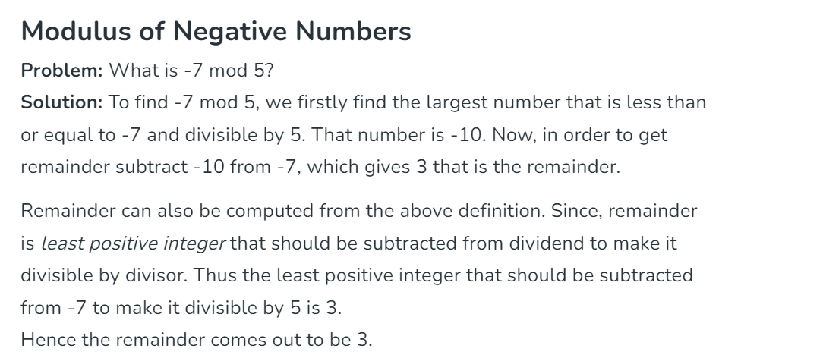

Slide 34
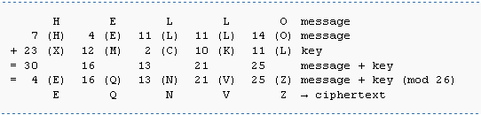
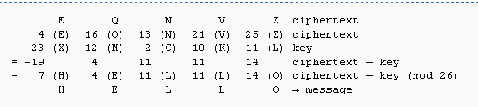

Slide 35
Rotor Machines
before modern ciphers, rotor machines were most common complex ciphers in use
widely used in WW2
German Enigma, Allied Hagelin, Japanese Purple
implemented a very complex, varying substitution cipher
used a series of cylinders, each giving one substitution, which rotated and changed after each letter was encrypted
with 3 cylinders have 26³=17576 alphabets
Notes:
The next major advance in ciphers required use of mechanical cipher machines which enabled to use of complex varying substitutions.
A rotor machine consists of a set of independently rotating cylinders through which electrical pulses can flow. Each cylinder has 26 input pins and 26 output pins, with internal wiring that connects each input pin to a unique output pin. If we associate each input and output pin with a letter of the alphabet, then a single cylinder defines a monoalphabetic substitution. After each input key is depressed, the cylinder rotates one position, so that the internal connections are shifted accordingly. The power of the rotor machine is in the use of multiple cylinders, in which the output pins of one cylinder are connected to the input pins of the next, and with the cylinders rotating like an “odometer”, leading to a very large number of substitution alphabets being used, eg with 3 cylinders have 26³=17576 alphabets used.
They were extensively used in world war 2, and the history of their use and analysis is one of the great stories from WW2.

Slide 36
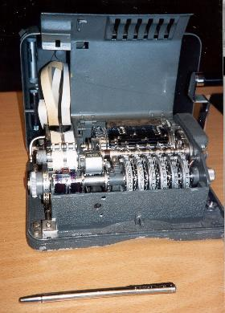
Hagelin Rotor Machine
Notes:
This photo of an Allied Hagelin machine was taken by Lawrie Brown at Eurocrypt'93 in Norway. Note pen for scale, and the rotating cipher wheels near the front.

Slide 37
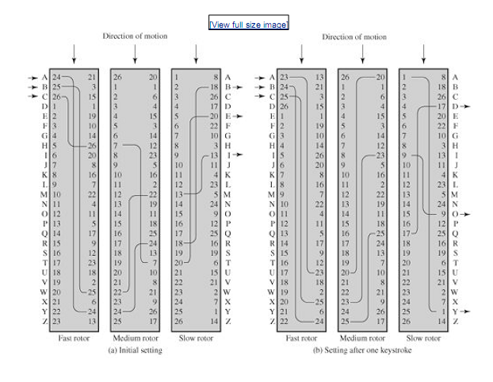

Slide 38
Public-Key Cryptography
public-key/two-key/asymmetric cryptography involves the use of two keys:
a public-key, which may be known by anybody, and can be used to encrypt messages, and verify signatures
a private-key, known only to the recipient, used to decrypt messages, and sign (create) signatures
is asymmetric because
those who encrypt messages or verify signatures cannot decrypt messages or create signatures

Slide 39
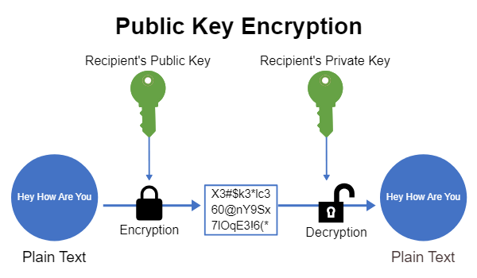

Slide 40
Factors
NUMBER Factors
5 1,5
12 1,2,3,4,6,12
20 1,2,4,5,10,20
Prime Numbers
Factors : 1 & itself
1,2,3,5,7,11,13,17,19……….
Modulus
M modulo N : remainder after dividing M by N
10 mod 3 = 1
10 mod 5 = 0
19 mod 7 = 5

Slide 41
RSA Algorithm
Two large prime numbers p and q
Let p = 7 and q=17
n modulus p x q
P X q = 119
e relatively prime to z= (p-1)(q-1) z= 6 X 16 = 96
where 1<e<z)
e
(PUBLIC EXPONENT)
Public key e such that it is not factor of z
The factor of z are 1,2 and 3 so we choose 5

Slide 42
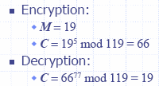
RSA Algorithm
d ( Private key decryption )such that
e X d-1 is divisible by (p-1)(q-1)
(PRIVATE EXPONENT)
e X d-1 divisible by 96
So we choose d = 77
(5 X 77) -1 divisible by 96
385-1 = 384 which is divisible by 96
Public key (119,5)
Private key (119,77)

Slide 43
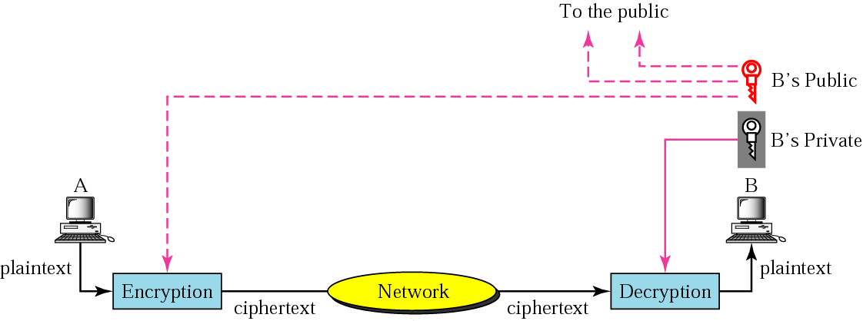
Public-Key Encryption
Public-key algorithms are more efficient for short messages.
A CA can certify the binding between a public key and the owner.

Slide 44
Public-Key Characteristics
Public-Key algorithms rely on two keys with the characteristics that it is:
computationally infeasible to find decryption key knowing only algorithm & encryption key
computationally easy to en/decrypt messages when the relevant (en/decrypt) key is known
either of the two related keys can be used for encryption, with the other used for decryption (in some schemes)
Notes:
Public key schemes utilise problems that are easy (P type) one way but hard (NP type) the other way, eg exponentiation vs logs, multiplication vs factoring. Consider the following analogy using padlocked boxes: traditional schemes involve the sender putting a message in a box and locking it, sending that to the receiver, and somehow securely also sending them the key to unlock the box. The radical advance in public key schemes was to turn this around, the receiver sends an unlocked box to the sender, who puts the message in the box and locks it (easy - and having locked it cannot get at the message), and sends the locked box to the receiver who can unlock it (also easy), having the key. An attacker would have to pick the lock on the box (hard).

Slide 45
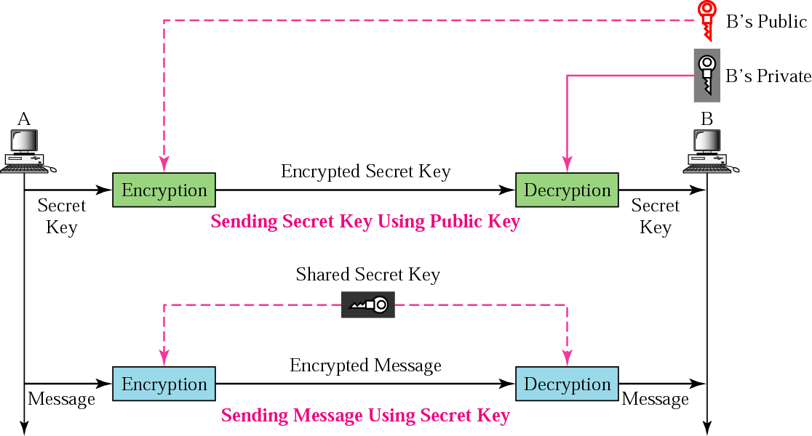
Combination
To have the advantages of both secret-key and public-key encryption, we can encrypt the secret key using the public key and encrypt the message using the secret key.

