Slide 1
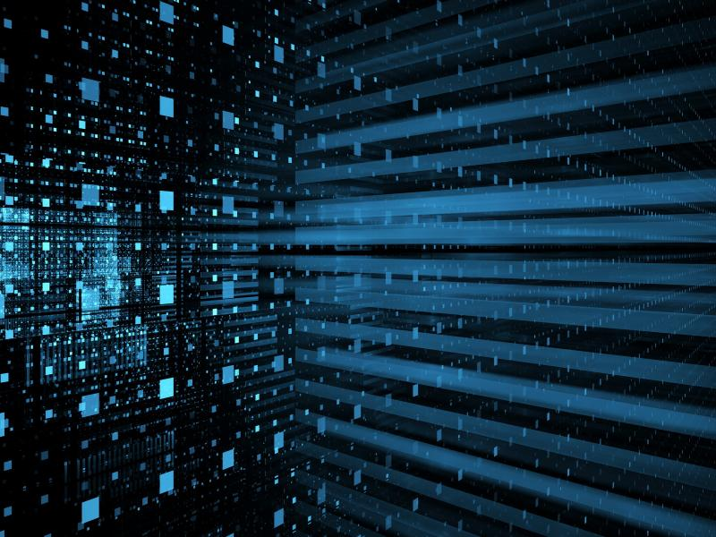
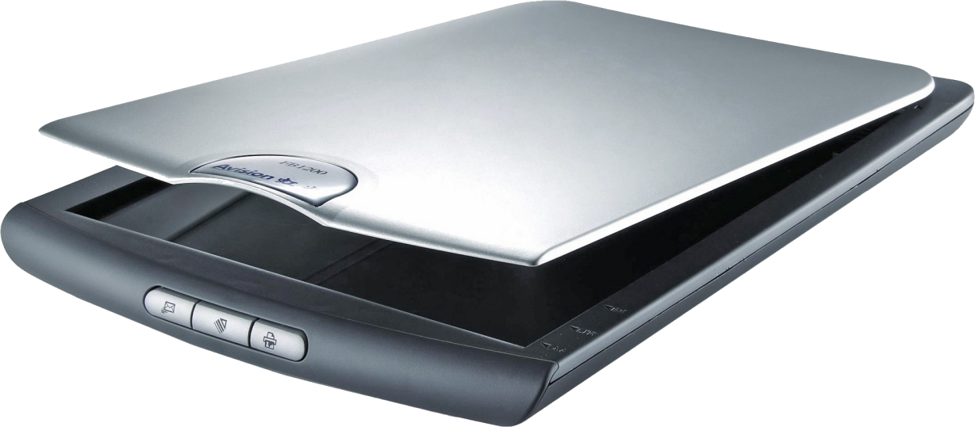
SCANNERS
Scanners are the optical input devices that use light to scan or read the input and display it on the screen.
Commonly used optical scanners are shown bellow:
Optical Character Reader(OCR)
Optical Mark Reader(OMR)
Optical Bar-Code Reader(OBCR)

Slide 2
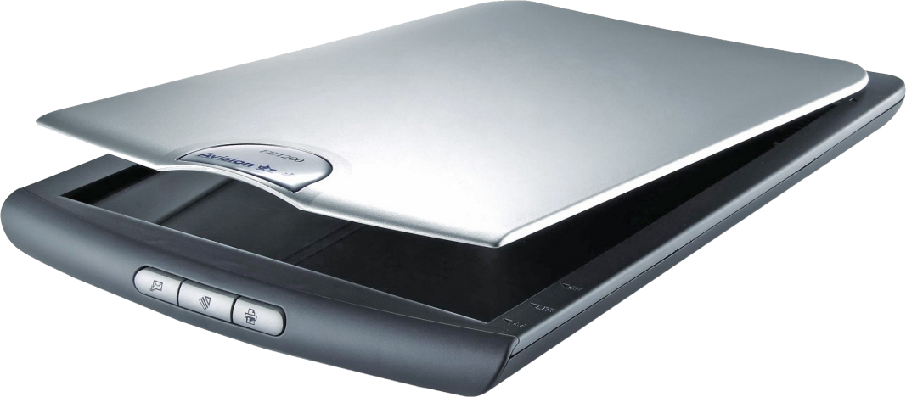
Optical Character Reader
It is used to scan special characters printed on the paper and fed into the computer as input data. It is used to scan paper documents and turn into a editable, Portable Digital Format(PDF) for easy storage or for portability. It is used in offices for file handling.

Slide 3
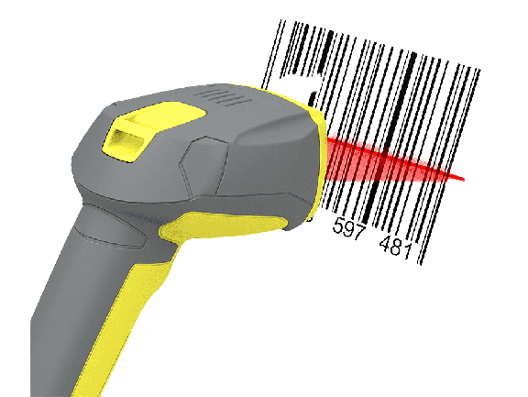
Optical Bar-CodeReader
A barcode reader is an optical scanner that can read printed barcodes, decode the data contained in the barcode and send the data to a computer. Like a flatbed scanner, it consists of a light source, a lens and a light sensor translating for optical impulses into electrical signals.
It is used in stores,packaged products and libraries.

Slide 4
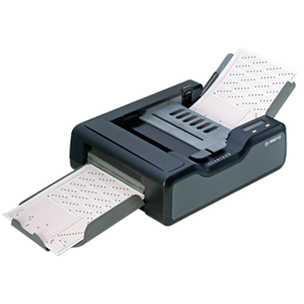
Optical Mark Reader
It is used to the information that people mark in surveys,tests and other paper documents. It is used to read questionnaires, multiple choice examination papers in the form of shaded areas.

